Slide 1
PatientCrossroads CONNECT
Promote
Collect
Extend
Share
CONNECT
Initially sponsored by Novartis
Provide advanced registry to even smallest of advocacy organizations
Collect data in a common manner, share openly
Enable pan-disease analysis and post-market surveillance
Launches publicly May 12th with 20 organizations

Slide 2
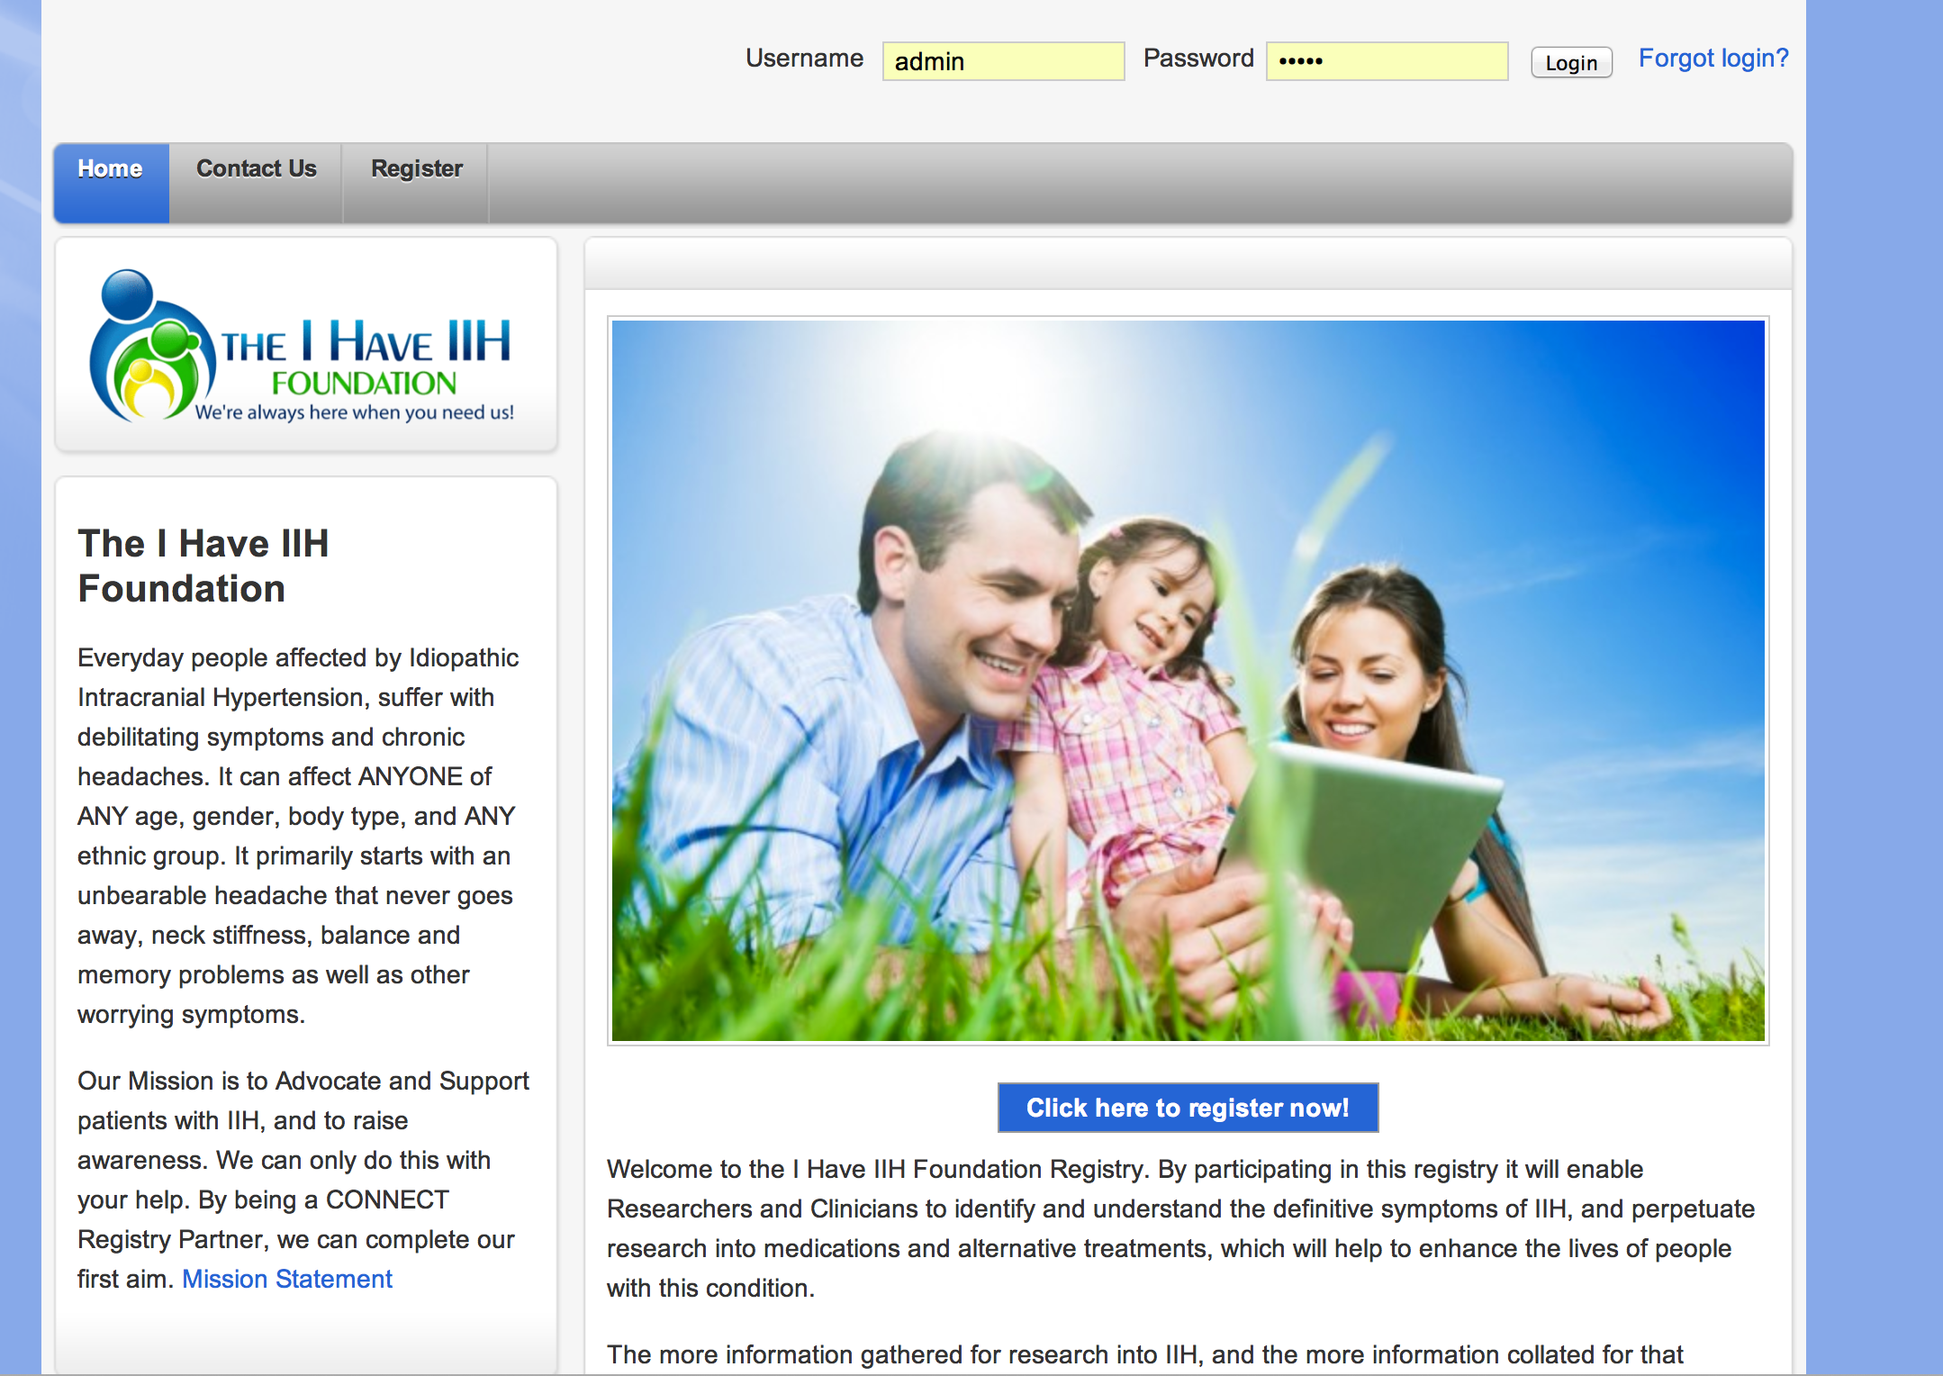
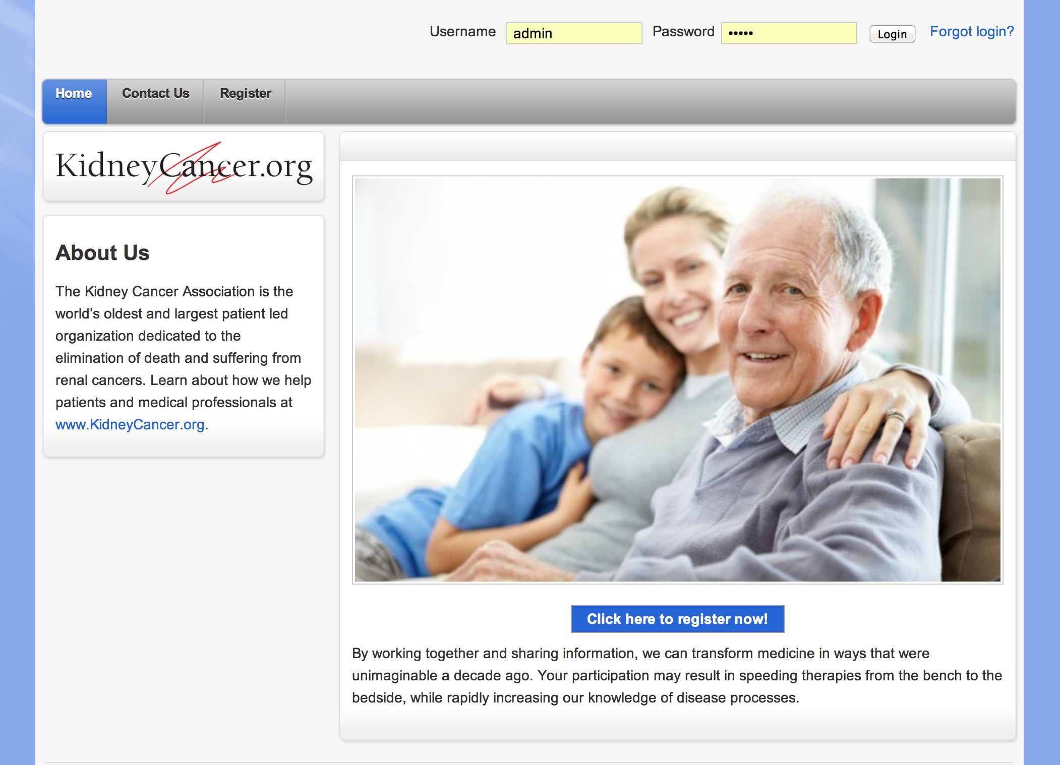
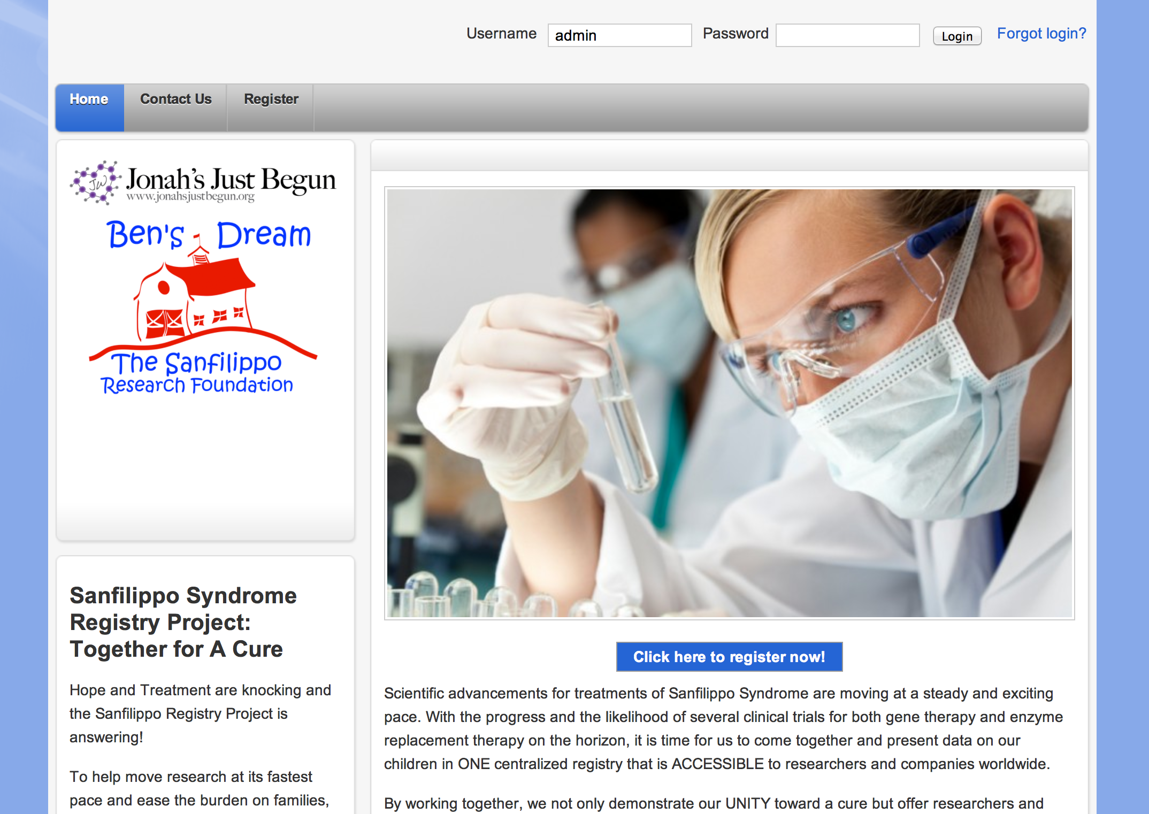
Promote
Collect
Extend
Share
CONNECT
Registry partners control branding and messaging

Slide 3
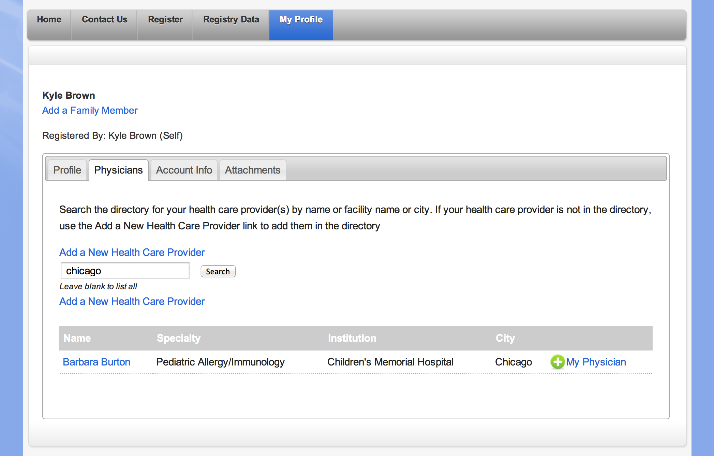
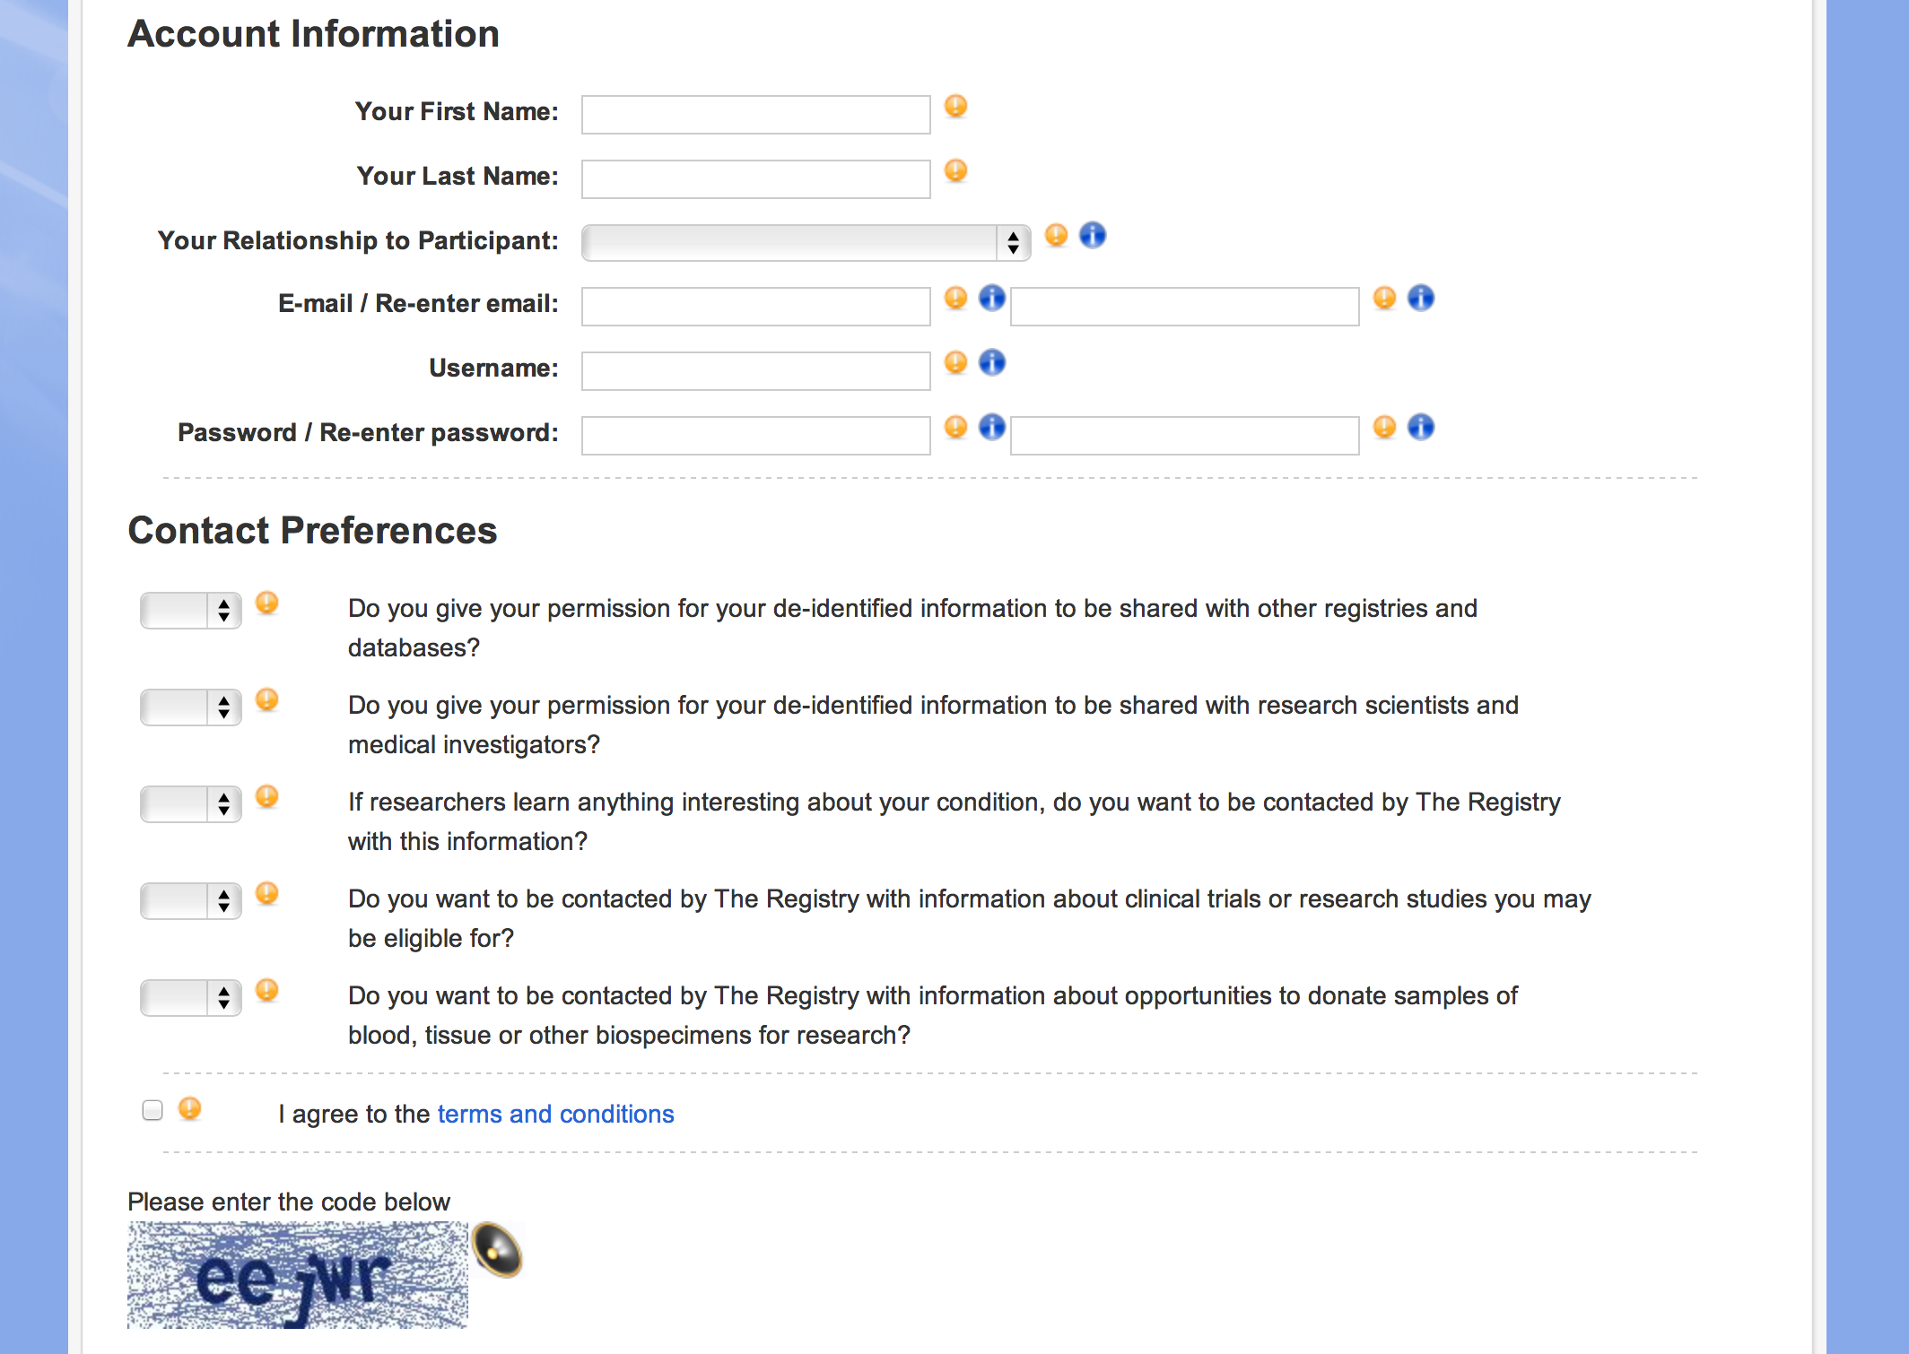
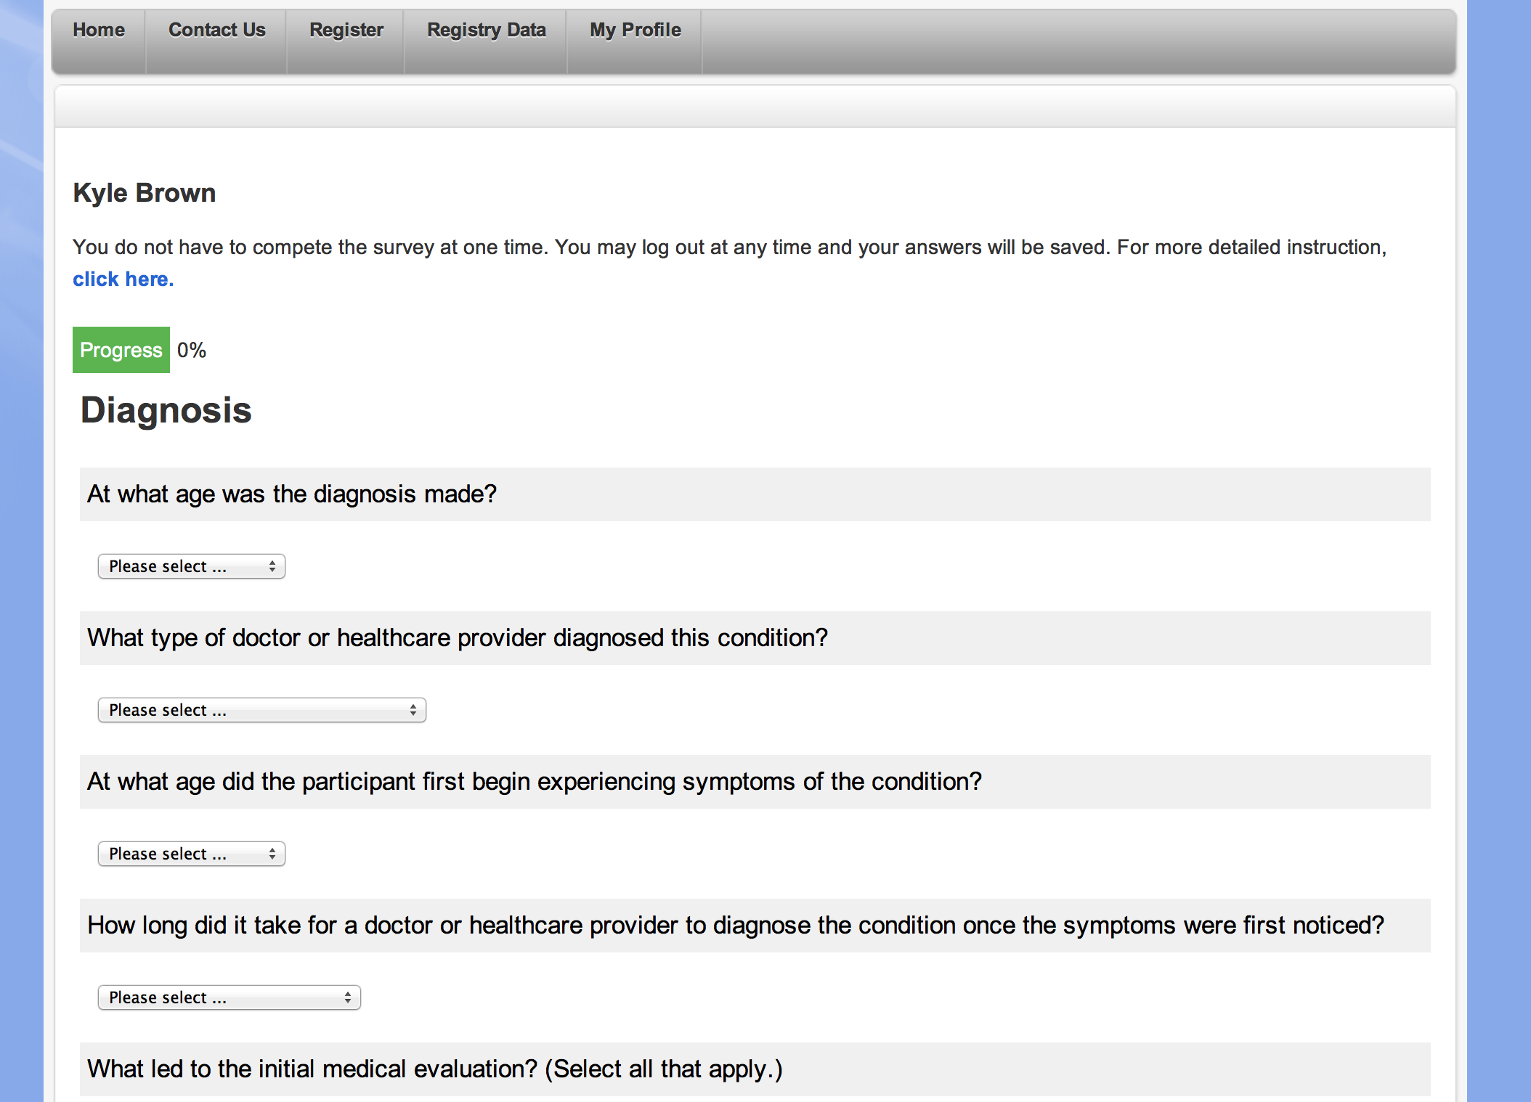
Promote
Collect
Extend
Share
CONNECT
Patients opt-in and complete standardized medical questionnaires including GRDR CDE’s

Slide 4
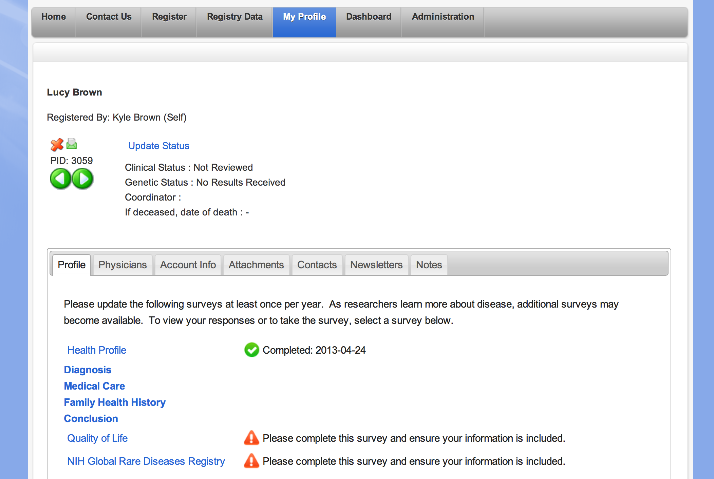
Promote
Collect
Extend
Share
CONNECT
Sponsor disease specific and proprietary surveys
Manually validate data and stratify based on confirmatory testing

Slide 5
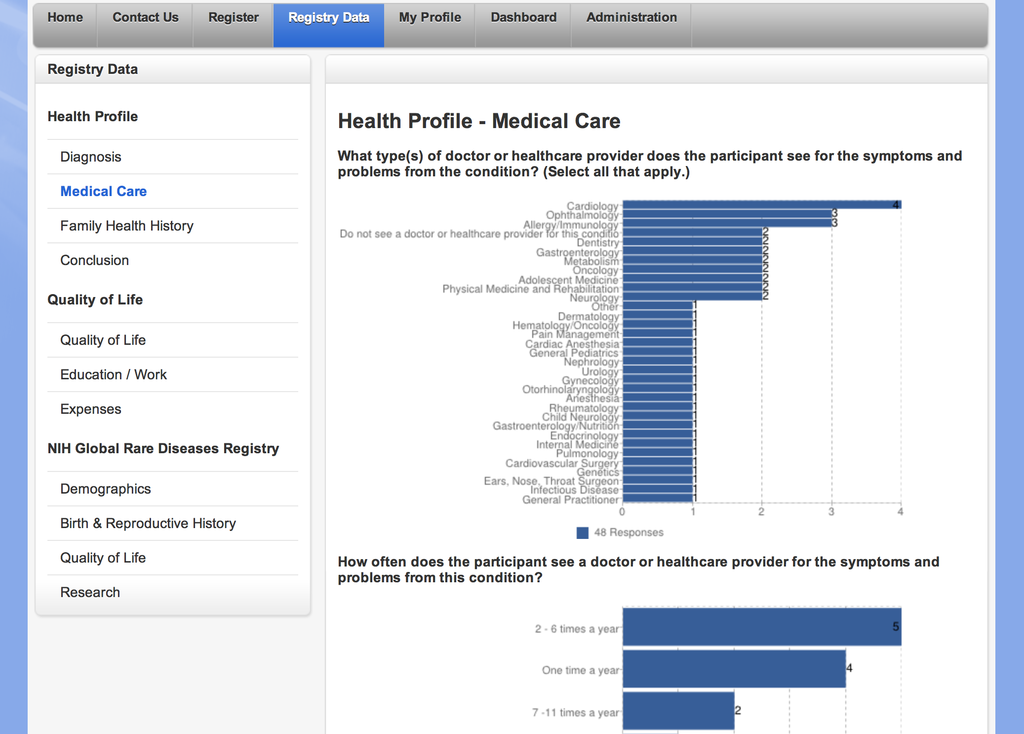
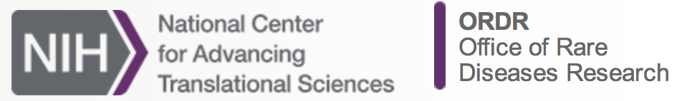
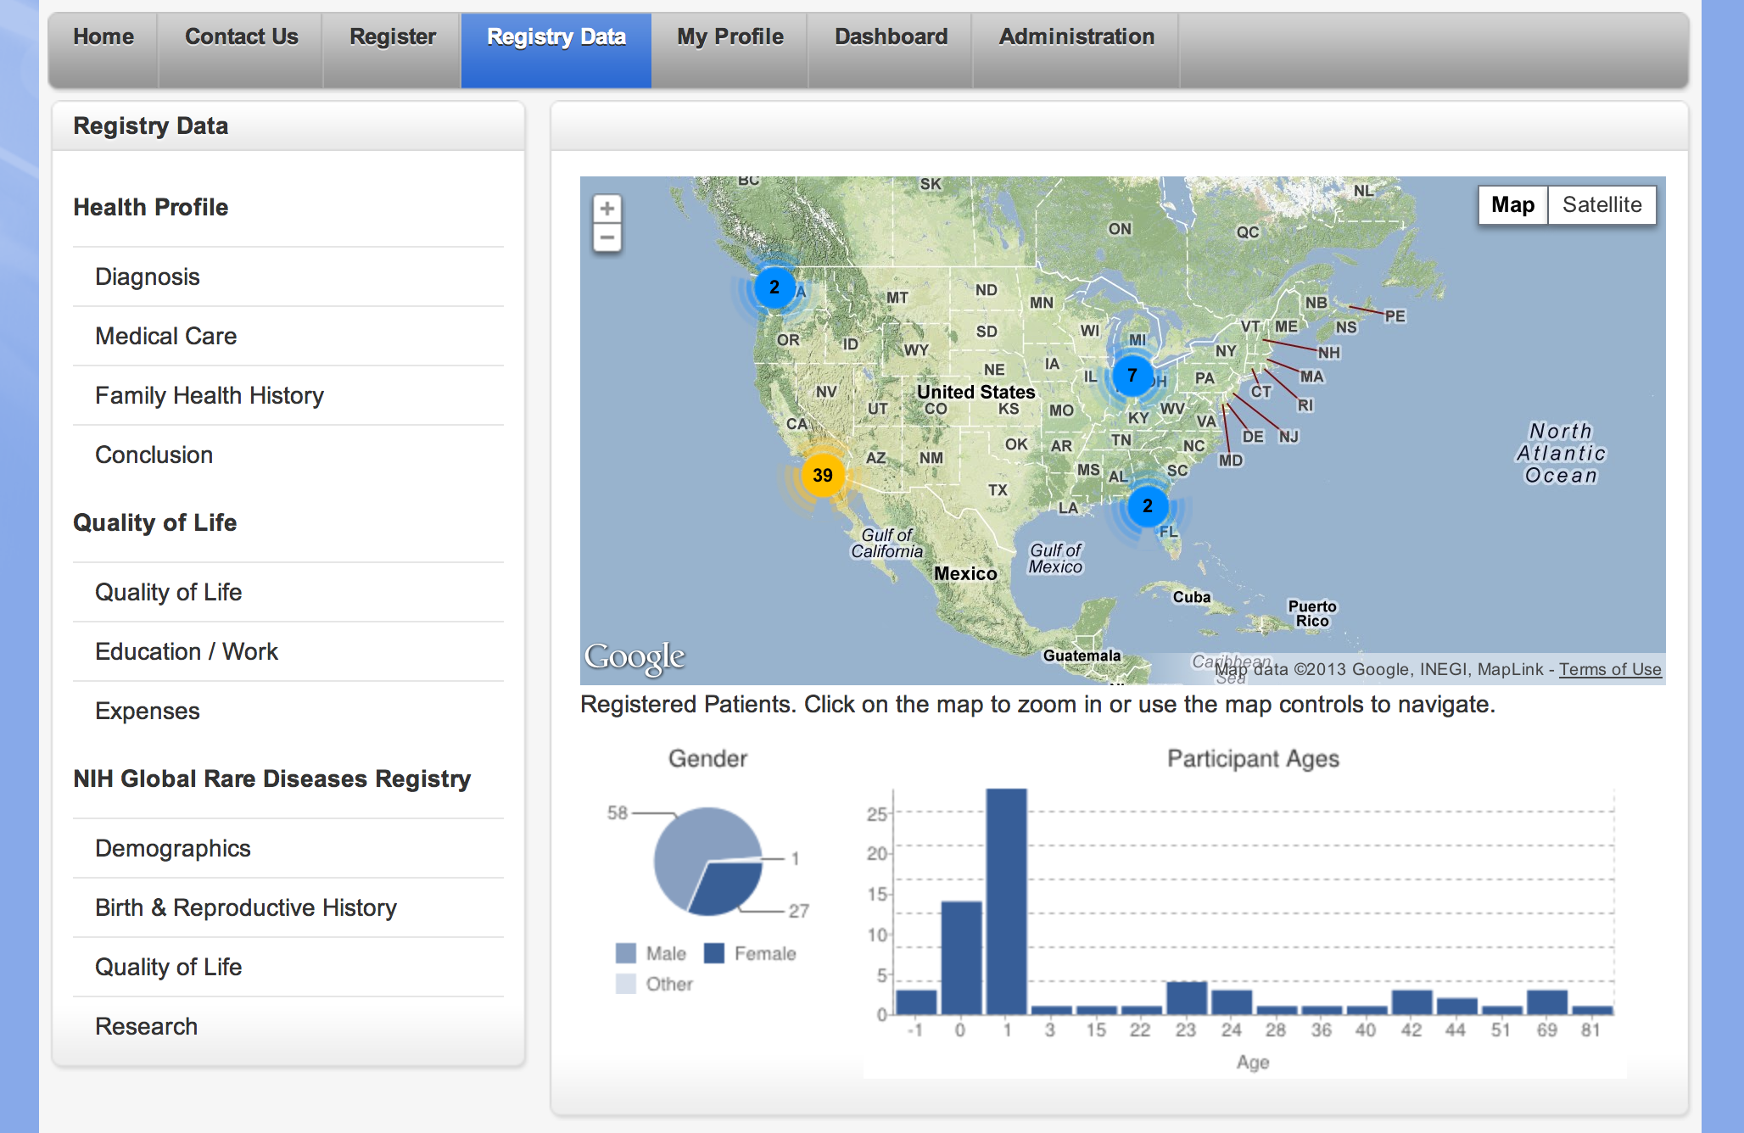
Promote
Collect
Extend
Share
CONNECT
Portions of collected data are shared with NIH
Available to academic, non-profits & sponsors

Slide 6
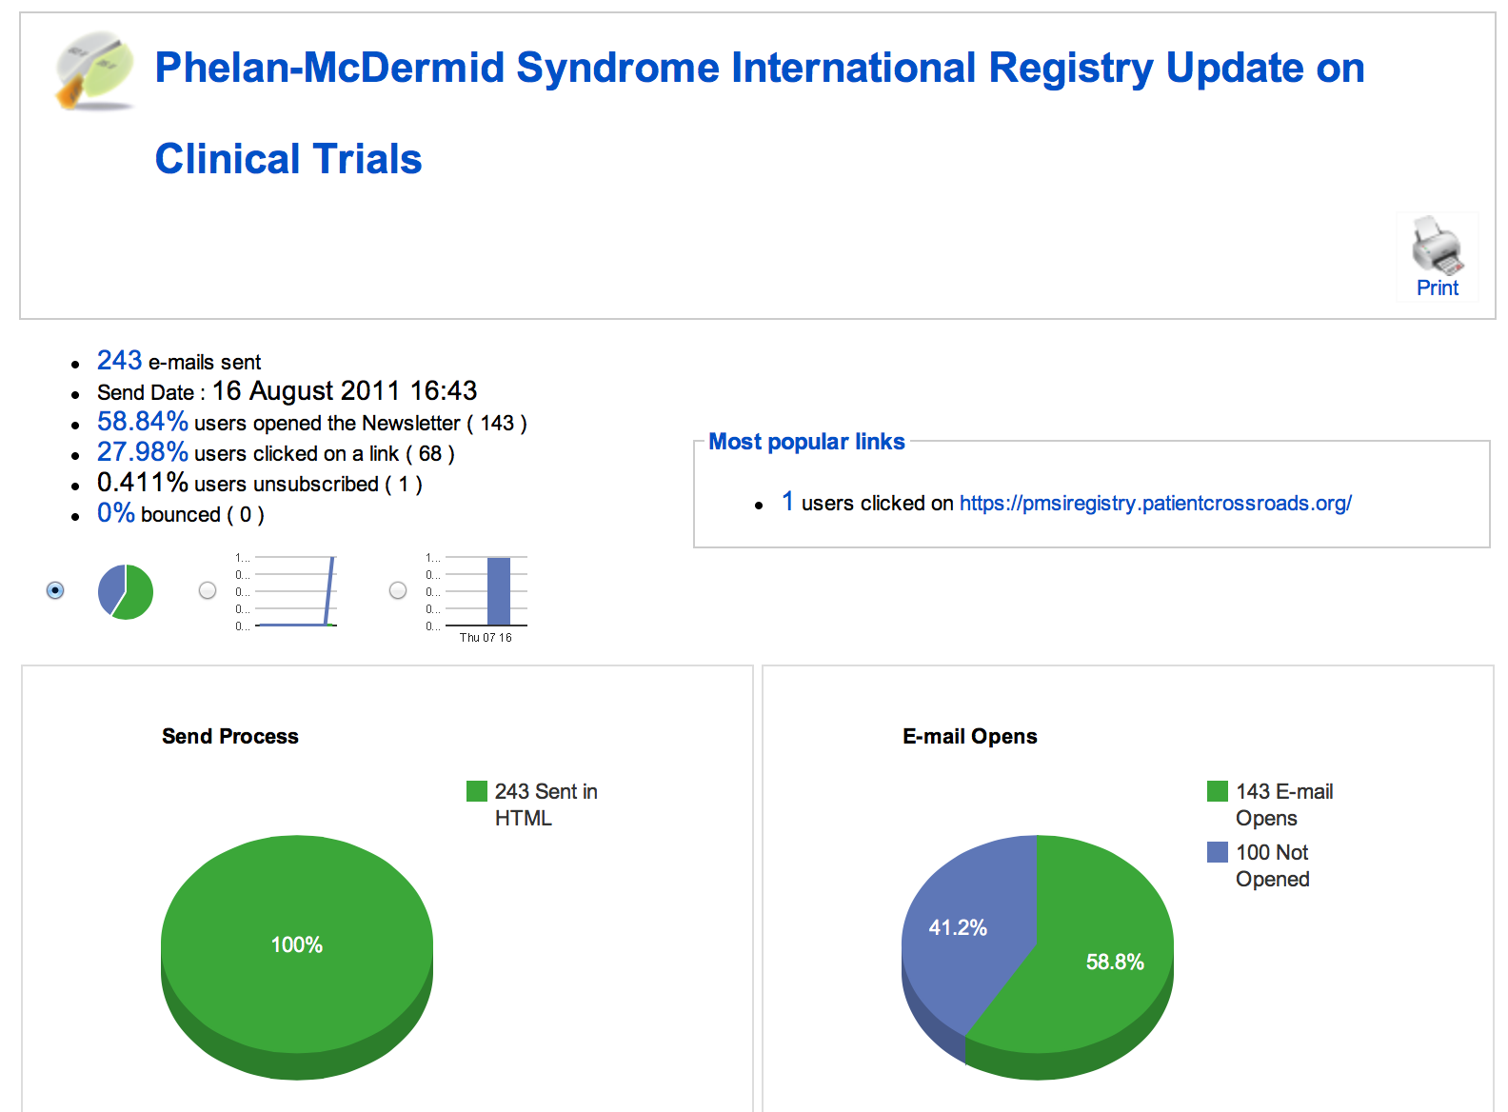
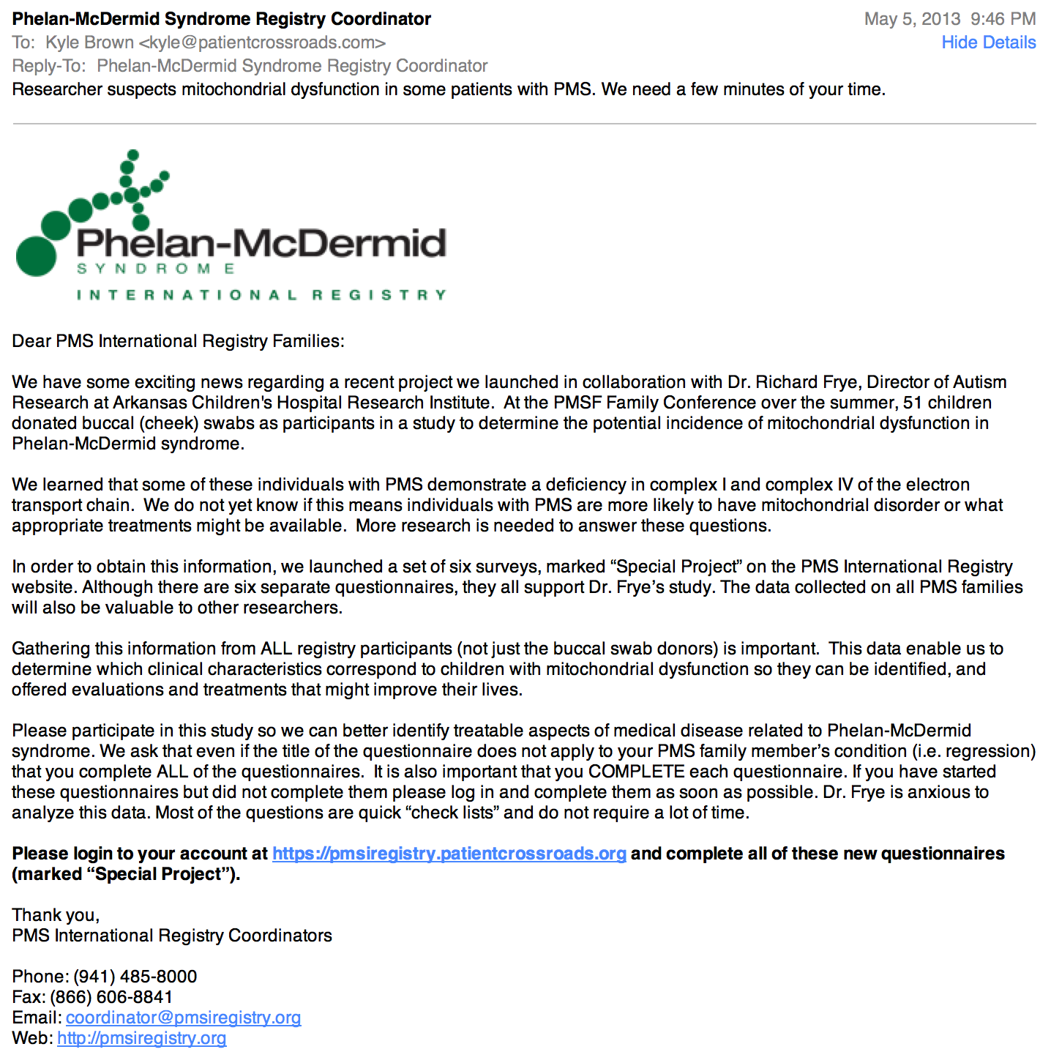
Promote
Collect
Extend
Share
CONNECT
Patients receive relevant study, trial notices & educational materials – contact info is never shared

