Slide 1
This is what the app looks like now.
NOTE: I will like to emphasis the Add button & deemphasize the subtract button

Slide 2
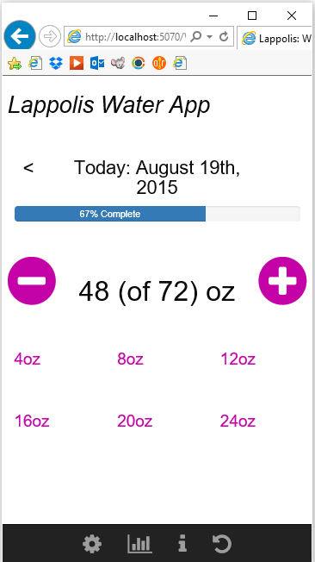
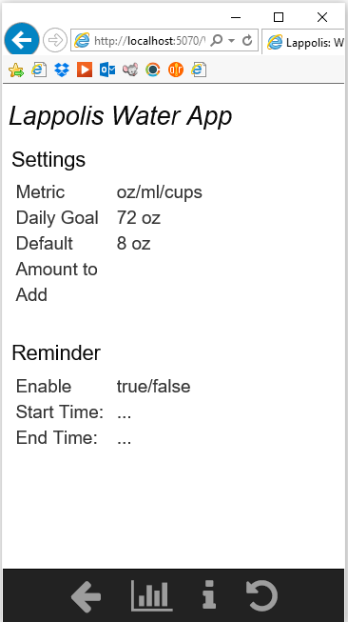
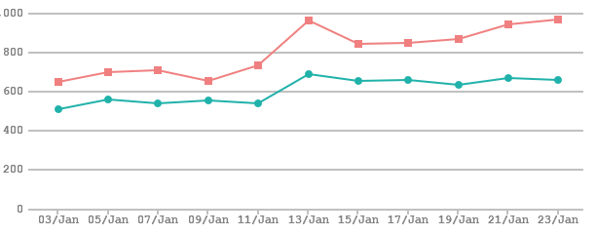

Slide 3
These are general look and feel ideas I have for the app suite:

Slide 4




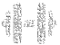

    Water
    Meditation
    Fitness
    Nourish
    Inspirations

Slide 5





    Water
    Meditation
    Fitness
    Nourish
    Inspirations

Slide 6

    Water
    Inspirations
    Meditation
    Get Fit!
    Nourish

Slide 7
These are pics of other app which I like:

Slide 8
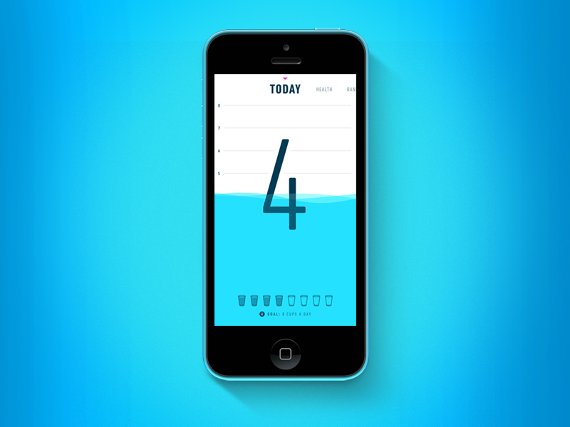

Slide 9
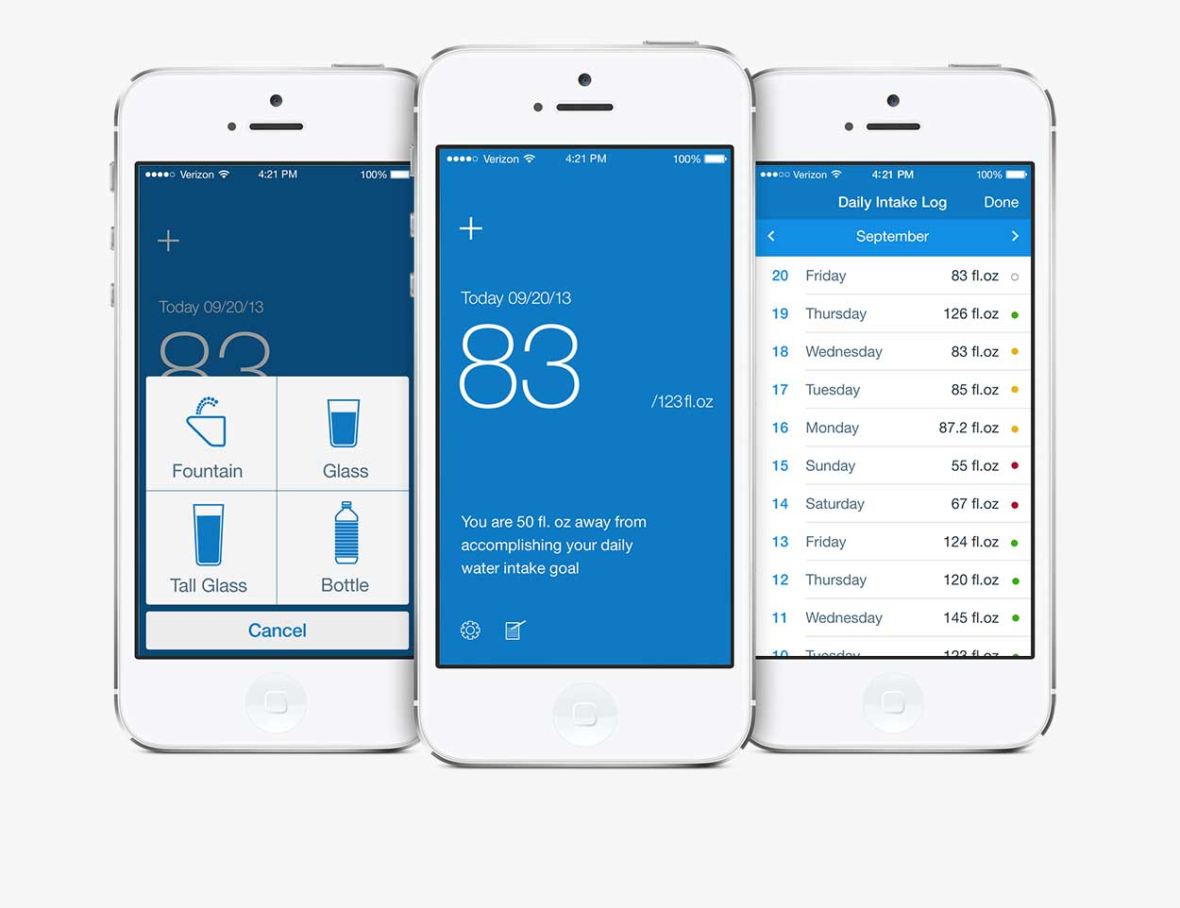

Slide 10
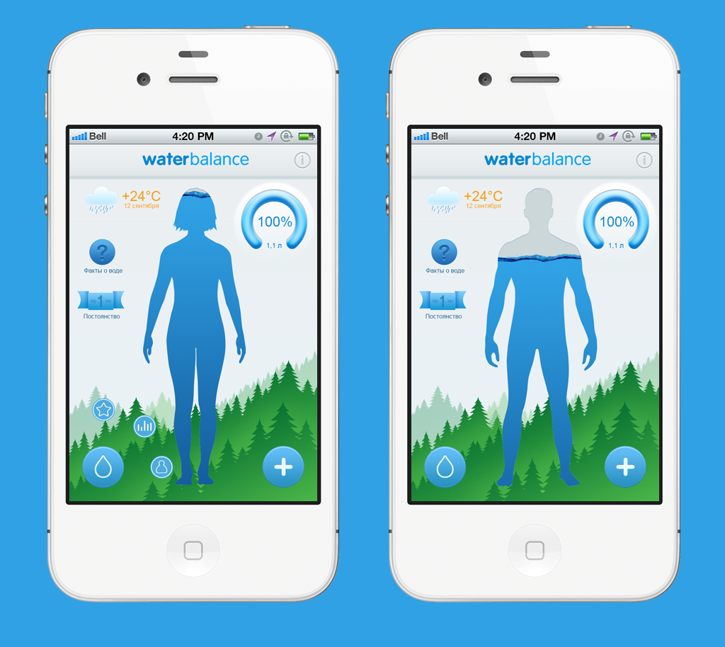

Slide 11
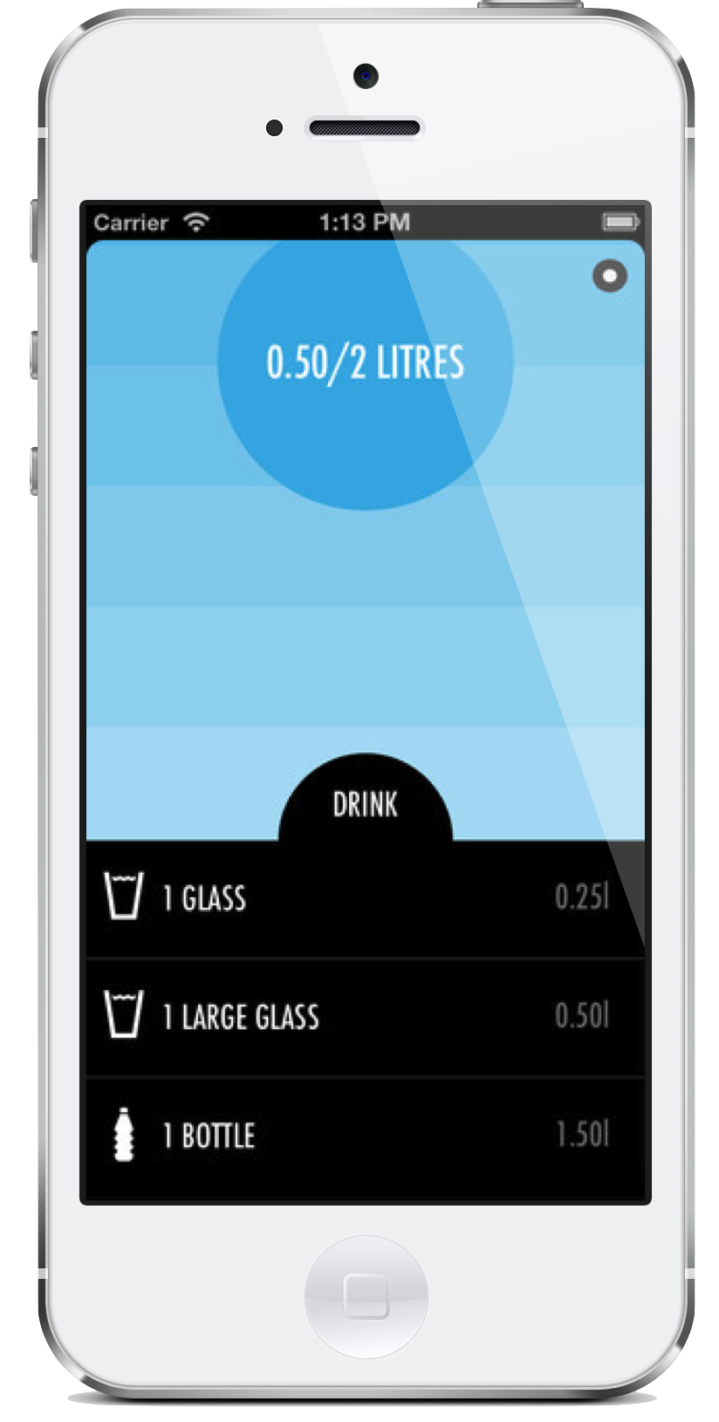

Slide 12
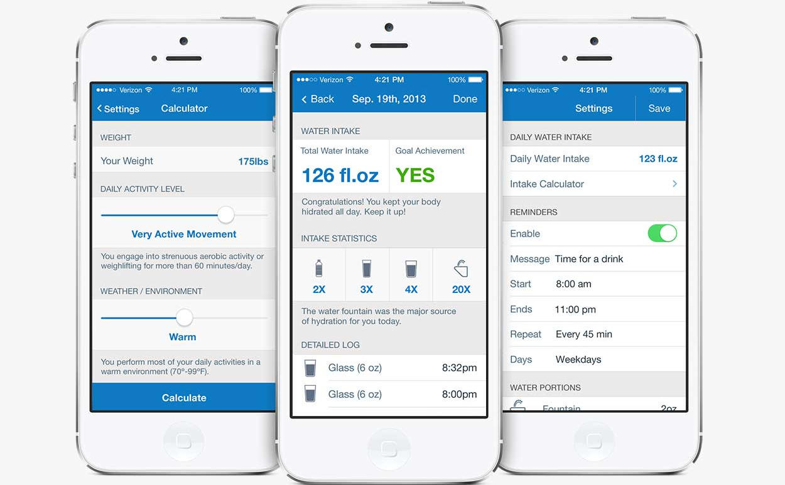

Slide 13
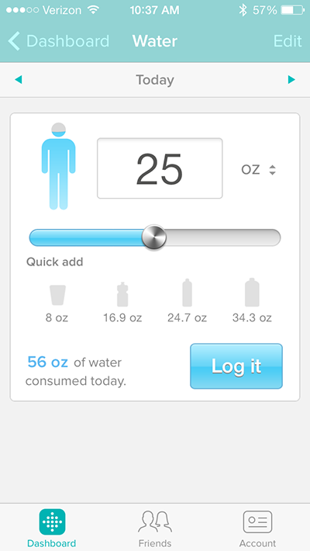

Slide 14
