Slide 1
MICRO BOATS
A detailed description including the Website outline and product images

Slide 2
Project Overview
At ZURU we need unique, fresh and modern webpages for each of our products. Our latest product is "Micro Boats", but we are yet to have a design for such a website.
It is a toy designed and targeted predominantly at adolescent and teenage boys. It needs to be exciting, detailed and scream fun. The images for the boats are attached in the files section, along with packaging and display type designs. There is also a sketch of the layout for the home page and overall theme we are looking for.
The home page needs to have these main elements:
-Big image of a micro boat (interchangeable across the 6 boat designs)
-Big/central title "Micro Boats" - ZURU logo bottom right
-A large screen that pops up shortly after (a few seconds) opening the webpage that displays a commercial Video (TVC) of the micro boats; this is currently in progress so as long as there is an ability for us to add a video as it becomes available, that would suffice. Also the ability to minimize the video if the consumer has seen it already etc.
-5 portals/sub-pages (boat portals as seen in the PowerPoint briefing) containing:
-Micro Boats (6 boats in total) - each with specs. as you click them (specs provided in the PowerPoint brief attached)
-Videos (need to be able to upload 5 videos on this sub-page as they become available to us)
-Where to purchase (links to our zuru.com/wheretobuy page
-Contact us (basis contact information can be found on the zuru.com website)
-Games (need to find an app that suits this product - currently in negotiation to obtain one of these - leave space to upload link to such an app)
-ZURU Logo
-Social media tabs linking to ZURU (Facebook, twitter etc.)
The sub-pages need to follow the theme of the home page (theme or feel of the product can be deduced from the PowerPoint brief attached)
If you have any questions or need clarity as to what we are looking for please contact me at jamie.lebrun@zuru.com
Let’s see what you have got!
Cheers!
Jamie

Slide 3
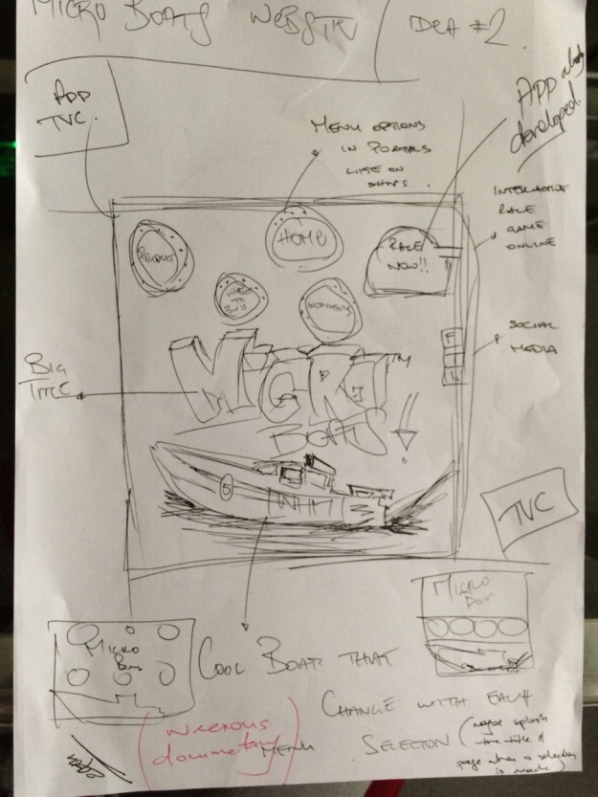
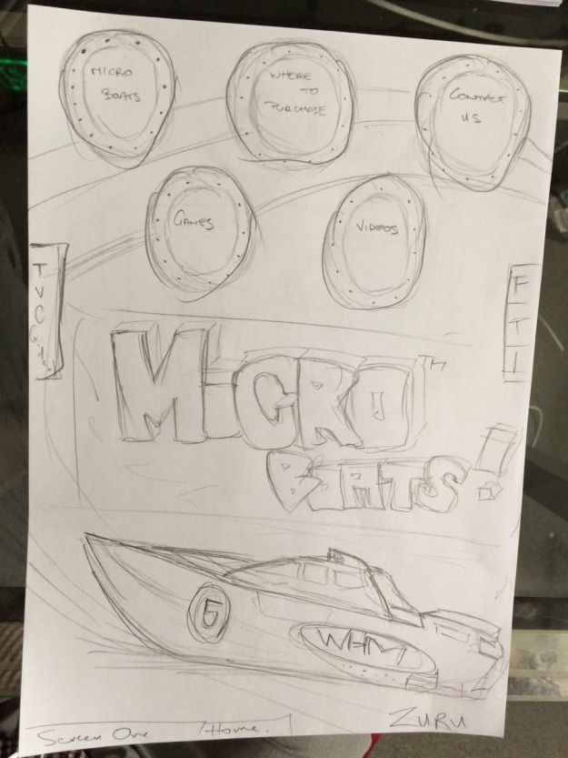
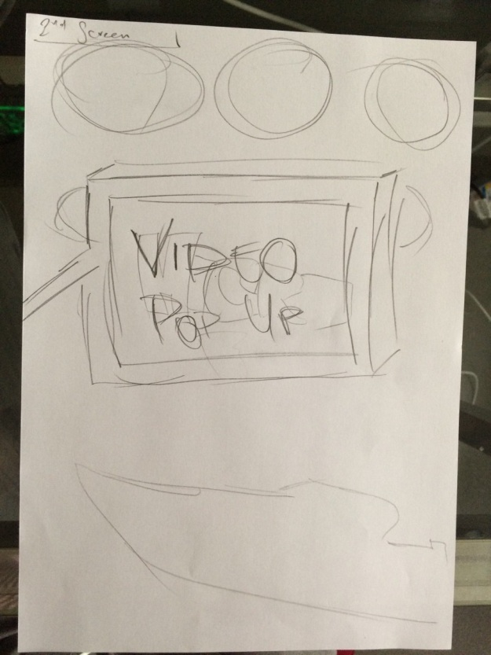
Sketches of Website
Here is a sketch of the general layout or vibe of the webpage.
Much like the Hamster page we would like to incorporate a TV somewhere on the page .
Maybe not in the middle though as this would block the title and boat image
The TVC should be somewhere on the side, or pop out after a few seconds of opening the page (option to minimize)
It could pop out like a start flag or starting lights?
The boat image should be detailed and large; maybe have a few boats that change
The options: videos, contact, where to buy, games, micro boat, are in portals like on a ship
When something is selected, it would be cool if the boat took off and splashed the screen ☺
General color scheme and theme can be found in the images section at the end of this powerpoint!

Slide 4
Sub-Pages
Each page should maintain the overall theme of the home page
Sub-Pages Consist of:
(1) Micro Boats:
A range of the boats; can be taken from the images at the end of the Powerpoint
Each boat design (of 6) should have some random specs as you click them: (details on page to follow) – want micro boats to be competitive items
-Name
-Acceleration
-Max speed
-Turning
(2) Games
Currently Looking to incorporate a boat app game
But in the mean time please redirect to zuru.com/games website; as long as there is an option/programming to add a weblink to an app for consumers to download and play
(3) Where to buy
Again links back to the Zuru.com/wheretobuy page that contains our location
As per previous email instructions please make this page busier with more/separate locations
(4) Contact
Add some basic information as you click on this portal that shows email, phone number etc. (no redirect to zuru please)
(5) Videos
As aforementioned, need to have on the home page a video pop up option, that we can upload our commercial/TVC when it is complete (just need the web page to have this function available) – TVC is predicted to be done end of November
Also the video sub-page should have available 5 slots for us to add videos as they become available

Slide 5
Product images
-Following this slide there are a range of images that contain:
Product range
Color scheme or theme
Contact information/purchase locations
Portal example
Boat image example
Product display images

Slide 6


Latest Images

Slide 7


Slide 8


Slide 9


Slide 10


Slide 11
6 Boats + Specifications
We are waiting on the latest version of these designs. On the following page is the old designs but if you want to use them for now in terms of initial design and layout that’s fine. I will send you the updated images if we like your formatting and web design for this exciting project.
Cheers,
Jamie

Slide 12

Old boat designs

Slide 13

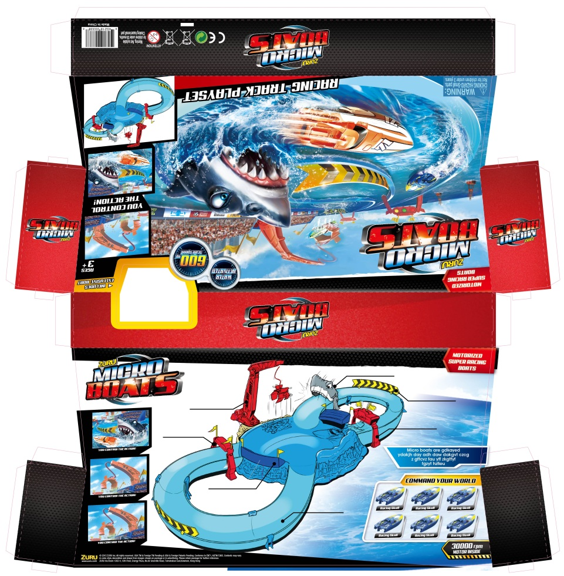


Slide 14
Concluding remarks
I will send a TVC as it is made, or if you just have the template for the pop up video on the home page ready and a function for me to add this I will upload myself
If you need any other images or information please contact me at jamie.lebrun@zuru.com
Goodluck and I look forwards to seeing what you can come up with, cheers
All rights reserved to Zuru ltd. Copyrights apply to all imagery and designs of Micro Boats located within this PowerPoint presentation.
Cheers,
Jamie

