Slide 1
DIAGRAMS FOR CONTACT CENTRES SERVICE

Slide 2
Customer Channel Management
Self Service (Web, Mobile, Phone, Social Media)
Performance Analytics
COOLHARBOUR Services
Channel Strategy
Operational Consulting & Change Management
Hosting
Cloud
On-Premise
Outbound Contact
Multi Channel & Unified Communications
Operational and Channel Health Check
Digital Gap Analysis
Business Case
Omni Channel Solution Design & Build
Managed Service
Hosting
Workforce Optimisation
Programme Governance
Business Strategy
Digital Strategy
Channels aligned to meet customer demand
Quick Wins
Long Term Benefits
Minimal total cost of ownership
Figure 1

Slide 3
Programme Governance
Customer Channel Strategy
Business Strategy
Digital Gap Analysis
Business Case
Design
Build
Support / Managed Services
Operational Health Check
Channel, Technology and operational Quick Wins
Operational Change
Figure 2

Slide 4
DIAGRAMS FOR PROJECT DELIVERY SERVICE

Slide 5
Leadership Manage politics Manage conflict
Team dynamics Communications Vendor relations
People
Risk
&
Issue
Management
Planning &
Resources
Stakeholder
Management
Change
Control
Demand &
Resource
Management
Business Strategy
Outcomes and Benefits
Quality
Assurance
Management
Governance
Communications
Management
Assurance
&
Management
Information
Business Case,
Benefits
Management
and
Control
Governance
Cost
Management
and
Control
Requirements
Definition & Analysis
Process
& Tools
Project
Programme
Portfolio
Figure 3.1

Slide 6
SYSTEM INTEGRATION SERICE DIAGRAMS

Slide 7

Client
Users
Developers
Dev 2
Dev n
Dev 1
Add Functionality
Release
Next Iteration
Feedback
Initiation
Requirements
Solution
Architecture
Integration & Test
App / U.I
Design
Multi- Vendor
integration
Release to Production
Accept?
Test
Yes
Cool Agile
No
Record & incorporate
Change
Adjust & Track
Re-populate features
Figure 4.2

Slide 8
Application Architecture, Design, and Development
Define application and technical architecture
System Integration
Custom application and package integration with enterprise systems and business partners
Application Development Consulting
Mobile /Application development: Agile development practices processes and environments
Application Assessment Consulting
Architecture, documentation, and code
Custom application development
Extend application lifecycle through enhanced functionality and integration and/or application re-platforming
Web services integration
Security integration
Software configuration management (SCM): Includes best practices, revision control, continuous integration, change management, SCM tool selection, etc.
Quality, maintainability, and scalability
Keep vs. replace recommendations
Build vs. buy recommendations
Usability Consultancy and Design
Mobile /Application Requirements
Figure 4.3

Slide 9
UNIFIED COMMUNICATIONS DIAGRAM

Slide 10
MODERN COMMS CHANNELS
COLLABORATION WITHOUT BOUNDARIES
MULTI-TIMEZONE TRANSACTIONS
COMPETITIVE ADVANTAGE
UNIFIED COMMUNICATIONS
REMOTE / MOBILE WORKING
COST SAVINGS
CLOUD / BYOD ADVANTAGES
PRODUCTIVITY & EFFICIENCY
Figure 5

Slide 11
Consult
Working closely with you on the full lifecycle of your UC initiative
Deploy
Proven deployment methodology to reduce time to benefit realisation
Develop
Adoption
Support
Working with your stakeholders to create a compelling strategy, business case, technical design and roll-out plan for a UC programme
Helping you gain the internal buy-in needed for your project
Implement, configure and test customised UC solutions from leading vendors
Carefully plan the switch-over and provide go-live support to minimise business disruption
Backed up by broad IT infrastructure and applications knowledge to overcome the most complex of challenges
Suite of training and user helpdesk services that are customised to your specific environment and requirements
Single point of contact to manage the end-to-end issue resolution in a timely and effective manner
Development services aimed at helping you extend and maximise the potential of your UC solution,
Combining the feature rich functionality of your platform with custom developed software
Increasing the end user uptake of your UC solution
Impart user knowledge and best practice that increases the rate of UC adoption and accelerates benefits realisation
24/7 ‘follow the sun’ support service addresses all aspects of UC deployment including hardware, software, network and system interoperability
customised SLAs to suit your specific requirements
backed by a strong working relationship with our software vendor engineering team to cover both technical & use-case issues.
BUILDING YOUR U.C. SOLUTION
Figure 6

Slide 12
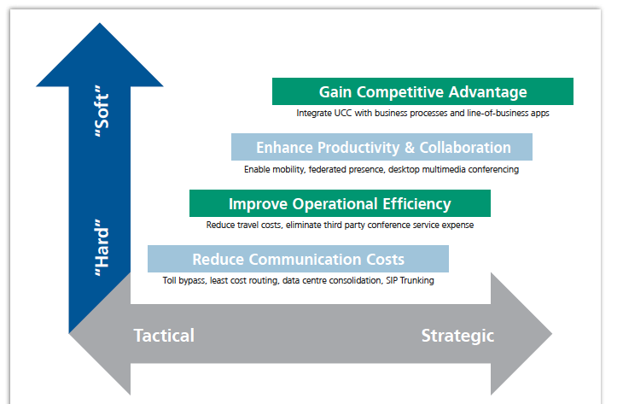
Source Frost & Sullivan’s: ““Finding the Value in Unified Communications – Understanding the Hierarchy of return””
Figure 7

Slide 13
Case Study Boxes

Slide 14
Programme Management & Delivery
Airport Operator
Client Background
Ageing Operation Systems with limited historical investment. includes the airport operational database, flight and staff information, enterprise service bus, modeling analytics, departure management & airfield capacity modeling.
Engaged to Deliver a 5 year roadmap for all operational systems
Client Challenges
  Working in a multi supplier model leading the Operational Systems Tower
  Planning to ‘Keep the Lights On’ while having to be Opex neutral
  Deliver a roadmap that will also be a stepping stone for Airport’s Strategic needs
What CoolHabrour Delivered
  Led the programme to prove airport thought leadership and delivered a 5 year roadmap based on world wide best practice.
  Provided Leadership and governance of a multi supplier Programme
  Managed other suppliers including Big 4 Consultancies

Slide 15
Contact Centre Solutions
Leading UK Insurance Provider
Client Challenges
The contact centre transformation programme facing quality and process issues.
Constantly changing customer requirements / scope of work.
Requirement for team that understood both Avaya and Microsoft infrastructure the key missing ingredient.
What CoolHarbour Delivered
Our team worked closely with Avaya to develop and implement IVR XML flows as migrations ramped up. Avaya retained CoolHarbour to develop and manage a change request process for IVR flows as part of operational services.
Delivered the implementation of Voicemail on Aura Messaging for the customer.
Implemented Windows infrastructure to host Verint call recording, WFO and WFM.
Implemented Call Back Assist for the project and migrated the Experience Portal reporting database to a larger server to meet the heavy logging requirements.
Key Technologies Involved
Avaya Experience Portal, Communication Manager, System Manager, Session manager, Callback assist, Aura Messaging, Windows 2008 r2 domain infrastructure, Posgresql, WFO/WFM, Verint Call recording

Slide 16
Systems Integration and Development
Example Projects
Integration of MS Lync Desktop Client with Avaya Infrastructure
MS Lync platform performance monitoring data integrated into a 3rd party, multi-vendor platform monitoring tool
Developed full self-provisioning platform for soon to be launched Public Cloud solution
Integration of Avaya Scopia video conferencing solution with MS Lync for a hosted Video Conferencing service provider
Developed a centralised phone directory – a specialised server module that connected to Avaya CMS and Siemens

Slide 17
Unified Comms & Collaboration
European Telco
Client Challenges
One of the first companies to setup a hosted cloud offering for Avaya IP telephony and Unified communications.
Limited in-house expertise in delivering multi-tenanted UC services around Avaya.
Engaged CoolHarbour to deliver multi-tenanted voicemail and presence services for this project using Modular Messaging and Aura Presence Services.
What CoolHarbour Delivered
Designed, deployed and configured MM for MSS
Customised the Aria TUI on MM to remove options for mailbox lookup and search in the auto attendant and during voicemail addressing. Other options which were breaking encapsulation of the tenants were also removed.
Avaya produced a Presence filter on the Presence server which allowed you to define tenants statically in a text file and the prevented people in a tenancy from searching and adding people in another tenancy. Our team implemented the Presence Server for the customer and installed and configured this Presence as well.
Key Technologies Involved
Avaya Modular Messaging 5.2 for Avaya Message Store Server, Avaya Communication Manager, System Manager, Session manager, Avaya Aura Presence Services

