Slide 1
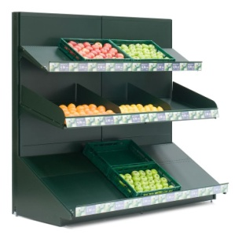
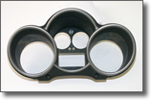


Track-record
Description
KIDER INDIA (UC): Store fitting supplier Indian manufacturing subsidiary of leading European store fitting group, KIDER. Since 2011 Kider India has been providing turn-key store fitting solutions for large multi-brand food retailers.
PPT (UC): Tier 2 Spanish supplier of advanced plastic parts to the automotive market. The company is specialized in injection and coating of cosmetic plastic components such as rings, panels, masks, lenses and buttons. Company was acquired in distress. After a successful restructuring, it is currently growing in India with the goal to set-up a brand new factory in the near future.
TSINGDA EEDU CORPORATION (CV): Affordable supplementary educational services for students ranging from 0 to 18 years’ old through both online and offline channels in China. The Company offers online pre-recorded courses/virtual internet classrooms to students and supplementary offline counseling through its learning centers.
• MOMOYOYO GLOBAL (CV): Founded in 2007, the company is currently the #1 B2C online retailer and
#1 B2B retailer in the pets product market in Beijing. The Company currently sells >50 brands and 4000-
5000 SKUs and has over 300,000 users. Founded in 2007 , the Company is currently the #1 B2C online
retailer and #1 B2B retailer in the pets product market in Beijing.

Slide 2




Track-record
Description
• LUMI HOLDING (CV).: Founded in 2007, the Company is one of the early movers in the “nutri – beauty”
space. (Nutri- Beauty - Addressing the needs of both beauty and health). The Company has a strong
product portfolio of skin care/ cosmetics, nutritional food products, which can either be consumed or
externally applied. It is currently the #1 brand in Collagen products.
• HANGYO ICE CREAMS (CV): Hangyo is an emerging regional leading brand manufacturing Ice-
creams and Milk Products, headquartered out of Mangalore, Karnataka. It has strong presence in
Karnataka, Goa, Kerala and Southern Maharashtra. The company has strong distribution networks and
retail presence in the form of shoppers and icy parlors. The brand has 50+ categories of ice creams in
150+ SKUs.
• MORF INDIA (CV): Morf India Limited is a unique sales company selling products enhancing health and
cleanliness of millions of households in India. It has partnered with Electrolux for the Kelvinator brand of
water and air purifiers. The Company also has a strong presence in the B2B water purification segment.
• B.LAB (CV): B.LAB, founded in 2012, has established itself as a leading direct marketer of premium beauty and wellness products in India. B.LAB uses long form TV info commercials, Internet and mobile to market its products, supported by a personalized advisory service program that creates customized solutions for each consumer’s skin type and usage.

Slide 3

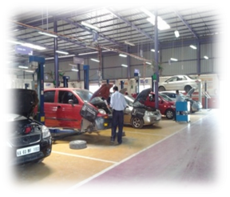
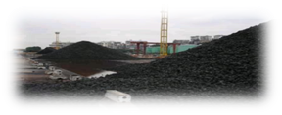
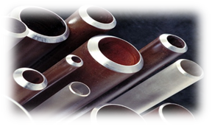
Track-record
Description
• RATNAKAR BANK (CV): A regional private commercial bank focusing on SME and retail customers, with a strong presence in western India; the bank currently has around 100 branches and holds new licenses
for more branches.
Exit Q2 2015 – IRR ..
• CARNATION AUTO INDIA (CV).: India's largest multi-brand, independent auto services player, offering the entire range of automotive services from preventive maintenance to major collision repairs. Core business verticals include repair, maintenance and body repair solutions for majority of car brands and models, and buy/sell/exchange of multi-brand pre-owned cars. The Company was founded in 2008 by Mr. Jagdish Khattar, the former MD & CEO of Maruti Suzuki India Ltd.
• DEE DEVELOPMENT ENGINEERS (CV).: One of the largest designers and manufacturers of prefabricated piping systems and fittings in India. A one-stop piping solution for various global engineering companies. List of clients include Alstom, Siemens, GE Energy, Doosan, BHEL.
Exit Q3 2015 – IRR..
• HALDIA COKE & CHEMICALS (CV): The Company manufactures Metallurgical (“Met”) Coke, which is a key input used in the manufacturing of steel, ferro alloys and soda ash. The Company is an integrated merchant met coke producer with met coke plants and captive coking coal mines, and is one of the largest merchant manufacturers of met-coke in India. The Company is promoted by Shriram EPC Ltd. and is a part of the Shriram Group, a highly reputed South Indian business group headquartered in Chennai.

