Slide 1
Using Child-Parent Psychotherapy to Treat Young Children Exposed to Trauma
Part I of an 18-month CPP Implementation Course
Chandra Ghosh Ippen, Ph.D. (chandra.ghosh@ucsf.edu)
with slides contributed by
Alicia F. Lieberman, Ph.D.
Patricia Van Horn, Ph.D.

Slide 2
Child-Parent Psychotherapy
Child Parent Psychotherapy Manual
  Lieberman, A.F., & Van Horn, P. (2004). Don’t hit my mommy: A manual for child parent psychotherapy with young witnesses of family violence. Zero to Three Press: Washington, D.C.
Book Describing Conceptual Framework, Intervention Modalities and Case Examples
  Lieberman, A.F. & Van Horn, P. (2008). Psychotherapy with infants and young children: Repairing the effects of stress and trauma on early attachment. New York: The Guilford Press.
CPP for Traumatic Bereavement
  Lieberman, A.F., Compton, N.C., Van Horn, P., Ghosh Ippen, C. (2003). Losing a parent to death in the early years: Guidelines for the treatment of traumatic bereavement in infancy. Washington D.C.: Zero to Three Press.

Slide 3
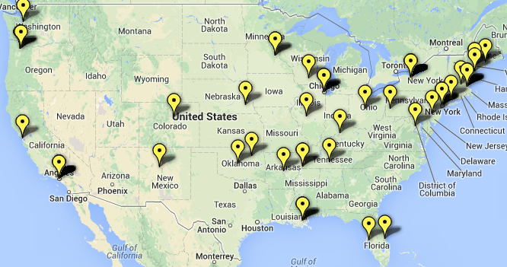
CPP Trainings

Slide 4
Agenda for Learning Session 1:
What we will be doing for the next 3 days

Slide 5
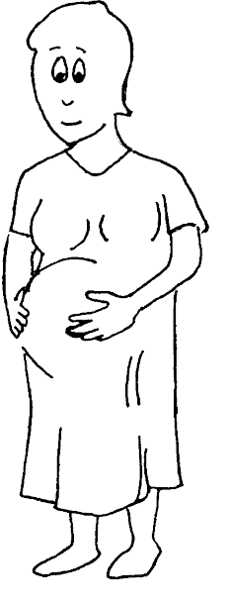
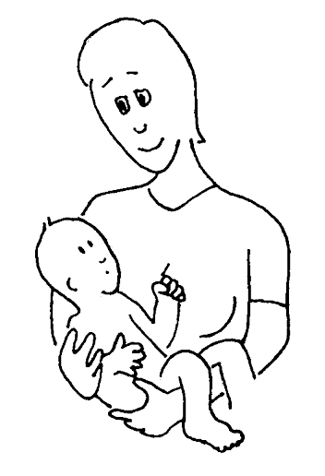
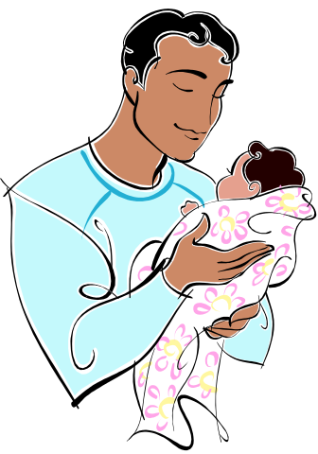
Angels in the Nursery
Becoming a parent brings back memories of what it was like to be a child
Memories of times when you were loved and cared for
Memories that show that despite the challenges your caregiver faced, they cared about you (I am loveable, and I can love)
© Ghosh Ippen, 2013

Slide 6
Angels in the Nursery
Importance of bringing up good memories
Integration of good and bad
Sometimes they are hidden
“Identification with the protector”
Lieberman, Padrón, Van Horn & Harris, 2005

