Slide 1


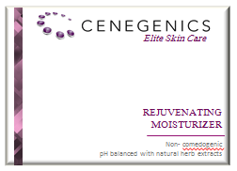
Elite Skin Care
REJUVENATING
MOISTURIZER
Non- comedogenic
pH balanced with natural herb extracts
40 ml

Slide 2
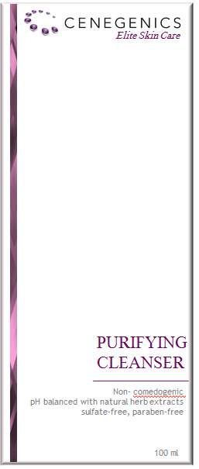

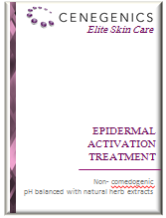
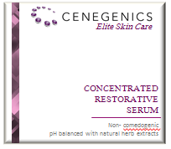
Elite Skin Care

Slide 3



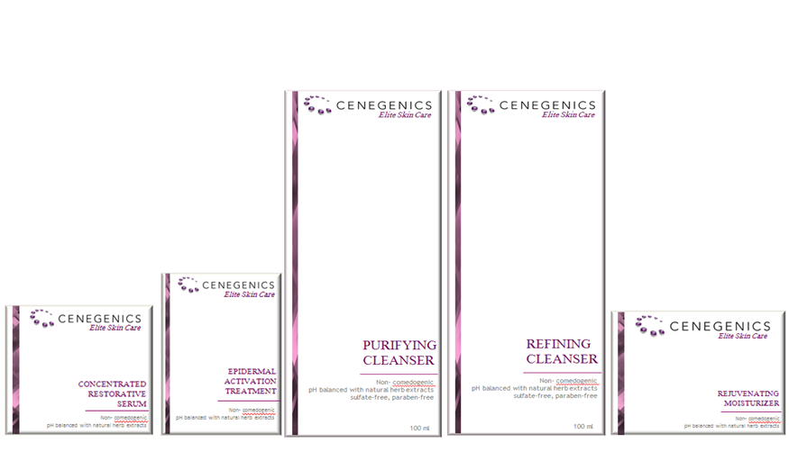

CONCENTRATED
RESTORATIVE SERUM
Apply this highly concentrated, restorative skin
serum topically, twice daily. Our formula features a unique proprietary blend of natural stem cell messengers and herbal ingredients that:
Activate dormant skin stem cells
Stimulate new skin cell growth
Stimulate collagen and elastin production•
Repair skin damage for firmer, tighter skin
Delay the onset of fi ne lines and wrinkles
Protect skin from age-related damage
Full line of Cenegenics Elite Skin Care now available on
www.cenegenicsstore.com
EPIDERMAL ACTIVATION TREATMENT
This unique activation treatment enhances
skin’s dramatic transformation with a natural,
powerful cocktail of 15 peptides and 36 other
ingredients including growth factors, antioxidants
and botanicals. These key ingredients repair
the skin and prevent further damage, creating
benefits like these:
Dramatic wrinkle reduction
Significant increase in production of collagen
and elastin
Rebuilding of skin’s firmness
Renewal of the epidermis at the cellular level
EXPERIENCE A NEW DIMENSION
IN SKIN CARE
Elite Skin Care
Introducing the Ultimate Choice for Skin Regeneration
851 S. Rampart Suite 220 Las Vegas, NV 89145 Cenegenics Skin Care Hotline: (866) 634-8560

