Slide 1
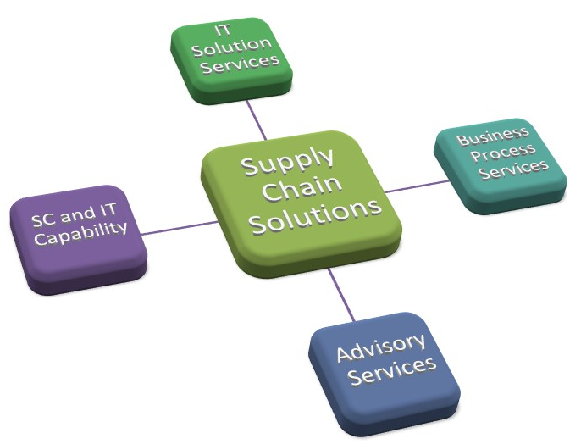
Business Overview
Supply Chain
Procurement
Related SAP Products
Procurement Sourcing/Auctions
Supply Chain
Control Tower/Telematics
Related SAP
Tender Response
Business Analysts
Sourcing
Architecture
Value Management
Project Management
Training
Strategy
Change and Architecture
Sourcing Services
Program Management
Service Management

Slide 2
Advisory Services
Initiate
Design
Buy
Implement
Run
Strategy
Change and Architecture
Sourcing Services
Program Management
Service Management
IT Strategy
ERP Strategy and Roadmaps
Business Case Development
Benefits Identification
Assurance
Coaching
Program and Project Plans and Costs
Benefits Management
Change Management and Readiness
Solution Design
Process Reengineering
Assurance
Procurement Plans
Market Scans
Requirements and Tender Development
Evaluation
Contract Management
Vendor Management
Program Management
Project Management
Project Capability
Solution and Technical Consulting
Solution Advisory and Governance
Assurance
Benefit tracking, reporting & recognition
Change Management
Solution Support

