Slide 1
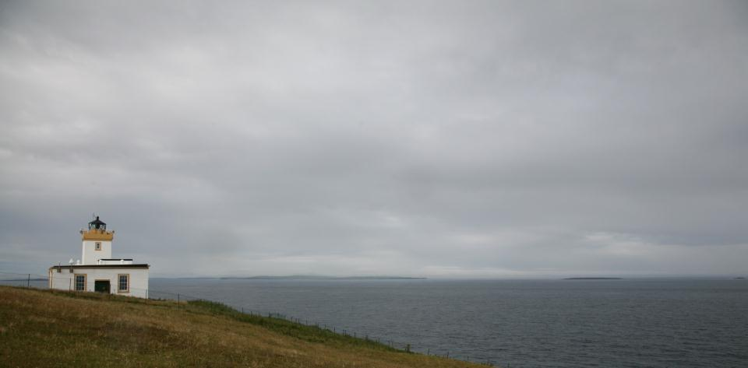
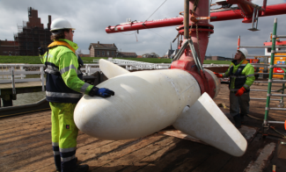
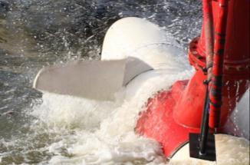
Tocardo Tidal &
In-Stream Turbines
Business Presentation

Slide 2
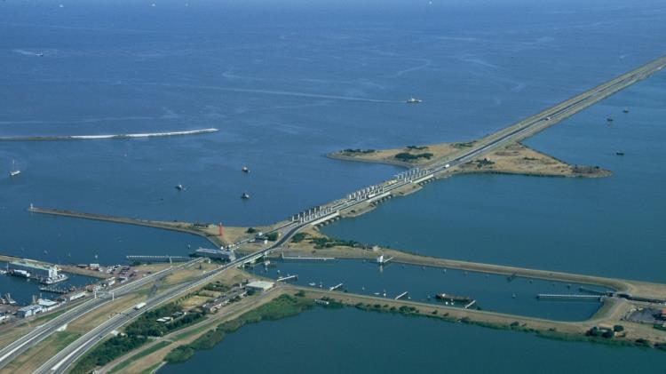
About Products Market Deployment
Who we are
Netherlands based tidal and river turbine manufacturer
Fully commercial since 2011
Proven technology
Worldwide network

Slide 3
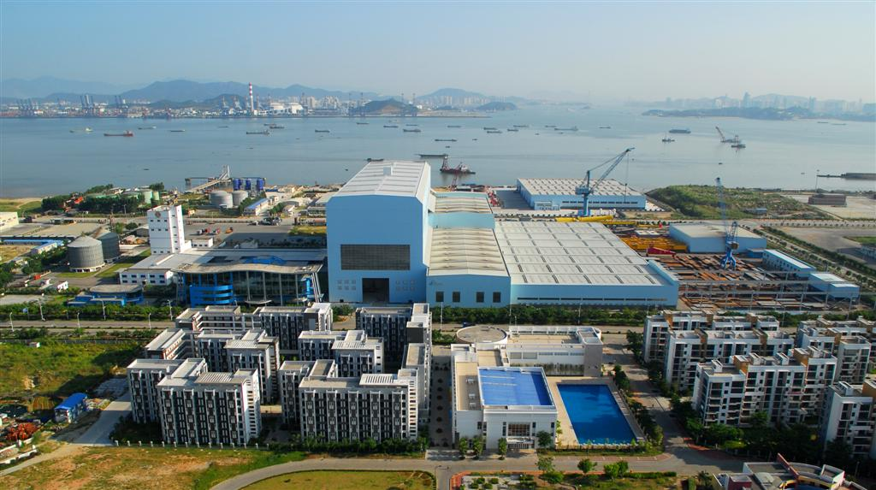

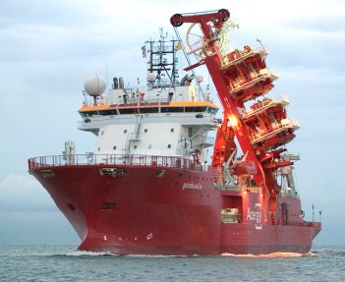
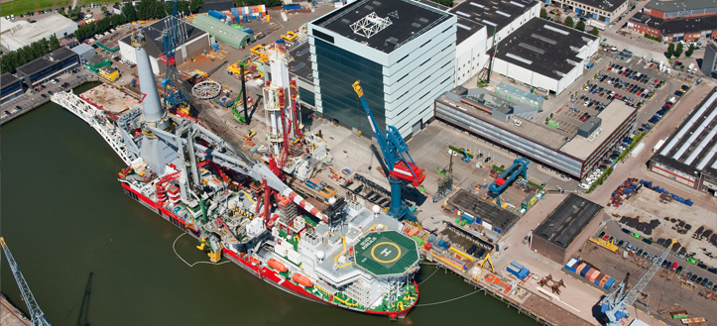
About Products Deployment
Behind TOCARDO
Dutch specialist in smart offshore subsea solutions
Production facilities worldwide

Slide 4
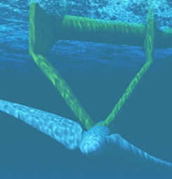
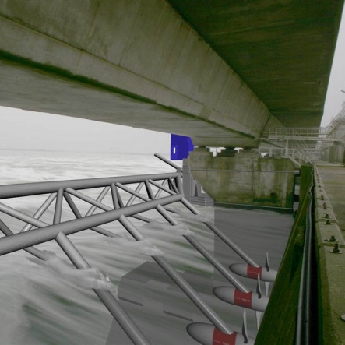
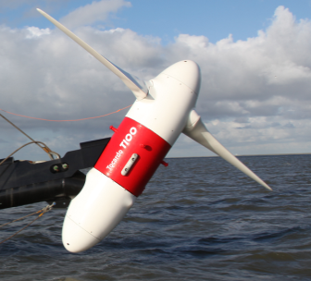
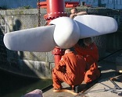
About Products Market Deployment
commercial
demonstration
testing
prototypes
1997
present

Slide 5
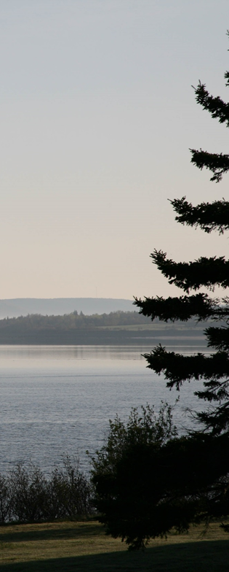

About Products Market Deployment
Sensible strategy
Stepped
up scaling
Current market for < 500 kW
Commercialize smaller turbines
Easier and cheaper to install
Focus on kWh price
Reliable technology
Minimize maintenance
Reduce project costs
Partner with specialists
Project development
Financing
Installation and foundation engineering

Slide 6
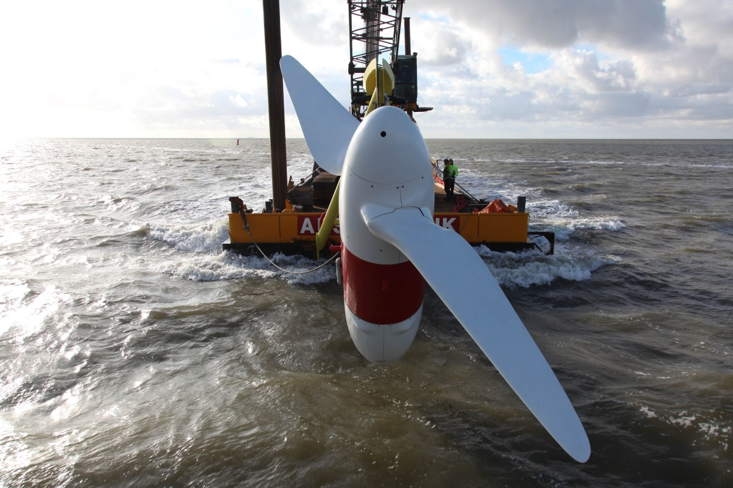
About Products Market Deployment
Tocardo’s technology
  Proven technology with 6 year track record
  20 year design life time
  Minimal maintenance
  Multiple foundation - floating, bottom or retro fit
Specs
  Direct drive permanent magnet generator
  Smart reverse rotor blade - no pitch!
  Advanced control system for tidal and river sites

Slide 7
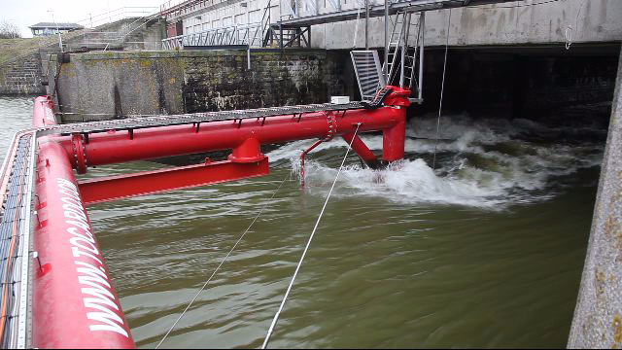
About Products Deployment
Den Oever project
(4 m/s water flow)

Slide 8
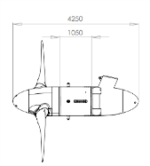
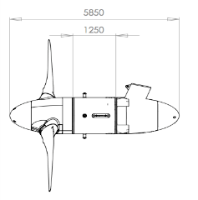
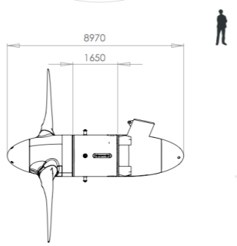
Product Portfolio
Commercially Available
  HT +
  HT s
Development
T1 & T2 - 100 & 200 KW in production now
T3 - 800 KW (Available early 2015)
T4 - 1.5+ MW (Available 2017)
(DD700 platform)
(DD1000 platform)
Characteristics
Ideal Operating range 2 - 4.5m/s
No gearbox, direct drive generator
Patented blade reversal method
Low maintenance
Life expectancy of 20 years
Easy install, with less expensive methodologies and equipment
Internet monitoring
(DD1600 platform)

Slide 9
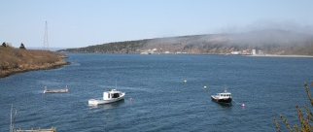
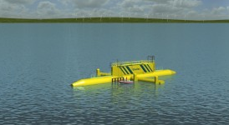
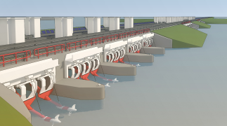
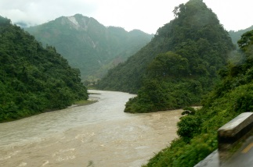
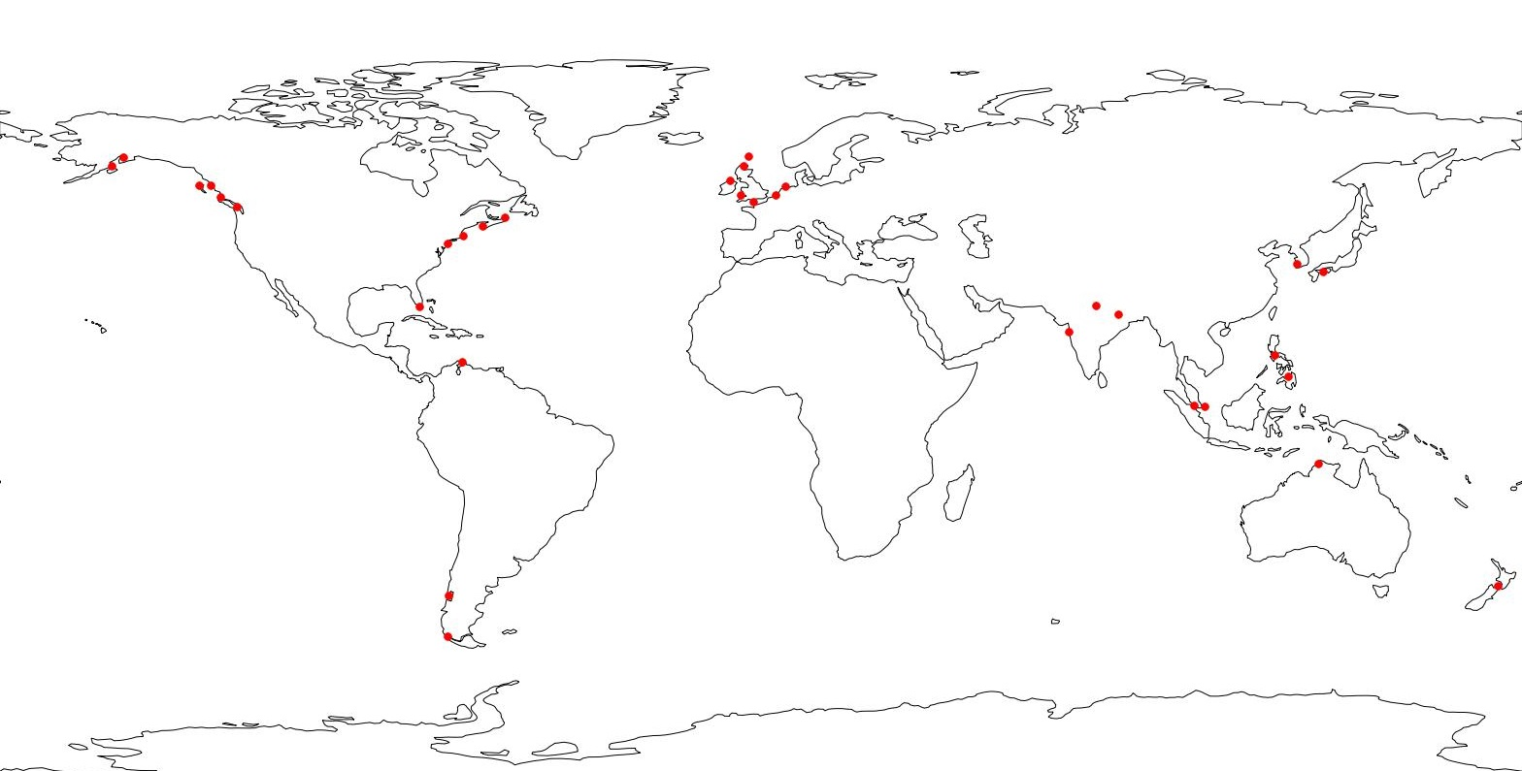
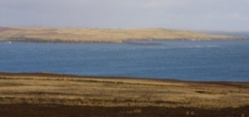
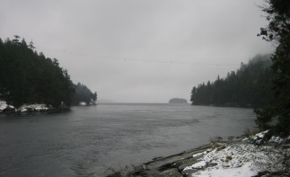

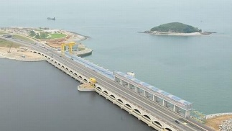
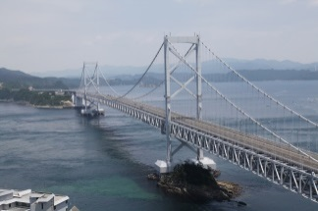
About Products Market Deployment
  Canada, Nova Scotia
  COMFIT
  First 2 MW array installed late 2015
  Marsdiep
  BlueTec, T200
  Afsluitdijk
  6 year track record
  4 turbines installed
  33 more agreed for 2016/17
  Nepal
  4 turbines sold
  Installing now
  UK & Ireland
  Large potential
  IoM -10 MW
  PTEC – 10 MW
  Ireland
  Morlais
  Bristol channel
  Canada, BC
  Large potential
  Contracts in negotiation
  Oosterschelde
  5 Turbines
  Start installation summer 2015
  South Korea
  Finalizing 72 turbine project
  3 x 2 MW projects
  Japan
  6 turbines sold
  Demo project in preparation

Slide 10
Other on-going discussions worldwide
Basse Normand & PNA
Myanmar
Pakistan
Faeroe Islands (SEV)
Pacific Islands, Philippines and Indonesia
Chile
Channel Islands

Slide 11
Contact
Tocardo International BV
www.tocardo.com
info@tocardo.com
Head Offices
Sluiskolkkade 2
1779 GP Den Oever
The Netherlands
Tel: +31 227 727 200
Canada Offices (NS)
Purdy’s Warf Tower 2
1300-1969 Upper Water Street
Halifax, Nova Scotia, Canada

