Slide 1

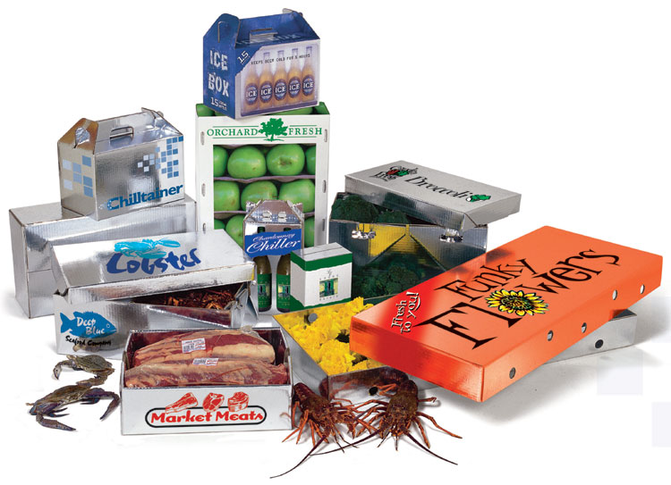
“Thermal Packaging that Saves the Earth”
Award-winning environmentally-friendly thermal packaging

Slide 2
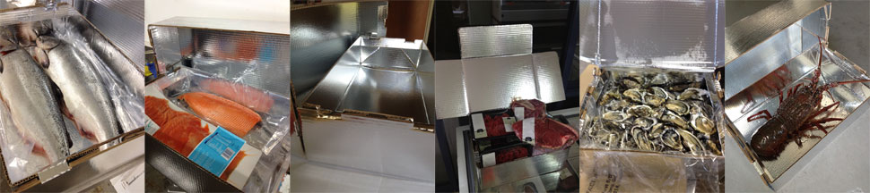
Overview
Thermal packaging to replace Polystyrene/EPS
Patented process that laminates a metallised plastic to corrugated cardboard
Sustainable Cost Effective Packaging
Salmon Markets: Norway/Europe/UK, Canada/USA, Chile/Sth Am, NZ/Aust
Exclusive packaging partners
“Thermal Packaging that Saves the Earth”

Slide 3
Chilltainer Benefits
Highly recyclable, Carbon neutral, Sustainable
Space efficient & Slim-line: Lower transport & storage costs
Strong, don’t fracture and Leakproof: Airline approved
No transhipping/repacking required in US/Europe
Print ‘brandable’ to distinguish your products
Lower cost across the Cool Chain
Better Product Delivered Sustainably & Economically
Chilltainers “ticks all the boxes”
“Thermal Packaging that Saves the Earth”

Slide 4
Key Success Factors
Chilltainer Success Factors
Product Temperature at packing
Coolant style and Packing technique
Box Design Customisation
Box Assembly
Box Branding
Eliminate double handling > Customer Direct
Recycling and Sustainability
  Better Product Delivered Sustainably & Economically
“Chilltainers Ticks All The Boxes”

Slide 5
Sustainability
Packaging shouldn’t cost the Earth ?
Chilltainers:
97% Sustainable paper
95-97% Recyclable in paper recycling = paid to recycle
Carbon Neutral = no carbon taxes
Easy to flatten, re-use or re-pack
Deliver Direct – no re-packing
Polystyrene/EPS > Oil based, Bulky, Breakages, Huge waste & recycling cost, Un-sustainable, Universally disliked….but 50+ years as the incumbent product
“Thermal Packaging that Saves the Earth”

Slide 6
Insulation Science
Chilltainers= Reflective (Radiation) insulation vs EPS = Conductive insulation
Chilltainers important characteristics:
  Reflects away light/heat (outside and inside)
  Dark inside -> cooler if in light
  Less efficient touching warm surfaces -> palletise
  Moisture can develop externally -> non-slip
  Holds internal temperature -> start product as cold as possible and minimise ambient air content
“Thermal Packaging that Saves the Earth”

Slide 7
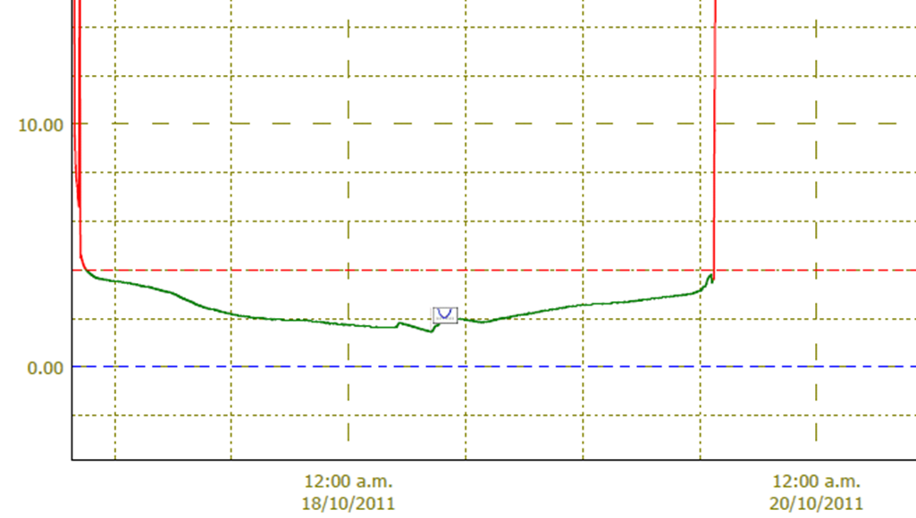
Thermal Performance
Salmon 64 hours transport NZ to Brisbane 0-3.5°C
“Thermal Packaging that Saves the Earth”

Slide 8
The Competition
The Incumbent = EPS / Styrofoam / Polystyrene
  Ugly Features:
      Completely unsustainable, 100% oil based
      not biodegradable
      Large breakages, not flexible
      Bulky and costly to ship
  Chilltainers -/+ 1.0 to 1.5 degrees temperature comparison
  Chilltainers more cost effective across the whole Cool Chain
  Poly-urethane and Wax box alternatives either not thermal or recyclable
  Chilltainers the cost effective answer to EPS
“Thermal Packaging that Saves the Earth”

Slide 9
Scientific Tests
Dept. Primary Industry, Queensland
      Compared EPS and Chilltainers with lobster and coolpacks over 36 hours
      Concluded no significant differences
Food & Crop, Ministry Of Ag & Fish, NZ
      Also compared EPS and Chilltainers with lobster and coolpacks over 36 hours
      Concluded no significant difference between the boxes
  Poly-urethane and Wax box alternatives either not thermally effective or not recyclable
  Chilltainers the cost effective answer to EPS
“Thermal Packaging that Saves the Earth”

Slide 10
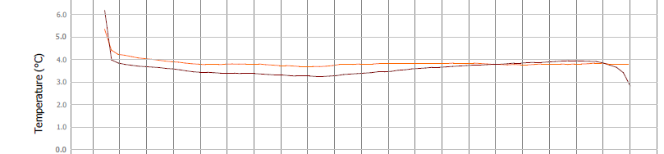
Scientific Tests
Chilltainer vs EPS
    36 hours from ambient with coolant
    No difference between the boxes
    Initial food/product temperature critical & coolant quantity
“Thermal Packaging that Saves the Earth”

Slide 11
Successful Shipping
Salmon (chilled)
  NZ to Aust; NZ to Europe, NZ to US, NZ to Japan
  Chile to US (photos below)
  Tasmania to Brisbane, Sydney, Perth, Asia
Tuna (chilled)
  NZ & Aust to Japan
Lobster (chilled)
  NZ & Aust to Asia; US to Europe
“Thermal Packaging that Saves the Earth”

Slide 12
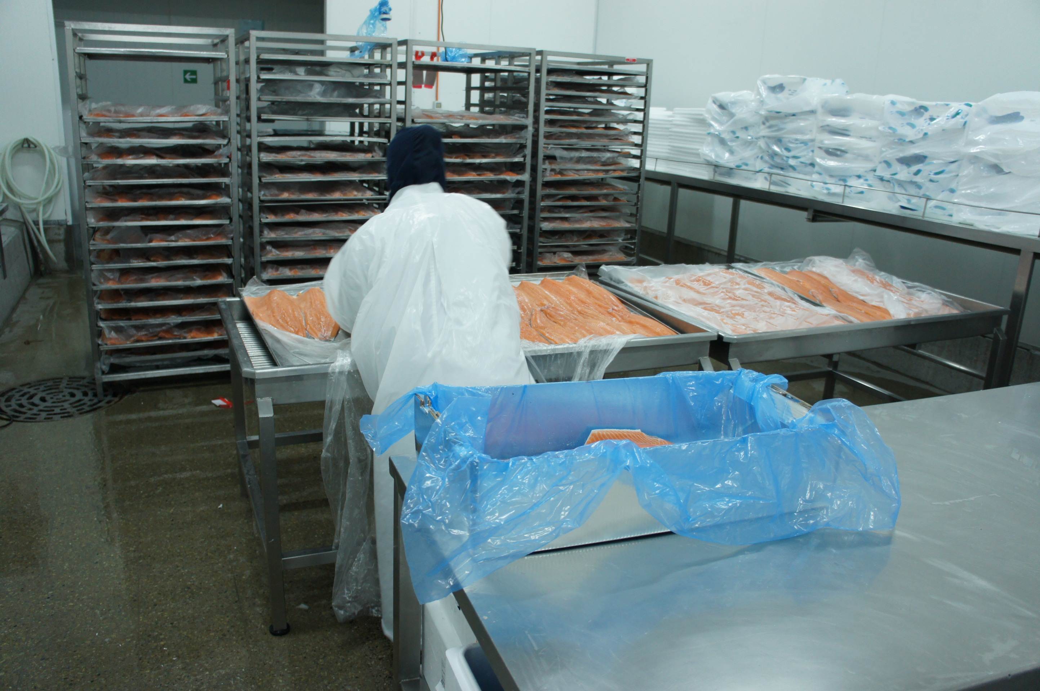
No Leaks, No Breakages

Slide 13
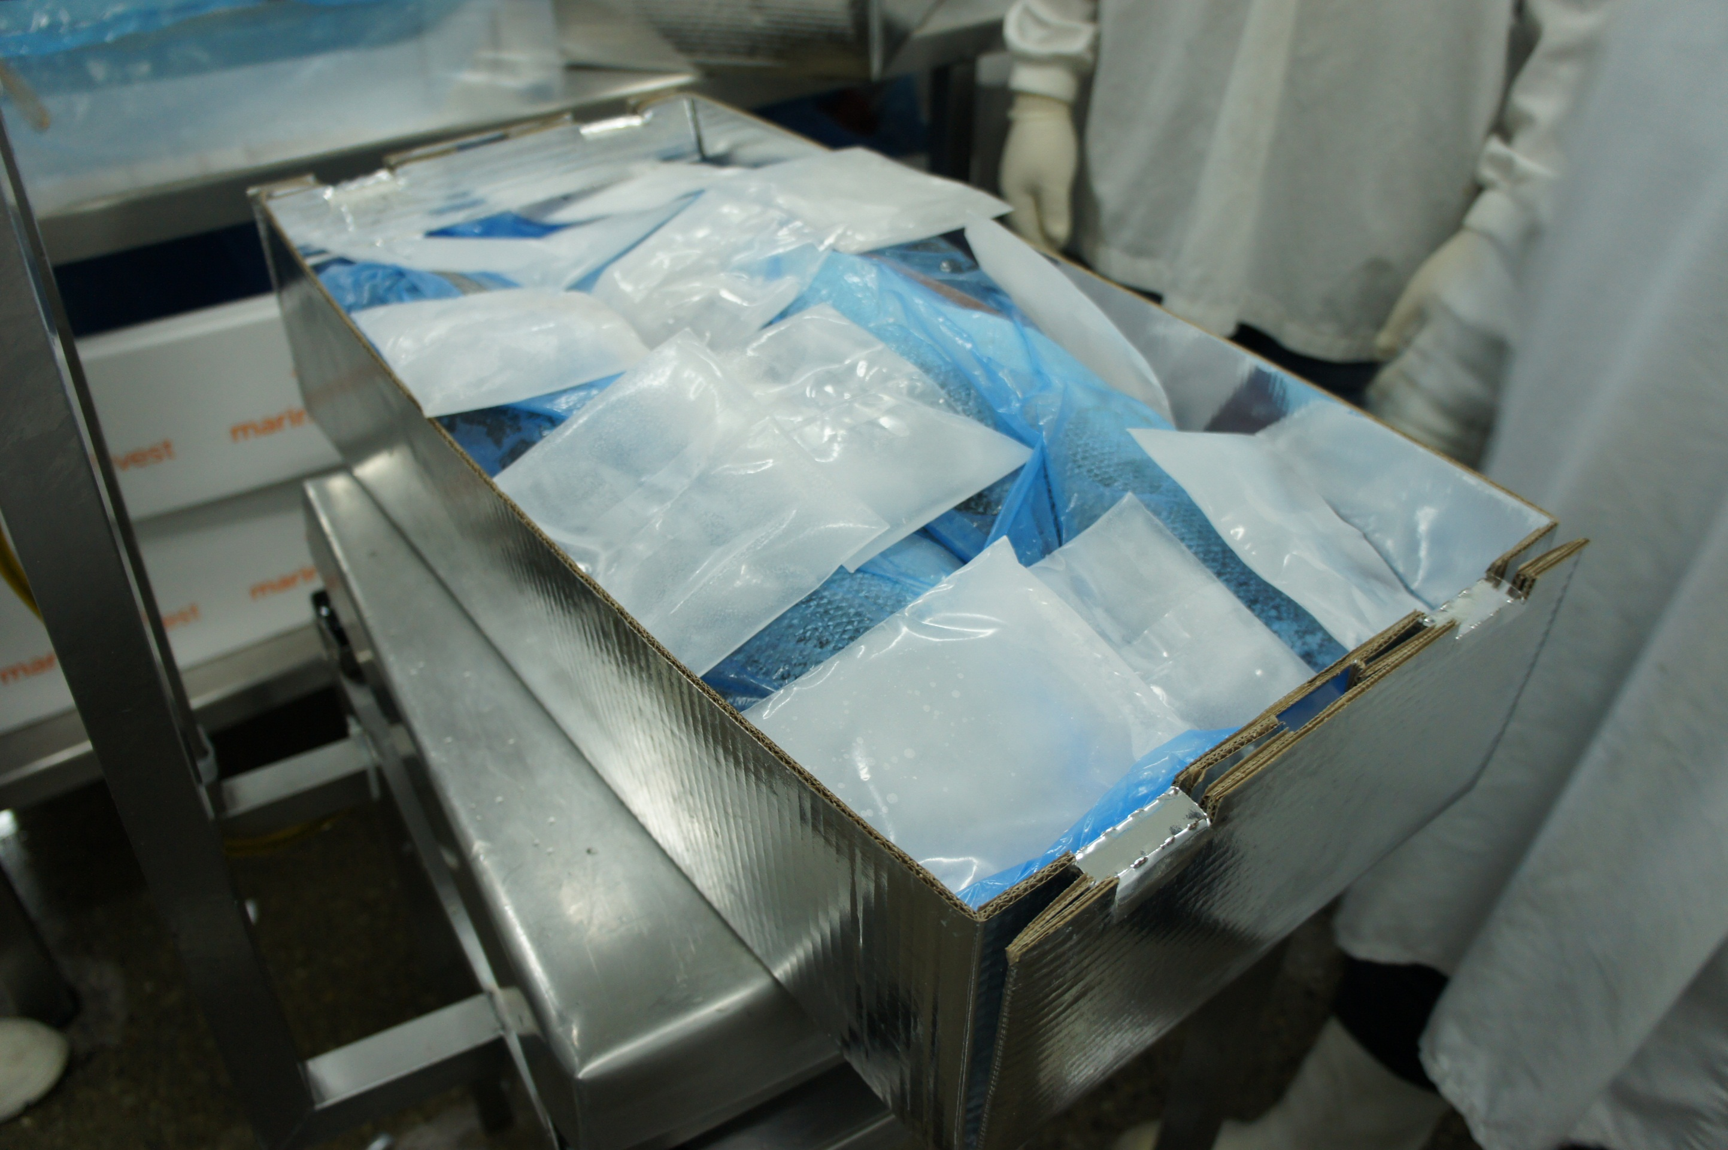
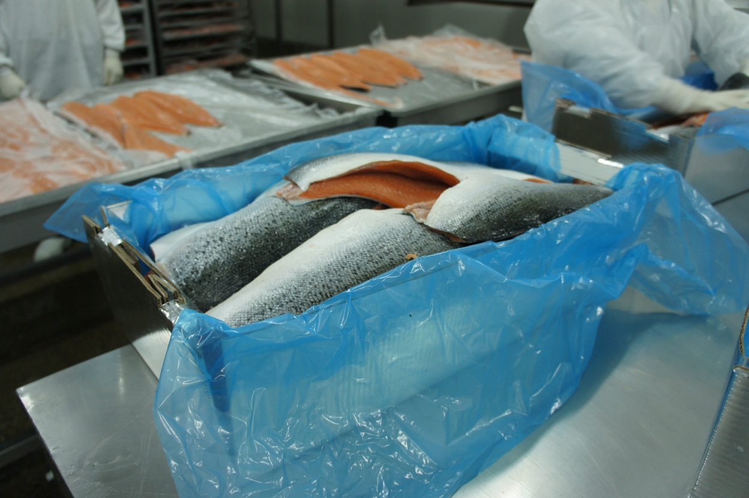

Slide 14


Slide 15
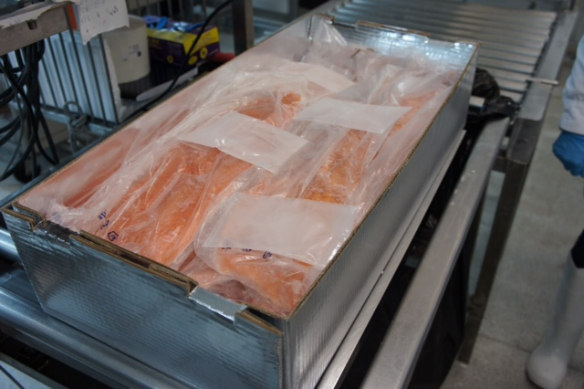
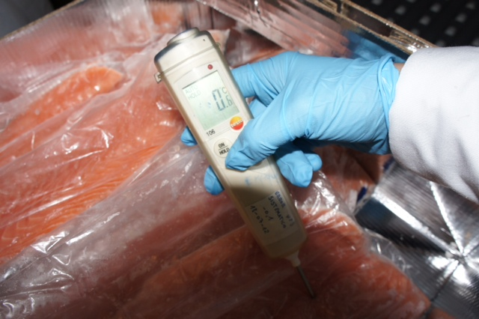
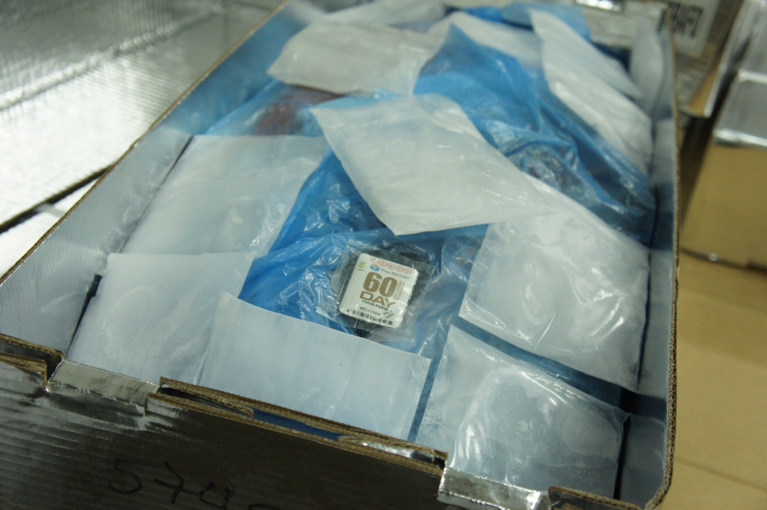
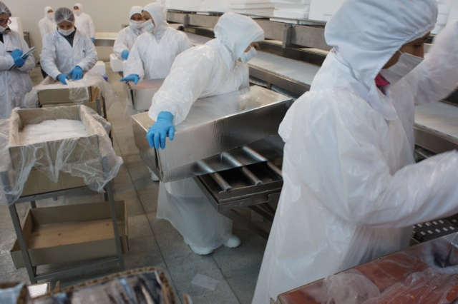
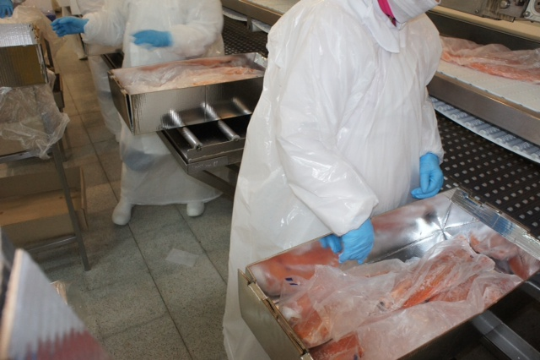

Slide 16
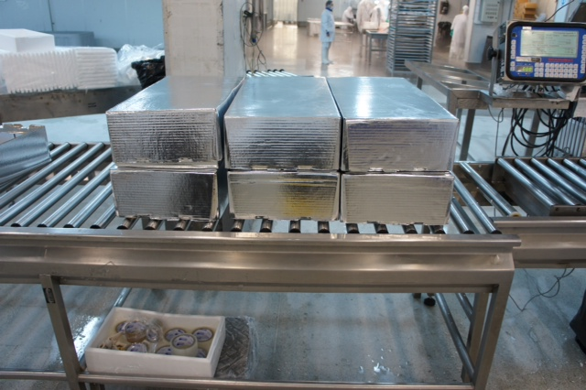

Slide 18
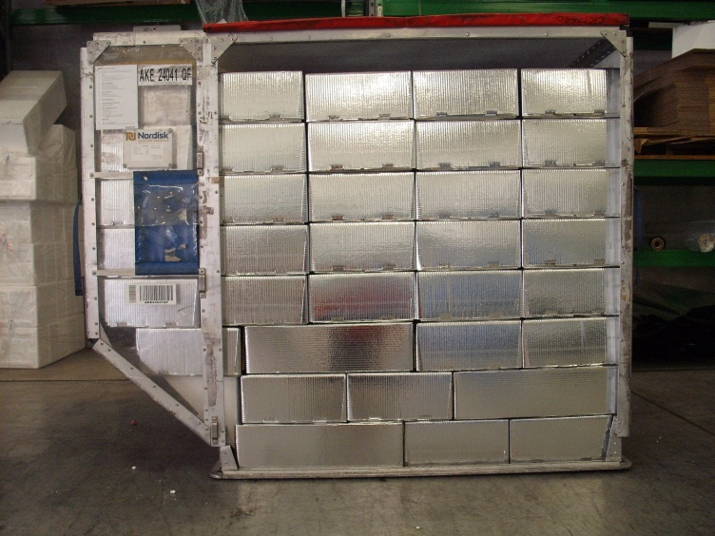
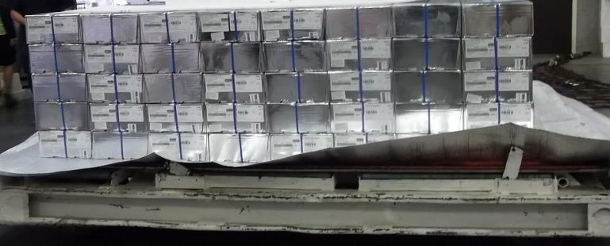
Space Efficient
Flat-pack
Make on site
Thin walls vs EPS/Styro
Up to 40% more in an airfreight container
Strong & robust
No breakages
No repack into US
Reuseable
“Thermal Packaging that Saves the Earth”

Slide 19
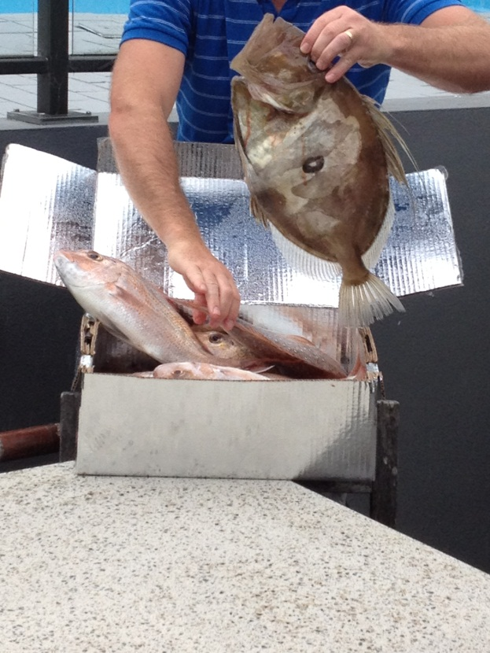

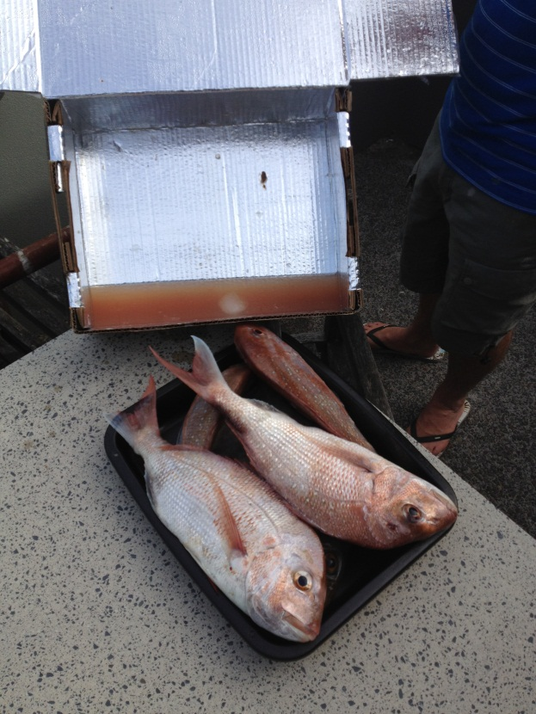
No Leaks, No Breakages

Slide 20
Chilltainer IP- Patents
Extended patents internationally since 2000
Patents in NZ, Aust., North America, Norway and Chile
Further patent improvements pending
Patent for laminating using the corrugator
More product patent applications possible
“Thermal Packaging that Saves the Earth”

Slide 21
The Sales Proposition
  Total “Cool Chain” Savings
End-to-End Comparison to Poly/EPS
Freight, Breakages, Labels, Printing, Airfreight/Truck volumes, Repack/Re-handle, Customer Sustainability Decision, Recycling & Reuse
Consumers and Supermarkets demanding change
-> Chilltainers are Sustainable
Chilltainers = 40-65% savings across total “Cool Chain”
“Thermal Packaging that Saves the Earth”

Slide 22
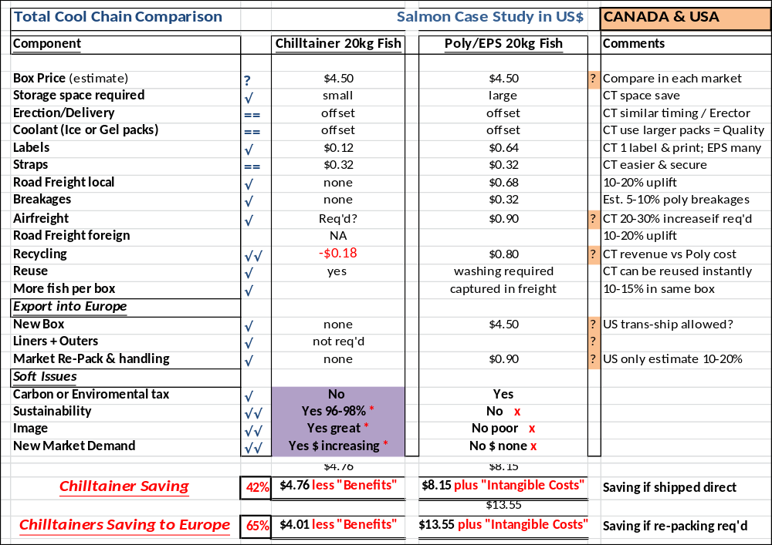
  Total “Cool Chain” Savings

Slide 23
Key Success Factors
Chilltainer Success Factors
Product Temperature at packing
Coolant style and Packing technique
Box Design Customisation
Box Assembly
Box Branding
Eliminate double handling > Customer Direct
Recycling and Sustainability
Better Product Delivered Sustainably & Economically
“Chilltainers Ticks All The Boxes”

Slide 24
Case Studies
NZ King Salmon – export US, Japan, Europe, Aust, NZ
Salmon Chile to US (airfreight) & Brazil (roadfreight)
Patruel/East Coast Seafoods USA – live lobster
Leigh Fisheries & Moana Pacific– live lobster exports
Mahurangi Oysters – chilled live oysters
Moana Pacific – chilled tuna export to Tokyo markets
My Food Bag – NZ & Aust leading recipe meal delivery Coy
Moreish Foods – courier delivery of organic foods
RKM – export of chilled meats
“Thermal Packaging that Saves the Earth”

Slide 25
What Sort of Products?
Replace EPS/Polystyrene packaging
Cold or Hot > anything perishable
Key Products:
    Chilled Seafoods: salmon, fish, lobster, shellfish
    Chilled Meats and Dairy
    Vegetables and fruit
    Pharmacueticals
    Local & Home delivery
“Thermal Packaging that Saves the Earth”

Slide 26
Contact Details
Wayne Harrison – Founder & Technical Director
      Mobile +64-275-995390
      wayne@chilltainers.com
Hamish McGregor – CEO
      Mobile +64-21-633677
      hamish@chilltainers.com
“Thermal Packaging that Saves the Earth”

Slide 27
Website
Please visit www.Chilltainers.Com
Photos and Videos and Assembly/Erection
Protocols, Trials & Technical Evaluation
www.Chilltainers.Com
“Thermal Packaging that Saves the Earth”

