Slide 1
Examples of logos

Slide 2


Integrated
( text name + logo)
Independent
(works without text)

Slide 3
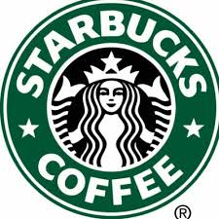
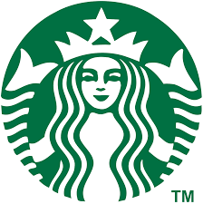
Integrated
( text name + logo)
Independent
(works without text)

Slide 4
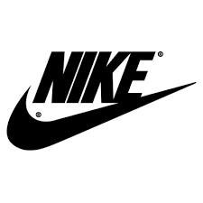
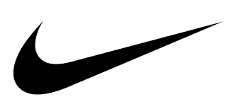
Integrated
( text name + logo)
Independent
(works without text)

Slide 5
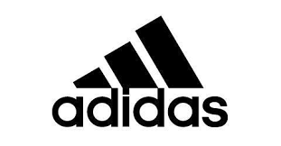

Integrated
( text name + logo)
Independent
(works without text)

Slide 6
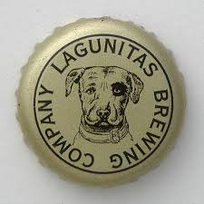

Round logos work better with beer
Integrated
( text name + logo)
Independent
(works without text)

Slide 7
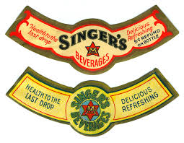
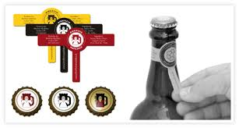
Round logos work better with beer
Round logo used in beer neck label

Slide 8
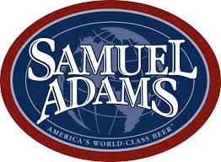


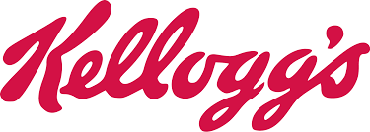
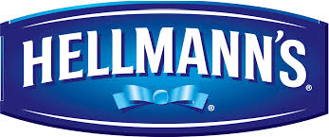
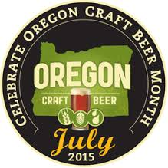
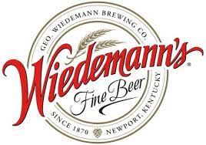
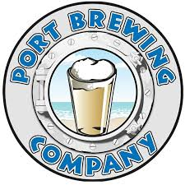
Logos that don’t work as intended.
Without the text, each one of these logos is difficult to associate to the brand

