Slide 1
Backyard
Craft Beer

Slide 2
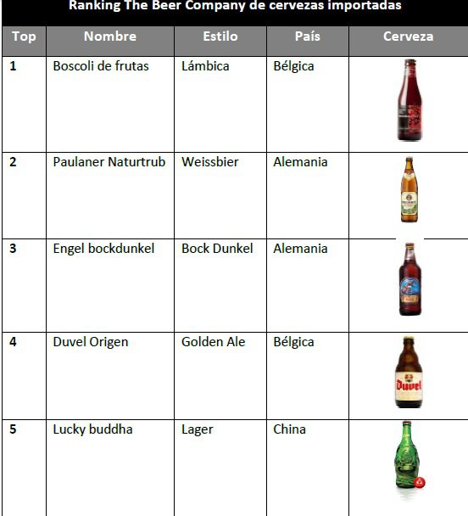
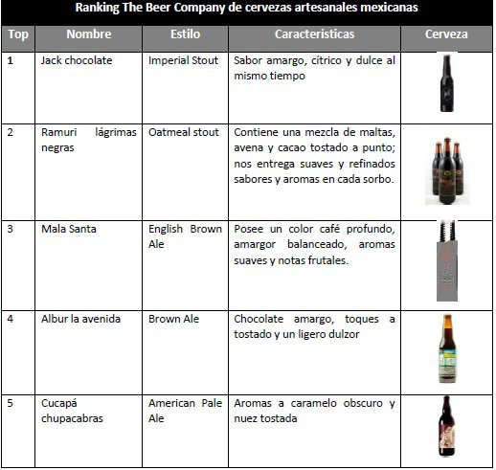
These are the top 10 craft beer most sold in our market (Mexico)

Slide 3
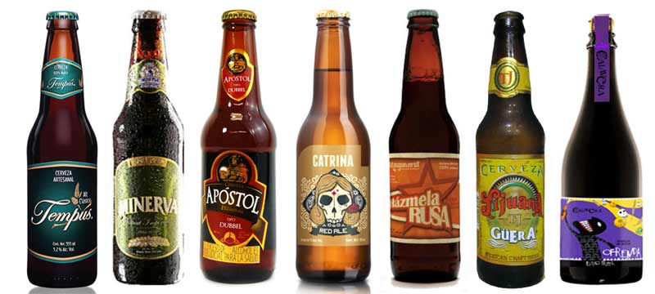

Slide 4
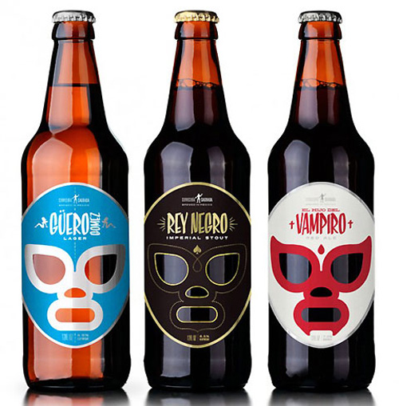
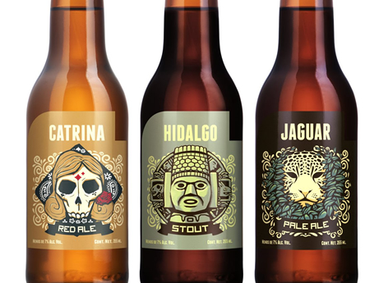

Slide 5
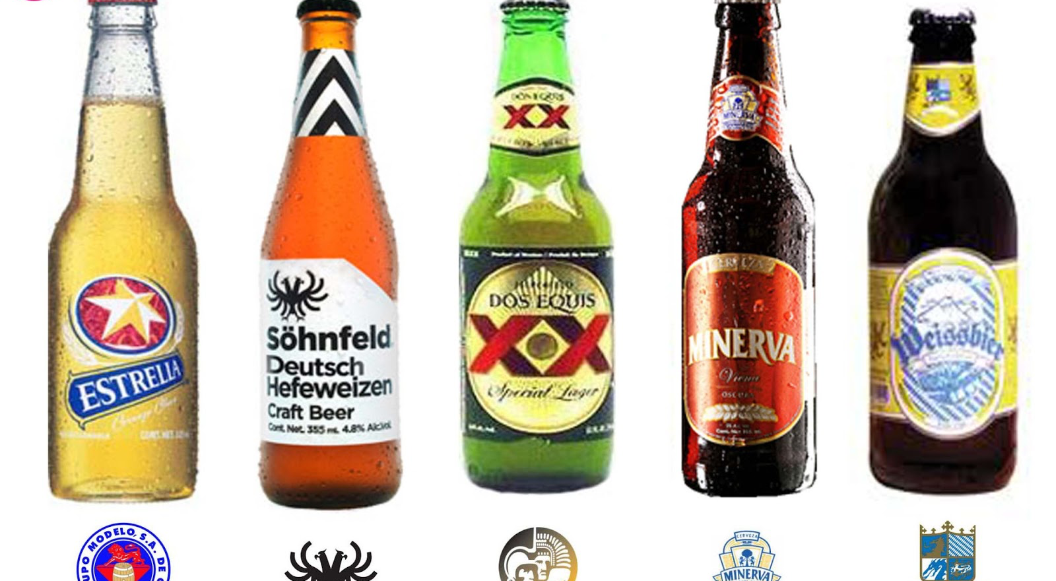

Slide 6
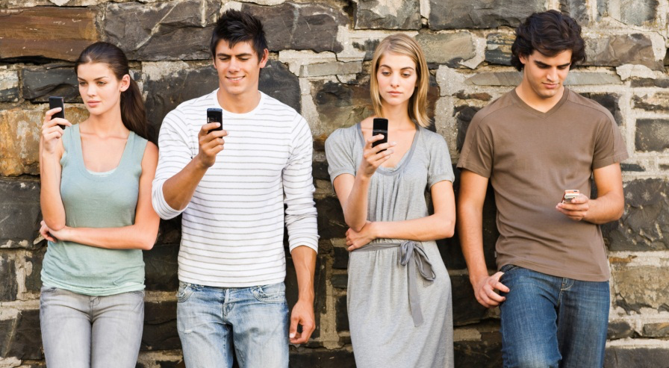
Who is our target?
Millennials

Slide 7
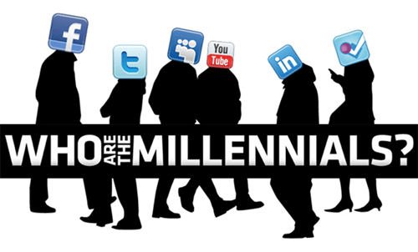
This is a new generation

Slide 8
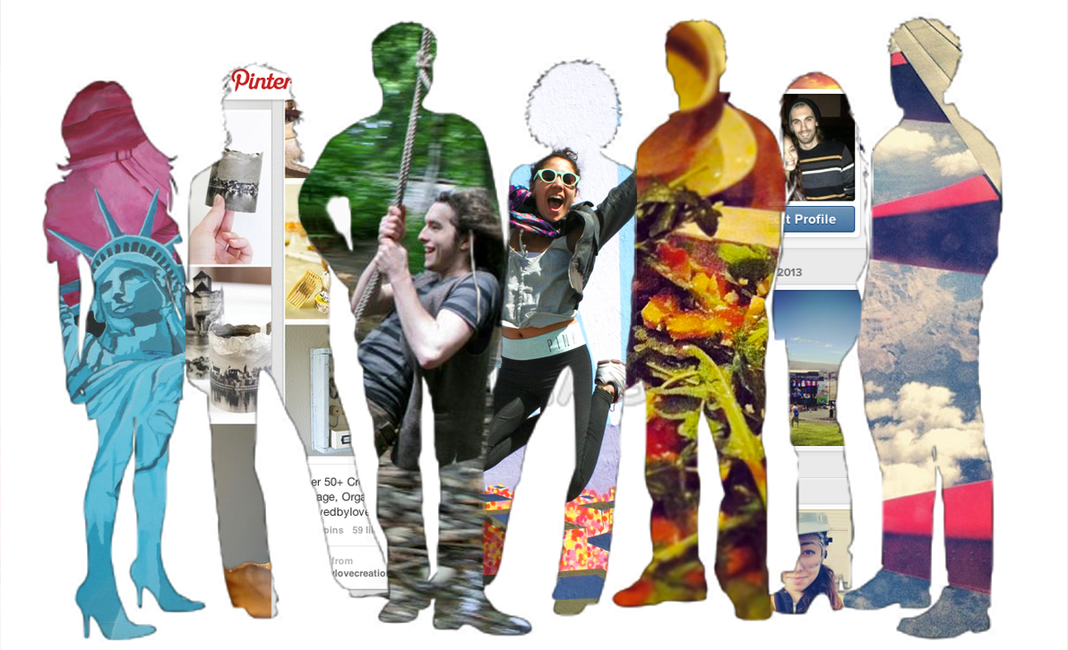
They want to feel unique, and they share everything, experiences, moments, products.

Slide 9
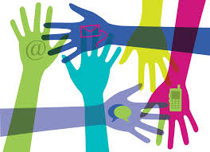
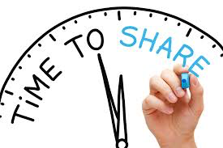
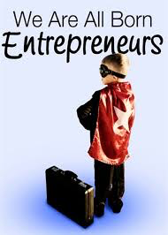
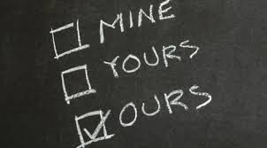
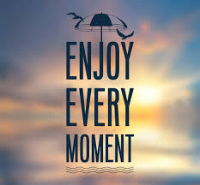
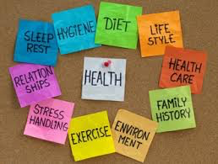
They Are connected
They love to share
To succeed is to create
They love to enjoy experiences
They look after balance
They are not individualists

Slide 10

They are aware of everything around them

Slide 11
How should a product be in order to appeal to them?

Slide 12
ESSENCE
Experiences and moments to connect with others
PERSONALITY
Leader, Unique, Free, Trendsetter, Joyful y Social
REASON TO
BELIEVE
This is a wheat beer, crafted to be higlhy drinkable (drink many without feeling full), Yet, made with a clear flavor differentiation vs. Mainstream big breweries’ beer, Our beer has taste.
BENEFIT
Funcional: Crafted beers have been playing an important role in early stages. More and more consumers are asking for crafted local beers as starting a meal or as a conversation kicker. Moreover, terraces and patios are the perfect freedom moment and licence to connect.
Emocional: To request a crafted beer makes you look different, unique, someone open to new experiences, part of the world and with an original peronality , someone that likes and is ready to share and live moments to the full, unique and social.
INSIGHT
In todays world to know what is happening is a must, in consumer products is not the exception. To know brands that are new and offering something unique stories allows consumers to project an image of knowledge and connection to socialize and what a better place that a backyard, patio ot terrace.
TARGET
Young adults 20 to 30, passionate, competitive and in search for the new next unique experience. They share moments and search to be the reference of everyone.

