Slide 1

Integro
Specializing In Inactive Well Management
Professional
Experienced
Reliable

Slide 2
Overview
  Introduction and background
  Strategic approach to inactive well management
  Cost and value benefit
  Next steps

Slide 3
Introduction – Integro services
  Plan, manage and execute end of life cycle for a well
  Inactive well management specialists
  Strategic planning of program
  Structural change to cost structure through strategic alliances
  Innovative financing and liability transition
    Need graph on end fo life cycle

Slide 4
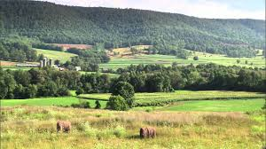
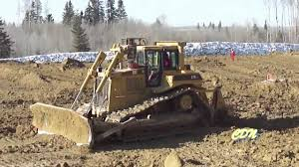
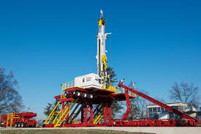
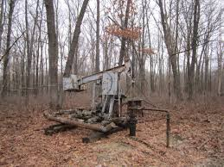
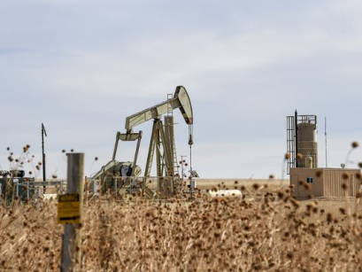
Introduction – Integro services
Lease
Abandoned
Suspension
Drilling
Production
Notes:
This slide was to be a pictoral of the area that Integro focuses on an oil and gas wells life cylce. We focus on the well once it is no longer productive.

Slide 5
Overview
Plan
Develop strategic plan
Manage
Proactive management with regulator
Compliance
Execute
High utilization
Focused delivery
Assess risks
Notes:
This slide was to be a pictoral on planning, managing and exeucting to save the company money.

Slide 6
What we do – Inactive well management
Non-compliance assessment
Plan, execute and ongoing monitoring of suspended wells and regulatory filings
Planning and executing well abandonment program
Corporate LLR assessments and regulatory submissions
Asset acquisition and divestiture due diligence

Slide 7
Corporate benefits
  Eliminates non-core activities – abandonments, suspensions, administration filing
  Focus on value add – production, reserves, netbacks
  Cost savings – focus drives savings
  Strategic and consistent focus – avoid AER notices
  Integrates inactive well strategy with overall corporate objectives
  Regulatory compliance
  Accurate costing of suspension and abandonments

Slide 8
Performance Scorecard
Inactive well compliance quota
Well abandonment program
AER submissions
Notes:
Insert scorecard design.

Slide 9
Summary of Risk areas -

Slide 10
Summary of Risk areas

Slide 11
Summary of Inacitve wells by Area

Slide 12
Summary of Risk areas - Arsenal

Slide 13
The Team
Completed over 4,000 well suspensions in Western Canada
Abandoned over 300 routine wells in Western Canada
Abandoned over 100 non-routine high risk wells in Western Canada
Extensive production knowledge, drilling, completions and field operations
Extensive finance and management knowledge of service and E&P companies
Extensive domestic and international E&P and service company experience
Practical and E&P focused background

Slide 14
The Team – Key Strengths
Successful in executing large capital projects and being under budget
Successfully working with regulators on numerous complex abandonment issues
Excellent relationship with AER staff

Slide 15
Abandon vs Suspend
Improve corporate LLR ratio
With industry downturn significant cost savings on services can be achieved
Eliminate ongoing suspension and surface lease costs
Wells transitioning from Low to Medium risk require bridge plug.

Slide 16
Additional slides

