Slide 1






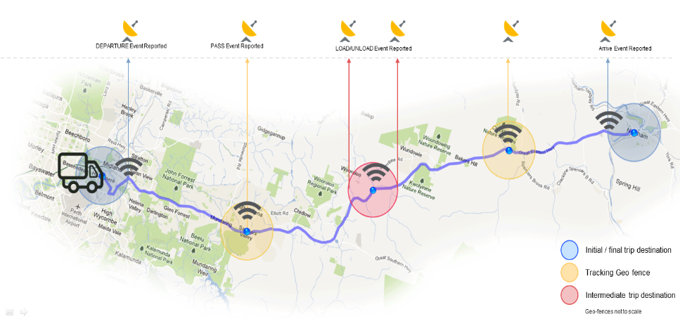
Some example images used in the project
LTL
+
-
LTL
LTL
+
-
LTL
+
-
LTL
LTL
Mobile
Devices
FoxTrax
GPS Tracking
Transmitters

