Slide 1

Immune SigDB
Nick Haining, B.M., B.Ch.
Assistant Professor of Pediatrics
Dana-Farber Cancer Institute
Harvard Medical School
Associate Member
Broad Institute of Harvard and MIT

Slide 2
What does BATF do that makes it so important for CD8 effector differentiation?
Notes:
So clearly BATF deficiency really messes up effector CD8 differentaiton.
So BATF is a really important part of the machinery…but where does it fit in the wiring diagram?

Slide 3
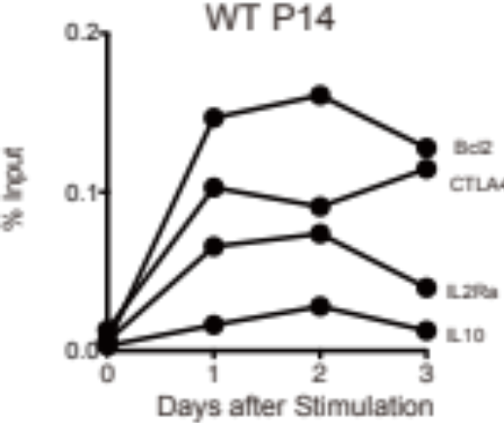
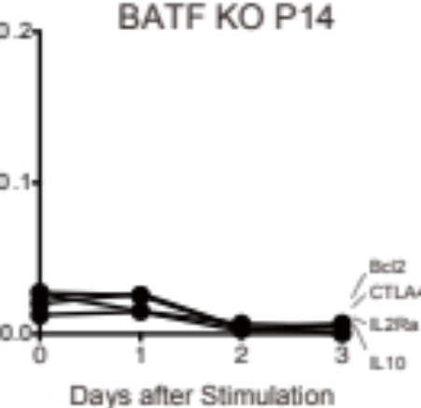
BATF binds to target genes within 24 hours of differentiation

Slide 4
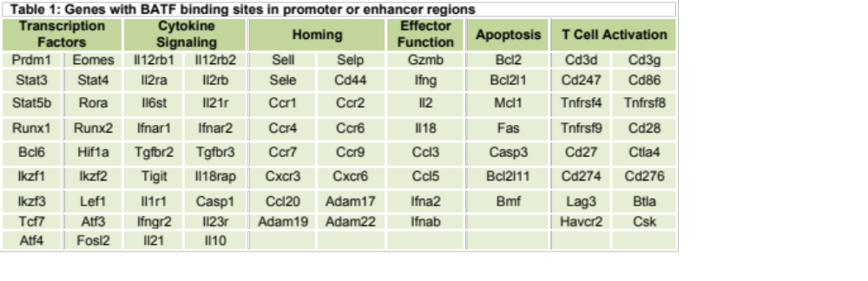
BATF binds to many key differentiation genes in CD8 T cells
Notes:
What happens to these BATF bound genes during effector differentaition?
Looked at expression profiles of WT cd8 T cells during effector differentiation focussing only on genes bound by BATF.
HC analysis showed that target genes highly dynamically regulated during differentiation – highly distinct temporal patterns.
BATF Target genes are overrepresented in these genses that are altered duing effector differentiation

