Slide 1
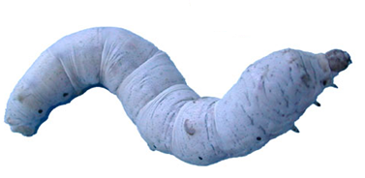
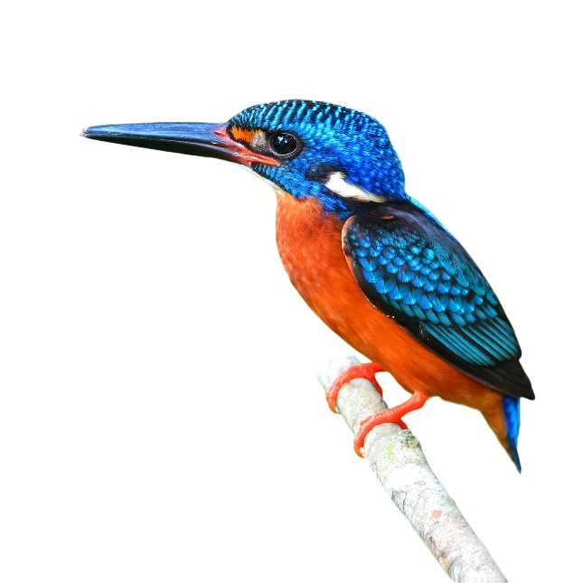
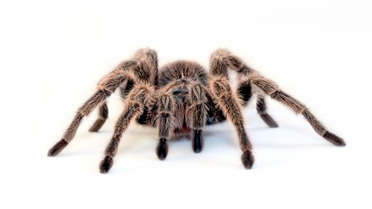
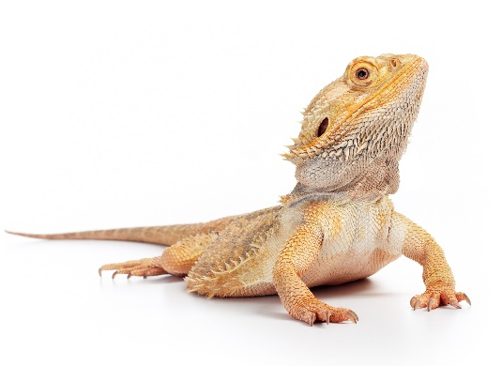
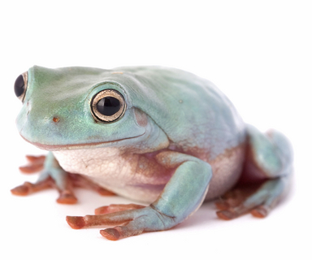
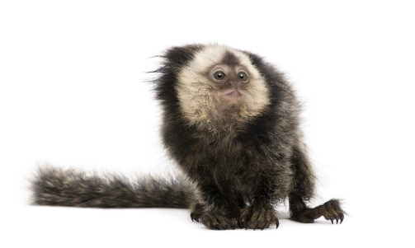
Silkworms a Healthy Alternative Feeder Insect
Silkworms are naturally high in:
  Protein
  Calcium
  Vitamin A
  Vitamins B1, B2, and B3
  Low in fat
With such high nutritional value encased in a soft and juicy body, silkworms are the ideal addition to a varied diet for reptiles, amphibians, fish, insect eating birds and mammals!

Slide 2
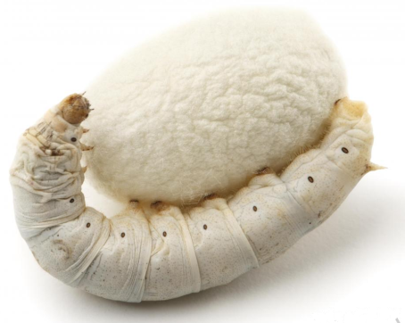
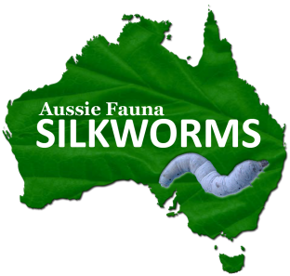
Aussie Fauna had been breeding and supplying silkworms to Australian Zoos, Public Aquariums, and the Pet Industry since 2012 and is the only commercial supplier of silkworms in Australia year round. The facility is owned and operated by a veterinarian ensuring highest quality feeder insects.
Silkworm Prices* Including Shipping and GST
500 Silkworms …..$85.00
1000 Silkworms …..$149.50
*Please contact for discounts on larger quantities.
Silkworm Chow (Mulberry powder based food)
250g bags…..$22.00
4.5kg bags….$135.00
For Further Information Contact:
Brett De Poister, Bsc., BVMS
0430463314
info@aussiefauna.com
ABN 78159235424

