Slide 1
makati, philippines
ABOVE
*subject to senior management approval

Slide 2
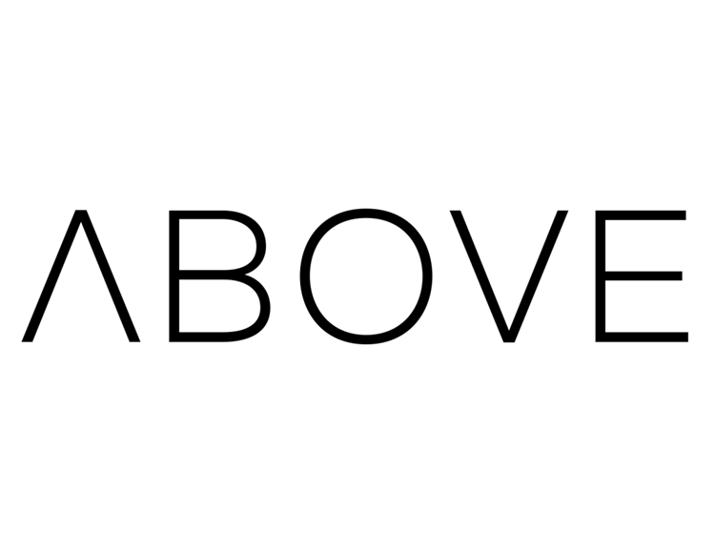
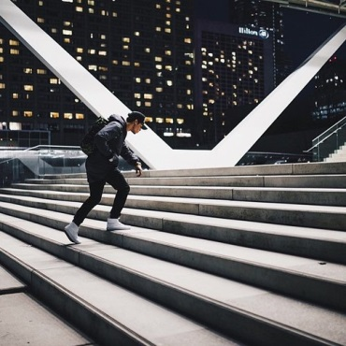
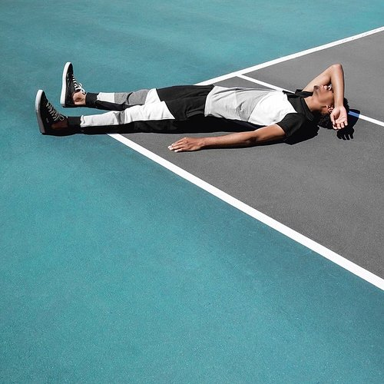
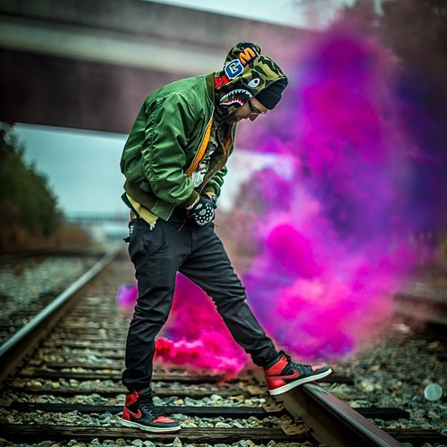
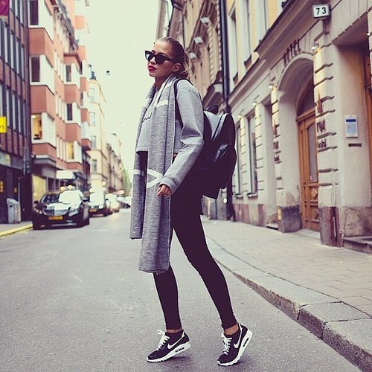
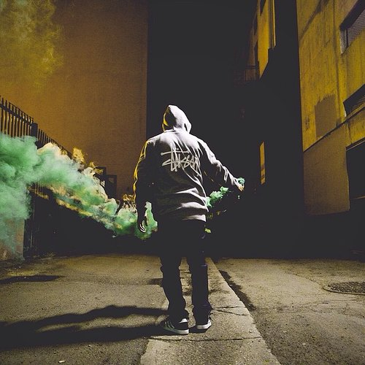
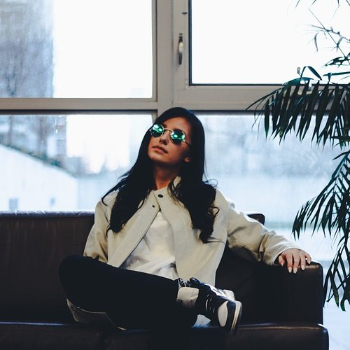
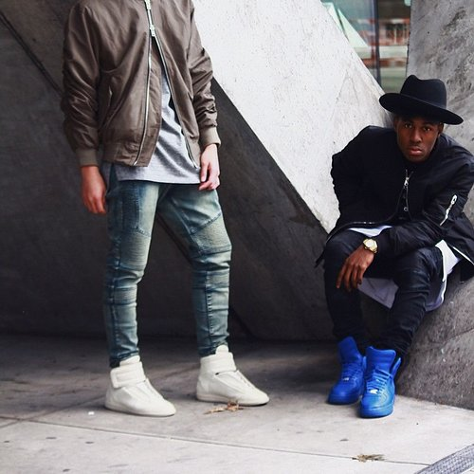
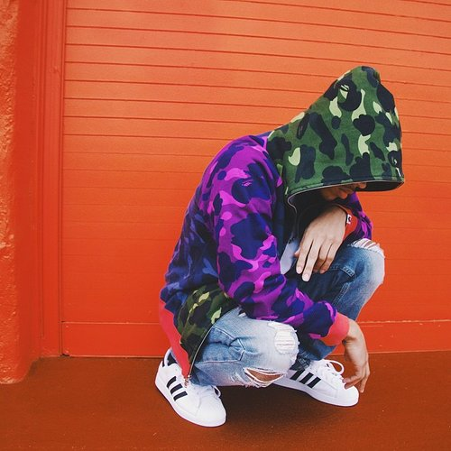

Slide 3


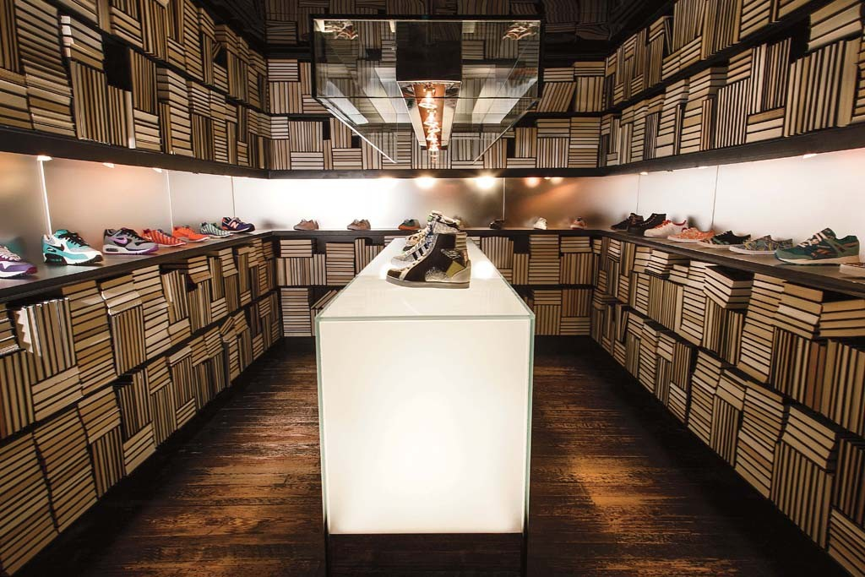
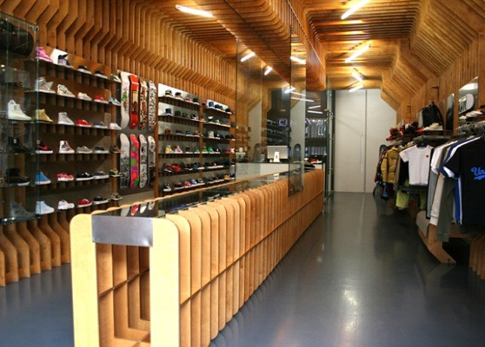
international stores
Atlanta, Georgia
http://wishatl.com/store/
Cambridge, Masschusetts
http://www.cncpts.com/
Inspired by the top sneaker boutiques in the world
Notes:
Inspiration

Slide 4
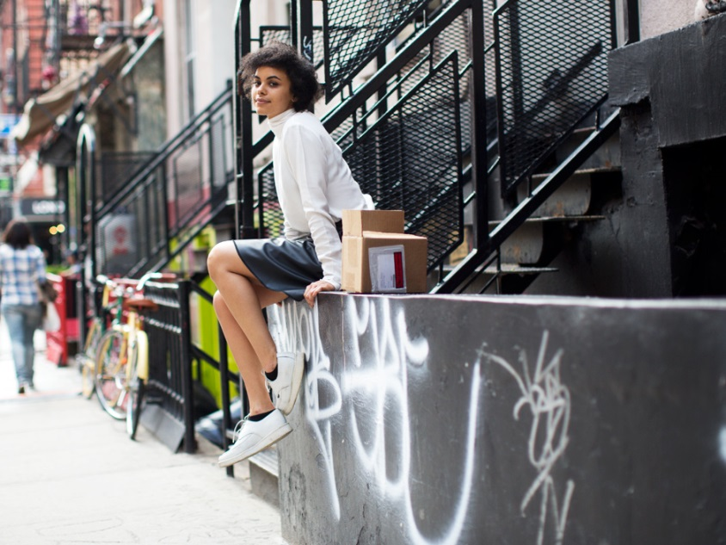
the concept
to become Manila’s finest multi-brand sportswear & lifestyle boutique
offer the most sought-after sneaker releases and a well curated apparel and accessories line
for the young, vibrant and active and discerning customer
seek inspiration from key cities such as new york, los angeles, tokyo, london, paris, stockholm

Slide 5
Adverb
In or to a higher place
In or to a higher rank or position
Preposition
Over or higher than
Superior or in rank, position, or number, greater than
Beyond the level or reach of
In preference to
More than

Slide 6
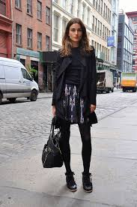
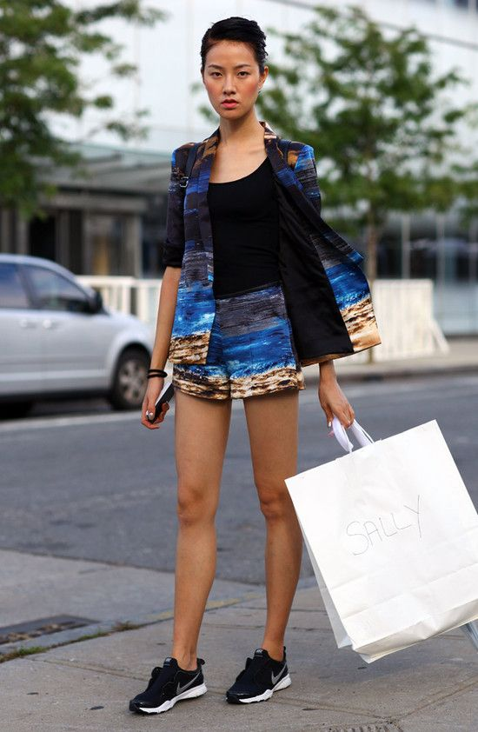
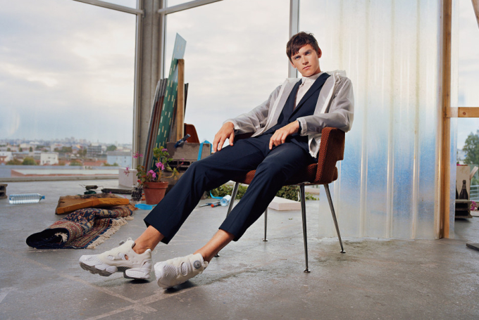
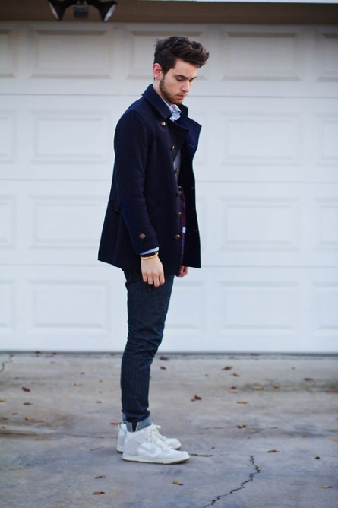
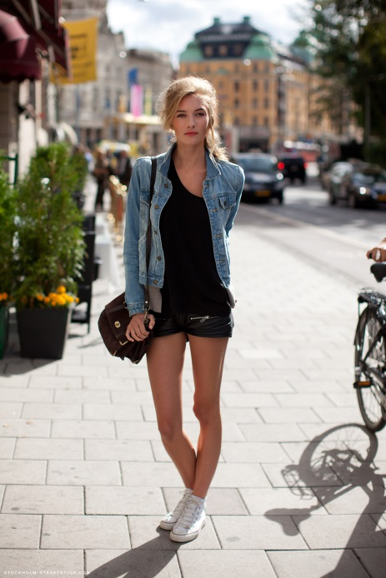
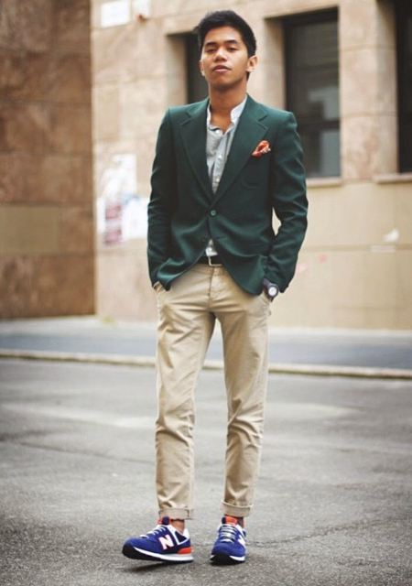
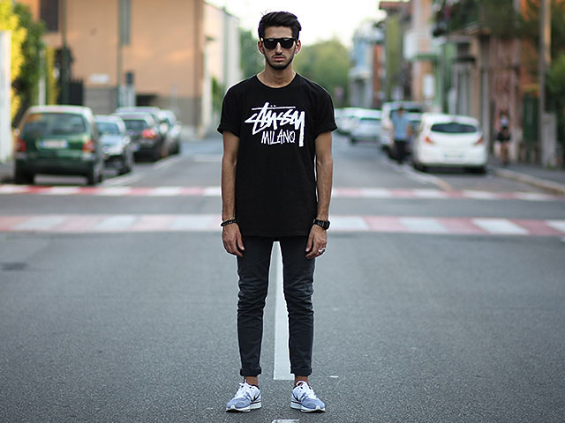
target market
young
hip
a & b market
life in the fast lane
fashionable
active lifestyle
competitive
ambitious
Notes:
New generation of style seekers or street hounds.

Slide 7
design studies
*subject to senior management approval

Slide 8
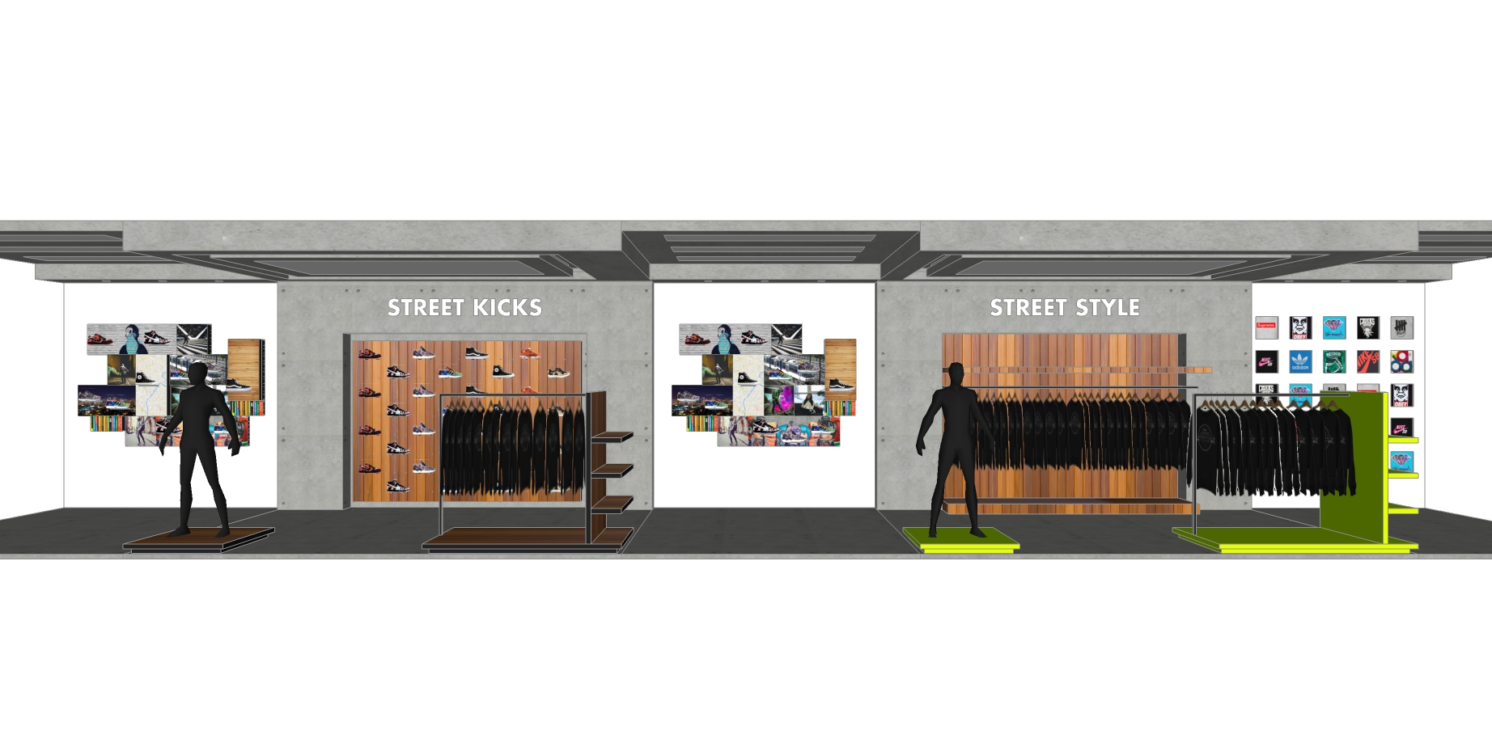
the perspective
We aim to pique the curiosity and interest of our customers by presenting the merchandise in a visually creative space that combines fashion, art & design.
*subject to senior management approval

Slide 9
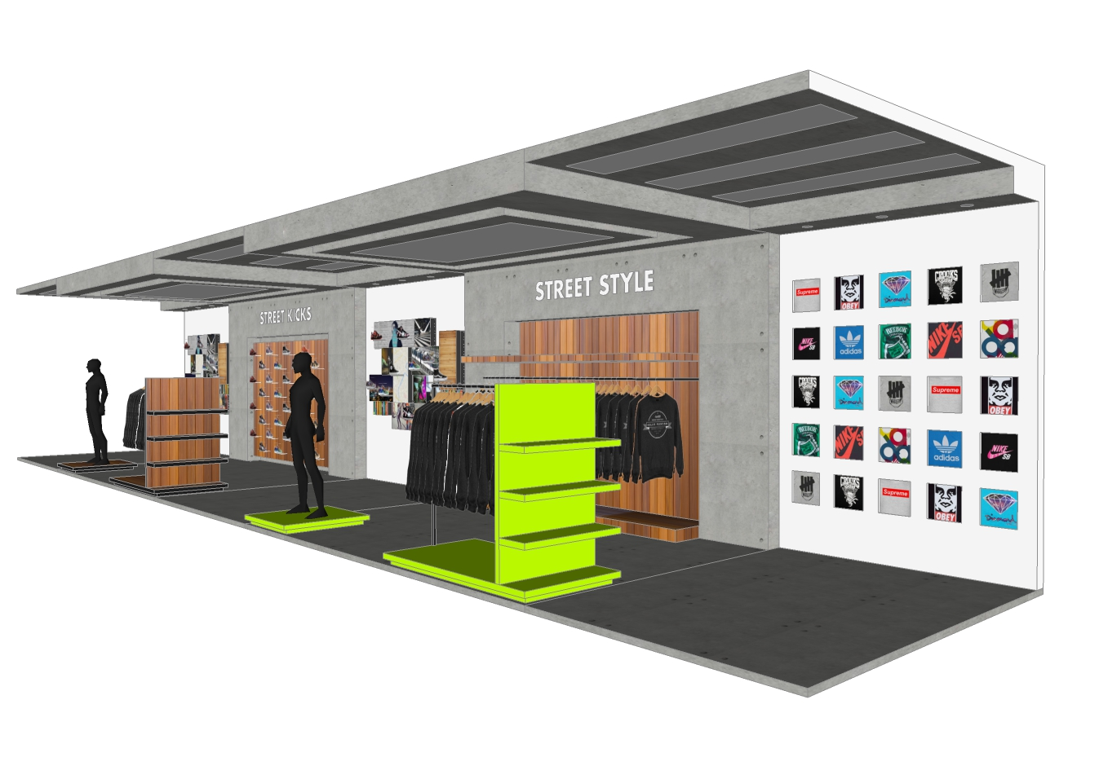
the perspective
what makes ABOVE different?
most discerning edit from the top sportswear and lifestyle brands
carry only the best brands per category
visually creative presentation that combines fashion, art & design
*subject to senior management approval

Slide 10
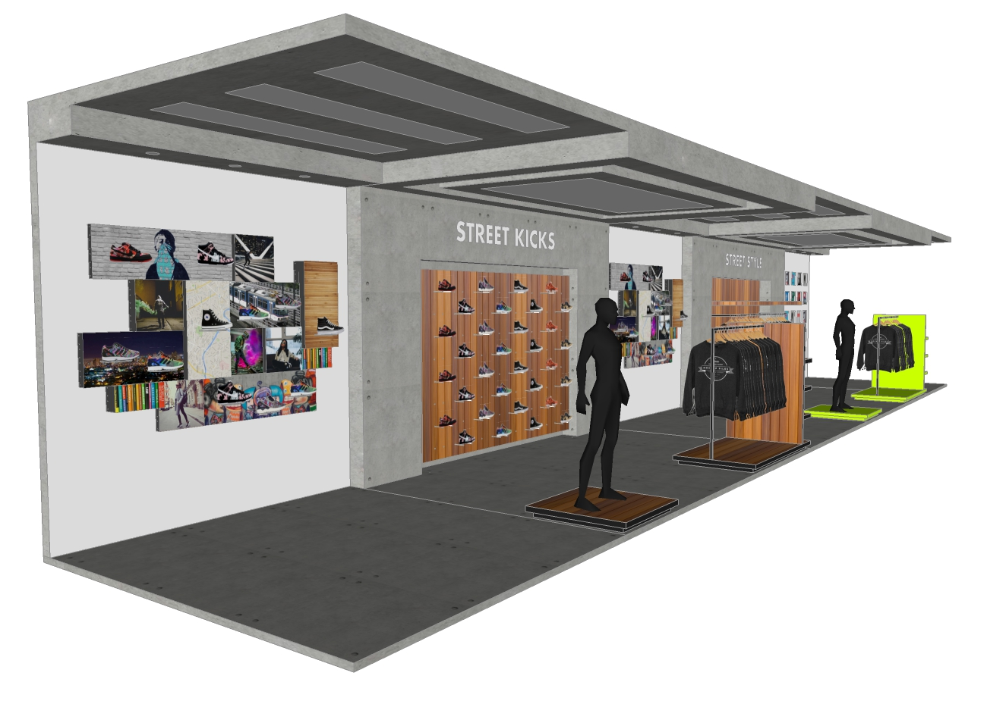
*subject to senior management approval

Slide 11
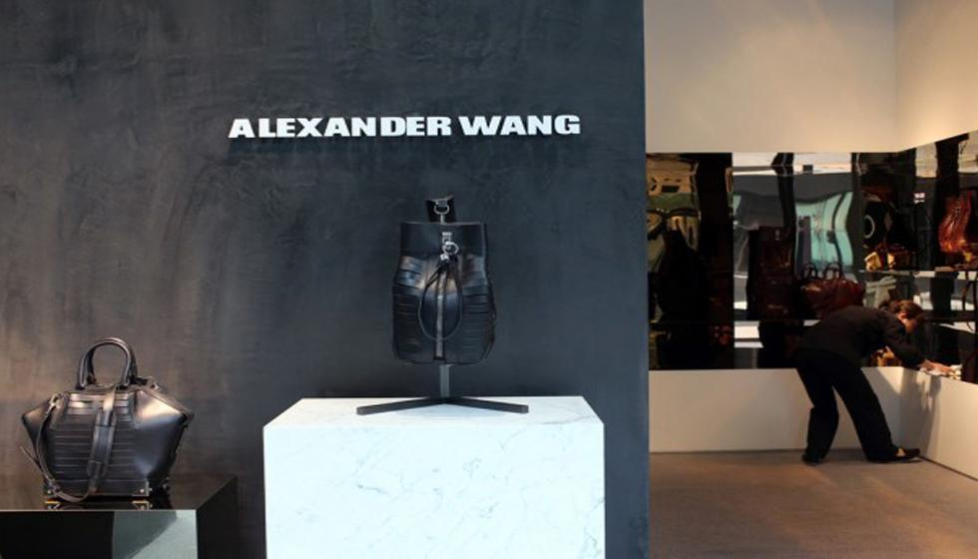
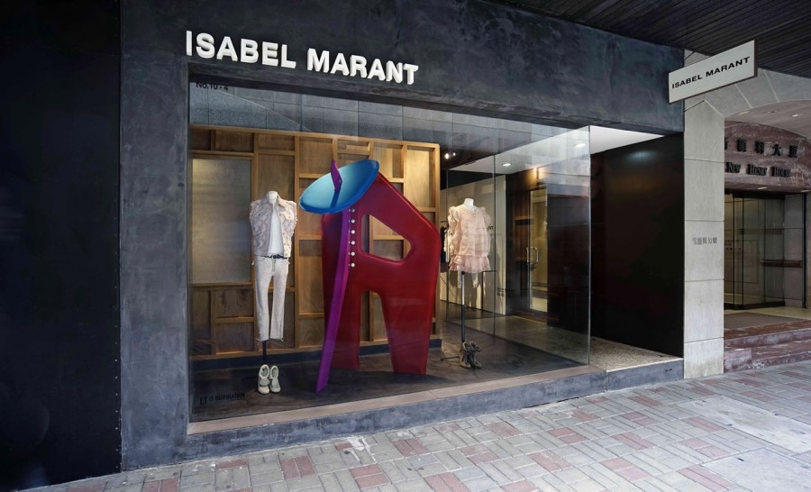
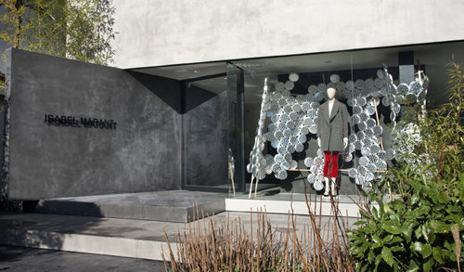
store front
Simple store front
Unfinished cement
Focal point: creative window displays
Notes:
unfinished cement
modern design
minimalist
highlight: window displays

Slide 12
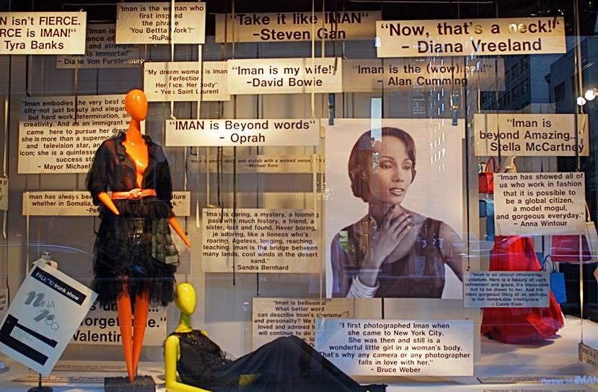
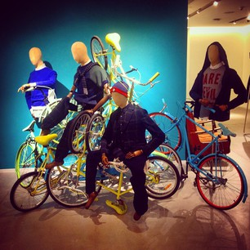
creative windows
Notes:
visually stimulating windows that grab attention

Slide 13
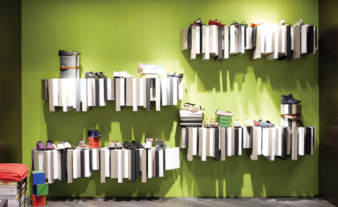
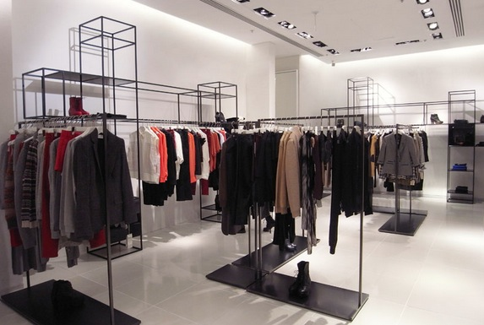
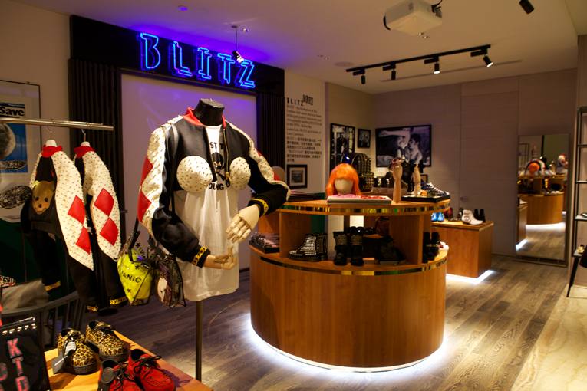
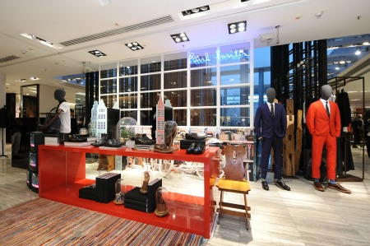
store interiors
Design inspirations
Notes:
Creative merchandising
Play of different lighting effects
Pops of color

Slide 14
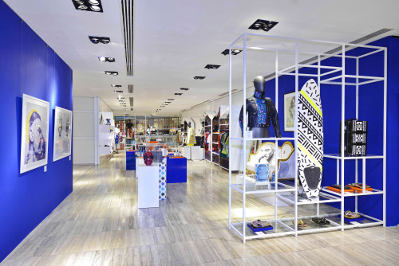
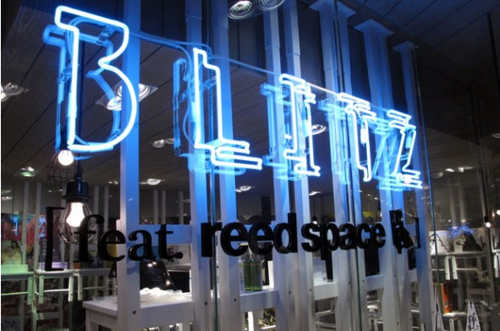
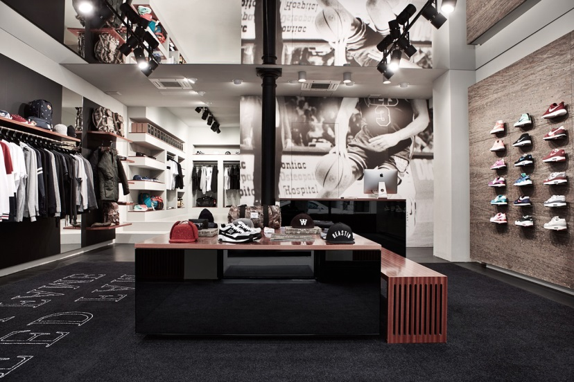
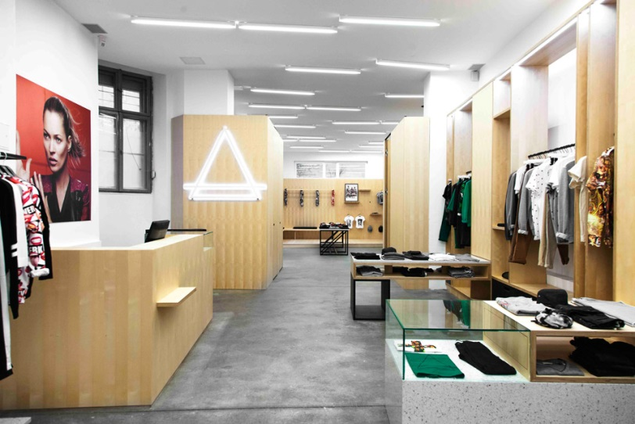
store interiors
Design inspirations
Notes:
Pops of color
Clean and modern design
LED lighting

Slide 15
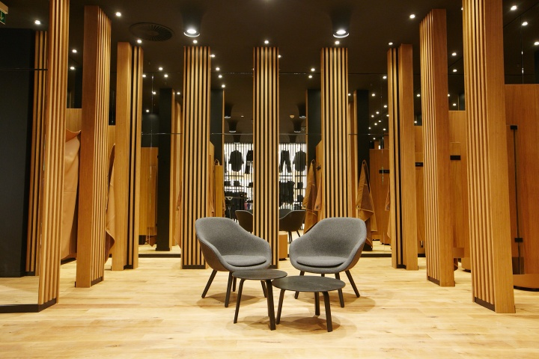
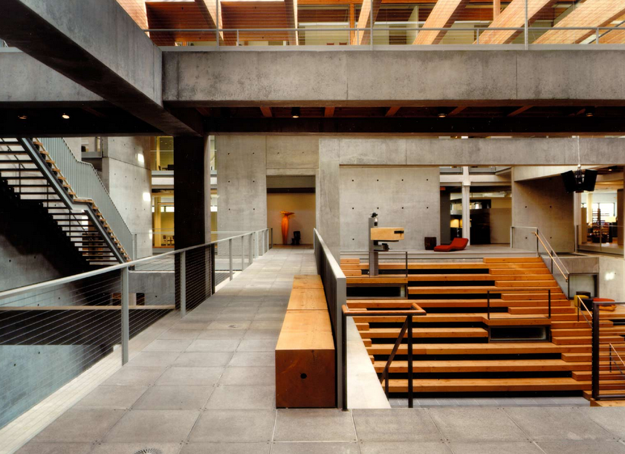
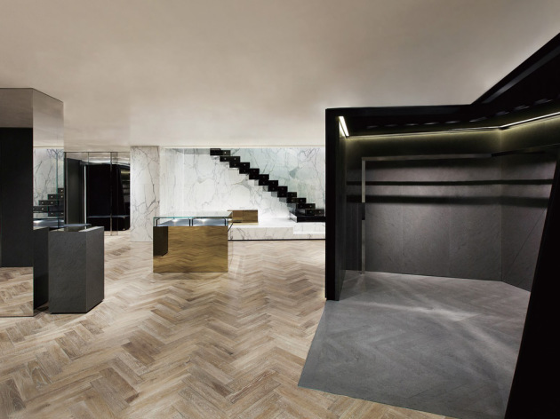
materials & elements
Materials used in the store
Pop of color

Slide 16





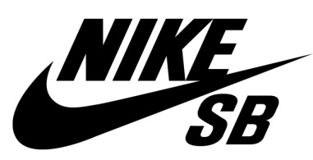









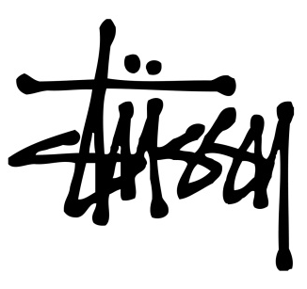




brands

Slide 17
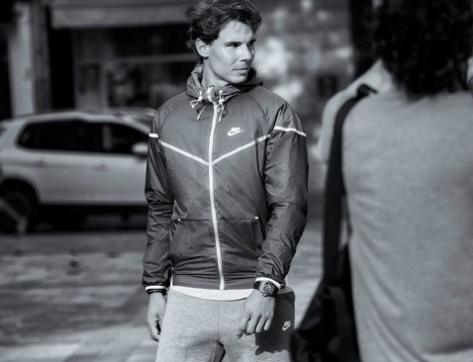
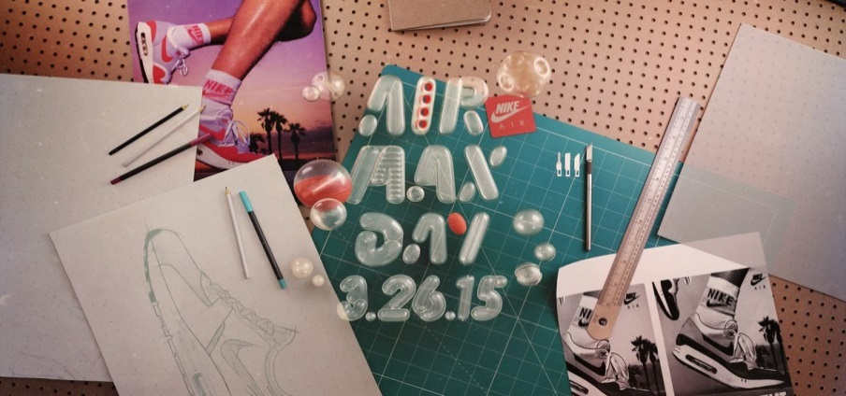

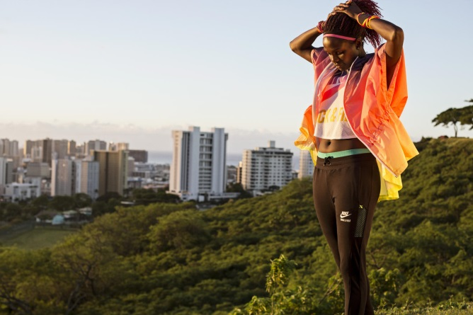
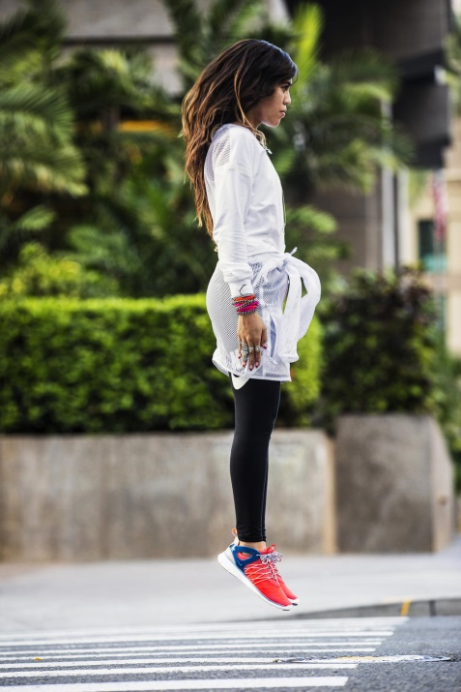
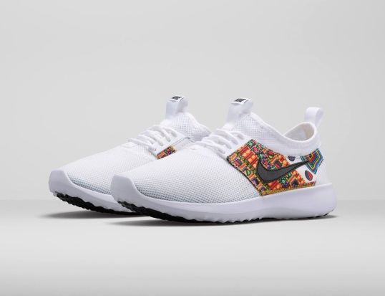
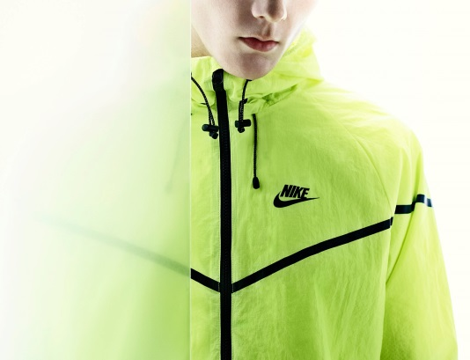
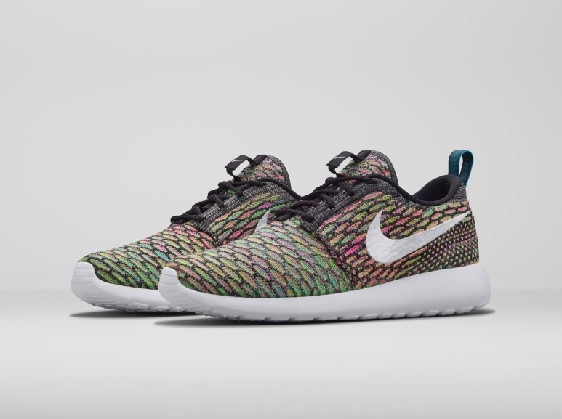
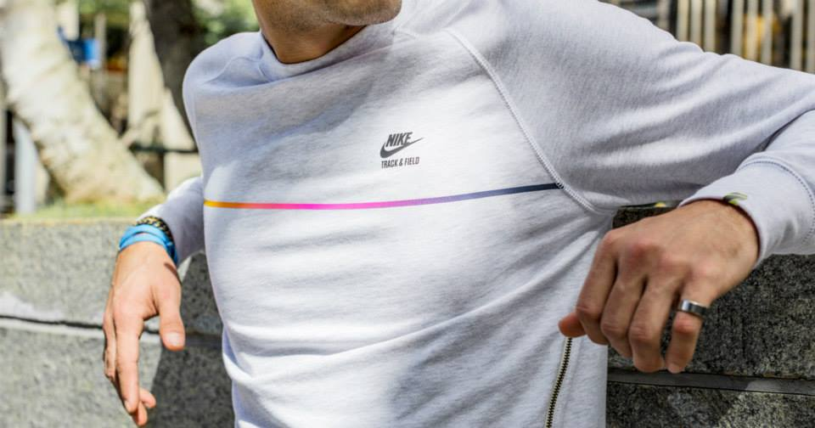
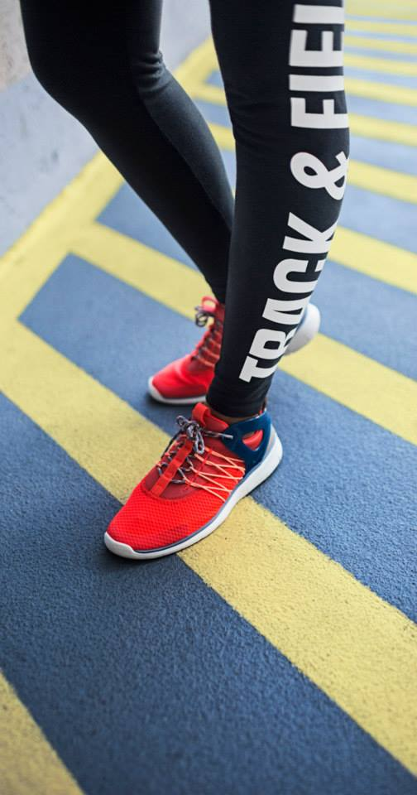
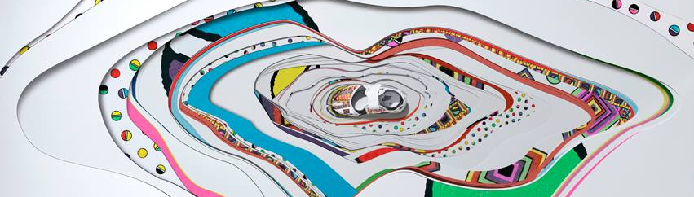

Slide 18










Slide 19













Notes:
wall mural / collage
creative merchandise displays

Slide 20




sample merchandise
Superstar Supercolor Pack
Stan Smith
Tubular Runner

Slide 21













Slide 22











Slide 23





sample merchandise
Chima Ferguson Pro
Old Skool 92 Pro
Gold Mono Era
AV Classic

Slide 24





apparel

Slide 25












other merchandise

Slide 26








other merchandise

Slide 27




social media & events
promote via instagram
post product shots, scheduled sneaker releases, events
invite guest dj’s to play in the store
in-store coffee/juice bar
*subject to senior management approval

Slide 28



marketing
non-traditional marketing to increase brand interaction with our audience
unique and fun
etc channel television feature
event tie ups with z hostel, satchmi (vinyl day), edsa design group
*subject to senior management approval

Slide 29


street marketing
*subject to senior management approval

Slide 30


premium items
store promotions & giveaways
*subject to senior management approval

Slide 31




uniforms
*subject to senior management approval

