Slide 1










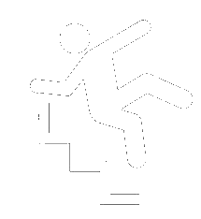

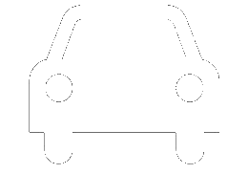


+
Ken York
View Account Logout
Learning Center
Get
Started
Tutorials
FAQ
Templates
Home
Plans
4
12
8
12
Documents
Messages
Plans
Contacts
Documents
Messages
Contacts
Learning
Recommended Plans
Community
Life
Accident
Home
Auto
Travel
More
Active Plans
END
Outdoor Adventure - LIVE Start: 7/1/2015 End : 7/05/2015 Groups: 2 Documents: 0 Contacts: 4
Angie A Birthday
Start: 9/9/2015 End: 9/9/2015 Documents: 0 Contacts: 1
Maui Vacation
Start: 10/9/2015 End: 10/16/2015 Documents: 3 Contacts: 8
START
Having a Baby x Start: Unknown End : Unknown Groups: 2 Documents: 0 Contacts: 4
Notes:
DASHBOARD
Landing site upon user login. Provides quick access to the various parts of the site and insight into current events.

Slide 2

Ken York
View Account Logout
Life Plans
BUILD
TIPS
Title: LIFE (or ACCIDENT)
Date: Unknown
Home
Plans
+
Choose Existing
Validations
Documents
Messages
Note: LIFE and ACCIDENT Plans are initiated by your Contacts. Use Validations to ensure the event is properly reported. Choose all that apply.
Angie A
Contacts
Learning
Billy B
Self
Executor
Auto
Chris C
Community
I would you like to validate the events is real before starting the plan. LifeExec will send me an Approve/Deny request
I give my executor authority to validate the event and start the plan. LifeExec will send him/her an Approve/Deny request
Automatically start the workflow if no validation is given in X hours from the time the event is reported
Enter Hours: 48
Next
Add New
Create Event Groups
4
4
1
Finish
First Name
Contacts
Documents
Messages
Last Name
Choose Existing
Add New
Email
Selected Contacts
Save
x
x
Angie A
Billy B
Delete Saved Group
Saved Groups
Are you sure you want to delete this group?
Family X
Contacts: 4 Documents: 4 Messages: 1
Work X
Contacts: 4 Documents: 4 Messages: 1
Yes
No
Notes:
WORKFLOW
Walks users through the creation of a workflow.

Slide 3



Create Folder
Ken York
View Account Logout
Documents
Name Folder
DOCUMENTS
TEMPLATES
Search: ENTER SEARCH TERM
Home
Plans
+Add Document
+Create Folder
Next
Documents
Messages
X
Title: Auto
Files: 3
Life Insurance
Contacts
Learning
Medical Card
Community
X
Title: Life Insurance Created: 4/03/2015
Type: Word Updated: 5/18/2015
Save
Preview
X
Add Document
Title: Medical Card Created: 3/15/2015
Type: Word Updated: 5/18/2015
File Name
Preview
Actual File Name.xls
Browse
Save
Delete Document
Are you sure you want to delete this document?
Yes
No
Notes:
DOCUMENTS
Document storage.

