Slide 1


San Francisco Peninsula
Multifamily Real Estate Investment
CAPSTONE

Slide 2

Your Opportunity
….safety, cash flow and appreciation
Capstone Investors is pleased to offer you the opportunity to invest in the San Francisco Peninsula multifamily real estate market.
Why invest and why here?
Investing in real estate is recognized as a significant wealth-creation strategy.
The San Francisco Peninsula is one of the top real estate markets in the world.
The multifamily asset class is considered a low risk investment.

Slide 3
Our Mission….to protect and grow your investment
FIND, BUY, HOLD FOR THE LONG-TERM
Capstone Investors’ core goal is to identify investments that produce consistent cash flow, have long-term value prospects not currently recognized by the market, and once acquired, increase their operational and managerial efficiencies to maximize cash flow and capital appreciation.
Why focus on a specific asset class and geography?
A focused approach is one of our competitive advantages. With 20 years real estate investment and development experience, Capstone Investors is a Silicon Valley-based multifamily investment and advisory firm, laser-focused on growing cash flow and lasting value for our clients.
We invest only:
In existing properties - we can evaluate existing expenses and rent rolls with more certainty;
In select San Francisco and Silicon Valley locations - we know the streets and neighborhoods;
Using low risk core and core plus investment strategies - to reasonably predict cash flow; and
For the long-term - your investment is a safe-haven that endures market fluctuations.

Slide 4
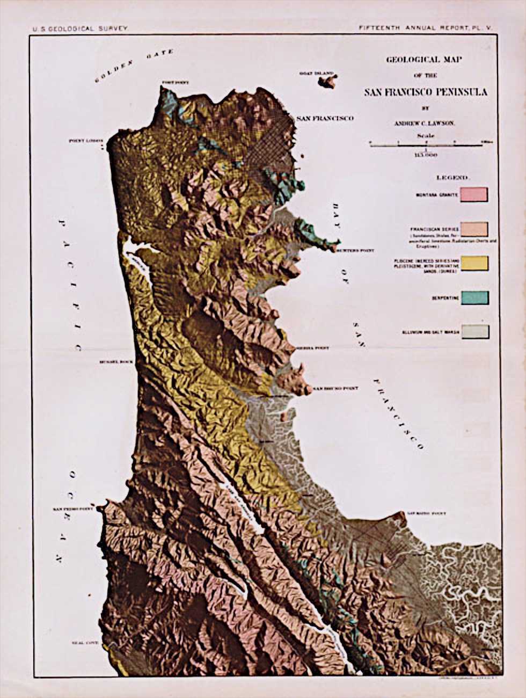
Investment Protection
Note: Need better map to show How constrained the real estate market is from San Francisco, Burlingame, Redwood City, Palo Alto, Mountain View, Sunnyvale, Cupertino and Santa Clara.
A world-class city attracts entrepreneurs, innovators and industry which in turn creates high demand for housing.
Supply constrained markets, such as the San Francisco Peninsula, have strong investment fundamentals. This leads to higher occupancy, rental growth and preservation of capital.
Laser-focus on a small geographic market will result in superior investment outcomes.
Multifamily properties as an asset class has lower volatility, higher resilience during downturns and offers attractive risk-adjusted returns.
Experienced management team that can execute the investment strategy.

Slide 5
Investment and Advisory Team
With 20 years of real estate investment and development experience, Capstone Investors is ideally suited to execute the investment strategy.
RW ZUKIN Property Management
MILLER, MORTON Legal and Financing
CAPSTONE Strategic Execution
HOLLAND & ASSOCIATES Accounting
RW Zukin
Miller, Morton
Holland & Associates
The RW Zukin Corporation has been providing property management services for over 49 years. They manage nearly 2, 500 units with a combined value in excess of $500 million.
Since 1929 their experienced attorneys provide effective drafting and negotiation services for real estate transactions throughout California.
Based in Palo Alto, the Holland & Associates Public Accounting team has been delivering distinctive accounting services and have 100 years of combined experience.

Slide 6

Investment Strategy
Our strategy is to buy and hold, with a focus on driving cash flow, capital appreciation and wealth creation over the long-term.
Investor formation: If we are not in a position to immediately illustrate proof of funds we will miss extremely valuable and hard to come by opportunities.
Acquisitions: Source and acquire core-plus multifamily assets within the target market.
Operations: Collaborate with investment and advisory team to execute a property specific asset management program.
Repositioning: Increase cash flows through value-add upgrades and refurbishment.
Distributions: Distribute cash flow from operations, re-finance proceeds and proceeds from dispositions.

Slide 7

Acquisition Criteria
We actively pursue new contacts and evolve existing relationships to ensure early identification of opportunities and to maintain our reputation as trustworthy and fair buyers - critical in a competitive market.
Multifamily properties
Located on the San Francisco Peninsula
Core-plus properties
Properties consisting of 10 plus units
Primarily off-market properties
Properties close to transit and public amenities
Properties with high benefit to cost ratios
Our value proposition to sellers is that we have an in-place capital stack and can provide proof of funds

Slide 8
Acquisition Process
Finding the right opportunity is one of the most critical factors that will contribute to the success of a real estate investment company.
Acquisition process steps
Maintain accurate data base of properties and property owners
Implement our CMU program – call, meet and uncover opportunity
Build long-term relationships with owners and brokers
Implement continuous touch point program
Network at property owner and property manager forums
Protect broker commissions for off-market opportunities

Slide 9

Investment Lifecycle
Acquire asset
Investor formation
Increase rents
Asset appreciation
Distribute cash flow
Reposition
Re-finance or sell asset
Distribute profits

Slide 10
Capital Appreciation
Price per Unit
San Francisco County
San Mateo County
63% increase (‘04 to ‘14)
66% increase (‘04 to ‘14)
Source: CoStar: 16 to 100 units broker sales. Numbers rounded

Slide 11
Rental Growth
San Francisco County
San Mateo County
85% increase (‘04 to ‘14)
79% increase (‘04 to ‘14)
Source: RealFacts

Slide 12
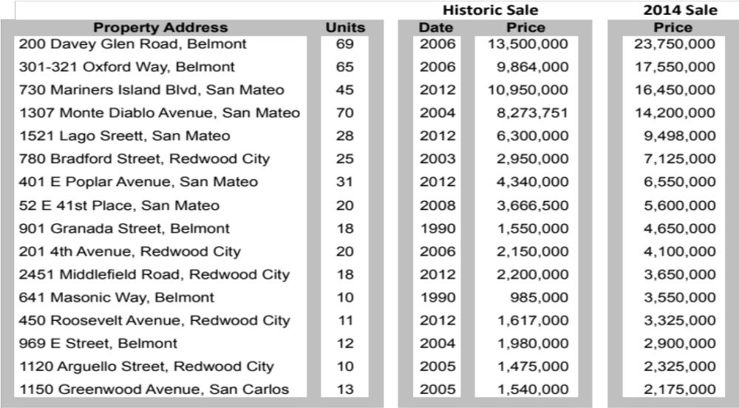
Growth in Sales Prices
San Mateo County
Source: CoStar

Slide 13
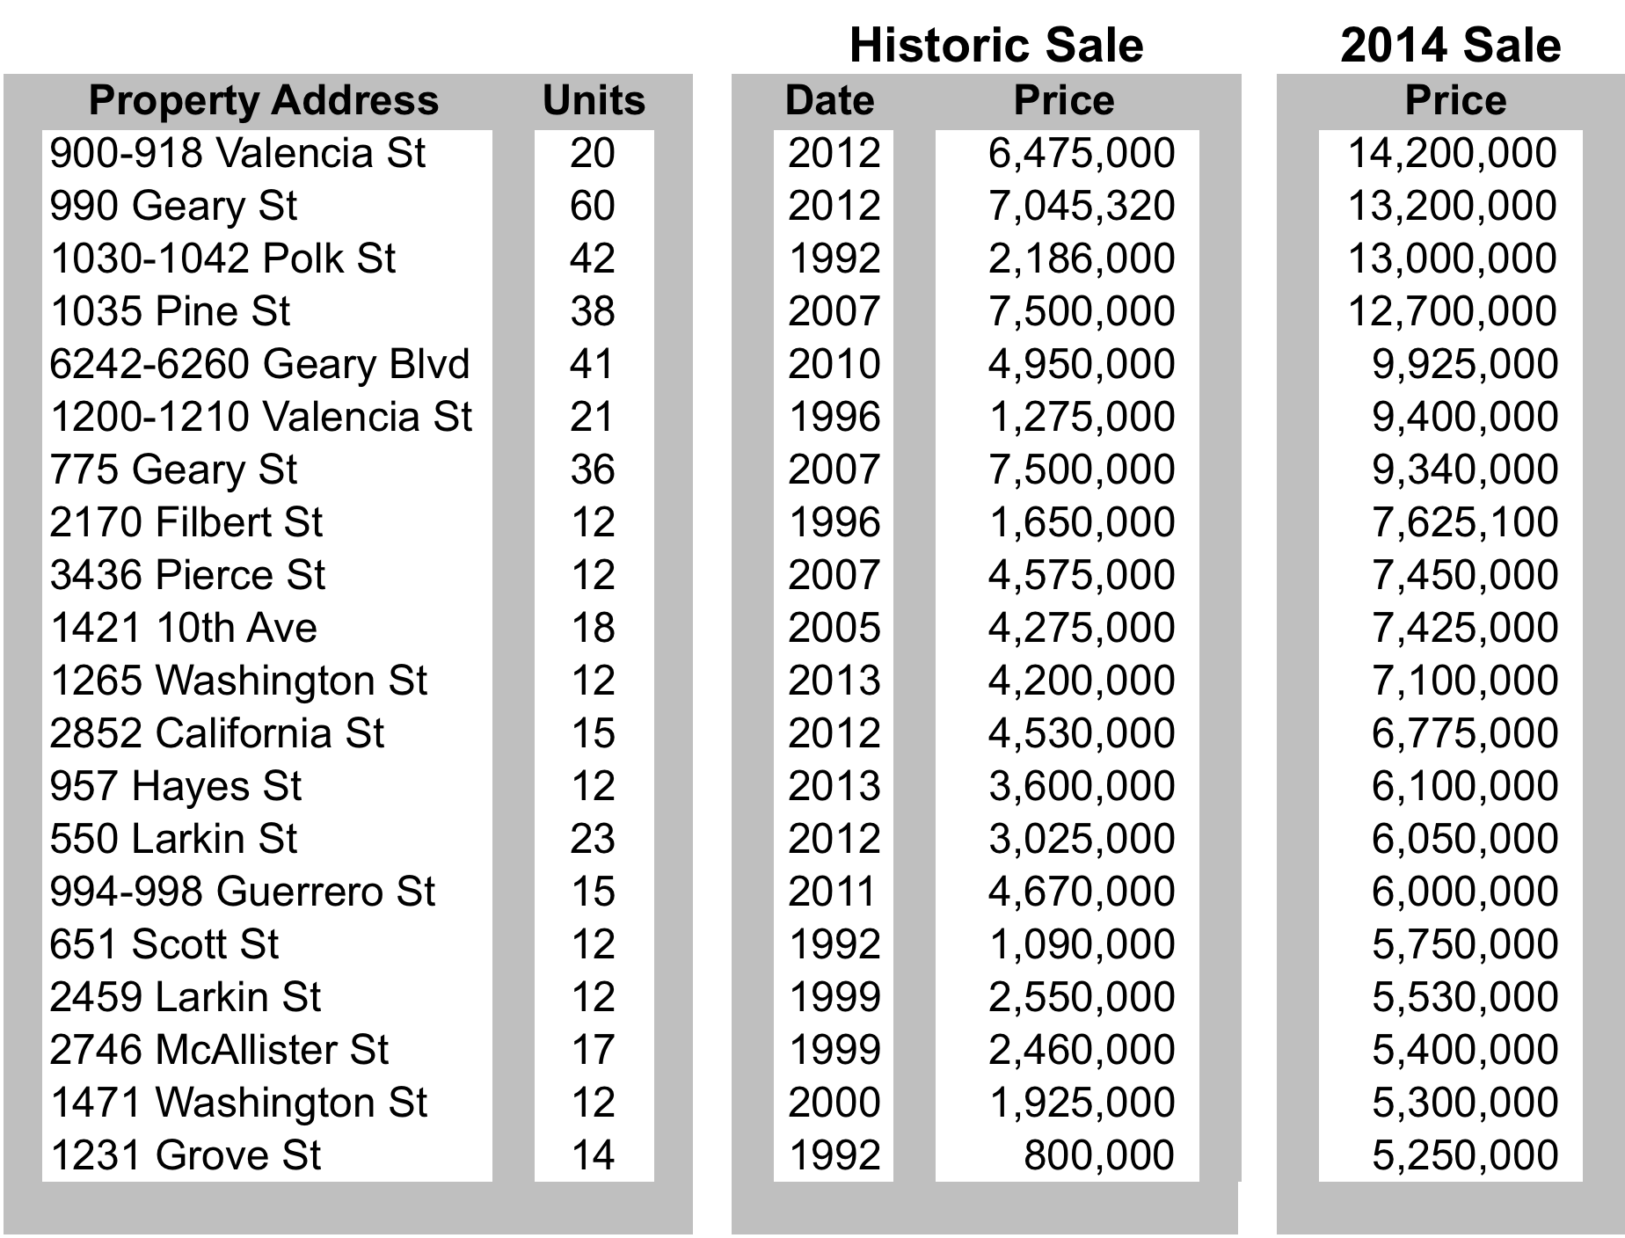
Growth in Sales Prices
San Francisco County
Source:CoStar
Continue…

Slide 14
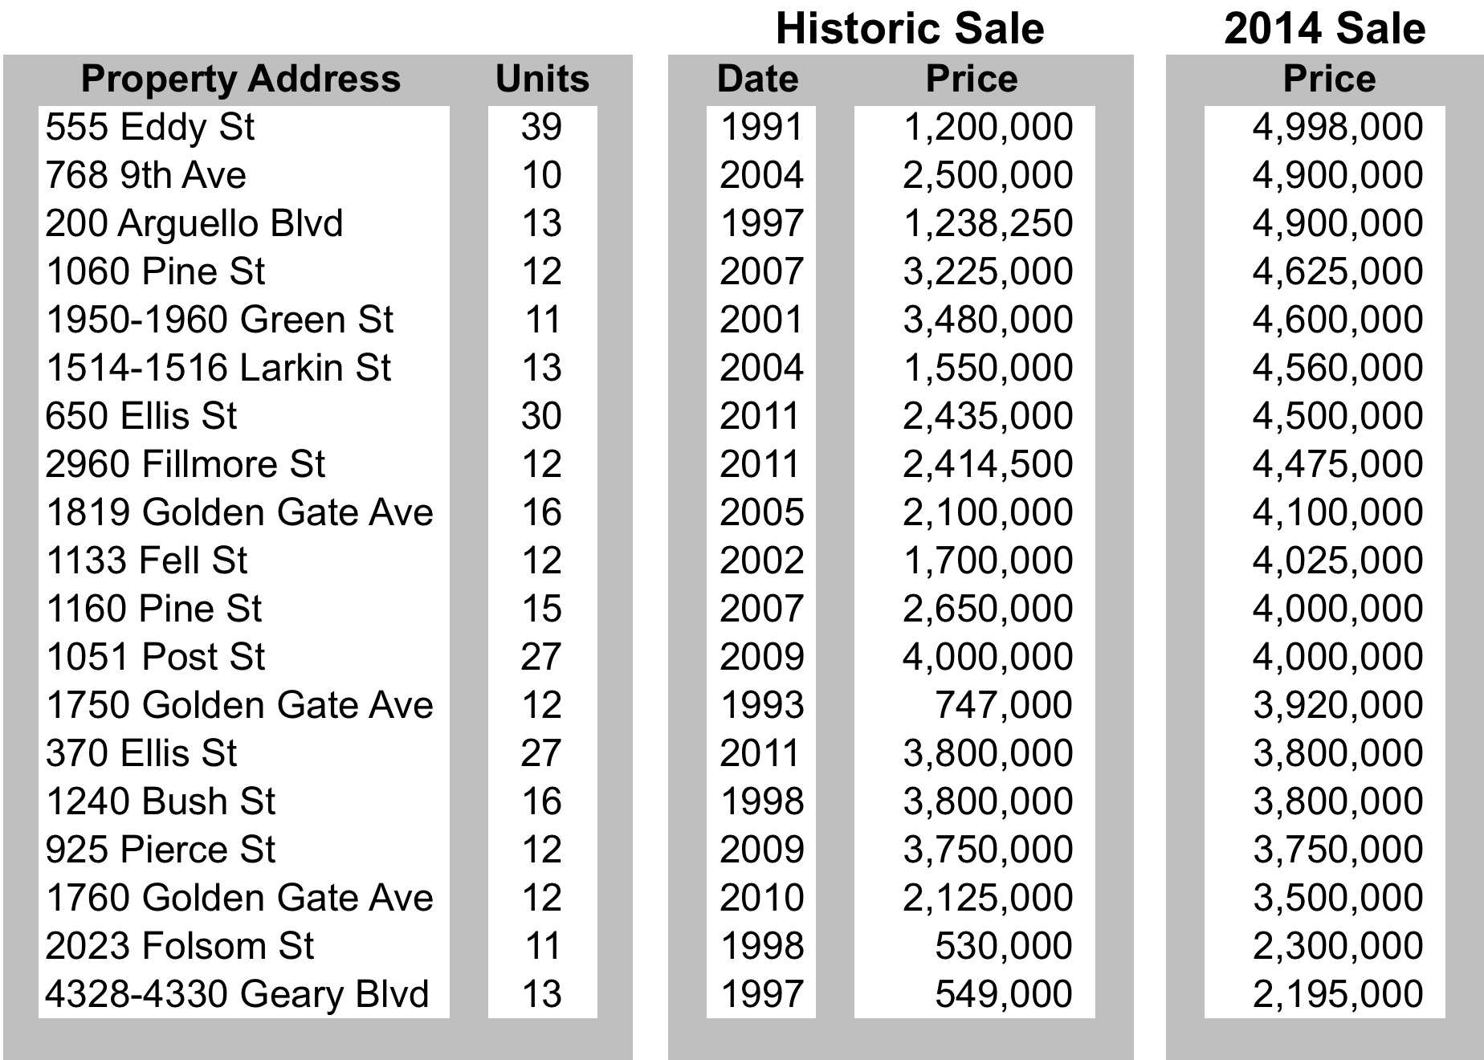
Growth in Sales Prices
San Francisco County continued…

Slide 15
Summary
World - class location
Safety, cash flow, appreciation
Familiar investment strategy
The San Francisco Peninsula is not just a mecca for investment but a way of life.

Slide 16
Contacts
Capstone Investors
Wes Tait
wtait@capstoneinvestors.com
1.415.361.9600
Holland & Associates (Estate Planning)
David Holland
davidh@holland-cpa.com
650.326.9100

Slide 17
Disclaimer
This document does not represent an offer to sell or solicitation of an offer to purchase any real estate or securities. Any such offering will be made only pursuant to definitive offering documents in a private placement limited to accredited investors.

