Slide 1
Crowd design contest
Brief attachment

Slide 2
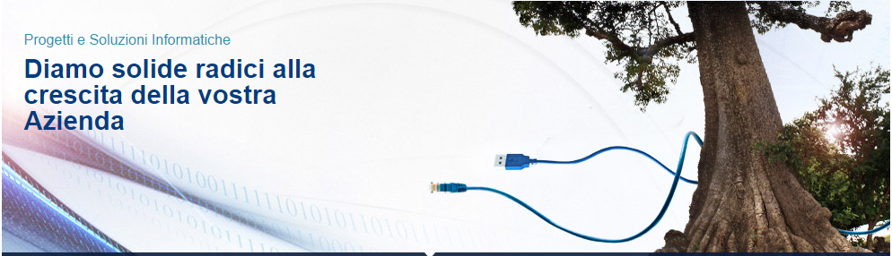
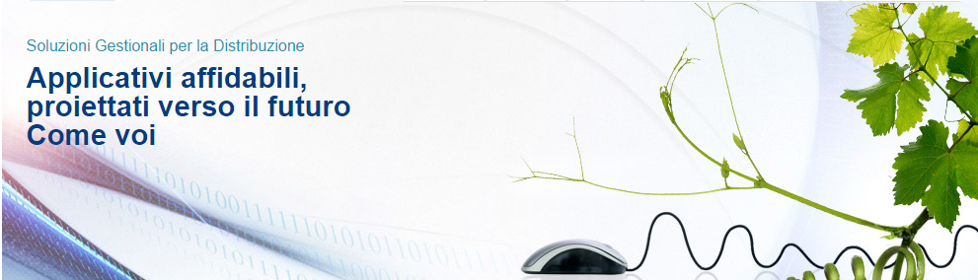
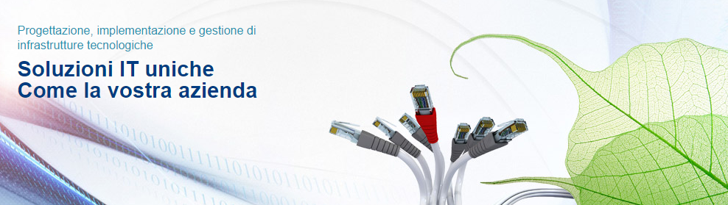
Our integrated communication
OUR SLOGAN
Primary Slogan
We give firm roots to the growth of your company
Secondary Product Offer Slogan
Application (software) reliable forward-looking like you
Secondary Solution Offer Slogan
Solutions IT unique as your company

Slide 3





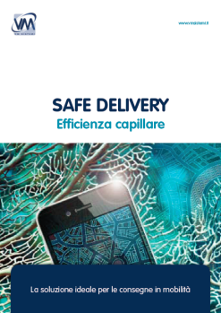


Our integrated communication
Product presentation images
Base solutions
Other modules

Slide 4
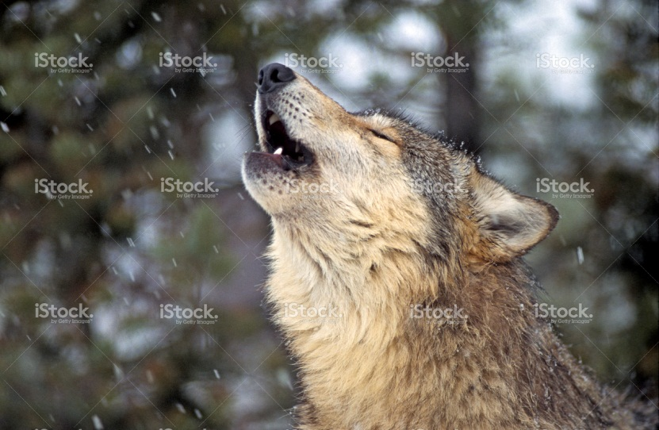
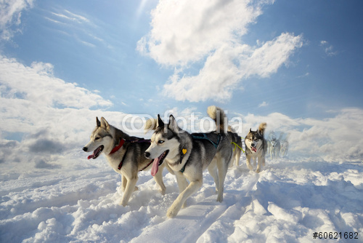
Our needs: pillar presentation images
Offering IT Pillar:
1. Managed Services
Sub-services / key features
Network & Systems Monitoring
Systems Support
Managed Backup
Endpoint Management Essential
Hardware Maintenance
Animal can be associated with the pillar
WOLF:
the wolf is related to the ancient masters . Particularly in light of the fact that he goes back to his pack after a long pilgrimage , bringing with them experiences and observations with which it shares . It ' a faithful animal as it chooses one mate for life , being able to reach the strength of this howling at the moon . Basically you are tied to your group but managed to maintain its independence. From the wolf is possible to extrapolate the energy to teach others , to guide them along the winding roads of life using his strength as we reach the master in us .
EXAMPLES

Slide 5

Our needs: pillar presentation images
Offering IT Pillar:
1. Managed Services
Sub-services
Network & Systems Monitoring
Systems Support
Managed Backup
Endpoint Management Essential
Hardware Maintenance
Technological image can be associated with the pillar
Storage Data bank:
EXAMPLE

Slide 6
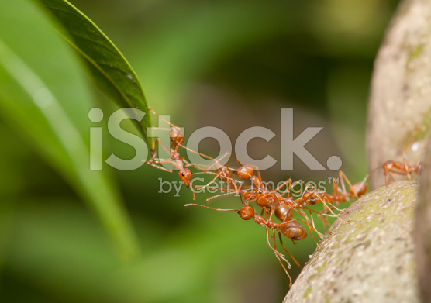

Our needs: pillar presentation images
Offering IT Pillar:
2. Networking
Sub-services / key features
• Sistemi di cablaggio strutturato
• Reti locali (LAN)
• Reti geografiche (WAN)
• Reti wireless (WLAN)
• Collegamenti in radiofrequenza punto-punto e punto-multipunto
• Site survey wireless
Ant
Small and tough , the ant symbolizes various qualities . Strength , endurance , accuracy , diligence , but also know how to defend aggression in properly , if it needs it. The ant is also the sacrifice of individual interests to the interest of the whole community . His sense of social and community is very strong , as well as the spirit of sacrifice and dedication . This is because people who embody the qualities of the ant are absolutely confident that every effort will lead , sooner or later bear results, then everything is worth to be tried , to be carried out with dedication and patience .
EXAMPLES

Slide 7
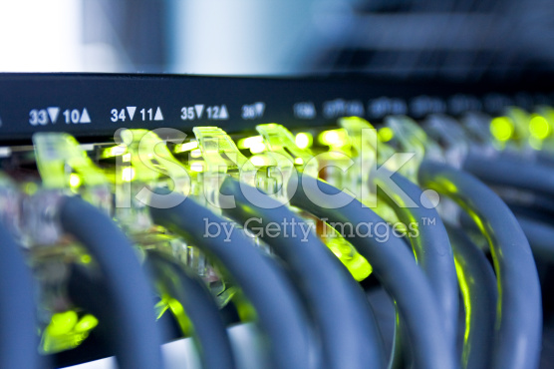
Our needs: pillar presentation images
Offering IT Pillar:
2. Networking
Sub-services / key features
• Sistemi di cablaggio strutturato
• Reti locali (LAN)
• Reti geografiche (WAN)
• Reti wireless (WLAN)
• Collegamenti in radiofrequenza punto-punto e punto-multipunto
• Site survey wireless
Technological image can be associated with the pillar
Networking cables:
EXAMPLE

Slide 8
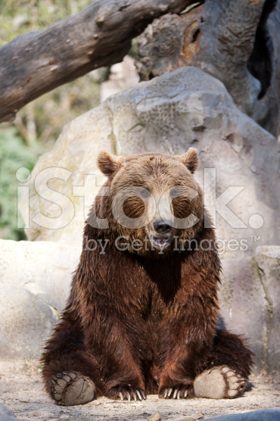
Our needs: pillar presentation images
Offering IT Pillar:
3. Data Center
Sub-services / key features
• Infrastrutture Data Center ad alta efficienza energetica
• Server consolidation
• Operating Systems
• Virtualizzazione
• Storage
Bear
A symbol of the brave and proud warrior . It is easily associated with the process of hibernation , for which accumulates ( stocking ) nutritional resources for the cold season , during which optimizes their energy to ensure its survival
EXAMPLE

Slide 9
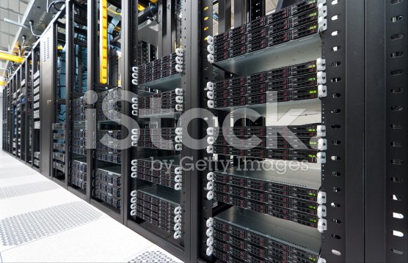
Our needs: pillar presentation images
Offering IT Pillar:
3. Data Center
Sub-services / key features
• Infrastrutture Data Center ad alta efficienza energetica
• Server consolidation
• Operating Systems
• Virtualizzazione
• Storage
Technological image can be associated with the pillar
Data Center:
EXAMPLE

Slide 10
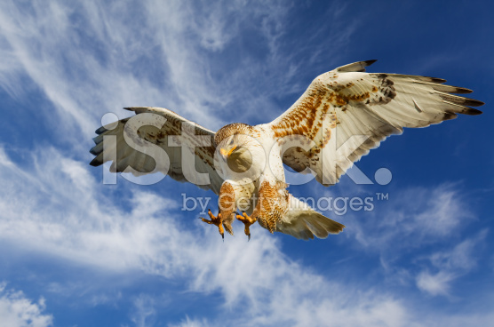
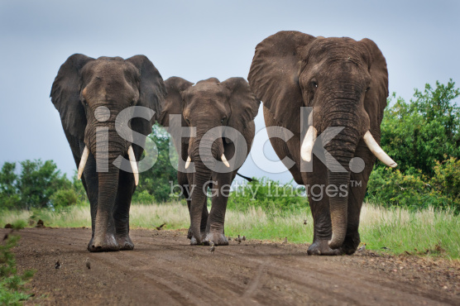
Our needs: pillar presentation images
Offering IT Pillar:
4. Data Availability
Sub-services / key features
• High Availability Cluster
• Backup & Restore
• Cloud backup
• Disaster Recovery
• Power Management (UPS/PDU)
Falco
The Hawk is the messenger of God par excellence . Intermediary between human and otherworldly , is the spokesman for the celestial design . People who embody his skills are generally very keen and careful observers , the photographic memory and developed very precise . Do not miss out on the smallest detail and are perfectly able to manage and control every situation , even the most difficult . They are also able to notice and interpret the signs that come from the divine sphere .
EXAMPLES
Elephant
It symbolizes the strength, greatness of soul and the ancient lineage , given its longevity . Remembered for his memory .

Slide 11

Our needs: pillar presentation images
Offering IT Pillar:
4. Data Availability
Sub-services / key features
• High Availability Cluster
• Backup & Restore
• Cloud backup
• Disaster Recovery
• Power Management (UPS/PDU)
Technological image can be associated with the pillar
Cloud data server:
EXAMPLE

Slide 12
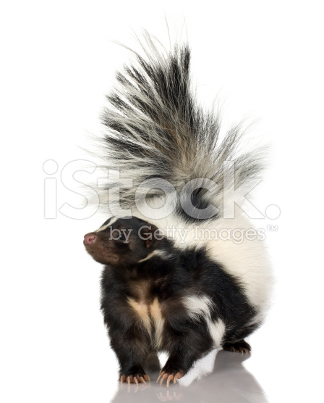
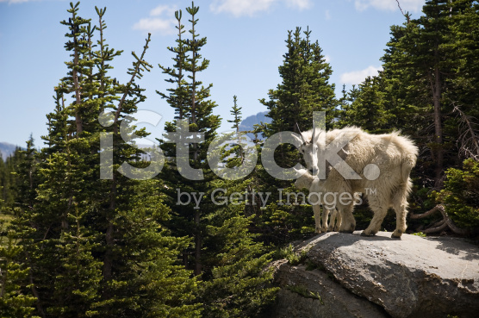
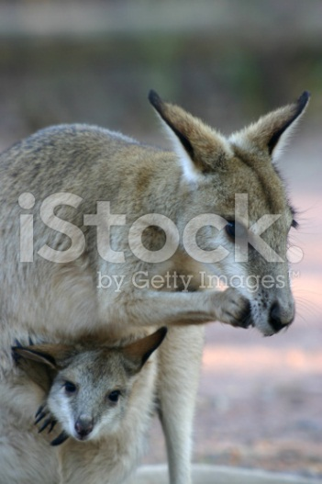
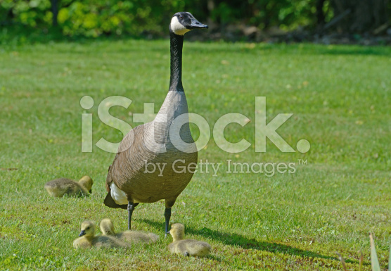
Our needs: pillar presentation images
Offering IT Pillar:
5. Security
Sub-services / key features
• Sicurezza perimetrale
• Sistemi IPS
• End point security & management
• Antivirus
• Controllo della posta
• Controllo della navigazione Internet
• Videosorveglianza
He-goat : as prolific , is just by the range and power of the seed . For his abilities as a climber , it is also a symbol of safety .
Polecat : And ' the symbol of self-confidence . His demeanor quiet and safe teaches us the importance of self-awareness . Although I have great defenses he commands respect to other creatures as they are able to threaten the sense of smell . This animal moves us toward wholeness through ideals of pride and dignity .
EXAMPLES
Goose : since this animal has a very light sleeper , it is a symbol of vigilance and custody
Kangaroo: teaches you to take good care of your projects , you know what is needed to protect them , nurture them and bring them lovingly completed . The Kangaroo can alert you that you are about to make a leap forward , learn to dare and if necessary to defend with determination .

Slide 13

Our needs: pillar presentation images
Offering IT Pillar:
5. Security
Sub-services / key features
• Sicurezza perimetrale
• Sistemi IPS
• End point security & management
• Antivirus
• Controllo della posta
• Controllo della navigazione Internet
• Videosorveglianza
Technological image can be associated with the pillar
Internet Cyber Security:
EXAMPLE

Slide 14
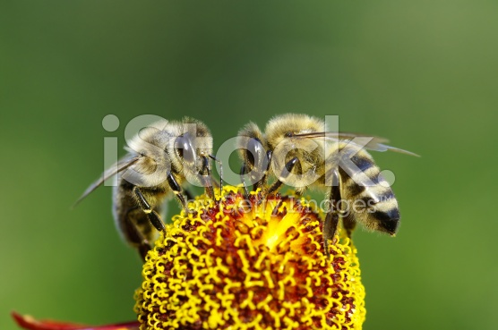
Our needs: pillar presentation images
Offering IT Pillar:
6. Collaboration
Sub-services / key features
• E-mail
• Instant messaging
• Mobility
EXAMPLE
Bee
Industriousness animal excellence symbol of the work . Cooperation and transport / shipping are for the bee on the agenda.

Slide 15

Our needs: pillar presentation images
Offering IT Pillar:
6. Collaboration
Sub-services / key features
• E-mail
• Instant messaging
• Mobility
Technological image can be associated with the pillar
New technology:
EXAMPLE

Slide 16
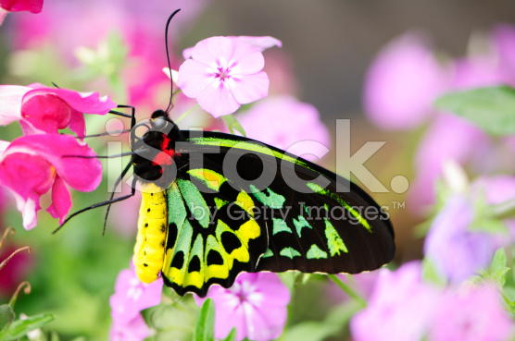
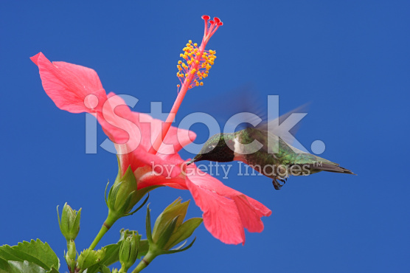
Our needs: pillar presentation images
Offering IT Pillar:
7. Business Process Management
Sub-services / key features
computerize and streamline operational processes
ongoing monitoring of the business
compliance with company procedures
identify critical points to improve them
check the workload of staff
Butterfly
As animal butterfly symbolizes the transformation process which enables it to achieve a higher order of things. People who embody his skills know how to improve their lives , as to adapt it to new circumstances , to regenerate continuously . They get to know that they have set and know how to carry out the projects , even the difficult ones . Maybe slowly , maybe one step at a time , but gradually manage to give shape and substance to their ideas .
EXAMPLES
Hummingbird
The lightness , the joy of life and happiness of little things is what characterizes this animal first . Small and delicate , has no interest in the affairs of life , he prefers to overcome them with a smile and turning the page . Everything felt as negative and in harmony with nature , and it frightens him flee . Does not know what is ugly and bad mood , harmony and joy are the center of his whole existence .

Slide 17

Our needs: pillar presentation images
Offering IT Pillar:
7. Business Process Management
Sub-services / key features
computerize and streamline operational processes
ongoing monitoring of the business
compliance with company procedures
identify critical points to improve them
check the workload of staff
Technological image can be associated with the pillar
Paper notes:
EXAMPLE

Slide 18






Our integrated communication
Managed Services Pillar, Sub-services Logos

Slide 19

Our needs: Managed Services Logo
Logo that we need must be aligned with the related Pillar presentation image (previously developed) and the 6 sub-services of the Pillar (previous slide).
Logo has to contain aconysm (3 character) of any sub-service (6 variants)
BRIEF EXAMPLE

