Slide 1
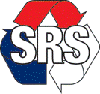
SRS Group

Slide 2
Overview
SRS Group offers total solutions in the areas of electrical, sheet metal, portable building manufacturing, engineering, design, maintenance, and repairs site works.
The group came into operations in 1994 and has experienced rapid growth due to our attention to detail, quality and delivery. The group became a leader in the Australian manufacturing industry, maintaining high standards of workmanship and exceeding our customers’ expectations, ensuring a true adaptation of our slogan ‘We lead and deliver’.
  Group of 7 companies;
  20years in business;
  160+ full-time employees;
  Covering most of Australia with offices in Victoria, NSW and QLD; and
  100% Australian owned, operated by local workforce and dedicated to the Australian market.

Slide 3
Our Services
Electrical Engineering and Manufacturing
Specialised in electrical switchboard manufacturing, offering engineering design, manufacturing, switchgear integration, maintenance and repairs. Our products vary from low and medium voltage cubicle manufacturing, substation control and protection panels, distribution boards, and other cubicles (such as Communications, PLCs & kiosks) providing a one-stop-shop for motor control centres (MCCs) requirements.
Sheet metal Engineering and Manufacturing
Mild steel, aluminium & stainless steel, offering a complete service including 3D design capabilities, punching, press brake, welding, fastener installation, powder coating & assembly. The products that we carry vary from custom (home-made Australian) design, up to local manufacturing of leading international sheet metal products such as ABB 66kV and 11kV Medium voltage PowerCube, Siemens S8 SIVACON, SIMOTROL and SICUBE 19’ Rack system.
Portable Building Engineering and Manufacturing
Geared towards commercial and industrial portable buildings manufacturing, offering engineering design, manufacture, transport, installation, testing, maintenance and repairs. Our primary focus is electrical switch, control and battery rooms, besides amenities and other specialised portable buildings.

Slide 4


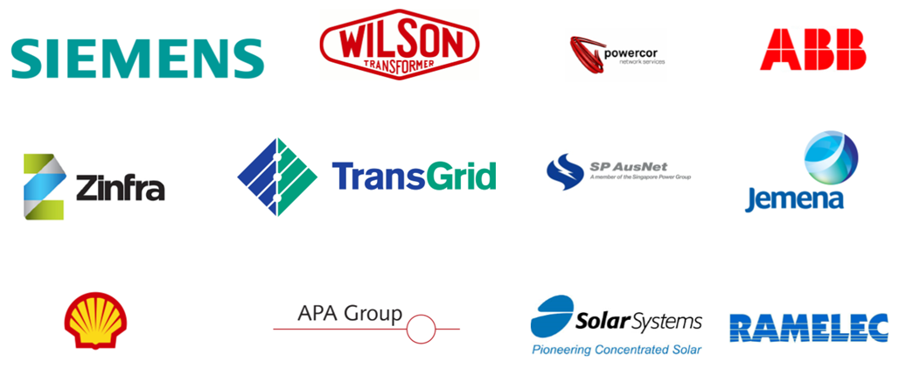

Our Clients

Slide 5
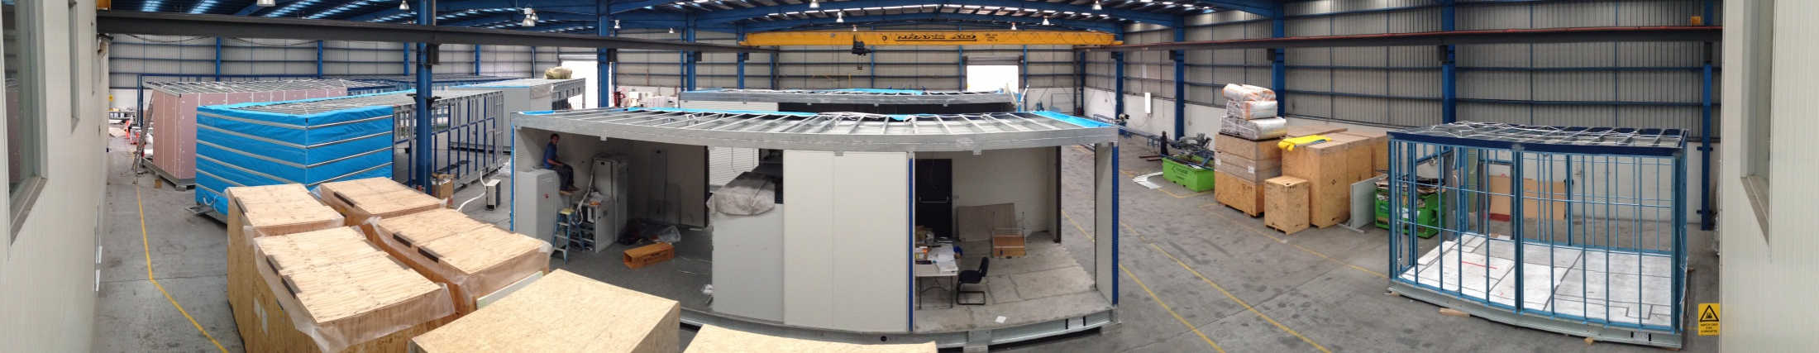
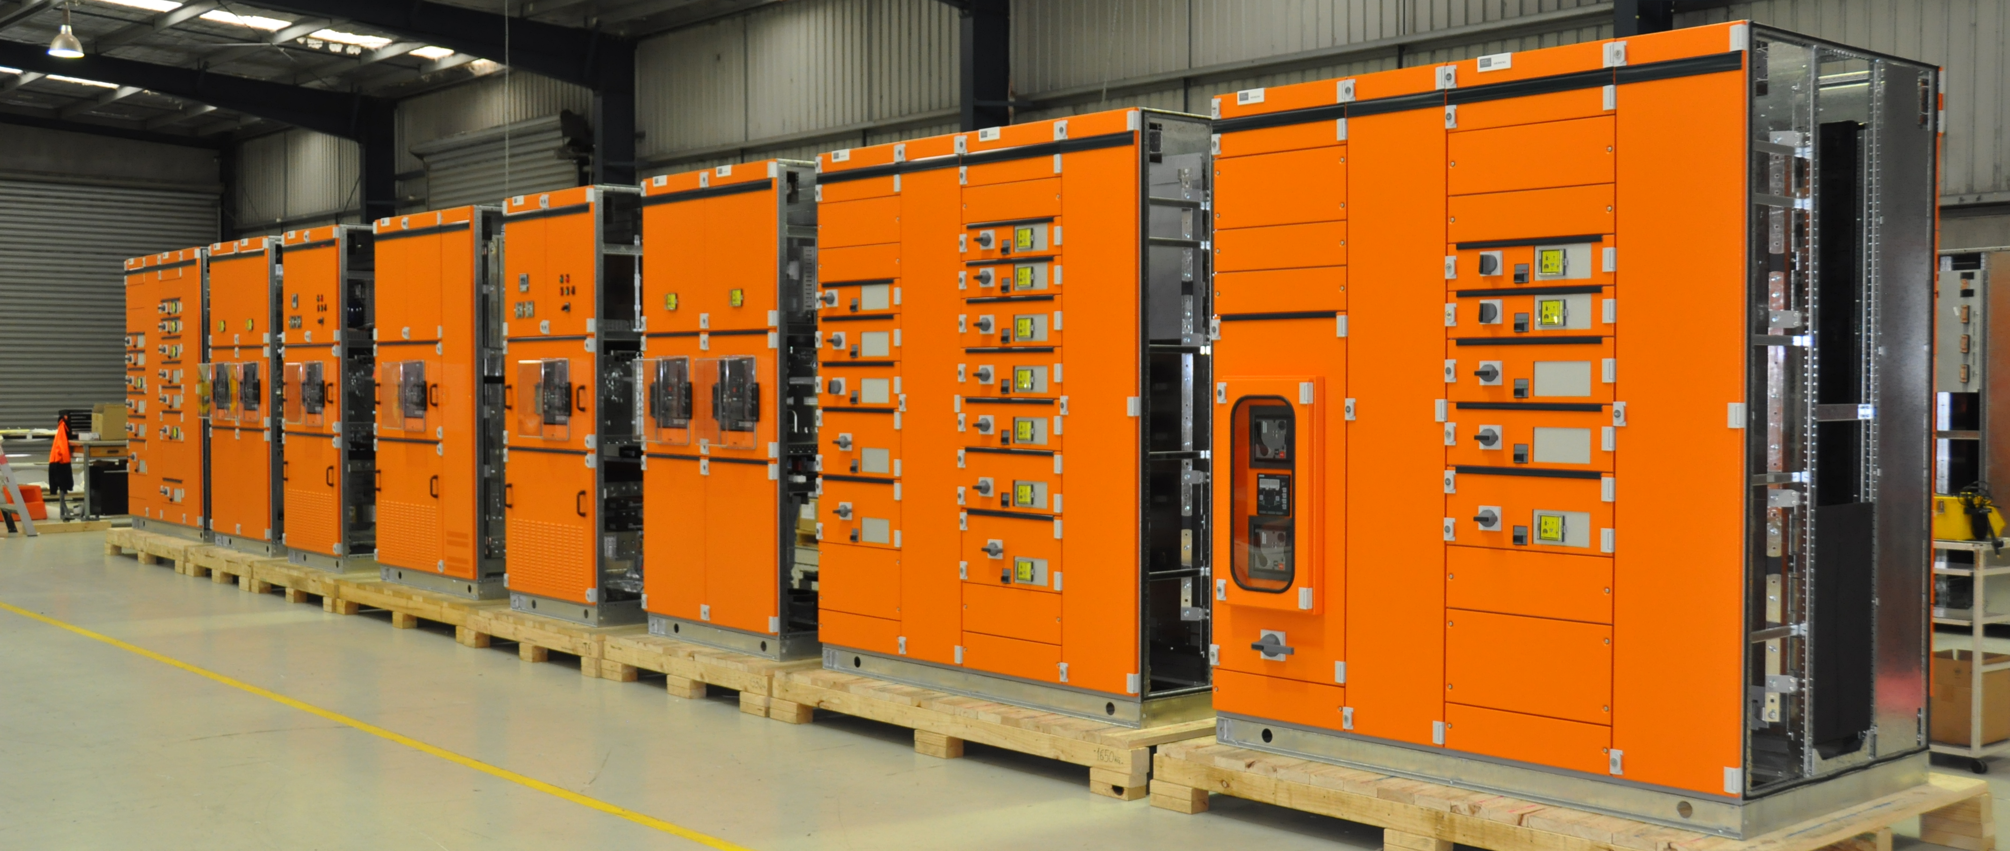
Projects
ABB - Gold Coast Rapid Transit Project
7 x 12m Switch rooms
150+ panels with inter-panel wiring
HV wiring and terminations
Essential Energy – Ellerslie Project & Gundagai
15m & 16.5m Control Room/Battery Room/Amenities
Theiss – Victorian Desalination Plant
Solar Systems – Mildura & Dubai
52 panels
APA Group – Winchelsea
27 panels
1 building
MCC panels

Slide 6

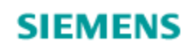
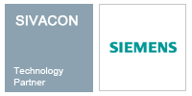
Partners
Siemens
In 2008 we purchased the licensing agreement from Siemens Ltd to manufacture SIVACON 8PT Type-Tested Power Distribution boards in both Victoria & NSW. In early 2010 we upgraded our License to include manufacturing of the latest SIVACON S8 Type-Tested board.
SIVACON 8PT & S8 both offer the required degree of power supply flexibility and are suitable for the frequently changing requirements of all industries.
ABB
In 2012 we purchased the licensing agreement from ABB Ltd to manufacture ABB Medium Voltage Switchgear.

Slide 7
In-house Manufacturing
Some of the products we manufacture:
Motor Control Cubicles (MCCs)
Marshalling cabinets
Distribution boards
PLC cabinets
Outdoor kiosks
Internal resources:
CNC Turret Punching
NC Press Brake
Mig, Tig & Spot Welding
Engineering
Commonly used material:
Stainless Steel
Aluminium
Mild Steel
SIVACON 8PT & S8 Type Tested
Tunnel boards
Control cubicles
Custom buildings and boards
Powder Coating
3D CAD Software
Assembly
Copper
Brass
Polycarbonate

Slide 8
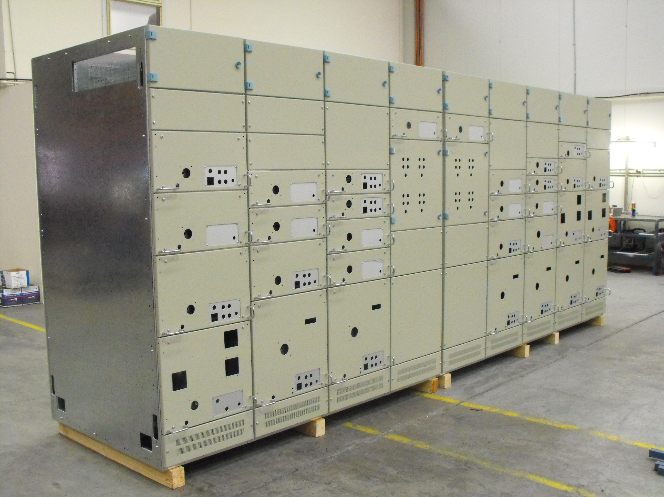
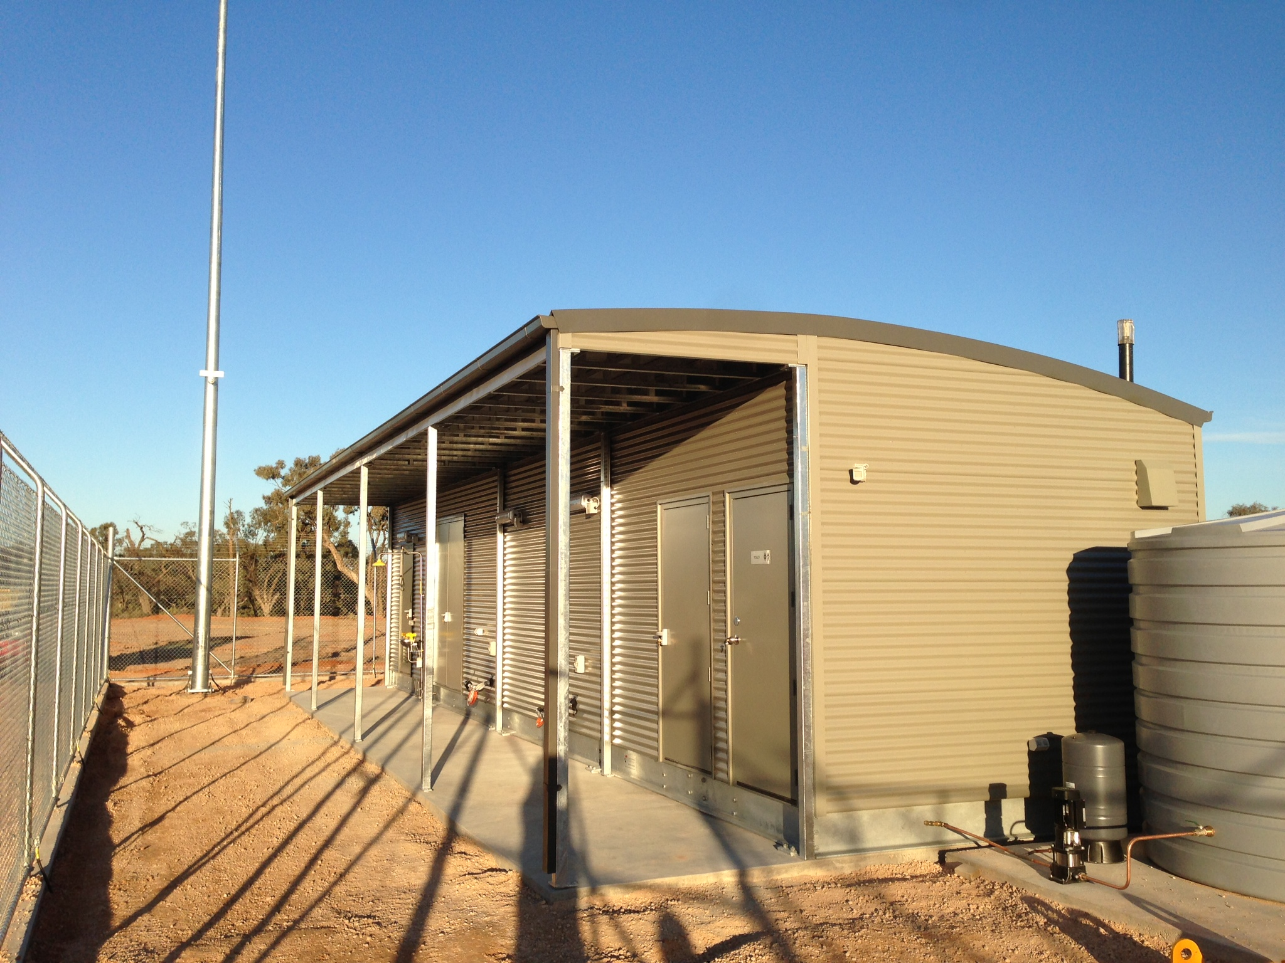

Slide 9
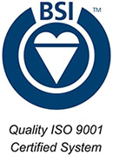
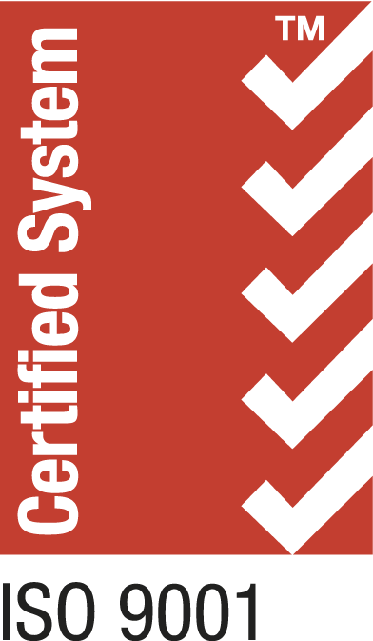
Systems and Processes
Quality
SRS has a commitment to quality and excellence, as quality is enforced through the continued investment in manufacturing technology, product development and engineering resources, with a slogan ‘Quality is the responsibility of all staff’. This is how we ensure that we understand customer requirements and meet and exceed them.
Occupational Health and Safety System
Whether it is in the office or conducting site work in hazardous conditions – safety is of paramount importance to SRS. We are committed to ensuring the safety and health of our employees. We abide by all Statutory Acts and Regulations as a minimum standard and strive to maintain a level of safety, which exceeds the legal requirements. We uphold the highest levels of safety standards and our low incident reports back this up – Safety First.
Environment
In regards to Environment, we are committed to protecting the environment. In order to meet this commitment, the company enforces our Environmental Policy, it is designed to ensure that the impact of all environmentally relevant activities are minimised in accordance with best practice.

Slide 10
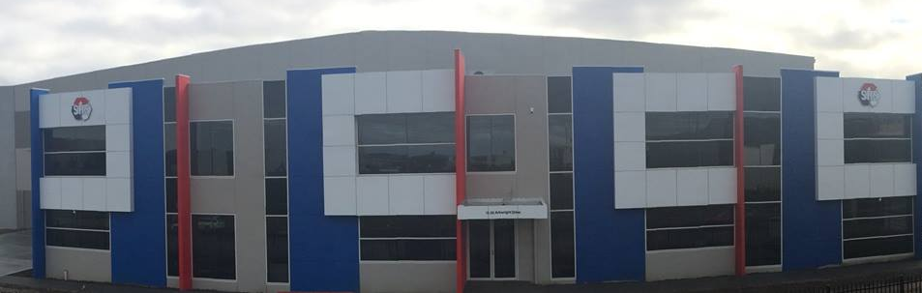
Infrastructure
Integrated ERP System
SRS has a fully implemented and robust ERP system which handles the entire project, this allows us to provide accurate quoting, scheduling, and forecasting. We can also help manage reporting and costing for our clients.
Document Management
Our cloud based system allows for a central depositary of documents for our projects, this system is hosted through Telstra and Microsoft and provides an easy interface for our clients and internal parties document control and sharing.
New factory
In June, SRS moved to our new location which will house our three main businesses under one roof. The new factory will be located in Dandenong South and is adjacent to the Eastlink freeway for ease of access and transportation. With over 7000 square meters of floor space we will be well placed to become leaders in Australia delivering complete solutions.

