Slide 1
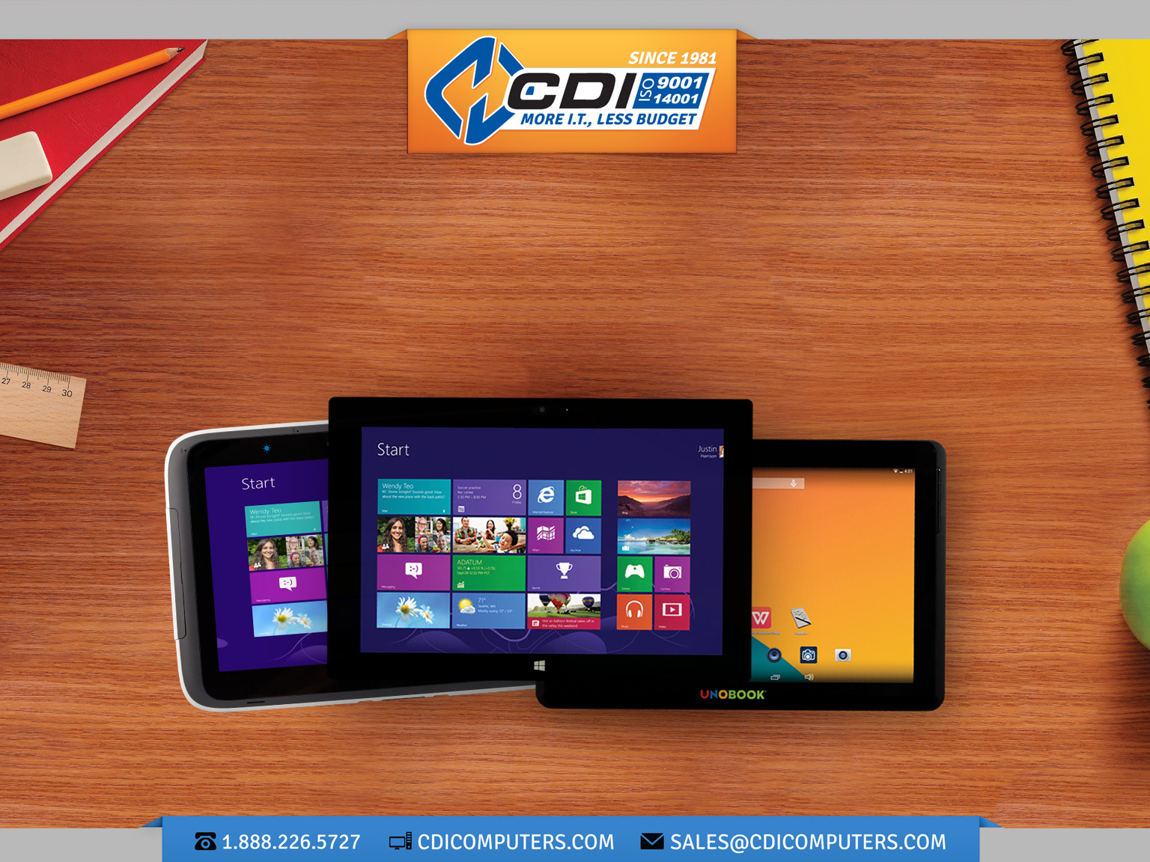
MOBILE TECHNOLOGY FOR THE DIGITAL CLASSROOM
CDI Education Ready Devices
© 2015 CDI Computer Dealers Inc. All rights reserved. eduGear™, UNOBOOK® are either registered trademarks or trademarks of CDI Computer Dealers Inc., in the United States and/or other countries. Microsoft and Windows are either registered trademarks or trademarks of Microsoft Corporation respectively in the United States and/or other countries. All other trademarks are the property of their respective owners. Descriptions are subject to change without notice. Product may not be exactly as shown. Errors and omissions excepted.

Slide 2






What is a CDI
“Education Ready “
Mobile Device
Starts with a mobile device of various form factors that is either purpose built or meets the requirements for use in a classroom environment.
Comes bundled with management tools for both IT and Teachers .
Includes free access to on-line tools, content and curriculum
Available Professional Development for HW, SW and teaching methods
Robust Warranty coverage

Slide 3



WHICH ECOSYSTEMS
ARE AVAILABLE?
  Windows – 7, 8.1 (10)
  Google – Chrome O/S
  Android - Kit Kate 4.4
Google
Windows
Notes:
If you decide to go mobile which platform do you choose

Slide 4
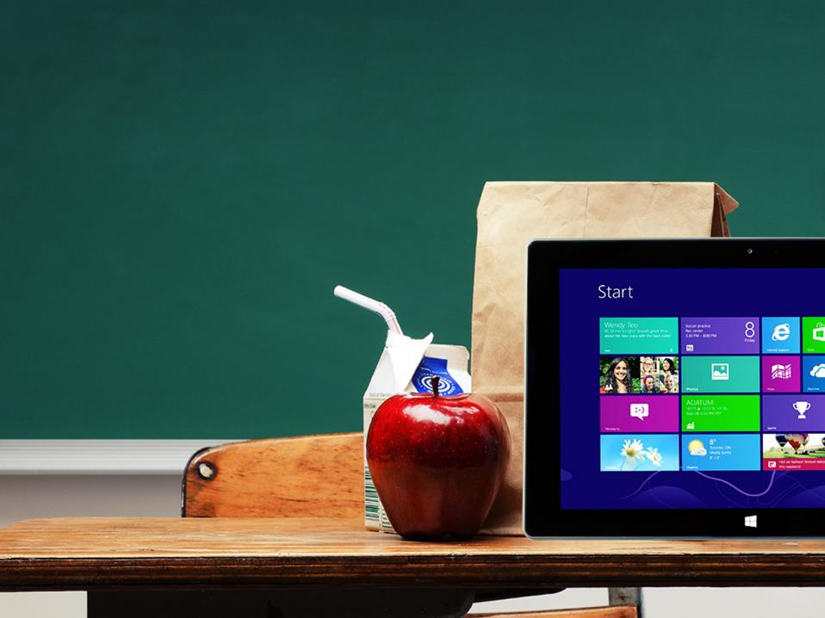
WHAT WE LOOK
FOR IN A DEVICE
Platform / OS
Ruggedness - can it stand up to the riggers of the classroom
Size - both physical size and screen size
Screen – quality, resolution, do you want touch
Wireless – Wi-Fi, Bluetooth, 3G, 4G, WiDi
Battery Life - 2 hours to 12 hours
Apps included and availability
Processor power – low power, dual core to higher power 64-bit processor
RAM and internal storage, external storage
Ports - USB, HDMI, headphone, micro SD
Audio - internal microphone and speakers
Web Cam - Camera / Video - front, rear quality
Accessories / Storage / Charging

Slide 5
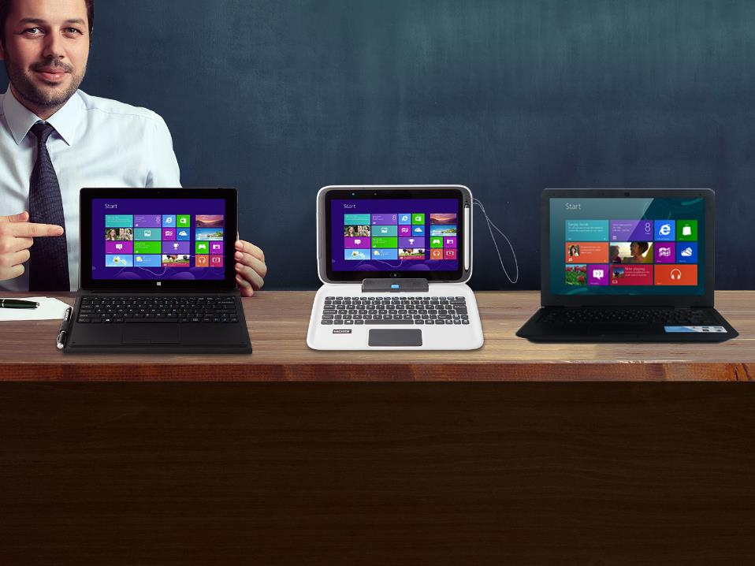

CDI “EDUCATION-READY” Windows DEVICES
Prices include free mobile device management, classroom management, access to online K-8 and 9-12 curriculum,
1-year warranty
UNOBOOK® 2/ter
10.1” Windows tablet 2GB/64GB with KB and protective case
Starting at
$359 US
UNOBOOK® 2 in 1 EDU
Semi rugged 10.1” Windows tablet 2GB/64GB with KB
Starting at
$399 US
UNOBOOK® A141, A11
Windows 8.1 certified 14“ and 11.6” notebooks, 2GB, 32/ 160GB Dual Core 1.58 GHz
Starting at
$269 US
© 2015 CDI Computer Dealers Inc. All rights reserved. eduGear™, UNOBOOK® are either registered trademarks or trademarks of CDI Computer Dealers Inc., in the United States and/or other countries. Microsoft and Windows are either registered trademarks or trademarks of Microsoft Corporation respectively in the United States and/or other countries. All other trademarks are the property of their respective owners. All prices in USD. Descriptions are subject to change without notice. Prices exclude all shipping & applicable taxes. Product may not be exactly as shown. Errors and omissions excepted.

Slide 6

CDI “EDUCATION-READY” GOOGLE DEVICES
Prices include free mobile device management, classroom management, access to online K-8 and 9-12 curriculum,
1-year warranty
UNOBOOK A 10
9.7” Android 1GB/16GB with KB
Starting at
$299 US
NL6 Rugged Intel
Chromebook
Starting at
$279 US
J2 Semi-rugged
Chromebook
Starting at
$199 US
© 2015 CDI Computer Dealers Inc. All rights reserved. eduGear™, UNOBOOK® are either registered trademarks or trademarks of CDI Computer Dealers Inc., in the United States and/or other countries. Microsoft and Windows are either registered trademarks or trademarks of Microsoft Corporation respectively in the United States and/or other countries. All other trademarks are the property of their respective owners. All prices in USD. Descriptions are subject to change without notice. Prices exclude all shipping & applicable taxes. Product may not be exactly as shown. Errors and omissions excepted.

Slide 7


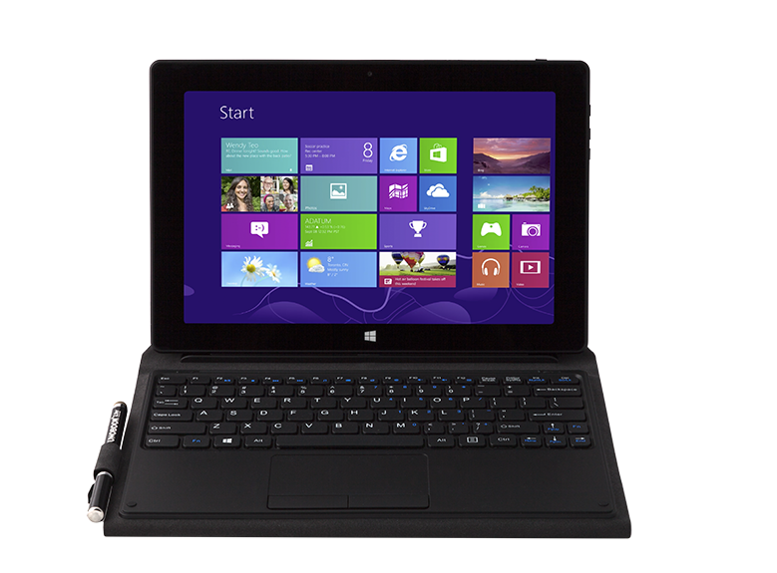
UNOBOOK® 2/ter
Starting at $359.00
Model | UNOBOOK® 2-Ter
Screen | 10.1 Wide Screen 1280 x 800
Touch Screen | 10 points Capacitive Multi-Touch – Win 8.1 certifiable
Processor | Intel Bay Trail – T 3735D Quad Core Speeds up to 1.8GHz Intel Bay Trail – T 3775D Quad Core Speeds up to 2,4GHz
Memory | 2GBs
Storage | 64GB
Wi-Fi - Bluetooth | 802.11 a/B/G/N Wireless dual band and Bluetooth 4.0, 3G Optional (Huawie E12200 Module)
Cameras | HD 720p/30fps/Indicator LED，USB interface 2.0M Pixel – Front and rear
I /O Ports | Combo Mic input & Line out x 1, DC-in x 1, Micro HDMI1.4a port x 1, Full size USB 3.0 Port x 1, Card Reader TF Card x 1, Pogo Pin style USB port for Keyboard cover x 1
Audio Ports | Headphone and Microphone combo
Battery - | 8,000 mAh Battery Pack - 9 Hour
Keyboard | Attachable keyboard with touch pad and protective case
Includes: KB, Protective case, Stylus, CDI Software Suite

Slide 8
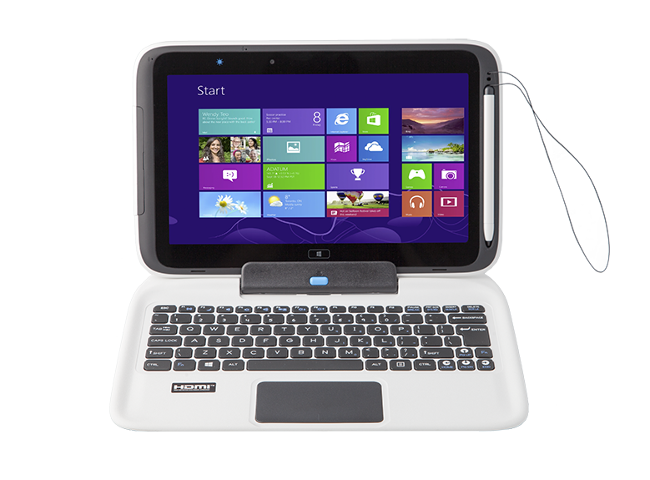
UNOBOOK® 2 in 1 PRO
Starting at $499.00
Includes: KB, Stylus, Probe, Magnifying Glass Intel & CDI Software Suite
Model | UNOBOOK® 2 in 1 PRO
Screen | 10.1", 1366x768, IPSLVDS interface
Touch Screen | 5 Point Multi-touch
Processor | Intel Bay Trail T – Quad Core ≤ 1.8 GHz
Memory | 2GB DDR3
HDD | 64GB eMMC
Wi-Fi - Bluetooth | 802.11 a/b/g/n MiMo 2x2 Wireless Bluetooth & WiDi 3G Optional (Huawie MU736 Module)
Webcam | 1.6 MP/ 5MP
I /O Ports | USB3.0 x1 ,Micro-SD slot, Micro-HDMI Combo Audio Jack
Card Reader | 2 in 1 SDHC/MMC
Audio Ports | Integrated audio, speaker and digital mic
Battery life | 14 hours – Includes extra battery in KB
Ruggedness | 70cm drop, water resistance, IP41

Slide 9
UNOBOOK® 2 in 1 EDU
Starting at $399.00
Includes: KB, Stylus, Probe, Magnifying Glass Intel & CDI Software Suite
Model | UNOBOOK® 2 in 1 EDU
Screen | 10.1", 1280 x 800 TN, LVDS interface
Touch Screen | Multi-touch
Processor | Intel Bay Trail T Z3735F – Quad Core ≤ 1.8 GHz
Memory | 2GB DDR3
HDD | 64GB eMMC
Wi-Fi - Bluetooth | 802.11 a/b/g/n MiMo 2x2 Dual Band Wireless ,Bluetooth & WiDi 3G Optional (Huawie MU736 Module
Webcam | 1.MP Front / 5MP Rear
I /O Ports | Micro USB2.0,Micro-SD slot, Micro-HDMI , Combo Audio Jack , Full size USB 2.0 in KB
Card Reader | 2 in 1 SDHC/MMC
Audio Ports | Integrated audio, speaker and digital mic
Battery life | 8 hours
Ruggedness | 70cm drop, water resistance

Slide 10
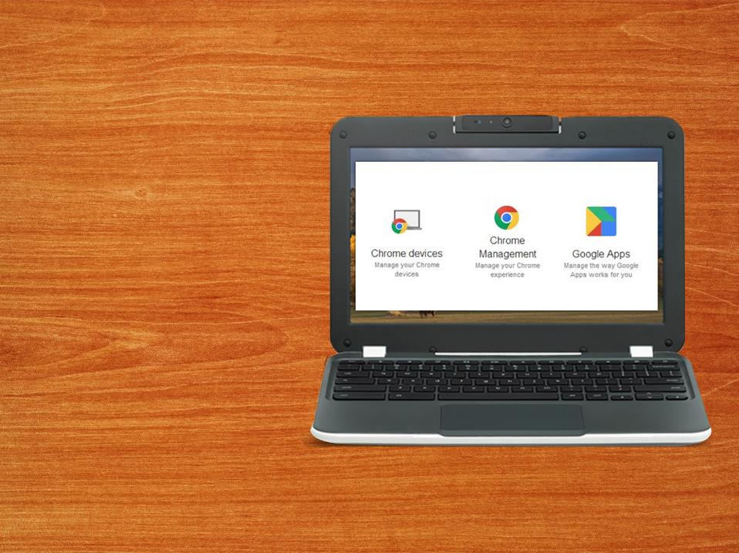
SEMI-RUGGED CHROMEBOOK
Model | UNOBOOK® 2 in 1 Premium
Screen | 11.6 1366x768 HD LED anti-Glare Screen
Processor | Intel Celeron N2930 (2M Cache), up to 2.16GHz-Quad Core-No Fan
Memory | 4GB DDR3
Internal Storage | 16GB Internal Storage
Wi-Fi - Bluetooth | Intel® Dual Band Wireless - AC 7260 adapter (Wi-Fi 802.11 ac/a/b/g/n 2x2 with Bluetooth* 4.05)
Webcam | Stereo, Mic that rotates with camera, HD webcam 1.0MP 720P HD Rotatable
I /O Ports | Full HDMI,1xUSB 3.0,USB 2.0
Card Reader | 2 in 1 SDHC/MMC
Audio Ports | Integrated audio, speaker and digital mic
Battery life | 9.5 hours – Field Replaceable
Ruggedness | 70 CM drop, water-resistant keyboard, anti-peel keys, reinforced ports and hinges, non-slip texture, Retractable handle

Slide 11
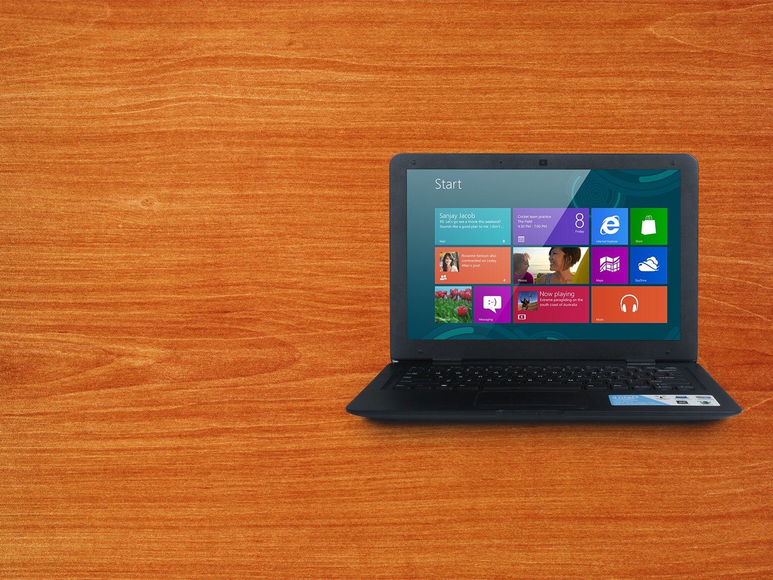
UNOBOOK® NL141
Starting at $279.00
Model | UNOBOOK® NL141
Screen | 14 inch 1366x768 (non-touch) LCD display
Processor | Intel Atom N2808 1.58GHZ Dual Core
Internal Storage | 160GB HDD
Memory | 2GB DDR3
Card Reader | Four-in-one SD/MS/MMC/MS-PRO
Wi-Fi - Bluetooth | 802.11 b/g/n Wi-Fi
Webcam | 1.3M pixels web cam
I /O Ports | USB2.0, HDMI, DC-in Jack, RJ45, Combo Audio Jack
Software | Windows 8.1, CDI Education Software Suite
Includes: Windows 8.1 Professional and the CDI Software Suite

Slide 12

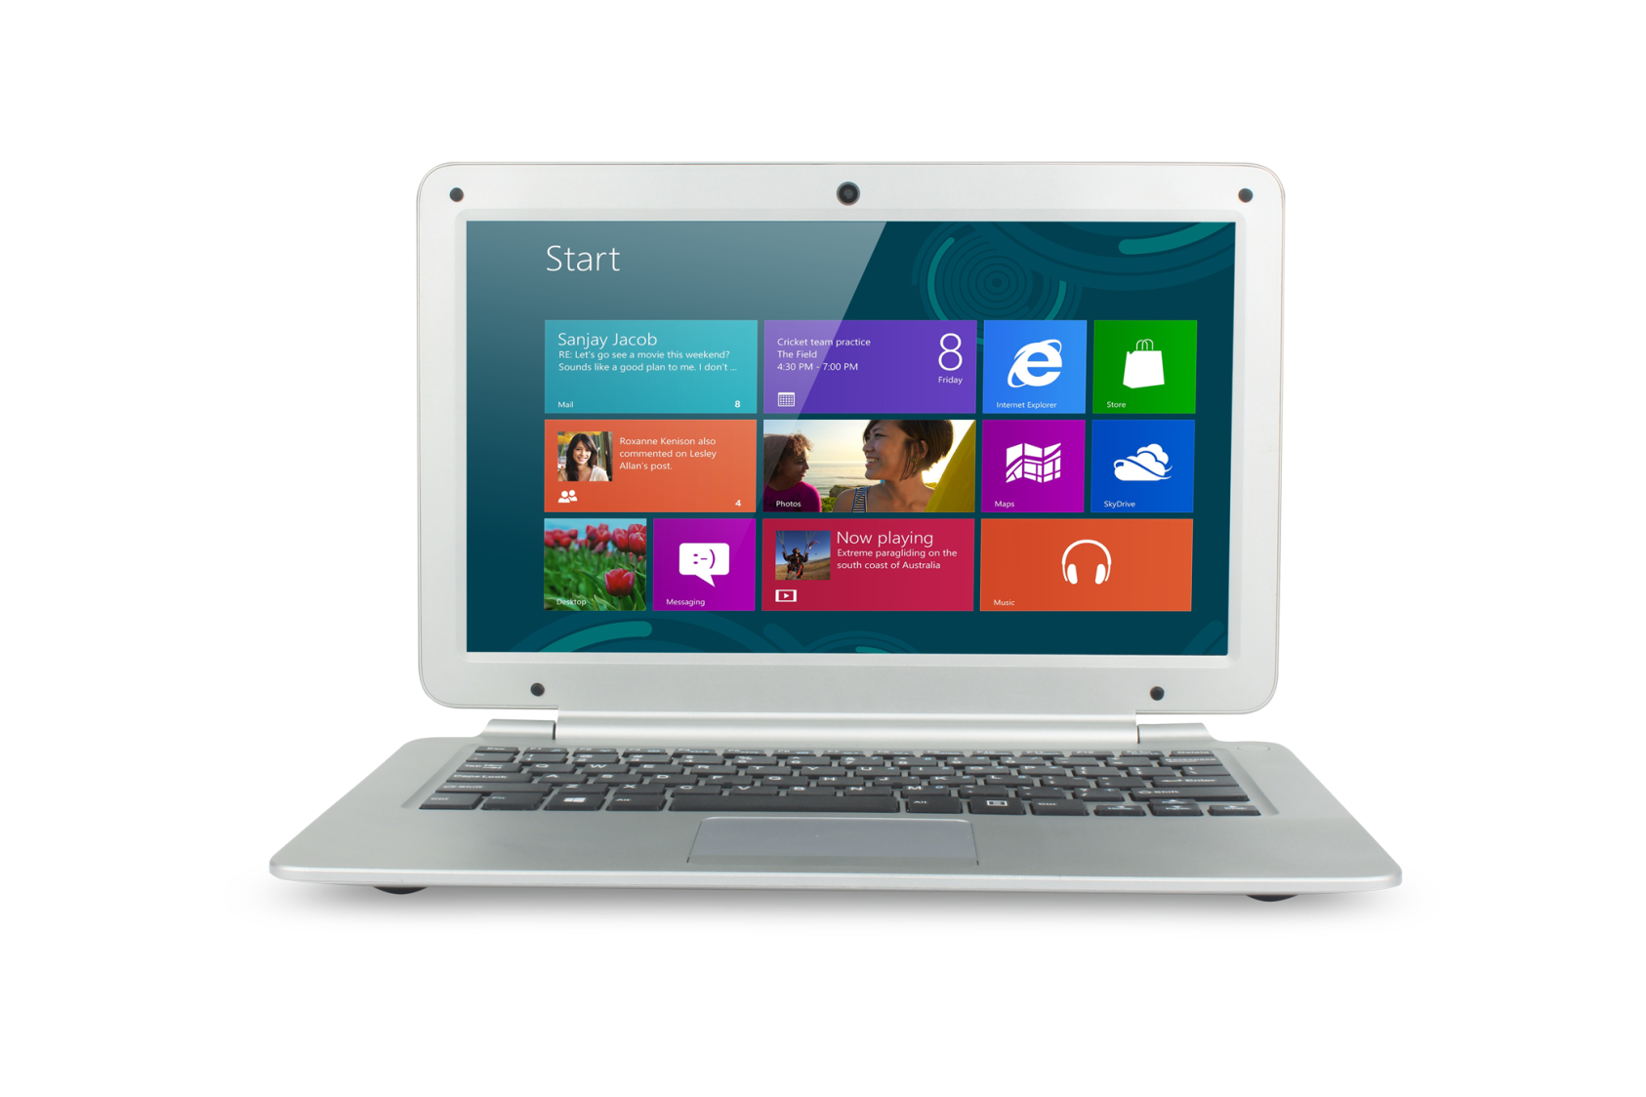
UNOBOOK® NL11
Starting at $269.00
Model | UNOBOOK® NL11
Screen | 11.6 inch 1366x768 (non-touch) LCD display
Processor | Intel Atom N2807 1.33GHZ Dual Core
Internal Storage | 32GB HDD
Memory | 2GB DDR3
Card Reader | TF Memory Card Slot
Wi-Fi - Bluetooth | 802.11 b/g/n Wi-Fi
Webcam | 1.3M pixels web cam
I /O Ports | USB2.0 x 2, Mini HDMI, DC-in Jack, RJ45, Combo Audio Jack
Software | Windows 8.1, CDI Education Software Suite
Includes: Windows 8.1 Professional and the CDI Software Suite

Slide 13


COMING SOON
Limited Demo Late March
Delivery in Quantity Mid April
Product Image
Confidential
Model | Chromebook Semi-rugged
Screen | 11.6” 1366 x 768 - Non-touch
Processor | Quad Core processor 1.8GHz
Memory | 2 or 4GB DDR3
Internal Storage | 16GB EMMC
Wi-Fi - Bluetooth | 802.11 a/b/g/n AC Dual Band MIMO 2x2 Wireless, Bluetooth 4.0
Webcam | 1.3 MP
I /O Ports | 2 x USB2.0,Micro-SD slot, HDMI , Combo Audio Jack , KB has touchpad
Card Reader | 2 in 1 SDHC/MMC
Audio Ports | Integrated audio, speaker and digital mic
Battery life | 9 + hours of battery life
Ruggedness | 70cm drop, water resistance
< $ 200

Slide 14



COMING THIS SUMMER
Model | UNOBOOK® Titan 2in1
Screen | 10.1 Wide Screen LED LCD - 1200 x 800
Touch Screen | Multi-touch
Processor | Intel Bay Trail T 3735F – Quad Core ≤ 1.8 GHz
Memory | 2GB DDR3
HDD | 64GB eMMC
Wi-Fi - Bluetooth | 802.11 a/b/g/n Dual Band MIMO 2x2 Wireless ,Bluetooth & WiDi, 3G/LTE
Webcam | 3MP/ 5MP
I /O Ports | Micro USB2.0,Micro-SD slot, Micro-HDMI , Combo Audio Jack , Full size USB 2.0 in KB, RJ45 in KB
Card Reader | 2 in 1 SDHC/MMC
Audio Ports | Integrated audio, speaker and digital mic
Battery life | 8 hours - Field Replaceable
Ruggedness | 70cm drop, water resistance
TARGET SELL $349
Limited Demo Units Late May
Delivery in Quantity July

Slide 15

COMING THIS SUMMER
Model | UNOBOOK® 360M
Screen | 11.6” Screen LED LCD – 1366 x 768
Touch Screen | Multi-touch
Processor | Intel Core M 5Y10C – 2GHz
Memory | 4GB DDR3
HDD | 64/128GB eMMC
Wi-Fi - Bluetooth | 802.11 a/b/g/n AC Dual Band MIMO 2x2 Wireless ,Bluetooth & WiDi
Webcam | 2MP/ 5MP
I /O Ports | USB3.0, Micro SD slot, Mini TF slot, HDMI , Combo Audio Jack
Card Reader | 2 in 1 SDHC/MMC
Audio Ports | Integrated audio, speaker and digital mic
Battery life | 4 hours - Field Replaceable
3G/4G | LTE 3G
TARGET SELL $479
Currently Testing
Available in Qty by June

Slide 16
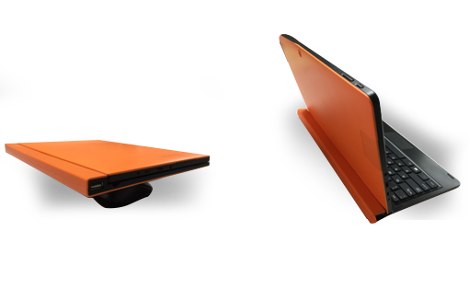
COMING THIS SUMMER
Model | UNOBOOK® Hard KB 2in1
Screen | 11.6” Screen LED LCD – 1366 x 768
Touch Screen | Multi-touch
Processor | Bay Trail-T Quad Core 3735F 1.8MHz
Memory | 2GB DDR3
HDD | 64GB eMMC
Wi-Fi - Bluetooth | 802.11 a/b/g/n Dual Band MIMO 2x2 Wireless ,Bluetooth & WiDi
Webcam | 2MP/ 5MP
I /O Ports | USB3.0, Micro SD slot, Mini TF slot, HDMI , Combo Audio Jack
Card Reader | 2 in 1 SDHC/MMC
Audio Ports | Integrated audio, speaker and digital mic
Battery life | 8 hours
3G/4G | LTE 3G
TARGET SELL $359
11.6” Tablet
Available in Qty by May

Slide 17
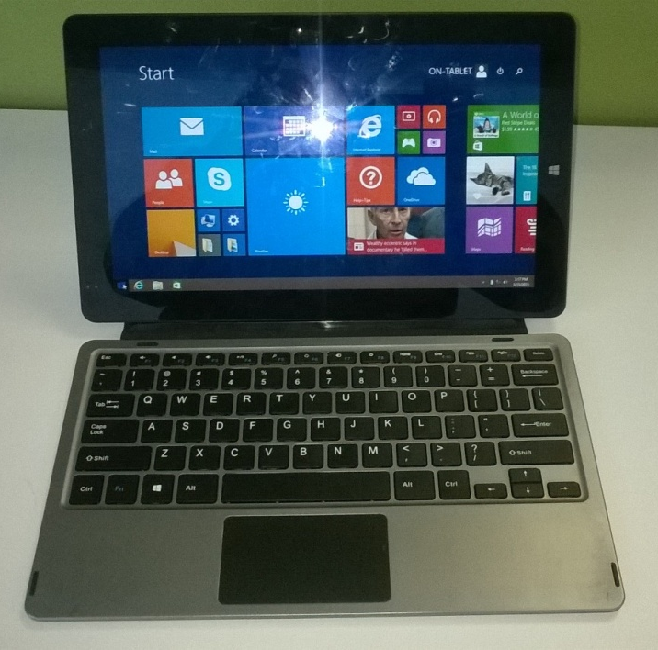
COMING THIS SUMMER
Model | UNOBOOK® 11.6” M116 Tablet
Screen | 1920x1080 11.6” Full HD eDP Panel
Keyboard | Attachable USB Keyboard with Touchpad
Processor | Intel Core M CPU 5Y10
Memory | 4GB DDR3
HDD | 64GB eMMC
Wi-Fi - Bluetooth | 802.11 a/b/g/n & ACDual Band MIMO 2x2 Wireless ,Bluetooth & WiDi 3G Option ($29)
Camera | 2MP Front, 5MP Rear
I /O Ports | 2xUSB3.0, Micro TF slot, Micor HDMI , Combo Audio Jack, SIM Slot
Card Reader | Micro TF slot
Audio Ports | Integrated audio, speaker and digital mic
Battery life | 9 hours
TARGET SELL $559
11.6” Tablet
Available in Qty by June – Demos in April

Slide 18
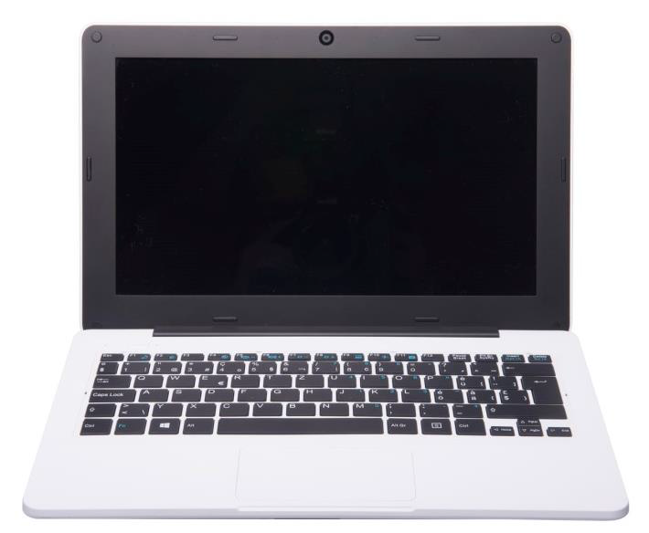
COMING THIS SUMMER
Model | UNOBOOK® Rugged 11.6” NB
Screen | 11.6”TN 1366 x 768 ( w/o Touch)
Housing | 50 CM Semi-Rugged design
Processor | Bay Trail-T Quad Core 3735F 1.8MHz
Memory | 2GB DDR3
HDD | 64GB eMMC
Wi-Fi - Bluetooth | 802.11 a/b/g/n Dual Band MIMO 2x2 Wireless ,Bluetooth & WiDi (3g?)
Webcam | 1MP
I /O Ports | 2xUSB2.0, Micro SD slot, HDMI , Combo Audio Jack, SIM Slot
Card Reader | 2 in 1 SDHC/MMC
Audio Ports | Integrated audio, speaker and digital mic
Battery life | 11 hours
3G/4G | LTE 3G
TARGET SELL $259
11.6” Tablet
Available in Qty by June – Demos in May

Slide 19



mobiLAB® STORAGE AND CHARGING
CDI also offers a variety of storage and charging options
We have Carts with capacity to store 20 – 32 devices

Slide 20







DEVICE MANAGEMENT - MDM
Centrally Manage Mobile Devices – a unified console for mobile devices with centralized policy and control across multiple platforms.
Proactively Secure Mobile Devices - dynamic security and compliance features continuously monitor devices and take action.
Streamline Mobile Device Management Support - helps you diagnose and resolve device, user or app issues in real time.
Monitor and Report on Mobile Devices - dashboards deliver an interactive, graphical summary of your operations and compliance, allowing IT to report in real-time across the entire enterprise.
Inventory Management - detailed hardware and software inventory reports.
Security - privacy settings block collection of personally identifiable information.

Slide 21


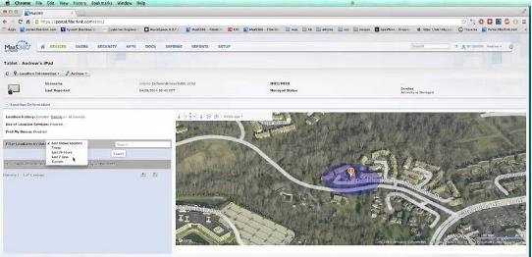





DEVICE MANAGEMENT - MDM
MDM options – Meraki free with any CDI ER device or Maas360
Either provides inventory management, application delivery and control
GEO Fencing, Time fencing
Security policies setting and
deployment
Support a multi-OS strategy
Monitor and manage all school devices, apps and documents from a single console

Slide 22







DEVICE MANAGEMENT - MDM
Quarantine new devices automatically until authorized to access your network
Authenticate against Active Directory /LDAP, one-time passcode or SAML
Push email, Wi-Fi and VPN profiles over-the-air (OTA)
Remotely locate, block or wipe (full and selective) devices that are lost, stolen or no longer authorized
Set security policies to whitelist, blacklist and
require apps on devices
Manage more devices without adding resources

Slide 23






DEVICE MANAGEMENT - CLASSROOM
MANAGE
  Remote control – manage device - lock
INSTRUCT
  Share screen, launch apps or sites, collaborate
MONITOR
  View, zoom, group, view background apps
TEST
  Quizzes, tests, first answer, team mode, peer
SECURITY
  Restrict access to apps and sites
  Control portable media
  Restrict reboot

Slide 24

LEARNING TOOLS
CURRICULUM
  MobyMax K-8 1-Year free subscription
    MobyMax is a completely integrated curriculum and teacher tools system
    Moby's adaptive curriculum creates a unique, individualized education plan for each student, allowing gifted students to progress as quickly as they like while simultaneously ensuring that remedial students get the extra instruction they need.
Recent Videos for your customers/prospects to view:
CDI’s Media Page: http://cdicomputers.com/company-profile-edu/media-streams
Direct links from our YouTube Account:
MobyMax Progress: https://www.youtube.com/watch?v=-47qa4azSAg
MobyMax Success: https://www.youtube.com/watch?v=lF4KseewuCg

Slide 25

LEARNING TOOLS
CURRICULUM
  AX/S Learning 9 -12 90 Day free subscription
    AX/S Learning is a comprehensive and robust 9 – 12 curriculum
    Additional elective course that schools can offer
    Include Credit Recovery Courses
    Free for a semester and then $99 per student per year

Slide 26



MICROSOFT LEARNING TOOLS
Windows 8 and Microsoft offer additional learning tools included on all the Windows devices.
OneNote, educators can create digital notebooks that support academic standards and outcomes across disciplines.
Students may use OneNote across content areas and grade levels. OneNote also supports research, collaboration, information management, communication, note taking, journaling, and other academic requirements.
Office Mix, a tool designed to make it easier for teachers to incorporate online content into their lesson plans.

Slide 27







GOOGLE LEARNING TOOLS
Google for education tools include:
Google Classroom - helps teachers create, assign, and collect student class work and homework on their device.
Google Docs Suite - documents, spreadsheets, and presentations can be accessed and edited offline or online and shared to one or to many.
Google Maps, Gmail, Search, YouTube
Chrome Management Console - web-based management console makes it easy deploy and control a fleet of devices and users.

Slide 28





PROFESSIONAL DEVELOPMENT OFFERINGS
CDI and their partners have a variety of PD offerings
We have training for the technical staff in terms of deployment
TRAINING FOR :
warranty repair
teachers … pedagogy
teachers application
students and parents
Work with community

Slide 29









SUPPORT / WARRANTY
Toll free support desk
Deployment planning and implementation services
Standard CDI warranty coverage for up to 4 years
Accidental Damage coverage
available – up to 4 years
Hot Swaps program
Spare Parts consignment
Warranty repair training – customers perform their own warranty work
Train students – provide skills

Slide 30



QUESTIONS?
Toll Free:
888-226-5727
Email:
On-tablet@cdicomputers.com
Web: http://cdicomputers.com/tablets

Slide 31


