Slide 1
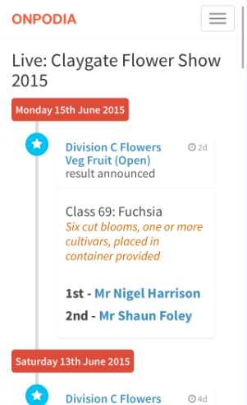



Insert livestream
image
Ready to try out Onpodia to manage your event competitions? That's great! Give us a call or send us an email and we will get back to you as soon as possible!
Onpodia
Event competition management -made simple
Introducing Onpodia
livestream
-Publish results as they happen
-Keep up to date with the events top scorers
Onpodia is powered by Portonomy 2015 – an Air Publishing product

Slide 2



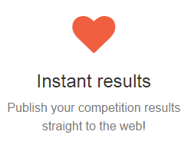
What do we do?
Examples
Onpodia has everything you need to get your event competition up and running in no time!
-Cakes and Baking
-Flowers and arrangements
-Photography arts and crafts
“Having a livestream has made publishing our event results so much easier.”

