Slide 2
Index
xxxxx
xxxxx
xxxxx
xxxxx

Slide 3
Title
XXXXXXXXX
XXXX
Text
Text
Text
XXXXXX
Text
Text
Text
Text
Text
Text
XXXXXXX
Text
Text
Text
Text
Text
Text
XXXXX
Text
Text
Text
Text
Text
Text
Text
Text

Slide 4

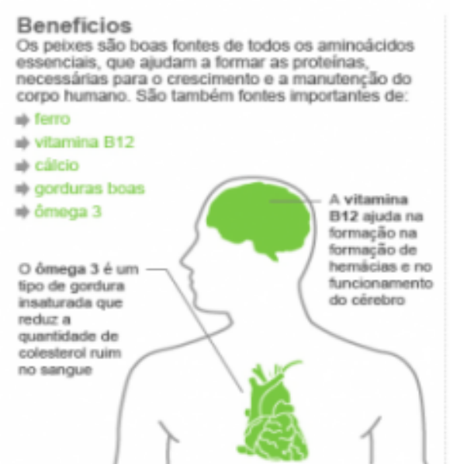

Title
xxxxxxxxx
xxxxx
xxxx
xxxx
xxxx
xxxx
xxxx
xxxx
Text

Slide 5
Imeri Capital
Phone: +55 (31) 3309-5335
Adress: Street Sergipe, 925 / 12 floor
30130-171 – Belo Horizonte – MG – Brazil

