Slide 1
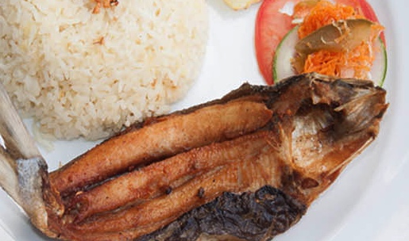
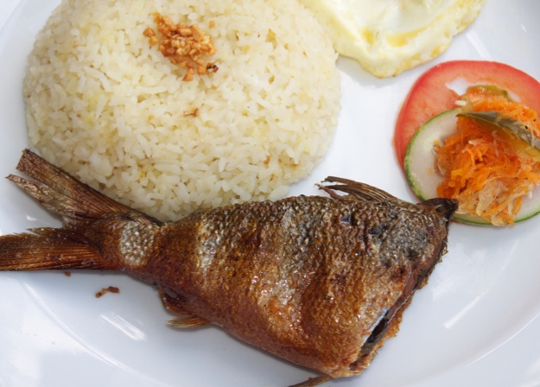
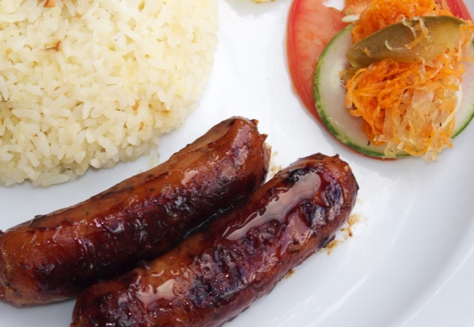
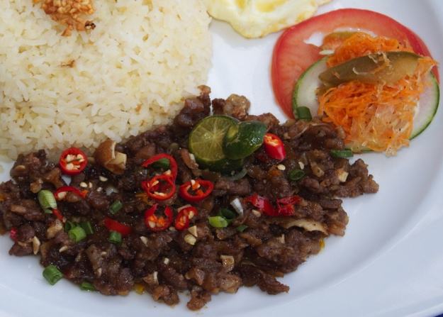
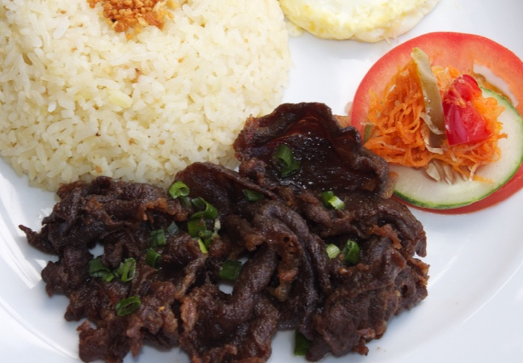
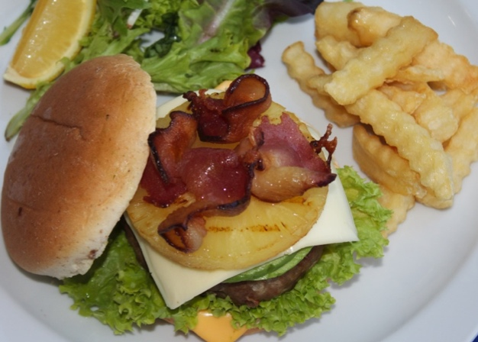
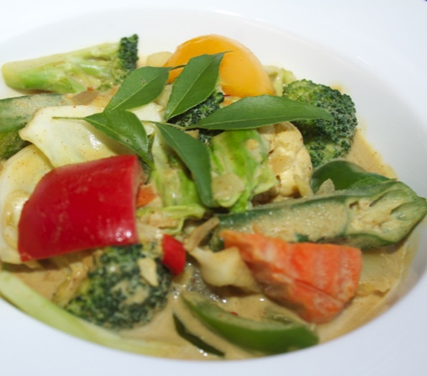
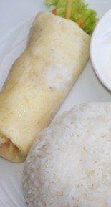
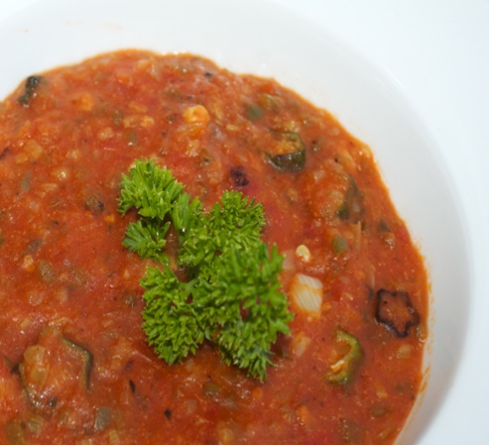


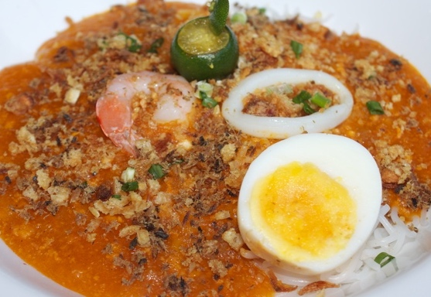
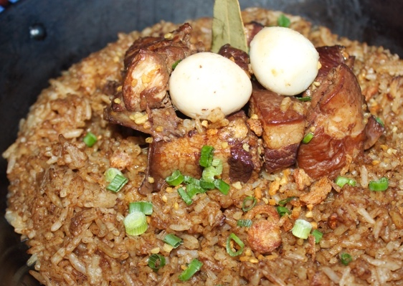

Lunch Menu - $8.80
Boneless Milkfish (Bangsilog)
Smoked Milkfish (Tinapsilog)
Chicken Sausage (Longsilog)
Minced Pork and Beef (Sisiglog)
Marinated Sliced Beef (Tapsilog)
Fiesta Burger
Curry w/ veggie Roll
Asian Gumbo w/ veggie
roll
Seafood Noodles
(Pancit Palabok)
Pork and Beef Rice (Arroz Adobo)
$1.00
Upsize A : Add a Drink
Upsize B : Add Extra Meat or Extra Curry
Vegetarian
$2.00

