Slide 1

aotea
Clear Cloud Limited
Notes:
Growth

Slide 2
Innovative Data Centre Park
Modular Data Centre
plus
Life-support to containerised data centres

Slide 3
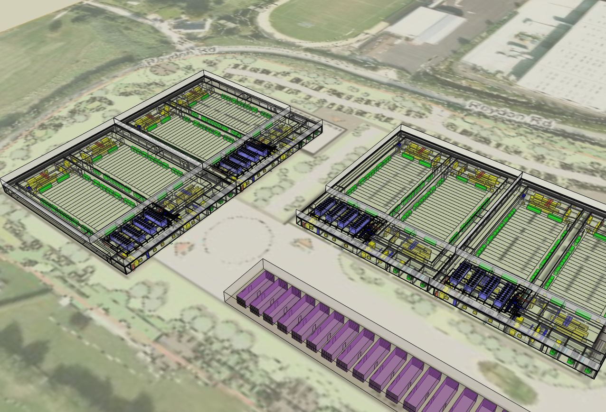

Slide 4
Modular Data Centre. Built using a hybrid of preassembled datacentre halls and cooling married to locally sourced accommodation and ups.
Uptime Institute accredited
Designed to be Tier IV enabled
World class facility -Efficiency (PUE of < 1.13)
Constructed to Gold Standard LEED

Slide 5
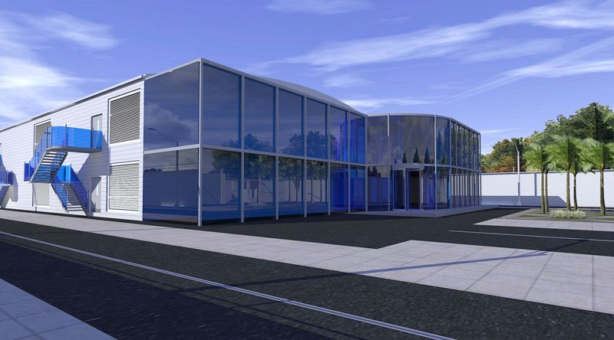
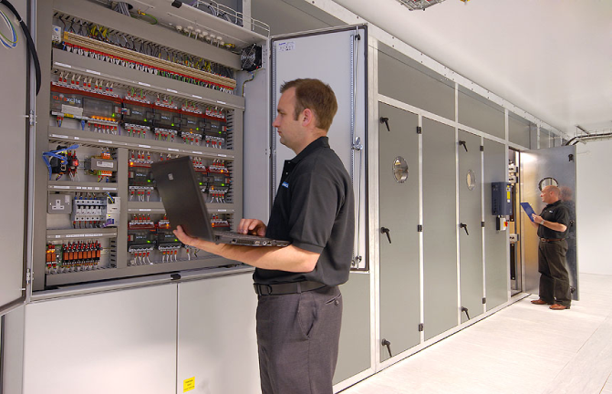
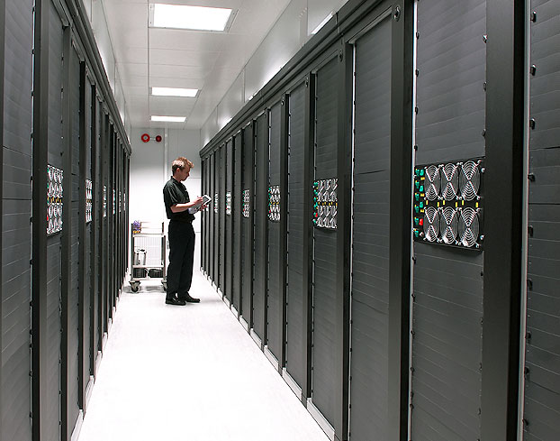

Slide 6
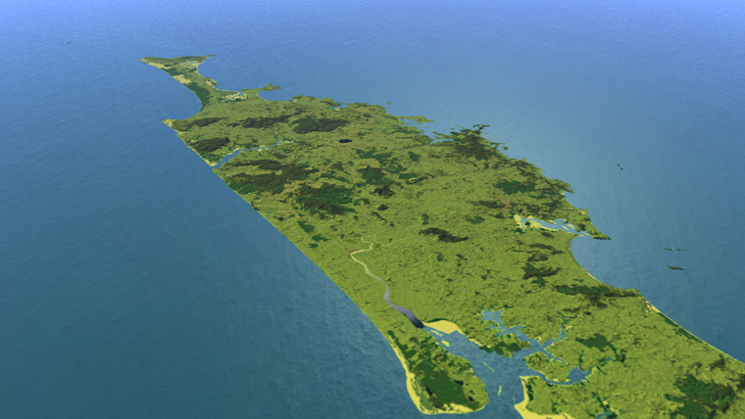
WHY NORTHLAND
NEW ZEALAND?
Diverse terrestrial and marine connectivity
Abundant, renewable, low cost power
Green sustainable energy
Geologically sound, elevated, flat land
Politically stable environment
A safe haven, no continental neighbours, centre of Pacific Rim
Notes:
Growth

Slide 7
Time Line
Stage1
Mar 2014
Develop business case
Stage II
Dec 2014
Stage III
Dec 2015
Construction
Processes and Procedures
Stage IV
Dec 2016
Stage V
Dec 2018
Raise Funding
Secure Customers
Finalise facility specification
Establish the entity
Open for business
Quality Standards
Recruit and train staff
Complete build out of the facility
Commence build-out of expansion

Slide 8
Revenue and EBITDA
Year | 2014 | 2015 | 2016 | 2017 | 2018 | 2019 | 2020
Revenue $k | 0 | 0 | 17,374 | 39,475 | 70,901 | 85,848 | 85848
EBIT $k | 0 | -360 | -2,564 | 4,616 | 18,114 | 26,960 | 26960
EBITDA $k | 0 | -360 | 4,129 | 15,043 | 32,550 | 41,712 | 41,712
Total Spend
Year | 2014 | 2015 | 2016 | 2017 | 2018 | 2019 | 2020 | Total
Building $k | 1,000 | 9,000 | 5,000 | 10,000 | 0 | 0 | 0 | 25,000
Fitout $k | 0 | 35,000 | 19,000 | 23,000 | 15,000 | 0 | 0 | 92,000
Project Management $k | 1,246 | 3,250 | 720 | 720 | 420 | 0 | 0 | 6,346

Slide 9
Building
Year | 2014 | 2015 | 2016 | 2017 | 2018 | 2019 | 2020 | Total
Shareholder equity $k | 0 | 2,000 | 1,000 | 2,000 | 0 | 0 | 0 | 5,000
Mortgage $k | 0 | 8,000 | 4,000 | 8000 | 0 | 0 | 0 | 20,000
Total $k | 0 | 10,000 | 5,000 | 10,000 | 0 | 0 | 0 | 25,000
Fit-out and Project Management
Year | 2014 | 2015 | 2016 | 2017 | 2018 | 2019 | 2020 | Total
Shareholder Equity $K | 1,500 | 8,500 | 0 | 0 | 0 | 0 | 0 | 10,000
Government Grant $k | 0 | 5,000 | 0 | 0 | 0 | 0 | 0 | 5,000
Bank Debt $k | 0 | 35,000 | 20,000 | 19,000 | 8,000 | 0 | 0 | 82,000
Cashflow $k | 0 | 0 | 0 | 0 | 20,000 | 32,000 | 32,000 | 84,000
Net cumulative debt $k | 1,500 | 39,000 | 59,000 | 78,000 | 66,000 | 34,000 | 2,000

Slide 10
Investment proposal
Aotea Clear Cloud are seeking individuals and organisations who will invest alongside the founding shareholders
The founding shareholders are seeking an investor who is prepared to commit up to $15.0 million seed funding in exchange for up to 30% of the business.
 | 2017 | 2018 | 2019
EBITDA | 6,933,330 | 9,443,030 | 18,059,920
Investment | 15,000,000 | 15,000,000 | 15,000,000
ROI | 13.9% | 18.9% | 36%

Slide 11
Outline use For Seed Funding
Secure Key staff
  Market Development
  Technology Staff
Retain specialist Consultants
  Architects
    Infrastructure
    Project management
  Retain Professional Services
    Legal
    Accounting
    Media

Slide 12
Regional support
Assistance in finding suitable land
Assistance with resource consent
Help with promoting the SKA opportunity in Northland
Incentivised land prices, for data centre and cable landing.

