Slide 1
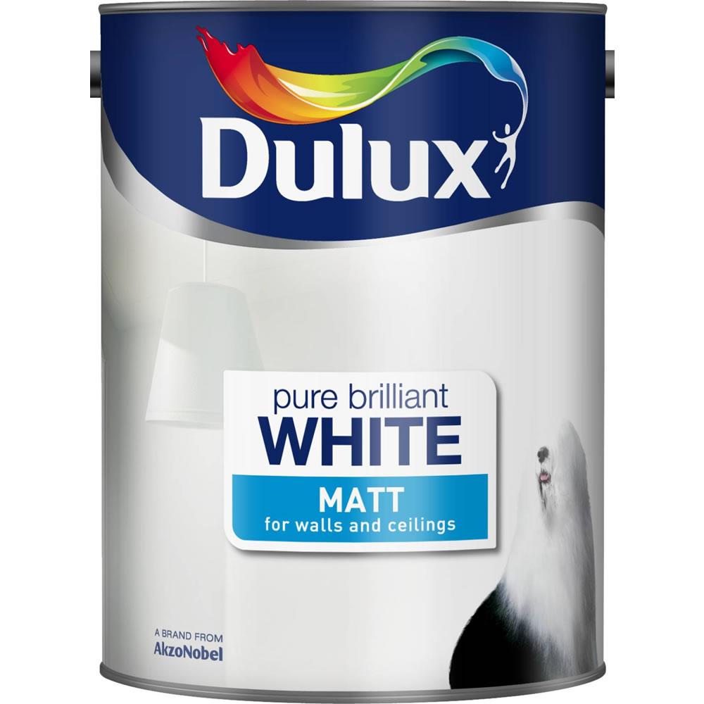
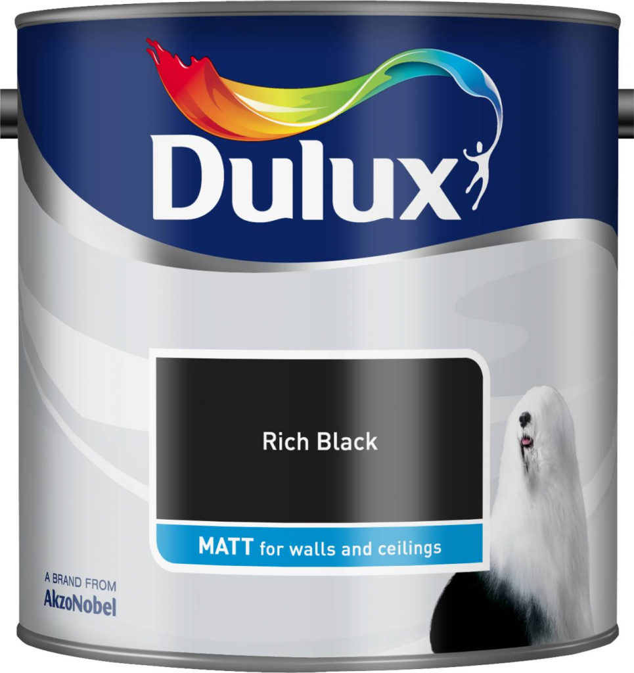
Paint tin criteria
Emulsion
Alkyd Gloss
The text box here will change for each product category example matt/emulsion/high gloss I will provide the titles in a separate word document.
In this example the tin has the same design the only thing changed here is the color. But I will have the same concept for the two paint types labeled above them only the colors will change and text
Colors here will change along with text for every tin example here is pure brilliant white( the color in the tin is white

