Slide 1
Introducing the
Financial Freedom Plan

Slide 2
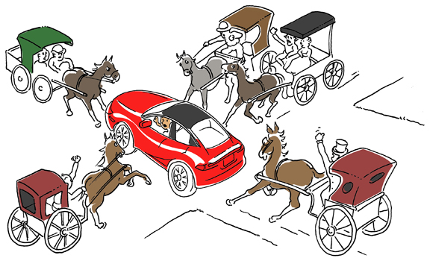
We Are Running Our 21st Century Economy on a 19th Century Operating System
It’s Time to Upgrade

Slide 3
Eliminating Income Taxes
Without Cutting Spending
The Cornerstone of the
Financial Freedom Plan

Slide 4

Remember the Shock of How Much Was Deducted From Your First Paycheck?

Slide 5
We Are Taxing the Wrong Thing
Financial Settlements
$4,500 Trillion
Income
$15 Trillion
Federal Budget $4 Trillion

Slide 6
What Are Financial Settlements?
Wire Transfers
(Fedwire & CHIPS)
Securities Cleared
(NSCC and FICC)
Delivery Instructions
(Federal Reserve & DTC)
ACH Transfers
Checks
Checks
Credit Cards
Personal Income
Federal Budget

Slide 7
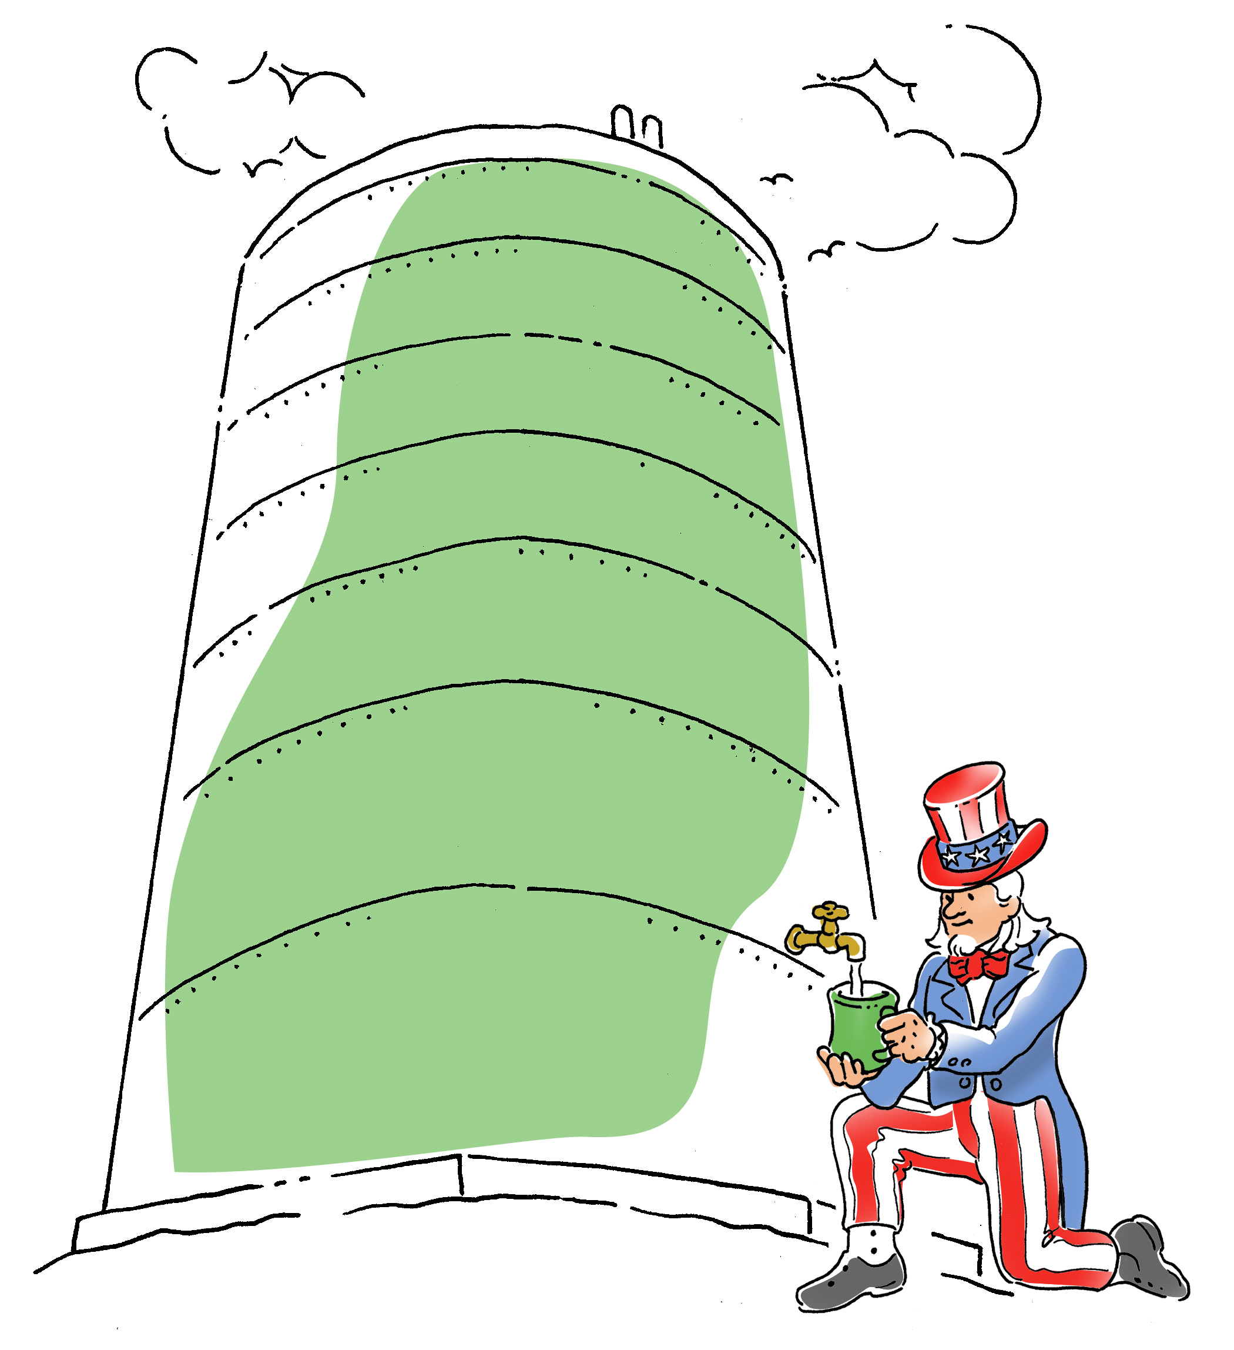

Taxing Income Versus
Taxing Financial Settlements
$15 Trillion
$4,500 Trillion

Slide 8
For every $100,000 in income, there are $30 million in untaxed financial settlements
No wonder we have a problem

Slide 9
If we taxed financial settlements, the tax rate would be 0.1%
And instead of a budget deficit, we’d have a half trillion dollar surplus

Slide 10
Today you pay up to $400 in taxes per $1,000 of income –
With the FST you’d only pay $1

Slide 11
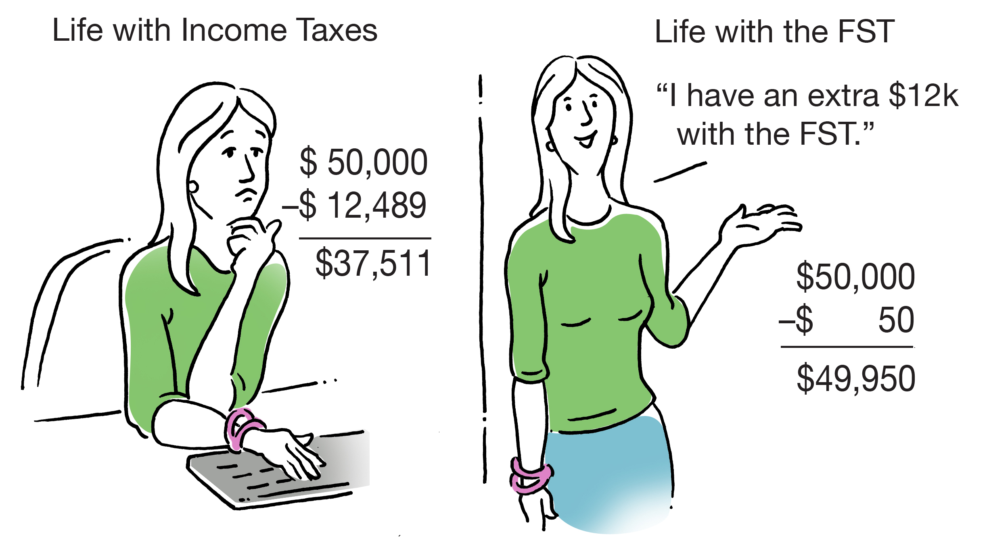
Income Taxes vs. the FST

Slide 12
Banking 2.0
Eliminating Interest
The Second Cornerstone of the
Financial Freedom Plan

Slide 13
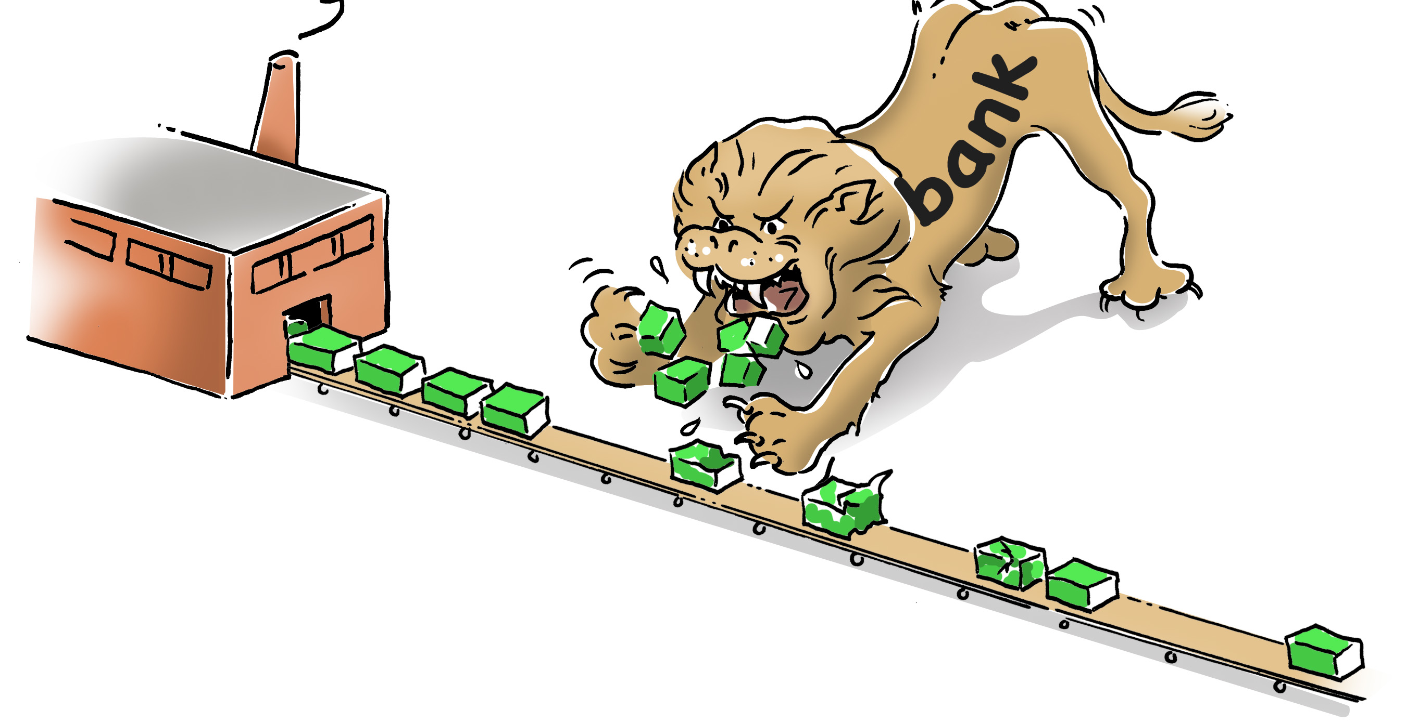
Today the Financial Sector
Earns 40% of Corporate Profits
This over-taxes our economy, depleting production

Slide 14
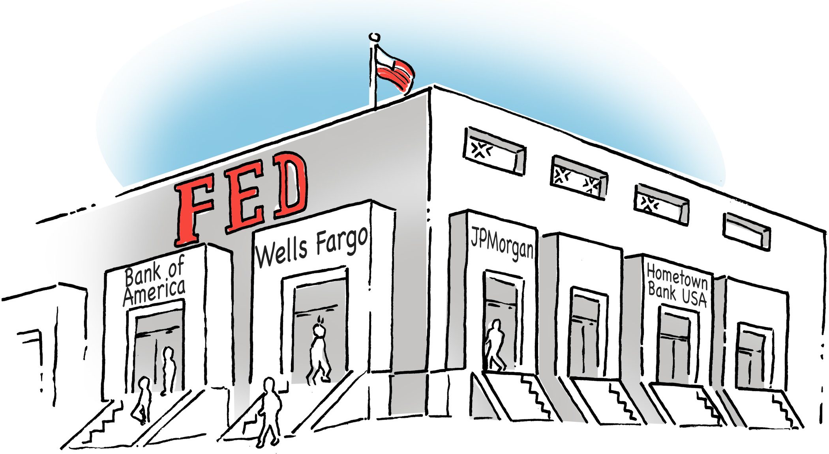
Banking 2.0
The truth is we issue money, so there is no cost of funds. Banks should be service agents for lending and investing money, earning service fees, but not charging interest.

Slide 15
By Eliminating Interest
Banking 2.0 Reduces the Cost of Financing
The payment on a $400,000 mortgage
drops from $2,147 to $1,111
The payment on a $100,000 student loan
drops from $763 to $417
The payment on a $50,000 credit card bill
drops from $901 to $417

Slide 16
Paying Off the National Debt
The Third Cornerstone of the
Financial Freedom Plan

Slide 17
We Have $18 Trillion in National Debt

Slide 18
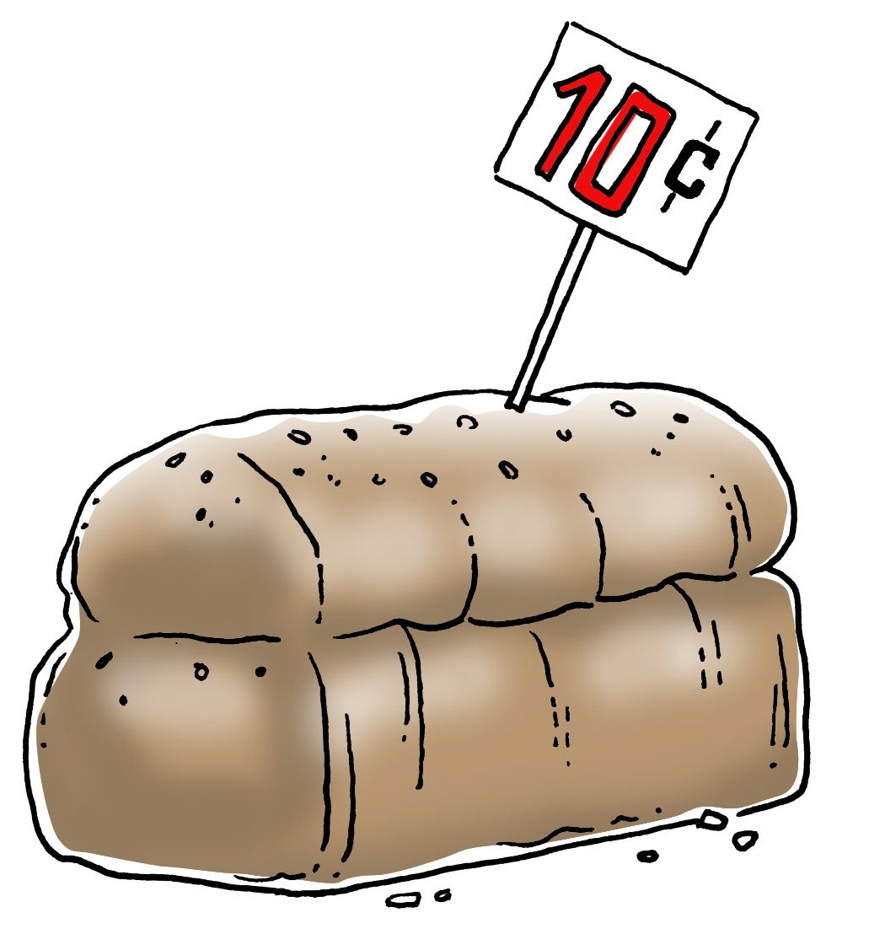
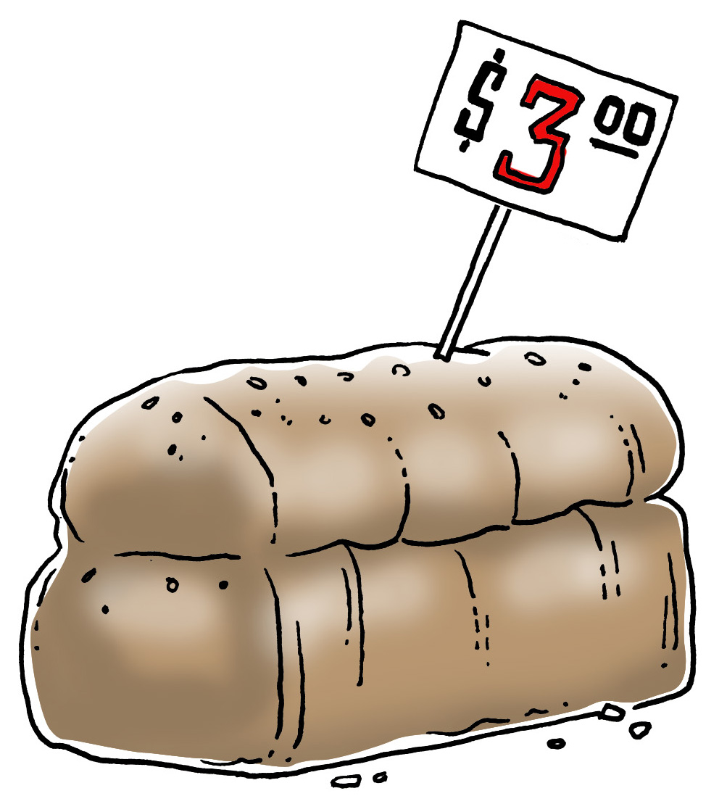
Today We Issue Interest-Bearing Treasury Bonds to Pay For Our Debt
1940
Today
Treasury bonds inflate the money supply, creating inflation. That’s why a loaf of bread was ten cents in 1940, and is $3 today.

Slide 19
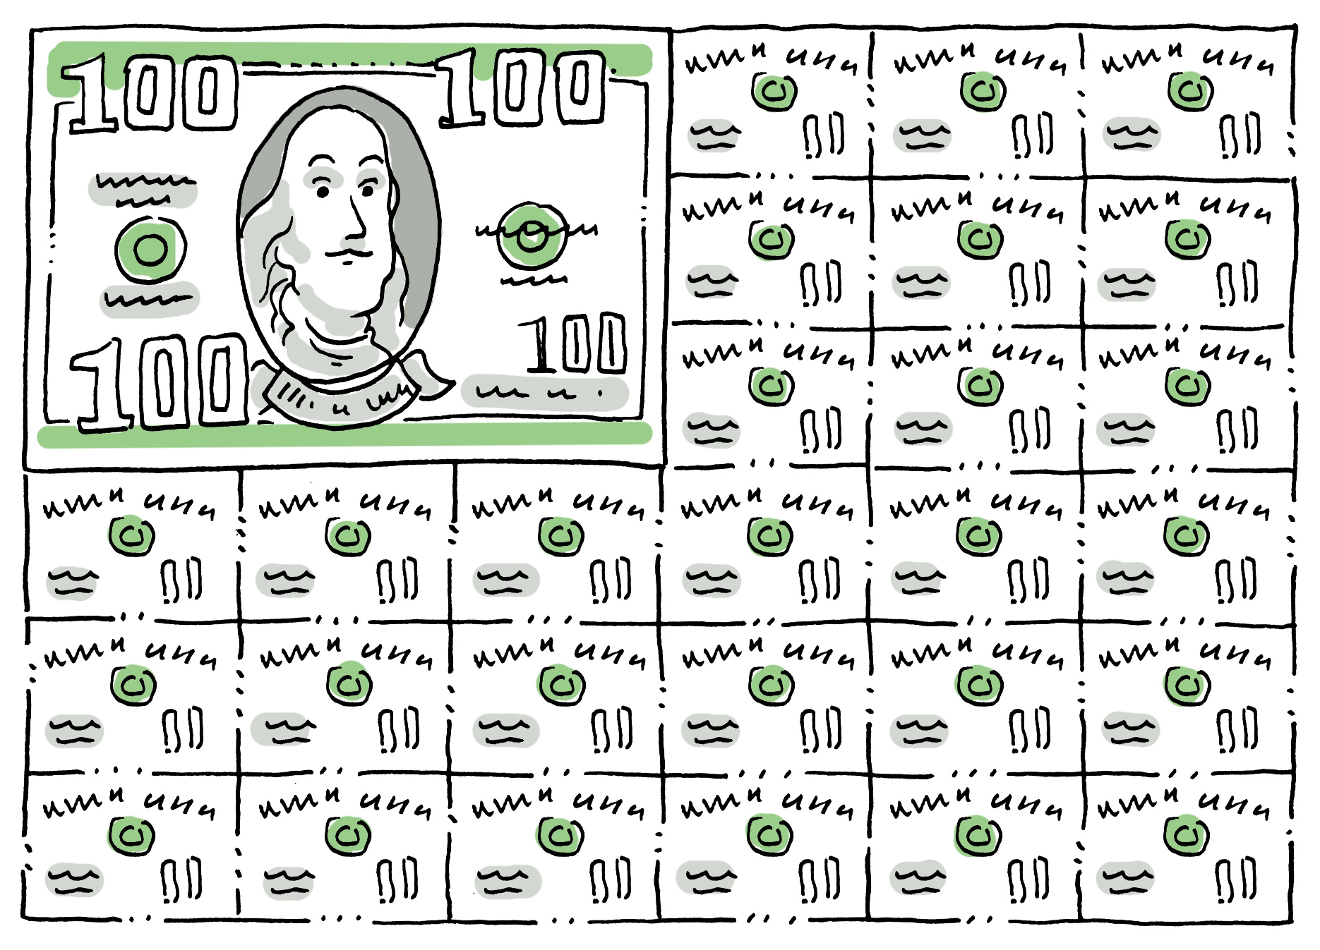
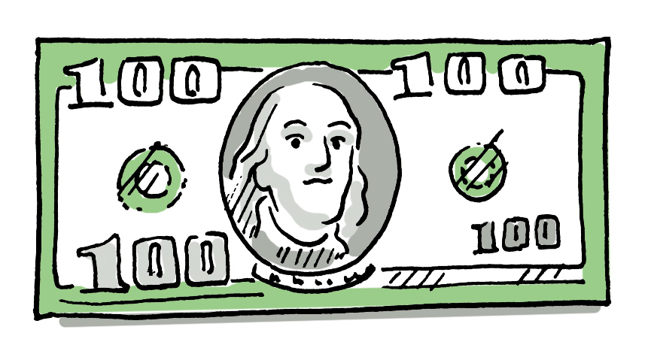
We Have Created Two Forms of Money
Good Money –
Non-interest bearing currency
Bad Money –
Interest bearing Treasury bonds

Slide 20
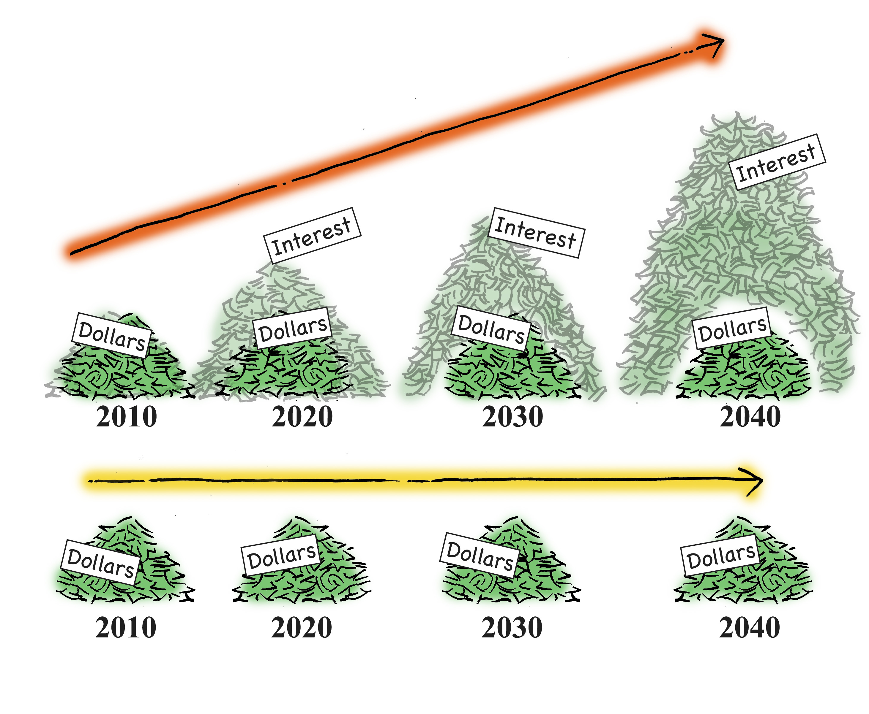
We Need to Replace Our
Bad Money With Good Money
Because Treasury bonds earn interest, they grow, inflating the money supply
Replacing Treasury bonds with currency stabilizes the money supply, reducing inflation

Slide 21
With Coupon Stripping We Can Pay Off the National Debt in Five Years

Slide 22
Stimulus Payments
Tapping Our Nation’s Latent Wealth
The Fourth Cornerstone of the
Financial Freedom Plan

Slide 23
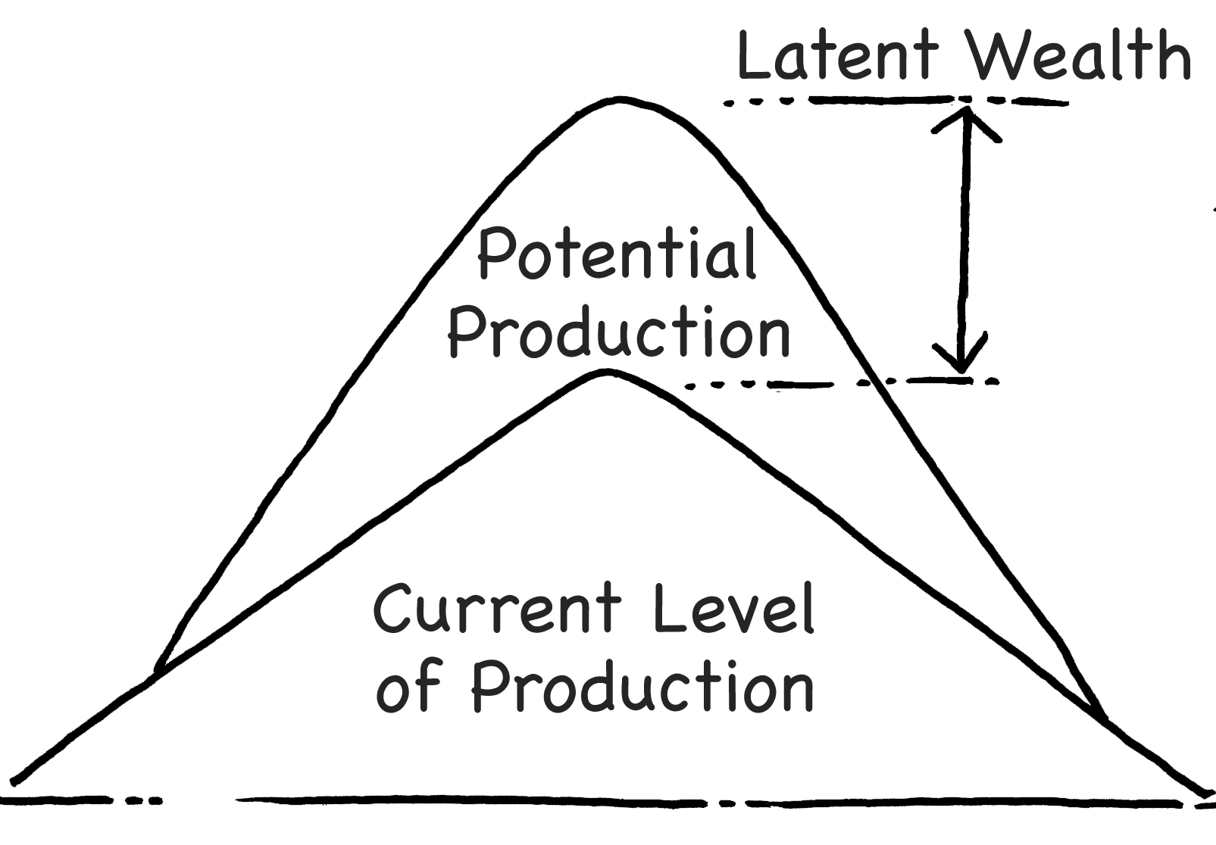
Today the Biggest Problem Businesses Have is Attracting Enough Customers
The difference between what our factories produce today, and what they could produce if they had enough customers, represents our nation’s latent wealth.

Slide 24
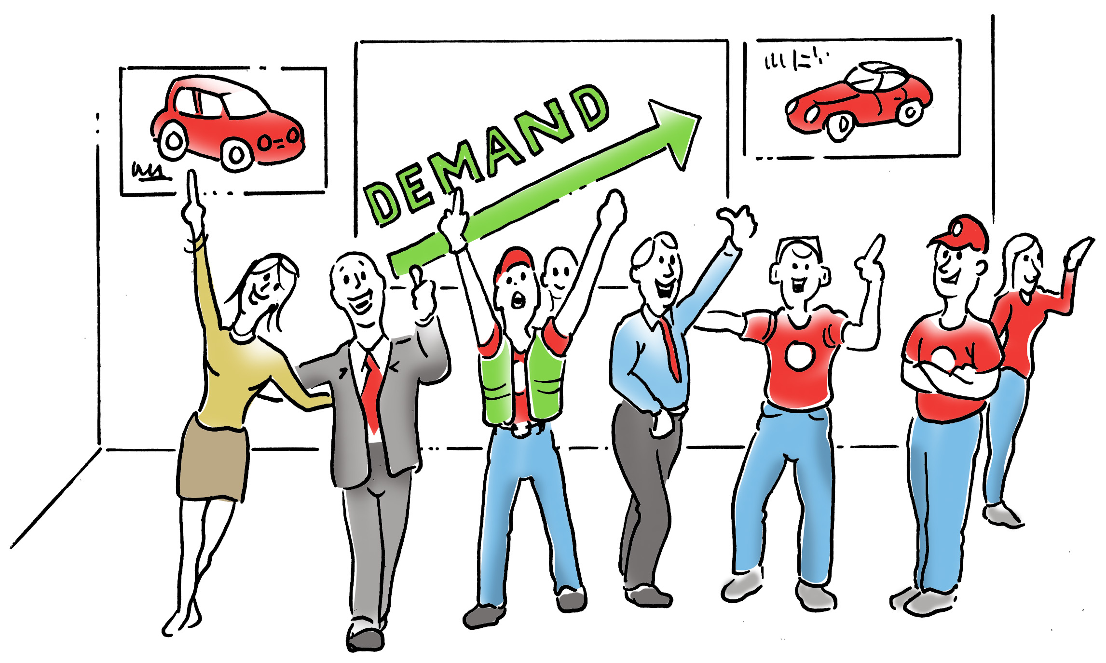
Stimulus Payments entail distributing money to citizens to increase spending
Stimulus Payments would increase demand and create jobs

Slide 25
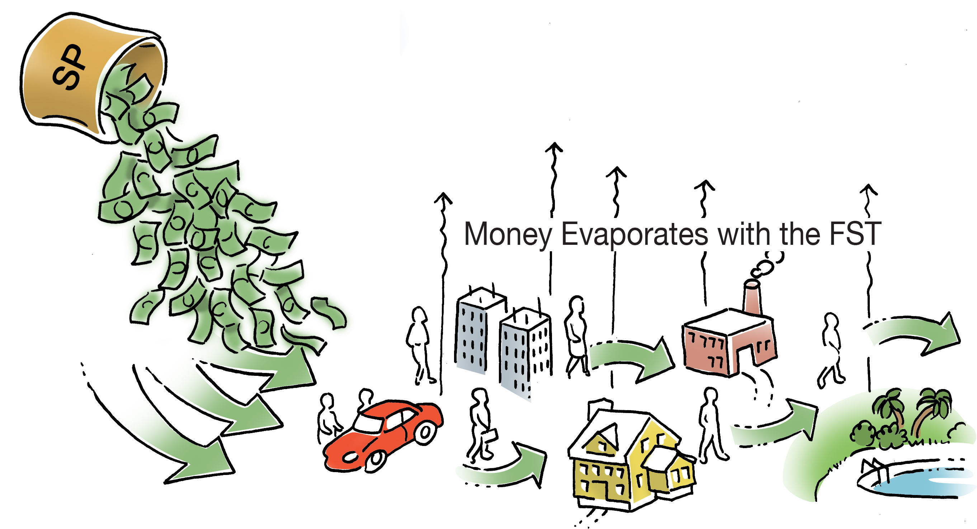
The Money Distributed Would Be Removed From the Money Supply with the FST
Stimulus Payments are not possible today, because with income taxes, the money distributed would have to come out of someone else’s pocket.

Slide 26
It would only cost 20 cents in Financial Settlements Taxes per $1,000 to distribute $3,174 to every citizen in the nation.

Slide 27
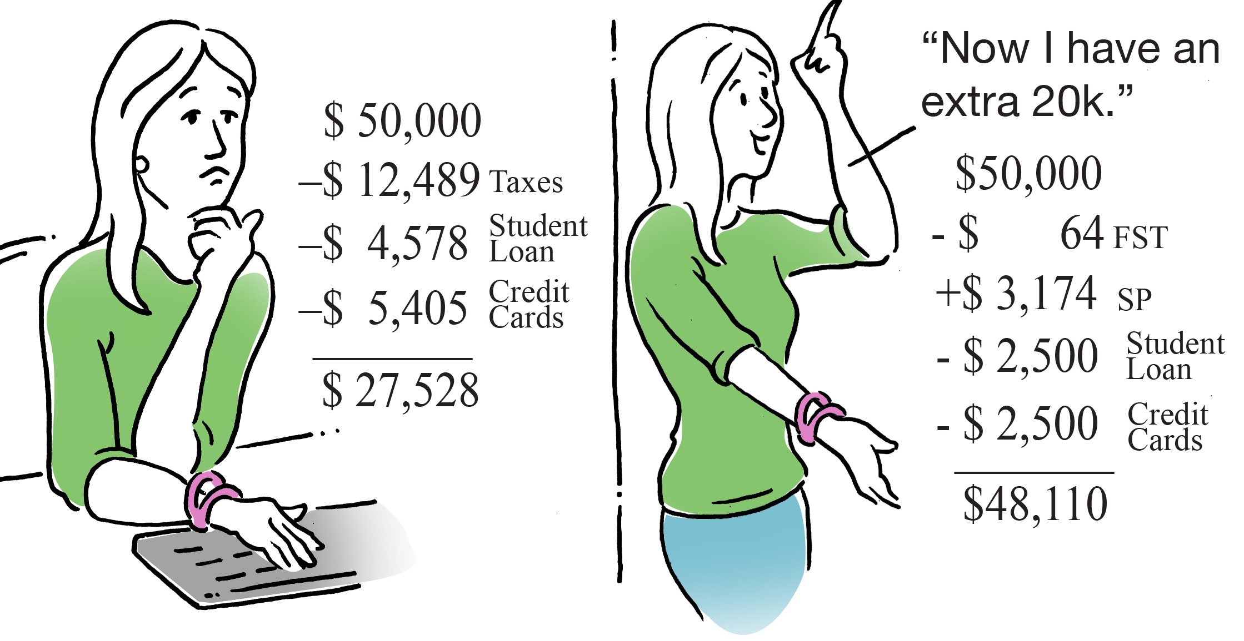
Life Today Versus the
Financial Freedom Plan

Slide 28
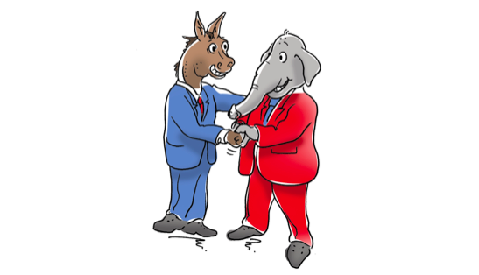
The Financial Freedom Plan
Something We Can All Agree Upon

