Slide 1
Republic Systems Inc.
2015

Slide 2
Open Innovation and Crowdsourcing

Slide 3
What is crowdsourcing?
Crowdsourcing is a blend of traditional top-down production and bottom-up user production.
Traditional production
Crowdsourcing
User production
Shared top-down and bottom-up process
Locus of control in between organization and online community
Examples:
Peer to Patent
Innocentive
Amazon Mechanical Turk
Top-down, hierarchical process
Locus of control in the organization
Examples:
In-house product development
Simple voting, marketing campaigns
Bottom-up, grassroots process
Locus of control in the online community
Examples:
Open source software
Wikipedia
YouTube
Replicated from: “Using Crowdsourcing in Government.” IBM Center for the Business of Government. Daren C. Brabham, USC. 2013.

Slide 4
Four types of problems are suited to crowdsourcing
Type of crowdsourcing | How it works | Types of problems | Use cases for government
Knowledge Discovery & Management | Organization tasks crowd with finding and collecting information in a common location and format | Information gathering Organization Reporting problems Creation of collective resources | Reporting conditions of parks, hiking trails, roads Tracking use of public transit Cataloging public art projects & murals for historical boards
Distributed Human Intelligence Tasking | Organization tasks crowd with organizing large volumes of information | Large scale data analysis where human intelligence is more efficient or effective than computers | Language translation Data entry Behavioral modeling
Broadcast Search | Organization tasks crowd with solving empirical problems | Ideation for problems with empirically provable solutions, such as scientific problems | Better algorithms for timing, traffic signals Improving actuarial solutions
Peer-Vetted Creative Production | Organization tasks crowd with creating and / or selecting creative ideas | Ideation on matters of taste Testing market support Design or aesthetic solutions | Designs for public art projects Urban or transit plans School redistricting Policy proposals
Replicated from: “Using Crowdsourcing in Government.” IBM Center for the Business of Government. Daren C. Brabham, USC. 2013. “Tech Trends 2014 Inspiring Disruption.” Deloitte University Press.

Slide 5
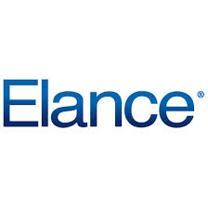



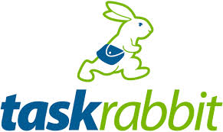










Choose a platform based on your project’s goals
Type
Platforms
Example Projects
Simple, task oriented crowdsourcing to gather or process information
SeeClickFix
USGS’s Did You Feel It?
USPTO’s Peer to Patent
Transcribing digital scans of old handwritten census records
White House SAVE Award
NASA’s use of InnoCentive for a solar flare prediction formula
NASA/topcoder Longeron Challenge
Complex, experience-based crowdsourcing; asset production
Open-ended, idea generating crowdsourcing
Next Stop Design bus
stop shelter design competition
ITS Congestion Challenge for alleviating traffic congestion
Source: “Using Crowdsourcing in Government.” IBM Center for the Business of Government. Daren C. Brabham, USC. 2013. “Tech Trends 2014 Inspiring Disruption.” Deloitte University Press.

Slide 6
Crowdsourcing growth by category & industry sector
Source: “The Crowd in the Cloud: Exploring the Future of Outsourcing.” Massolution. Jan, 2013.

Slide 7
Outsourcing v. Crowdsourcing?
Pay for performance
Outsourcing service agreements have per-hour or per-person (FTE equivalent) pricing models
Flexibility is compromised by all inclusive service agreements
Crowdsourcing allows agencies to pay only when tasks are completed satisfactorily
Pay for what you get = 100% output-based pricing rather than input-based pricing
True flexibility to ramp-up or down based on needs as compared to traditional outsourcing
“The potential for disruptive impact on cost alone makes early experimentation worthwhile.”
–Deloitte, Tech Trends 2014
Source: “The Crowd in the Cloud: Exploring the Future of Outsourcing.” Massolution. Jan, 2013.

Slide 8


Four trends lead to enterprise crowdsourcing growth
Cloud
SaaS
Micropayments
Global Talent
70% of companies are using cloud computing, in part due to adoption of mobile devices
Drives standardizes of internal processes
Move away from captive workforce for global labor rates, specialized skills, task management processes at scale
Provides needed agility
Allows movement of non-integral business needs to cloud while focusing on core differentiators
Integral to cloud adoption
Lowered transaction costs for international transfer of small amounts of money
Online, global workforce expected to exceed 3 BN in 2016
Crowdsourcing workers increased 100% in 2011
74% of executives think outsourcing helps a company survive in today’s economy –Cap Gemini survey, 2009
Allows workforces to be paid on a per task basis through PayPal
Source: “The Crowd in the Cloud: Exploring the Future of Outsourcing.” Massolution. Jan, 2013. Pictures: Cloud. SaaS. Micropayments. Global talent.

Slide 9
Crowdsourcing in Government

Slide 10
America COMPETES Reauthorization Act of 2010
In January 2011, the Obama Administration
“granted all agencies broad authority to conduct prize competitions to spur innovation, solve tough problems, and advance their core missions.”
–Office of Science and Technology Policy (OSTP)
Why incent crowdsourcing?
Pay only for success Establish an ambitious goal without having to predict which team or approach is most likely to succeed Reach beyond the “usual suspects” to increase the number of solvers tackling a problem Identify novel approaches, without bearing high-levels of risk Bring outside perspectives to bear Increase cost-effectiveness to maximize the return on taxpayer dollars
Results in first 3 years?
Increased focus on using prizes to identify novel solutions Emphasis on creating a post-competition path to success for new solutions More prizes offered for effective and low-cost software and IT solutions New models for engaging the public and building communities during competitions Growth in the number of competitions and prize dollars
Source: Implementation of Federal Prize Authority: FY 2013

Slide 11
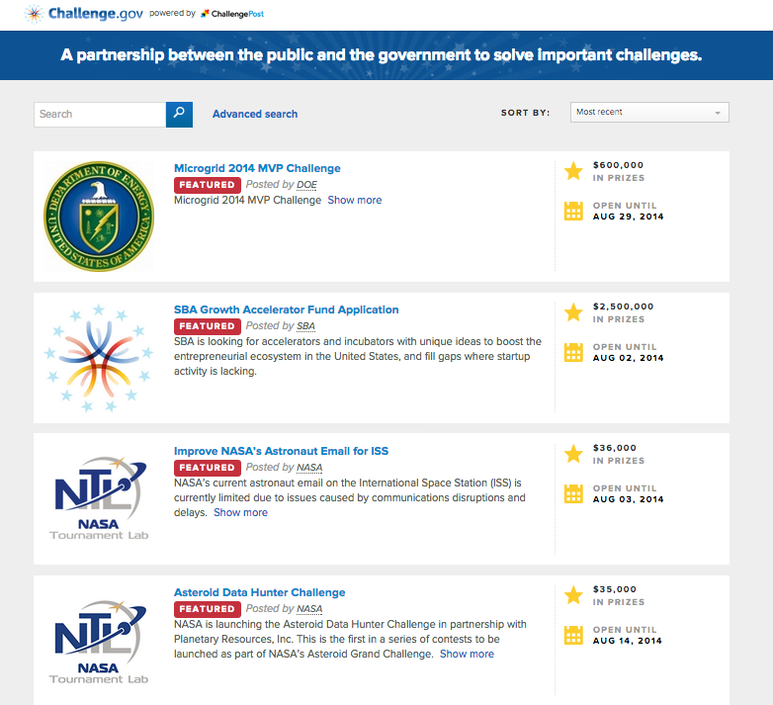
Challenge.gov shows power of collaborative innovation
$35 MM in prizes
300+ challenges in 3 years
“Pay only for results, not the hope of a desired outcome”
“Creating a more accessible government”
“transparency and collaborative environment”
“Leverage the intelligence of the American people”
Innovations in American Government award in 2013
3.6 MM visits – from every US state and ALL countries
42,000 solvers!
“Drive innovation in creative ways you could have never imagined.”
-Government users of challenge.gov
Source: challenge.gov, Challenge.gov wins award
Notes:
What government users are saying:
“transparency”
“pay only for results, not the hope of a desired outcome”
“impact”
Leverage the intelligence of the American people
Create stronger connections between our government and citizens
Engage citizens in meaningful ways
Create a collaborative environment
Make a nationwide impact
Accelerating innovation and creating a more accessible government
Start-ups being able to help the government
Drive innovation in creative ways you could have never imagined

Slide 12
HHS has taken America COMPETES seriously
CAGR 80%
CAGR 140%
[HHS has] “utilized this authority to promote and advance innovation across the agency.” – Bryan Sivak, CTO, HHS
Prize money is also on the rise with a total of $1.2 MM in prizes offered in FY 2013—a 150% increase over 2012.
Source: Implementation of Federal Prize Authority: FY 2013

Slide 13
Government Cloud Computing

Slide 14
US federal government spending on cloud computing
Key Definitions
SaaS
PaaS
IaaS
SaaS CAGR 21%
SaaS = Applications designed for end users, delivered over the web
PaaS = Set of tools and services designed to make coding and deploying those applications quick and efficient
IaaS = Hardware and software that powers it all – servers, storage, networks, operating systems
Cloud First policy – initiated in December of 2010, requires government agencies to evaluate secure cloud computing options before making new IT investments.
Sources:
Source: “Cloud First Policy: Lessons Learned from the US Government”, Frost & Sullivan. “Government Cloud Spending by US Federal Agency”, IDC Insights. “Understanding the Cloud Computing Stack”, Rackspace.

Slide 15
What is the government buying?
US Government, Top 10 Cloud Computing Primary Service Areas
FY 2012
Criminal investigation and surveillance
Social security benefits
Accounting
Continuity of operations
Enterprise architecture
Collaboration tools
Customer services
Crime prevention
Employee benefits and compensation
Healthcare administration
Note: Primary service areas are as those identified within the Federal Enterprise Architecture Business Reference Model
1) Numbers are estimated from IDC Insights report. Source: “Government Cloud Spending by US Federal Agency”, IDC Insights.

Slide 16
Case Studies

Slide 17
Overview: CMS & Minnesota provider enrollment
Problem
Medicaid programs draw more than $180 BN annually from federal budgets and are Medicaid providers must be screened. Enrollment done manually. Time consuming and error prone. Leads to 10 – 15% fraud as compared to 1 – 1.5% in private insurance States individually spend $100s MMs on 54 separate IT systems to manage Medicaid (MMIS), which are separate, redundant, and not interoperable Interoperability and automation pushed by ACA
Contest Overview
Partnership - CMS and State of Minnesota used the help of NASA’s CoECI and the TopCoder platform Challenge - Participants asked to develop a software that can be integrated into an open source solution to Reduce processing/transaction time Improve availability of key provider data Improve accuracy Align with current MITA framework Contest Type - Series of 100+ contest run between May 2012 – August 2013
Results
Modular platform created – currently piloting this solution with the state of Minnesota Faster, cheaper, more accurate provider enrollment module Incredible returns to scale - $250 MM in savings for one single MMIS module if implemented across all 50 states “product quality is outstanding, but documentation is spotty”
Source: “Evaluation of Short Innovation Contests”, Emily Calandrelli, MIT. How to Mitigate Medicare and Medicaid Provider Fraud through Crowdsourcing, Harvard NTL. An MMIS Story, Provider Enrollment Challenge, John “Chip” Garner. August 21, 2012.

Slide 18
MMIS Costly & Ineffective
2013 enhancement costs projected nationally at $4B projected for completion in 2021
100% of MMIS implementations are missing required functionality
Annual maintenance/support costs are $2.5B
Funding requests growing at 33% annually
Systemic chronic failures in systems to process transactions.
Source: CMS – The MMIS of the Future, September 2013

Slide 19
MMIS Costly & Ineffective cont’d
Each state has own MMIS implementation with 95%+ functionality identical to all other states
All implementations utilize older, antiquated and unsupported technology
Many states dependent upon employees and consultants well past retirement holding knowledge and skills not available otherwise
Source: CMS – The MMIS of the Future, September 2013

Slide 20
Significantly more cost effective way to acquire tech
Key Insights
Savings of 5X over traditional development methodologies for
technology
Faster and better solutions from the wisdom of the crowd
  topcoder helped a major pharameuetical company gain speed of 1200X on Genome Wide Association Studies shortening processing time from 10 hours to 30 seconds.
“As long as the crowd is large, you have the potential for incredible results at fractional costs” -Deloitte, Tech trends 2014ç
Notes: 1) This graph is a specific example from the CMS Provider Enrollment module built for the state of Minnesota. Source: “CMS Provider Enrollment Challenge.” Chip Garner and Anne Wood. September, 2013. “Appirio Testifies Before Congress – Crowdsourcing, Innovation and Prizes.” April, 2014. “Tech Trends 2014 Inspiring Disruption.” Deloitte University Press.

Slide 21
Cost comparison: Provider Enrollment
Agency | Cloud Service | Upstream acquisition & contract cost | Downstream contest development, prize purse | Total
CMS Prime Contractor | Costs for traditional procurement sourced from CMS¹ | $1,450,000 | $6,000,000 | $7,450,000
Contest | CMS Provider Screening Innovator Challenge | $370,000 | $1,150,000 | $1,520,000
5X Savings!
1) By Emily Calandrelli, MIT. Source: “Evaluation of Short Innovation Contests”, Emily Calandrelli, MIT.

Slide 22
Office of Personnel Management Case Study
Extensive process of re-engineering of existing midrange application software.
Time to market dramatically reduced with significant increase in quality and adherence to standards.
Established templates, processes and workforce ready for reuse.

Slide 23

America Competes
-The Flu App
On January 4, 2011, President Obama signed
into the law the America COMPETES Reauthorization Act,
granting all agencies broad authority to conduct prize competitions to spur innovation, solve tough problems, and advance their core missions.
…examples of how prizes have enabled the National Aeronautics and Space Administration (NASA), the Department of Defense (DOD), and the Department of Energy (DOE)
Establish an ambitious goal without having to predict which team or approach is most likely to succeed;
Benefit from novel approaches without bearing high levels of risk;
Reach beyond the “usual suspects” to increase the number of minds tackling
a problem;
Bring out-of-discipline perspectives to bear;
Increase cost-effectiveness to maximize the return on taxpayer dollars; and
Pay only for success. (Implementation of Federal Prize Authority: Progress Report 2012)

Slide 24
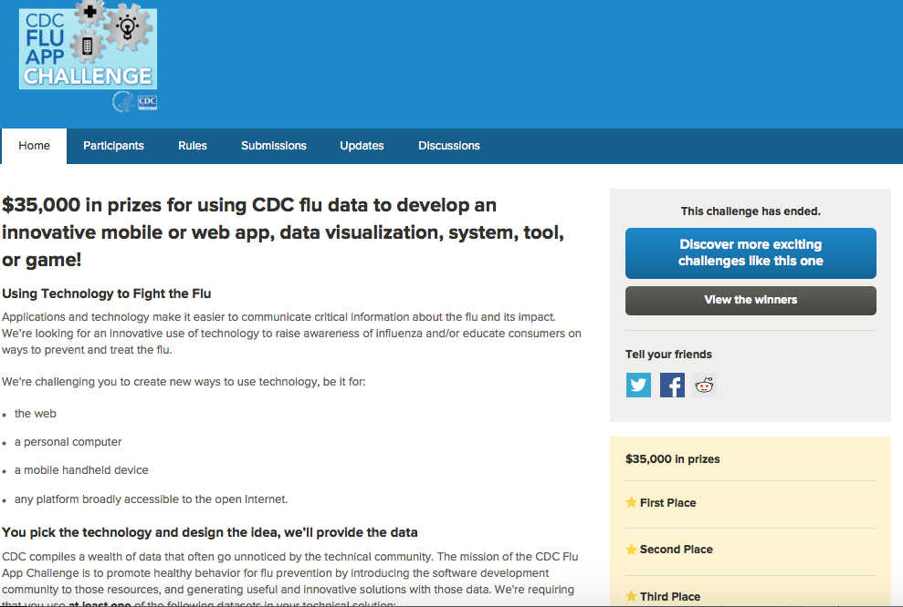
http://fluapp.challengepost.com

Slide 25
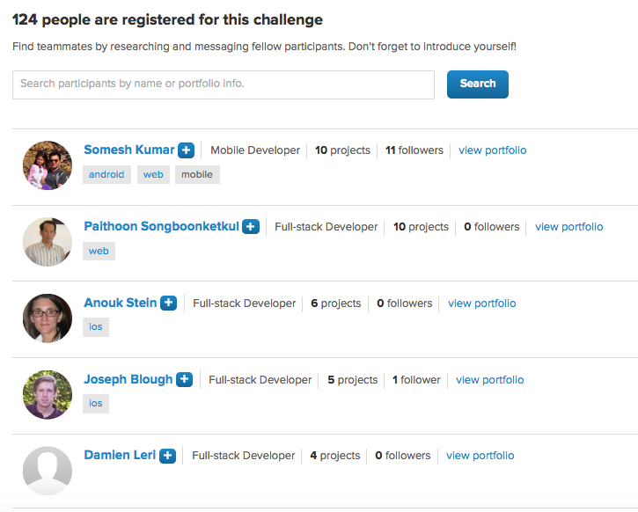
Talk about the diverse people that compete on the challenges
http://fluapp.challengepost.com

Slide 26
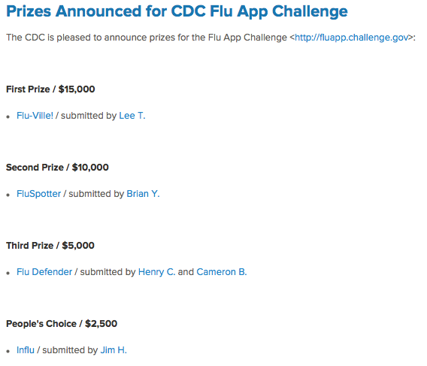
Talk about cost savings, paying only for results
http://fluapp.challengepost.com

Slide 27
Republic Systems

Slide 28
Advisory Board
This Advisory Board represents the assembly of the greatest depth of knowledge and experience in open innovation, crowdsourcing and technology platforms. Several additional members completing paperwork.
Rob Hughes, Founder and President
  Co-founder Tallan, topcoder
Jack Hughes, Cofounder
  Founder/Co-founder Tallan, topcoder, Tongal
  Chairman Christopher and Dana Reeve Foundation
Karim Lakhani, Co-Founder
  Professor Harvard Business School
  Co-founder NASA Center of Excellence in Open Innovation
Ira Heffan, Counsel
  General Counsel, topcoder
  Recognized Intellectual Property/OS Attorney

Slide 29
Business Model
Partner with government leaders in open innovation to supply SaaS and cloud based solutions to federal and state governments.
Leverage dream team of open innovation leaders to deliver extreme value solutions to the most frustrating government large scale system problems.
Directly attack the market share enjoyed by the inefficient, bloated industrial complex that has grown to serve government.
Make heavy use of open source and social platforms to synthesize light solutions that grow quickly in functionality, stability and usage.

Slide 30
Operating Plan
RSI version of open source Provider Enrollment module on multiple private clouds.
Apply new functionality from MN to OS stack. Aggressively market to all states.
Seek federal and state funding for the development of new modules.
Framework Solutions are mobile/social apps combined with existing open source and commercial apps.
Republic Systems provides resources for discovery and specification.

Slide 31
When launching the new company we will initially choose one of three technology strategies.
Implement solutions using each state’s hardware
Individual cloud virtual machines for every state
Healthforce.com web-services approach
Description: Charge states to install and service provider enrollment software in the state’s hardware. Build new software on TC platform and continue same model.
Description: Provide each state with unique portal to access customized software in cloud. Charge for development, storage, and BOP services.
Description: Start building web-services platform to host provider enrollment. Single portal for all states. One virtual machine for all data processing.
Benefits: 1) immediate revenue; 2) minimum upfront investment; 3) states are accustomed to this type of service; 4) shortest time to market
Benefits: 1) cloud storage provides cost savings to states over centralized hardware; 2) cloud data service revenue; 3) relatively short time to market
Benefits: 1) lower long-term integration costs; 2) most differentiated offering; 3) allows states data to talk with one another sooner
Disadvantages: 1) less differentiated approach compared to competitors; 2) less upside in data storage and analytics; 3) long-run more costly for states; 4) costly to move to cloud in later laters
Disadvantages: 1) cost to set-up each portal and integrate with state’s infrastructure; 2) moving to SaaS platform later will be costly
Disadvantages: 1) most costly to build; 2) longest time to market; 3) technically sophisticated; 4) new offering to states, may be a difficult sell at first

Slide 32
To implement stage 1 and execute for 5 states, we will need to start with the following technical team.
Project Manager
Business Analyst (1)
Technical Architc. (1)
Quality Control Programmer (2)
Director of Security (1)
Project Manager
Execute technical implementation plan using crowdsourcing
Manages core product and customer product
Business Analyst
One for every 5 states, responsible for documenting states enrollment requirements
Convince states portal is the way to go
Technical Architect
Design architectural plan based on strategic technical implementation plan, architectural tweaks for each state
manage crowdsourced game plans and execution
Quality Control Programmer
lead development role, responsible for setting up continuous test/integration systems with crowdsourcing
ensure final tweaks are complete and successful for each state
Director of Security
Focusing PII policies, penetration avoidance and detection, could be consulting relationship or contractor

Slide 33
Discussion points
http://m.theatlantic.com/business/archive/2014/10/why-new-ideas-fail/381275/?single_page=true
  Innovation funnel and the role of experts
http://www.mesconference.org/wp-content/uploads/2012/08/Tuesday_MMIS-Story_Garner.pdf
  Detailed review of Provider Enrollment project
http://www.mesconference.org/wp-content/uploads/2013/09/Wednesday_MMIS_allison_gorman.pdf
  The future of MMIS

Slide 34
Contact
Robert C. Hughes
Founder and President
rhughes@republicsystems.com
860.604.3469

