Slide 1
Trying to have number 1 in the formation of white background (reflecting that it is a number 1 law firm)
Z. HASHIM & CO
Advocates . Solicitors . Syariah Counsel
V e r i t a s V i n c i t O m n i a
Reflecting the letter H
(being the capital for the initia of the surname
Essence of the logo: Reflect a forward looking, dynamic and think out of the box law firm
Corporate Colour: Chilli red
Grey Colour: it is supposed to be silver
Font Type: Preferably Lydian (or any recommended font reflecting the dynamism of the firm)
Slogan: Veritas vincit Omnia = Truth Conquers All
To delete the words: Syariah Counsel. Just remain Advocates and Solicitors
Reflecting the letter G (being the initial for the nickname of the founder)

Slide 2
ZH 1
AFT 3
ZM 1
JP 2
Z. HASHIM & CO
Advocates . Solicitors . Syariah Counsel
V e r i t a s V i n c i t O m n i a

Slide 3
JP 1
NZ 1
Z. HASHIM & CO
Advocates . Solicitors . Syariah Counsel
V e r i t a s V i n c i t O m n i a

Slide 4
Z. HASHIM & CO
Advocates . Solicitors . Syariah Counsel
V e r i t a s V i n c i t O m n i a

Slide 5
Z. HASHIM & CO
Advocates . Solicitors . Syariah Counsel
V e r i t a s V i n c i t O m n i a

Slide 6

AFT 2
ZM 2

Slide 7
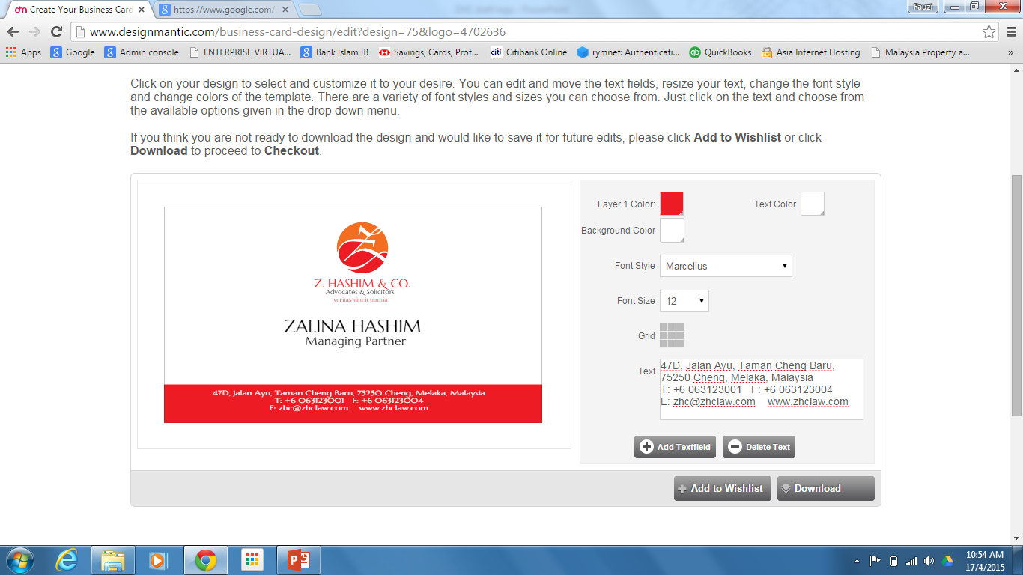
Intan 3
NZ 3

Slide 8

Intan 1
NZ 2
JP 3
Z. HASHIM & CO
Advocates . Solicitors . Syariah Counsel
V e r i t a s V i n c i t O m n i a

Slide 9

AFT 1

Slide 10
ZM 3
Z H C
Z. HASHIM & CO
Advocates . Solicitors . Syariah Counsel
V e r i t a s V i n c i t O m n i a

Slide 11
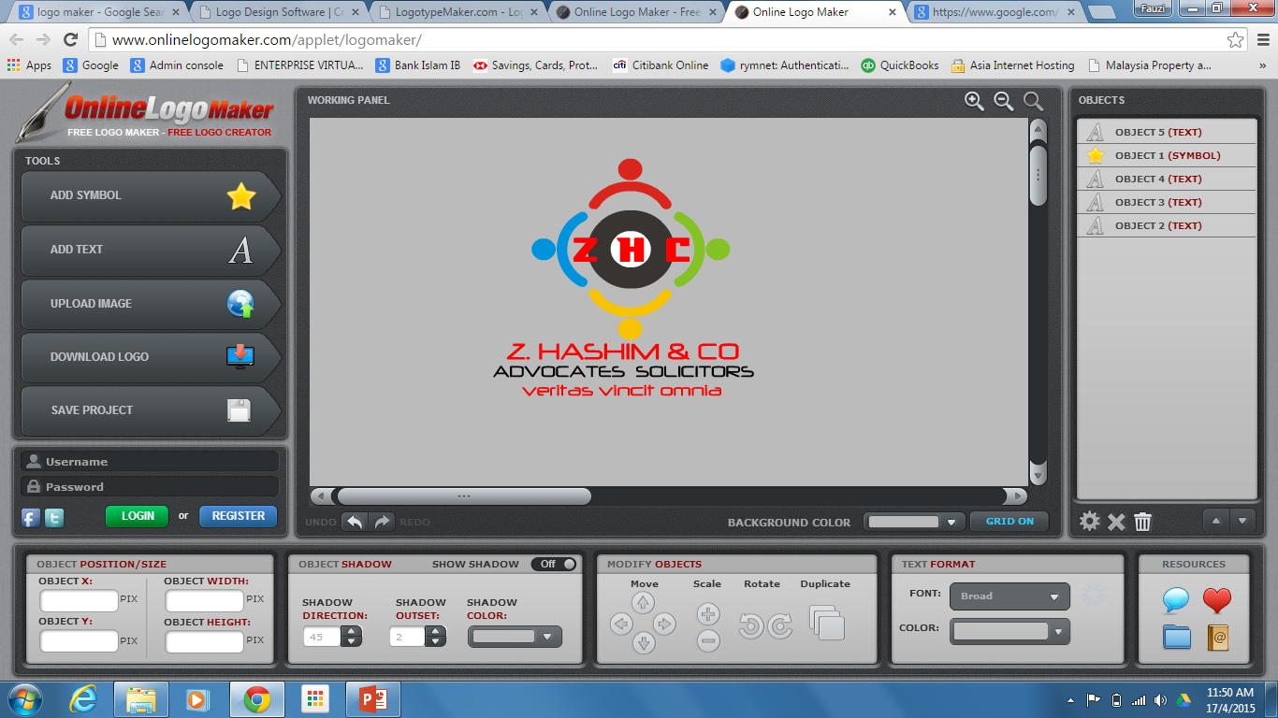
Intan 2

Slide 12
Z. HASHIM & CO
Advocates . Solicitors . Syariah Counsel
V e r i t a s V i n c i t O m n i a

Slide 13
Z H C
Z. HASHIM & CO
Advocates . Solicitors . Syariah Counsel
V e r i t a s V i n c i t O m n i a

Slide 14
Z
Z. HASHIM & CO
Advocates . Solicitors . Syariah Counsel
V e r i t a s V i n c i t O m n i a

Slide 15
Z
Z. HASHIM & CO
Advocates . Solicitors . Syariah Counsel
V e r i t a s V i n c i t O m n i a

Slide 16
Z
Z. HASHIM & CO
Advocates . Solicitors . Syariah Counsel
V e r i t a s V i n c i t O m n i a

Slide 17
Z
Z. HASHIM & CO
Advocates . Solicitors . Syariah Counsel
V e r i t a s V i n c i t O m n i a

Slide 18
Z
Z. HASHIM & CO
Advocates . Solicitors . Syariah Counsel
V e r i t a s V i n c i t O m n i a

Slide 19
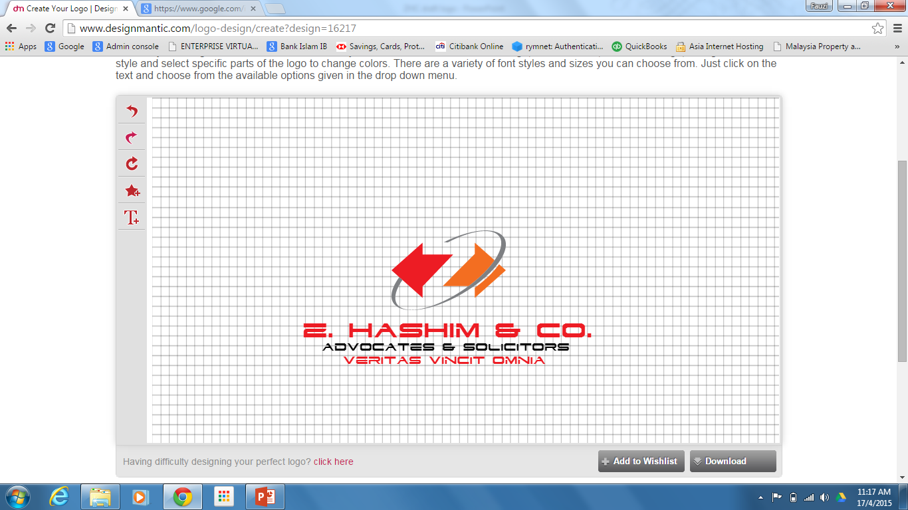

Slide 20
