Slide 1


Slide 2
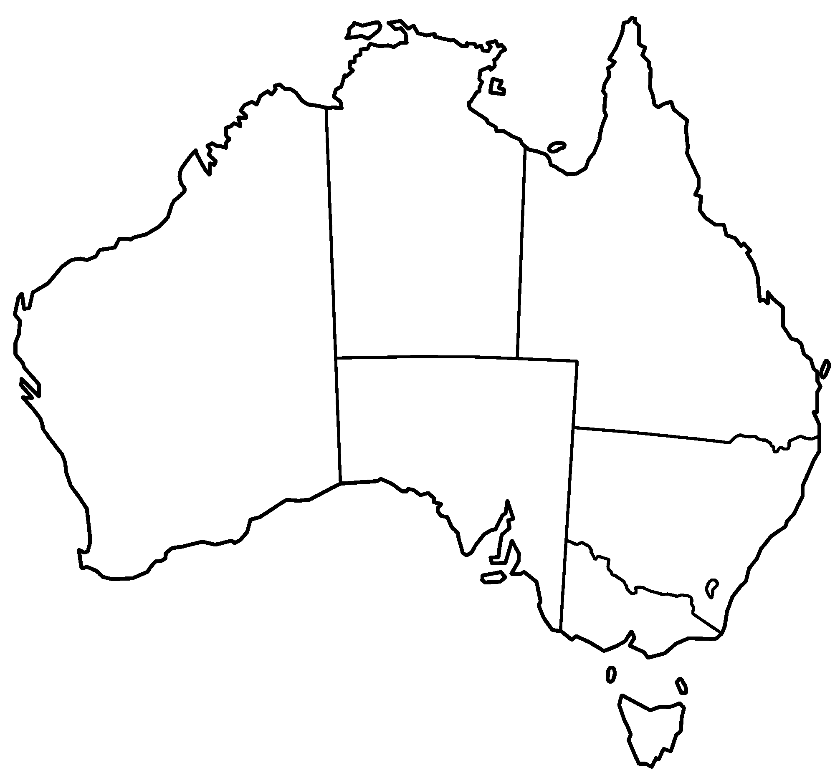

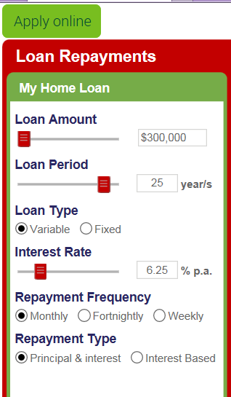
Front page Option 1
50 Days 10 Mins
Remaining
Look like a counter
Team NT $50,000,000.00
9560 People registered
Team QLD $200,000,000.00
9560 People registered
Team Australia $900,000,000.00
9560 People registered
Team WA $300,000,000.00
9560 People registered
Team NSW $500,000,000.00
9560 People registered
Click on each team to break down into regional teams
Team ACT $20,000,000.00
9560 People registered
Team SA $10,000,000.00
9560 People registered
Register Interest located somewhere
Team TAS $5,000,000.00
9560 People registered

Slide 3

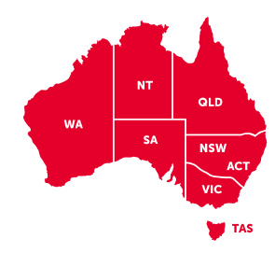
Front page
Option 2
Register Interest
Team NSW $200,000,000.00
9560 People registered
Team QLD $200,000,000.00
9560 People registered
Team WA $200,000,000.00
9560 People registered
Team SA $200,000,000.00
9560 People registered
Team VIC $200,000,000.00
9560 People registered
Team NRL $200,000,000.00
9560 People registered
Team NT $200,000,000.00
9560 People registered
Team TAS $200,000,000.00
9560 People registered
Team AFL $200,000,000.00
9560 People registered

Slide 4
Click on Each state team to Break down separate page.
Team NSW $10,000,000.00
9560 People registered
Team Newcastle $10,000,000.00
9560 People registered
Team Hunter Valley $10,000,000.00
9560 People registered
Team Sydney $10,000,000.00
9560 People registered
Team West $10,000,000.00
9560 People registered
Team North Coast $10,000,000.00
9560 People registered
Team South Coast $10,000,000.00
9560 People registered

Slide 5
Break down NRL Vs AFL offer free sponsorship to both on website
Teams could do joint promo with sponsors for the sponsors clients and employees. Allow major sponsor for free on page.
Team NRL $10,000,000.00
9560 People registered
Team Newcastle Knights $10,000,000.00
9560 People registered
Team Broncos $10,000,000.00
9560 People registered
Team Rooster $10,000,000.00
9560 People registered
Team West Tigers $10,000,000.00
9560 People registered
Team Melb Storm $10,000,000.00
9560 People registered
Team Rabbitohs $10,000,000.00
9560 People registered

Slide 6
Register Interest
Each page to have a register interest tab
Name
Email or text *
Loan amount *
Equity amount *
Residential or business selector tab
Fixed or variable tab
Postcode *
Current rate
Current financial institution *
* indicates must enter

Slide 7
Potential SLOGANS
WHICH TEAM ARE YOU ON?
SAVINGS THROUGH TEAMWORK!
BE APART OF THE TEAM!
DON’T BE LEFT ON THE SIDELINE!
WERE ACHIEVING GREAT RESULTS BY BRINGING GREAT PEOPLE TOGETHER!

