Slide 1
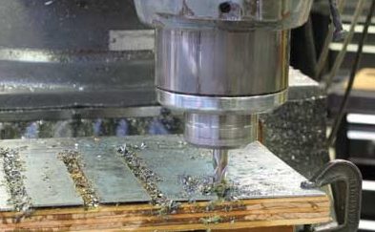
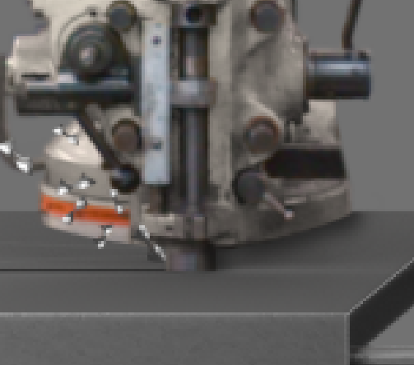
The yellow box should look like the blue box. The bit should be visible, and is much smaller than the column above.

