Slide 1
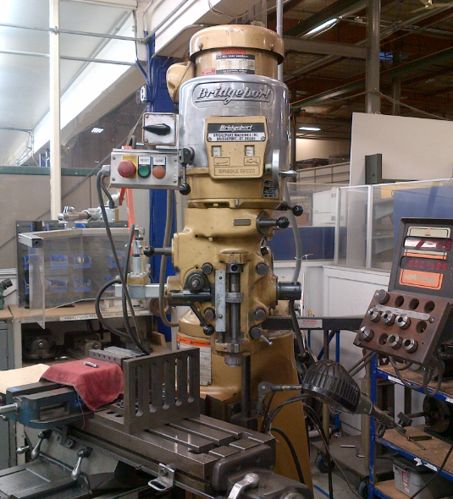
Delete Machine Guard
X
Mill Bit
X
& Chips Flying off here
Delete Wires

Slide 2
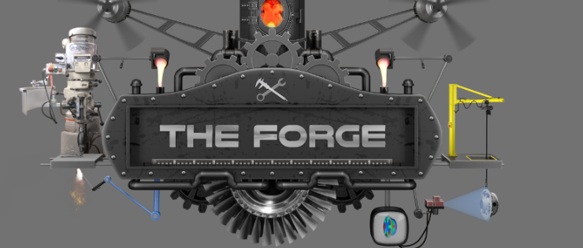


Try to keep the finished mill at about the same height as the top of the crane. I would like to keep separation from the arm of the molten metal arm.
I swear this wheel is still a slightest bit off-center still. Can you bump a little to the right?
Great shape, but please darken the color of the blue arm.
Please make the blue more intense at the projector (as shown above) with a fade to the part if possible. Also, the projector should be a richer red.

