Slide 1
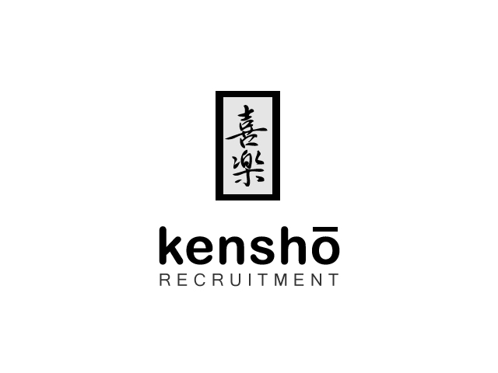
Concept & Web brief

Slide 2
Tagline
‘Seeing ones true nature’
or
‘See through one true nature’
Or something else that responds to this.

Slide 3
Brand story
Kenshō (見性) is a Japanese term from the Zen tradition.
ken means "seeing,"
shō means "nature, essence".
Kenshō is an initial insight or awakening, to be followed by further training to deepen this insight, and learn to express it in daily life.
The term kenshō is often used interchangeably with satori, which is derived from the verb satoru,^{[9]} and means "comprehension; understanding".

Slide 4
Chinese Buddhist terminology
The Chinese Buddhist term jianxing:
jian 見 "see, observe, meet with, perceive";
xing 性 "(inborn) nature, character, personality, disposition, property, quality, gender".

Slide 5
Buddhist Monk Sanskrit-Chinese
Buddhist monks who produced Sanskrit-Chinese translations of sutras faced many linguistic difficulties:
They chose Chinese jian 見 to translate Sanskrit dṛś दृश् "see, look", and the central Buddhist idea of dṛṣṭi दृष्टि "view, seeing (also with the mind's eye), wisdom, false view".
Translators used xing 性 or zixing 自性 "self-nature" for Sanskrit svabhāva स्वभाव "intrinsic nature, essential nature".
Thus, jianxing was the translation for dṛṣṭi-svabhāva, "view one's essential nature".
The (c. 8th century) Chinese Platform Sutra (2, Prajñā "wisdom, understanding") first records jianxing.

Slide 6
What we do?
What makes us unique?
We do recruitment based on ones belongings and purpose in life. Finding that purpose in life, and just aligning ones values to correspond with the company one wishes to apply. Our branding is guided by genuinely, trustworthy, helping one another and making the world a better place to be in!

Slide 7
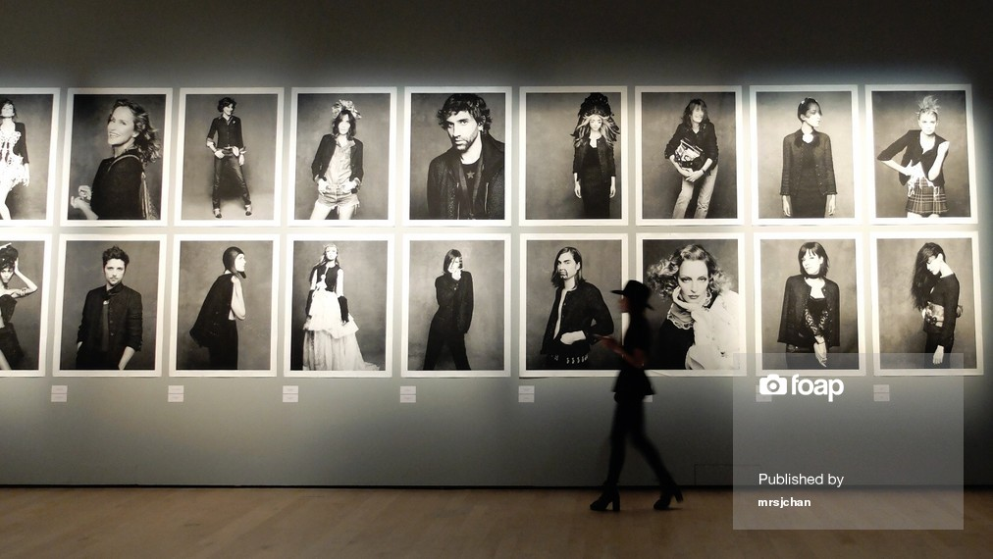
This photo we love for headline.
(maybe a girl walking needs to be removed)
Why: next slide

Slide 8
Why we love that slide
We love the slide, since majority of our time we are wearing masks, especially when in our working premises, when our heart beats for something else. We want to reveal our self, our true nature, remove the mask and be whoever best we may be in this life!
Are we rebel, yes.
We are not promoting here complete soul freedom, and going at Tibet for the rest of the life praying – no.
What we want to achieve is giving one chance in life to be themselves, than is when we perform the most and companies work force that will be guided by the self-competition, team work, genuine hearts and top performers. The perfect match, based on Kensho TM methodology of work and human capital selection.

Slide 9
Quotes in squares
KENSHO RECRUITMENT ®
Inspired by the purpose in life and seeing through one true human nature. Let by community of enthusiastic recruiters and life experts that have the desire to share their passion and help you become the best version of who you may be in this life. Driven by belief that all of have that special talent that the world needs!

Slide 10
Branding & Creative Guidance Points
Needs to be clean and easy to navigate
Preferably black, white and/or gray
Needs to represent group/umbrella
Serious, reliable and professional
Applicable/Convertable design to tablets, phones and androids
Please do not use pictures like the rest of the globally existing recruitment companies, its useless for our concept ☺

Slide 11
Web structure
Web structure
Specialist Areas
Home
Team
Clients
Kensho group
Methodology
Candidates

Slide 12
Web for inspiration
http://www.phaidoninternational.com/careers/entry-level-careers/meet-the-team/
http://www.artifactuprising.com/paper/
http://marieforleo.com

