Slide 1
Slovenian Convention Bureau
Brand Value Proposition

Slide 2
SoolNua and the
Slovenian Convention Bureau
Project 1
Brand Value proposition
Devise a new strategic brand value proposition model based on key pillars / messages
Take the Energy Drink as the hook and develop BVP around 5 “human factor” characteristics:
  Slovenian Energy
  Team Flexibility
  24h Smile
  Personal Touch
  Natural Charm
Deadline: End of March 2015

Slide 3
Introduction
The Slovenian Convention Bureau is a member based organisation whose role it is to market Slovenia as a destination for meetings, incentives, conferences and events.
It is funded partially by Spirit Slovenia (the Public Agency of the Republic of Slovenia for the Promotion of Entrepreneurship, Innovation, Development, Investment and Tourism) and by members’ annuals fees and contributions
The Slovenian Convention Bureau sits under the “I feel Slovenia” brand, is imbued with its mission, vision and values and informed by its brand value proposition

Slide 4
Using “I Feel Slovenia”
“Synergies are achieved in the area of development and implementation of the I FEEL SLOVENIA national trademark and the use of this trademark in individual activities in the agency.
The national trademark is the strongest market tool of modern countries in individual areas – also for economy, technological development and tourism - therefore, SPIRIT Slovenia is acting in the direction of the development and implementation of the national trademark in all areas with consistent use for various activities and tools.
This will lead to a more efficient and uniform presentation of Slovenia and its economy abroad in the direction of building the recognition of Slovenia, Slovenian companies and other organisations in foreign markets as globally competitive, quality and reliable development partners”.
SPIRIT Slovenia, the Public Agency of the Republic of Slovenia for the Promotion of Entrepreneurship, Innovation, Development, Investment and Tourism

Slide 5
Key Elements of the Master Brand
I Feel Slovenia
  The Core of the Brand
    In Slovenia, green represents more than just a colour
    it is Slovenian green, expressing the balance between the calmness of nature and the diligence of Slovenians
    It speaks of unspoilt nature and our focus to preserve nature as such
    The Slovenian green also shows our orientation to the elementary, to what we feel inside
    Our vision is clear. We are committed to preserving Slovenia’s boutique green offering and to growing this through organic development.

Slide 6
Key Elements of the Master Brand
I Feel Slovenia
  Other Colours
    Apart from green, characteristic Slovenian colours are also blue and white.
    They are connected to nature too. Both symbolise peace of mind and purity of form, while white stands for authenticity, which is at the heart of the Slovenia Brand.

Slide 7
Key Words
ORGANIC DEVELOPMENT
UNSPOILT NATURE
AUTHENTICITY
CALMNESS OF NATURE
DILIGENCE of SLOVENIANS
PEACE OF MIND
PURITY OF FORM
PRESERVE NATURE
NATURE
BOUTIQUE
EMOTIONS

Slide 8
the Slovenia Convention Bureau towards a brand value proposition
As a nation brand, Slovenia portrays itself as a oasis of peace and calm, closely connected to nature and to values like diligence and authenticity.
The tone of voice is modest and humble – this is not a country to hog the limelight, beat its own drum or make extravagant claims about itself.
And yet there’s strong innate self-assurance at the heart of Brand Slovenia, an awareness of the beauty of its landscape, the quality of its food and wine, the variety of experiences available etc.
The brand value proposition of the Slovenian Convention Bureau must fit within these parameters

Slide 9
the Slovenia Convention Bureau towards a brand value proposition
The Slovenian Convention Bureau is targeting a very specific, defined market, the so-called MICE sector. While this market is far from homogeneous , it does have the following common characteristics:
B2B
Clients are seeking a business outcome or pursuing a business objective
Decisions on destination choice for MICE are made around set criteria – access, infrastructure, value, safety, experience, appeal
Channels to market are known and very specific
Clients often travel to escape from the familiar

Slide 10
Fitting it all together
SPIRITSlovenia | Slovenian Convention Bureau | MICE Market
Nature | Natural Charm | Need to escape
Oasis of Peace and Calm | Slovenian Energy | With you all the way
Diligence | 24h Smile Team Flexibility | Professionalism
Authenticity | Personal Touch | Desire for authenticity
Feel the business opportunities
Taste the fresh ideas

Slide 11
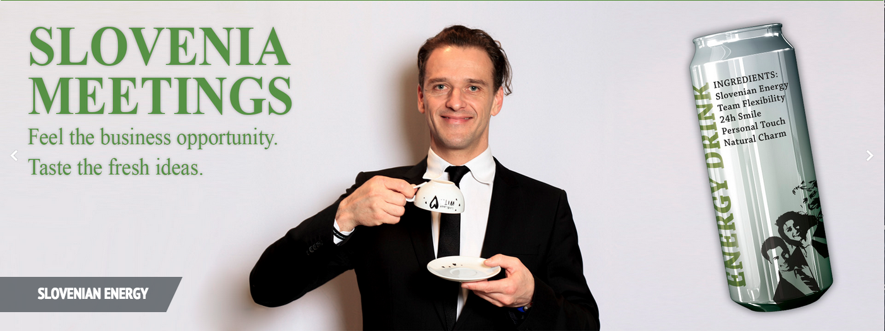
Slovenian Energy
Slovenian Energy is different.
It’s naturally laid back. Relaxed. Calm.
Not all sparkly on the outside but then running quickly out of fizz.
It’s slow release, enduring, in it for the long haul.
Slovenia energy is there when you need creative input in planning your event. And it’s there throughout the event journey, right until the end when your attendees give you a standing ovation for a job well done. With you all the way.

Slide 12
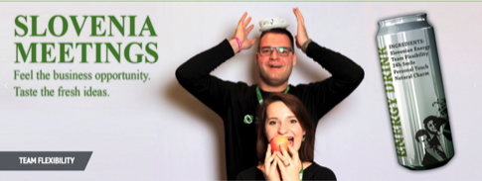
Team Flexibility
Meetings and events come in all shapes and sizes. There’s no such thing as “one size fits all”. That’s why you need a destination partner with “flexibility” etched into their DNA. It comes naturally to us in Slovenia, we’re born with it. That’s professionalism, Slovenia-style!

Slide 13
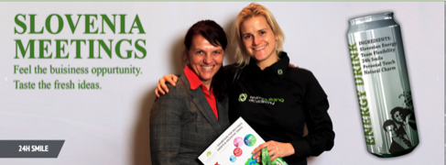
24h Smile
Working in meetings and events is full on. It’s much more 24 7 and a lot less 9 to 5. It’s requires a yes-we-can attitude, an ability to run with the punches and, of course, a 24 hour smile. That’s professionalism, Slovenian-style!

Slide 14
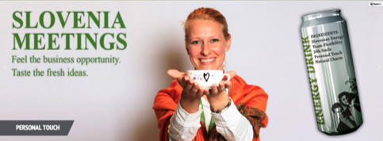
Personal Touch
The big advantage of being small is that you can focus on the little things. The details. The personal touches that make your meeting really matter. That make it real. Authentic. And isn’t authenticity what every meeting and event planner wants these days?

Slide 15

Natural Charm
Digital technology has swept like a tsunami across the meetings and events industry. All the old paradigms have been washed away and new, exciting horizons have opened. But sometimes it’s all too much. We need to escape. Go back to first principles. To nature. To the natural charm of simple, face to face meetings.

Slide 16
IMEX Communication Plan
SoolNua suggests that 5 communications be sent in advance of IMEX utilising the text developed here as par of the wider brand value proposition with the addition of a specific call to action:
  “Come and see us at IMEX Frankfurt at CXXX” [insert booth number]
This ensures perfect tie-in with existing on-line platform as well as showcasing the new language for the brand value proposition
The invitation should be in HTML format and should feature the panel / image from the slider with the text underneath it as per the rough mock-ups that follow

Slide 17

Slovenian Energy is different.
It’s naturally laid back. Relaxed. Calm.
Not all sparkly on the outside but then running quickly out of fizz.
It’s slow release, enduring, in it for the long haul.
Slovenia energy is there when you need creative input in planning your event. And it’s there throughout the event journey, right until the end when your attendees give you a standing ovation for a job well done. We’re with you all the way.
Come and see us at IMEX at CXXX …

Slide 18
Team Flexibility
Meetings and events come in all shapes and sizes.
There’s no such thing as “one size fits all”.
That’s why you need a destination partner with “flexibility” etched into their DNA. It comes naturally to us in Slovenia, we’re born with it.
That’s professionalism, Slovenia-style!
Come and see us at IMEX at CXXX

Slide 19
24h Smile
Working in meetings and events is full on.
It’s much more 24 7 and a lot less 9 to 5.
It’s requires a yes-we-can attitude, an ability to run with the punches and, of course, a 24 hour smile.
That’s professionalism, Slovenian-style!
Come and see us at IMEX at CXXX

Slide 20
Personal Touch
The big advantage of being small is that you can focus on the little things.
The details.
The personal touches that make your meeting really matter.
That make it real. Authentic.
And isn’t authenticity what every meeting and event planner wants these days?
Come and see us at IMEX at CXXX

Slide 21
Natural Charm
Digital technology has swept like a tsunami across the meetings and events industry.
All the old paradigms have been washed away and new, exciting horizons have opened.
But sometimes it’s all too much. We need to escape. Go back to first principles. To nature. To the natural charm of simple, face to face meetings.
Come and see us at IMEX at CXXX

Slide 22


