Slide 1

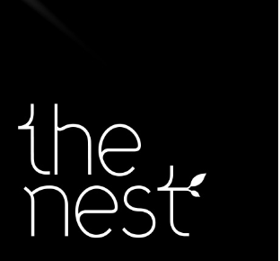

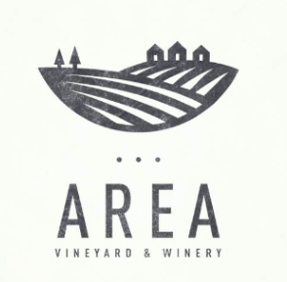


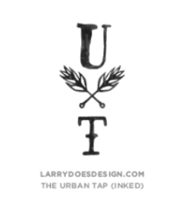
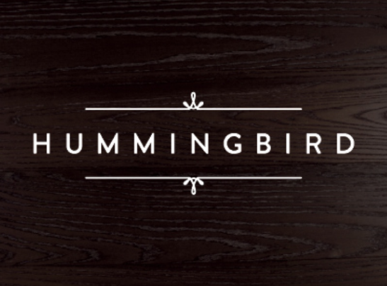

Logo Deck- Hauted
We like the little love heart idea and the one letter in a different colour idea – dislike the font and the caps and look and feel of these!
We love this! the softness of this and the creative typography like the little love heart idea. The white on black looks great and think it would equally good the other way around. We love this! Simple, sophisticated and soft.
We love the texture of this. Typography with texture. We also quite like the softness of the grey and the little dots at the top are a good concept
We love the fullstop idea. And the little letters. Again sophisticated, simple and soft.
We love the raw texture of this with the little ink spots and the feather concept.
We love the raw handwritten type feel of this as well as the grey/ not quite black. Typography with texture.
We love the little detail at the top and bottom. And the texturized background. Don’t really like the capital letters
We like the two different colour idea of this. We hate the font!

Slide 2
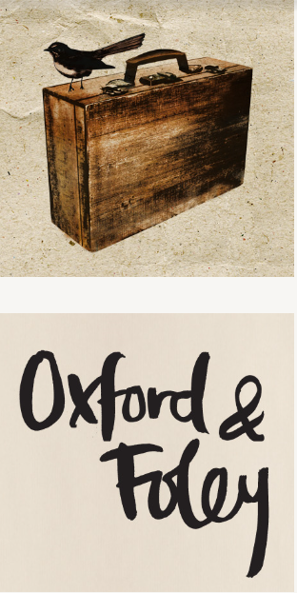


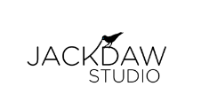
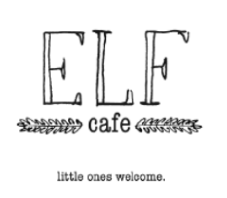
We love the paper background. Is unique and artistic and cute without being ridiculous. Creative and innovative.
Simple and nice we like the grey too.
Nice font. Unsure about the capital letters for us though.
We have no idea why we like this one. Messy kind of writing. Quite like the cream background.
Creative and simple little picture connected. We like!
Handwritten typography. Looks like someone did this with a pen. Cool. We also like the little subtext at the bottom!

