Slide 1


Slide 2


Mission
To offer integrated solutions for medium and low speed processes, with high technological and quality levels.
To research & develop innovative solutions that integrate leading-edge Italian competence and expertise in every component of the line.
History & Values
Specialists who have been working together in the field for over 20 years, with countless installations worldwide: ESN represents the maximum expression of the experience and competence of its personnel.
Specialized companies, renown for the excellent quality of their products cooperate to provide customers with integrated solutions, in minimum space requirements and with maximum flexibility.
What we do
Our goal is provide the turnkey solution most suited to the specific application.
We are a committed team and will work in close collaboration with customer personnel responsible for project review, bringing high-level professionalism and competence to each phase of project engineering, from the feasibility analysis to project implementation, during commissioning and start-up, right up to production and beyond, providing full 360° customer service support.
Market Segment
Home & Personal care
Chemicals
Foods
Beverages
Alcohol & wineries

Slide 3
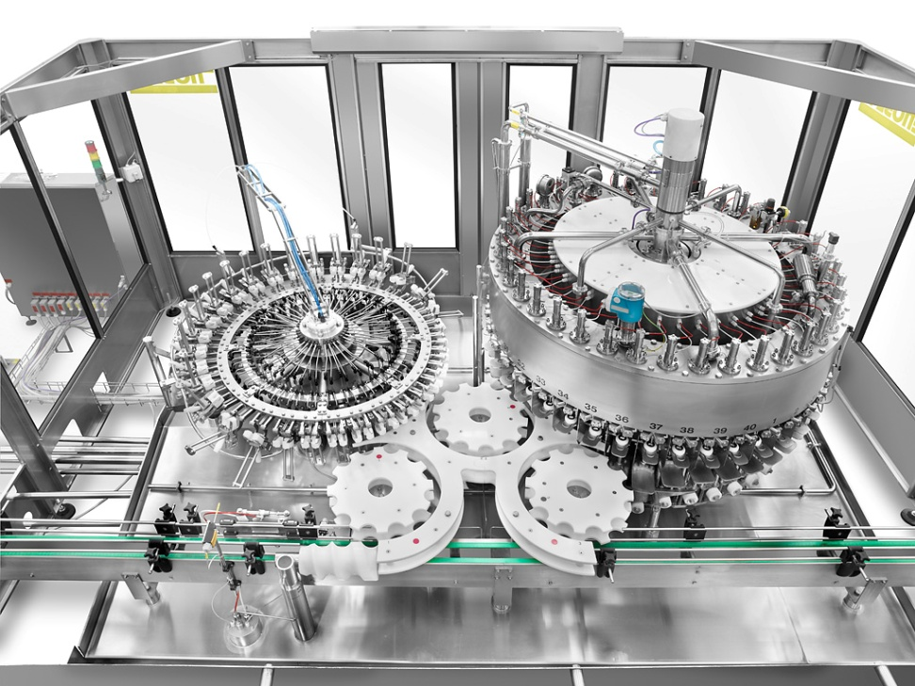
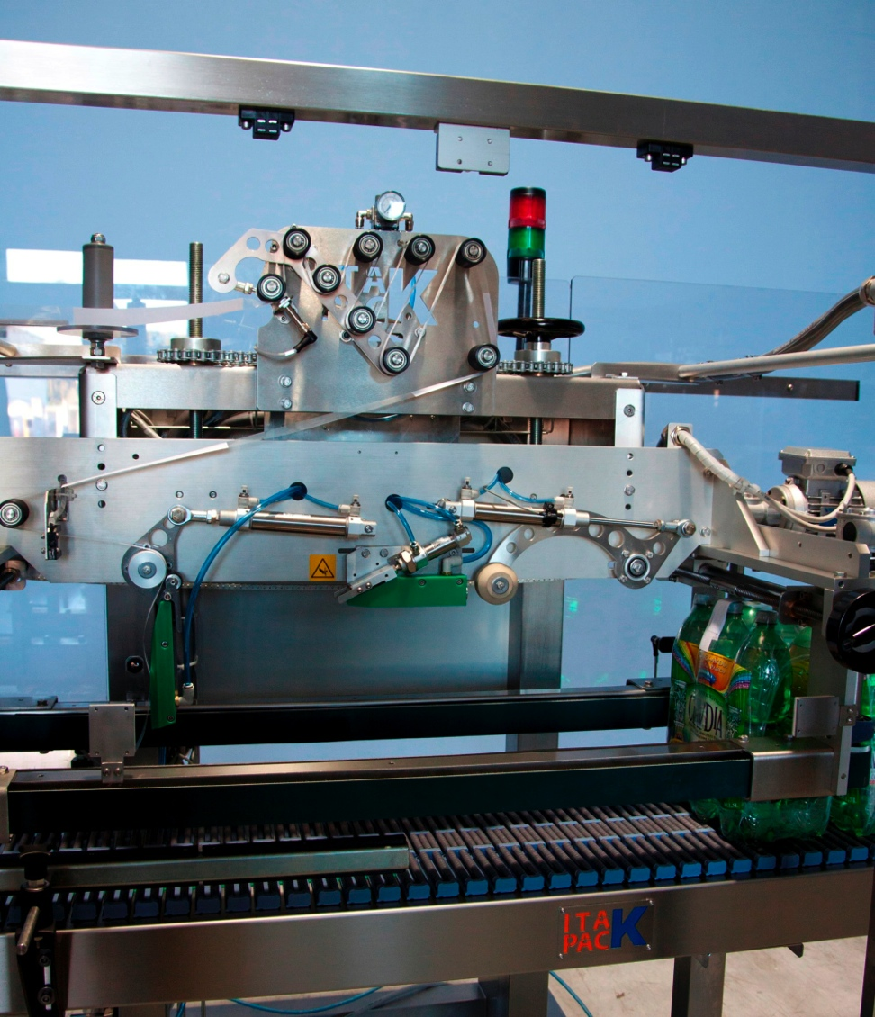
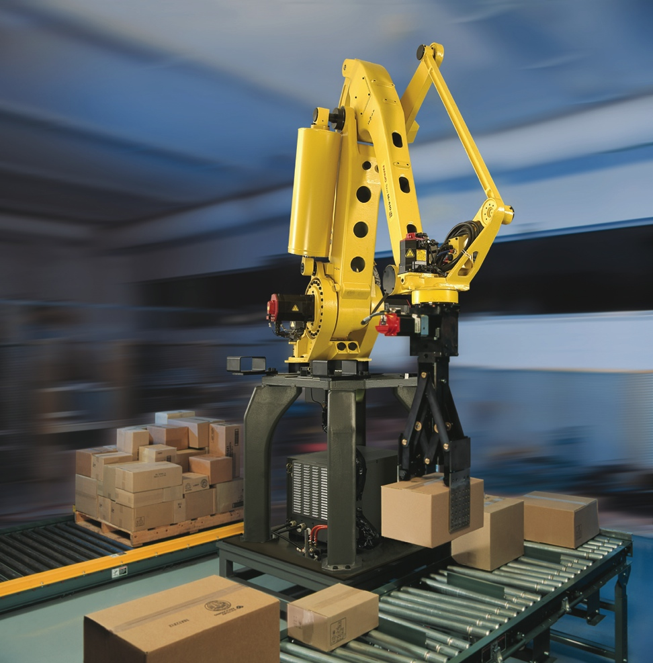
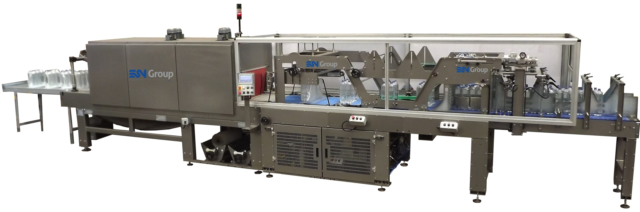
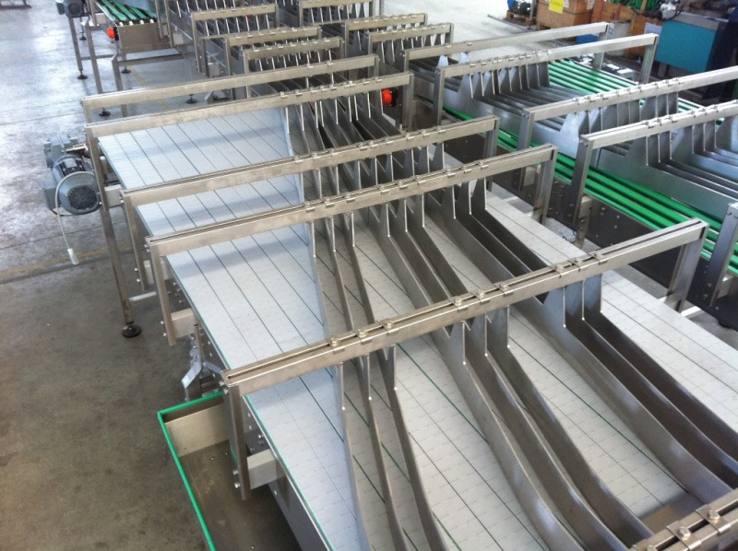
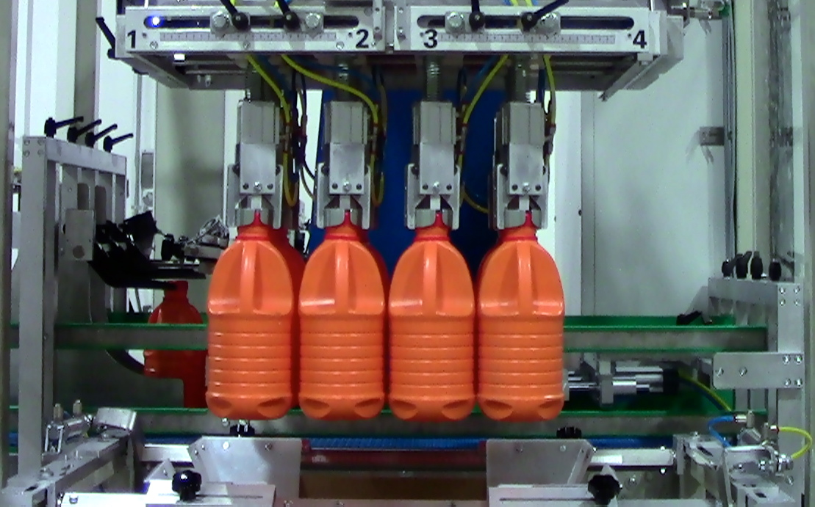
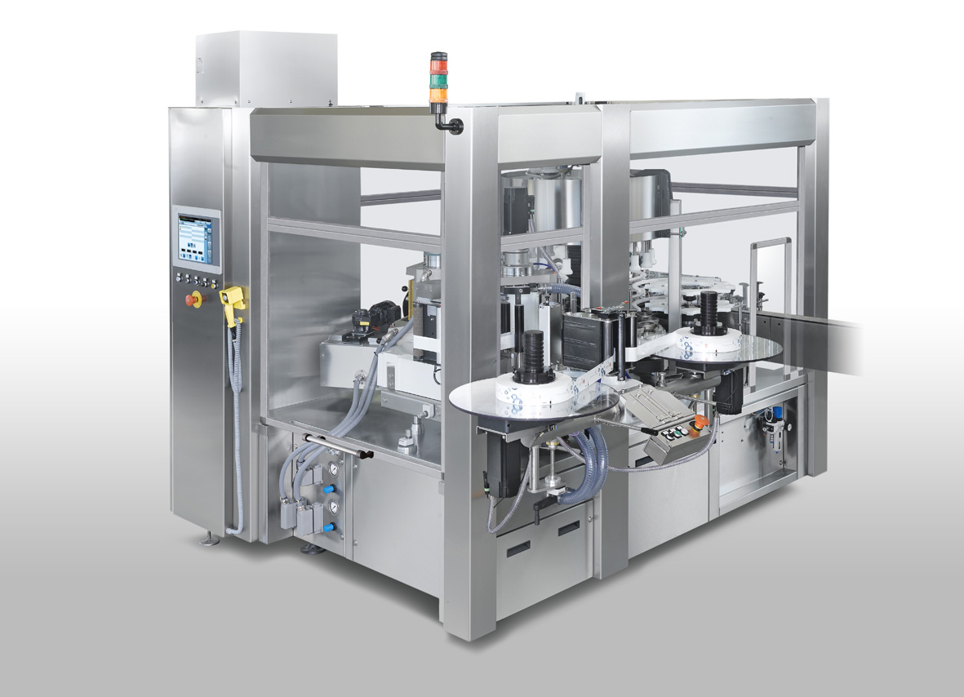
Equipment
The engineering of our equipment are driven by:
Quality
Reliability
Modularity
Semplicity

Slide 4
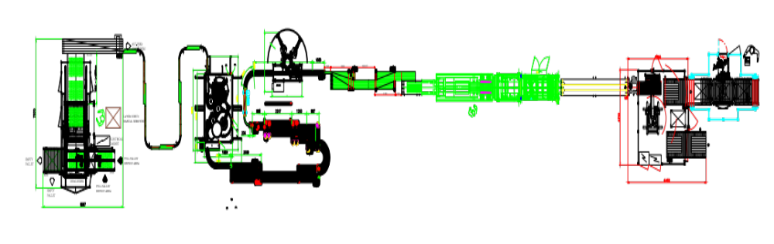
Integrated Solutions
The market presents us with a series of demands that are notoriously more frequent than others. Precisely in order to meet these market needs, ESN has standardized production, permitting us to:
Reduce our lead time
Improve the quality of global supply
Reduce the cost of the investment for our customers

Slide 5
Engineering
Our team will work closely with customer operations people, providing the highest professionalism and competence, from the feasibility analysis up to the final project definition.
Our network of specialized engineers, with a solid experience and expert knowledge of each specific machine, is at your disposal to provide all the assistance you may require and meet your specific needs.
Project Analysis
Project Definition & Planning
Project Commissioning, Start up & Performance Test
Project Implementation

Slide 6

We offer all our knowledge and expertise in order to improve line performance.
Customer Service
Spare parts & Upgrades
Immediate availability
Efficient logistics
Stock optimization
Training
Training is a part of the project, allowing for improved efficiency and cost savings during production. Line stoppages, be they for minutes or for hours, are often simply due to elementary issues or to inadequate operator training.
ESN dedicates time and energy to preparing training for customer personnel, to familiarize operators with the line and ensure safe and efficient line management and operation.
Maintenance Programs
We provide full preventive maintenance programs, based on specific customer needs and requirements and on the type of line installed. We offer annual contracts or multi-year maintenance
ESN- Engineering Service Network s.r.l.
Via Vincenzo Monti, 15 – 20123 Milano
P.IVA/CF: 08459710961
___________________________________
Phone: +39 0287198356
Email: info@esngroup.eu
WEB: +39 345.8056998
ESN Group Polska s.c.
Fabryczna 14 26-670 Pionki
___________________________________
Phone: xxxxxxxxxx
Email: biuro@esngroup.eu
WEB: http://www.esngroup.eu/pl/

