Slide 1
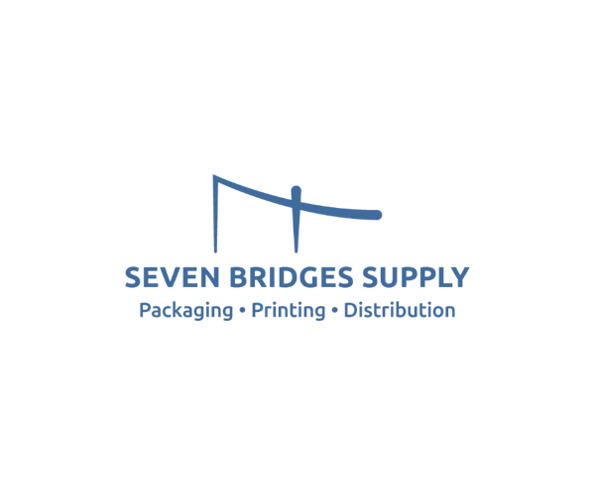
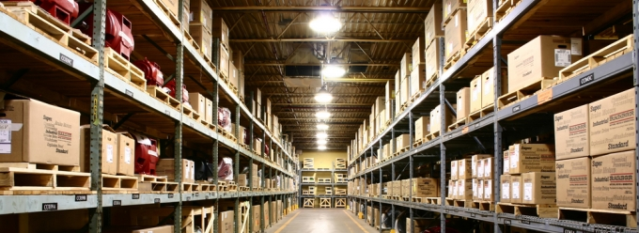

Time spent on procurement is time that could be better spent growing your business.
Seven Bridges Supply is your Single Source Solution partner for everything you need to operate your business. From general supplies to packaging and retail support including full-service flexographic printing, Seven Bridges can meet your demands while reducing costs and improving efficiency every day.
We understand your procurement challenges.
Have you experienced any of these issues with your current supplier?
Are you managing purchases with multiple vendors across multiple locations, departments or business units?
Would you like to lower your indirect supply spend across multiple categories and suppliers?
Would you like to consolidate your indirect supply purchases on one time-saving order platform?
Would you like to prevent spending abuse?
Frequent backorders or lack of sufficient inventory
Billing Errors
Long Lead Times
High Minimum order amounts
Inability to source correct products
Simply taking your orders without adding value or offering better solutions
Difficulty in ordering process
Poor Customer Service
Inability to deliver product when and where needed.
Inflexibility
How can Seven Bridges help?
Sourcing and Procurement Support
  Let us manage your suppliers while you manage your business, saving money and time
Warehousing and Fulfillment
  Our distribution centers allow us to efficiently manage fulfillment and delivery of supplies
Inventory Management
  We allow our customers to remain competitive while avoiding overstocks and shortages
Specialty Printing
  SQF certified manufacturer of plain and printed labels up to 8-colors
Integrated IT Order Management
  Customer-specific reporting and web ordering allow you to conduct business at your convenience
Packaging
  From common corrugated to specialized, custom product packaging
8500 Baycenter Road, Suite 18 Jacksonville, FL 32256 Phone (904) 730 - 9966

Slide 2

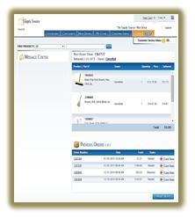
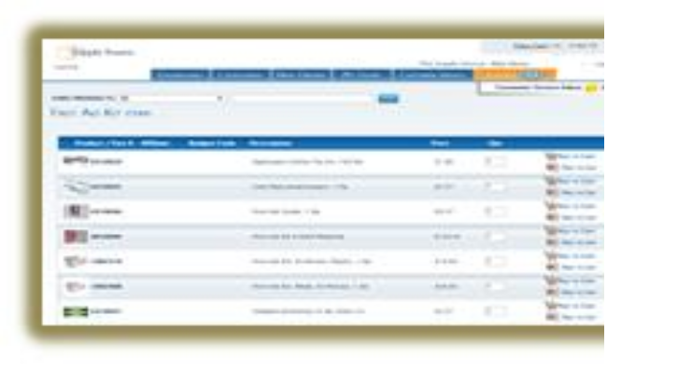


WEB PLATFORM DESIGN
User-friendly storefront Web interface
Each user has their own User ID and password
Purchases are mapped to the particular
User/ Department
Dashboard allows User to quickly review most
current order and previous orders.
Communicate messages to users via the
website.
Chat with TSS Customer Support regarding
your orders
What can our Web platform do for you?
Better supply chain performance and value with Seven Bridges Supply
Make purchasing easier
Control your spend and improve cash flow
Prevent spending abuse
Identify trends and patterns
Gain purchasing efficiencies with real-time order tracking
Manage multiple business units or locations with ease
▪ Cost Reduction on Direct and Indirect spend.
▪ Strategic Sourcing - access to our network of suppliers for specialty items unique to your industry
▪ Seamless ordering of large quantity Items without inventory holding costs, reducing working capital and preventing overstocking and supply shortage
▪ Better Management, Control, and purchasing analysis
▪ Ease of ordering through proprietary online ordering system (Web View), FTP, file transfer and EDI
CONSOLIDATE: WE ALSO OFFER FULL SERVICE IN-HOUSE FLEXOGRAPHIC PRINTING
Up to 8 colors
Paper, Synthetic Label, Tags,
BOPP, +Others
Fully Integrated, SQF Certified Flexographic Printing
Partnerships with 2,000 world
class suppliers
8500 Baycenter Road, Suite 18 Jacksonville, FL 32256 Phone (904) 730 - 9966

