Slide 1
Web-Site Design Overview
Introduction
The purpose of the phase 1 iter8ltd.com web-site is to provide a short overview of iter8. The web-site will be developed in 2 phases.
1. Phase 1 (this phase) - We are starting up the business, and need an initial on-line presence to demonstrate credentials whilst we hire resources and recruit partners.
2. Phase 2 – A full web-site structure.
Phase 1 Overview
Single page design.
Navigation bar at the top of the page.
No cookies (phase 1 design)
Good example of preferred web page design:
www.hydro66.com
https://nest.com/thermostat/life-with-nest-thermostat/
http://www.garrisontechnology.com
Clear sections on page as structured in following slide.
Image use must be royalty free.

Slide 2
Web Page Structure
Banners x 3
About Us
Services
Our DNA
Competencies
Delivery
Contact

Slide 3
3 x Home Page Banners
We wanted to do something different
  Charge less, for doing more.
  Always deliver.
  Bring some rigour.
So we came up with this
Combine local market coverage, with access to global markets
Share the financial benefits of resourcing more efficiently together.
Bring IT service delivery quality to the resourcing process
Why us
  Expert - IT Service Delivery & Resourcing professionals
  Combines the best of IT service delivery and resourcing:
Banner example http://www.hydro66.com

Slide 4





AN ITERATION OF TRADITIONAL RESOURCING
In a market where outstanding people are hard to find, we wanted to offer a solution:
TIME TO HIRE
Combine local market coverage, with access to global markets to deliver exceptional people quickly.
COST TO HIRE
Reduce cost per hire by sharing the financial benefits of resourcing more efficiently together.
QUALITY OF HIRES
Bring IT service delivery quality to the resourcing process to assure the quality of hires.
Proprietary
03

Slide 5




OUR SERVICES
Our focus is on saving you time and money on your IT resourcing, without compromising quality.
High quality IT resources delivered on-site.
Permanent or contract hires
LOCAL
Access to global markets to deliver hard to find resources.
High quality IT resourcing delivered from Eastern Europe.
Near-shoring - Permanent, flexible and project delivery solutions.
On-shoring – Bringing global resources to the UK.
RESOURCING
GLOBAL
Take responsibility for some or all of your IT recruitment process.
The greater responsibility, the lower the cost.
Maximize hiring cost and time savings from time to hire, lower churn, and improved candidate experience.
No service charge AND lower rates to reflect efficiencies.
RESOURCING
MANAGEMENT

Slide 6
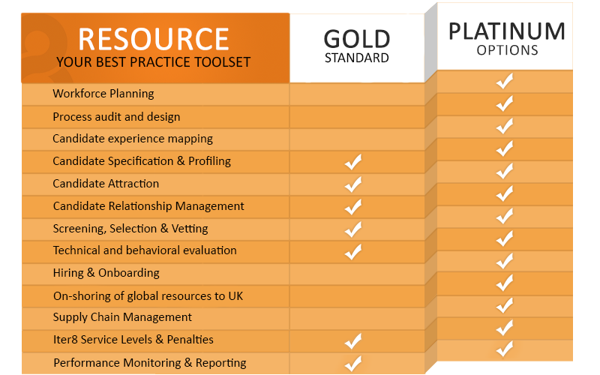
OUR DNA
iter8 RESOURCE is our best practice resourcing toolset. Included every time.
Defined, proven, measurable processes.
Assuring resource quality, time and cost.

Slide 7



TECHNOLOGY COMPETENCE
We have proven experience in hiring IT resourcing both as a resourcing partner, and in complex global enterprise operational environments.
Software
Development
Mobile
Applications
Senior
Appointments
Roles across entire SDLC
Desktop, web & enterprise solutions
Java, C#, C++
Ruby, Php, Python, JavaScript
Role across entire SDLC
Android
iOS
Windows Phone
CTO & Development Directors
Development, Project & Product Managers
Programme, Service Delivery Management / Directorship (ITIL)

Slide 8
OUR DELIVERY
If you were delivering a customer IT project you’d do it like this.
Why would you not get your resourcing services delivered the same way ?
KICK-OFF
SERVICE MANAGEMENT
  We review the project and set it up to ensure success.
  Offering full transparency and control over your service.
1
2
3
4
YOUR REQUIREMENTS DEFINED
DELIVERY
  Define and agree your requirements in a Statement of Work
  We deliver your services:
  iter8 Resourcing, iter8 Resourcing Management.
  We deliver your services:
  iter8 Resourcing, iter8 Resourcing Management.

Slide 9
About us
We created iter8 because we wanted to offer something different in IT resourcing.
We’re expert at what we do, with a track record of IT Service Delivery and Resourcing excellence in high growth environments:
David Cooper – With a background in sales management and recruitment, Dave founded a highly successful recruitment agency and built it into one of the UK’s leading specialist agencies. Successfully exiting the businesses after 10 years.
Julian Laister – With a history in telecoms and IT services, Julian has held many senior level positions from marketing to operations. His last role was as COO for an IT services company, supporting the growth from 250 to 2000 people whilst he was there.
One of our core aims with iter8 is to build a fantastic team. Happy team, happy customers, successful business !
Proprietary
10

Slide 10
Contact
If you think we can help, we’d love to hear from you.
Title
Body text
Submit
DDI Telephone
E-mail
Twitter Facebook Linked In E-mail

