Slide 1
TKC 2015 – V2
Iterarions to initial design

Slide 2
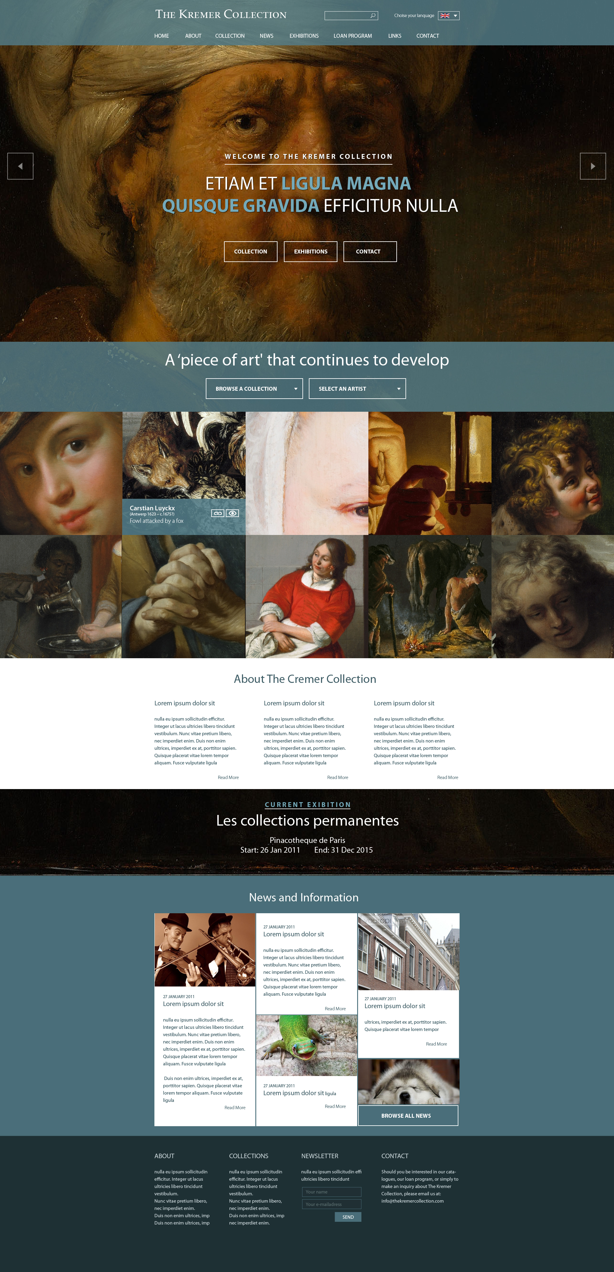
Homepage V2

Slide 3
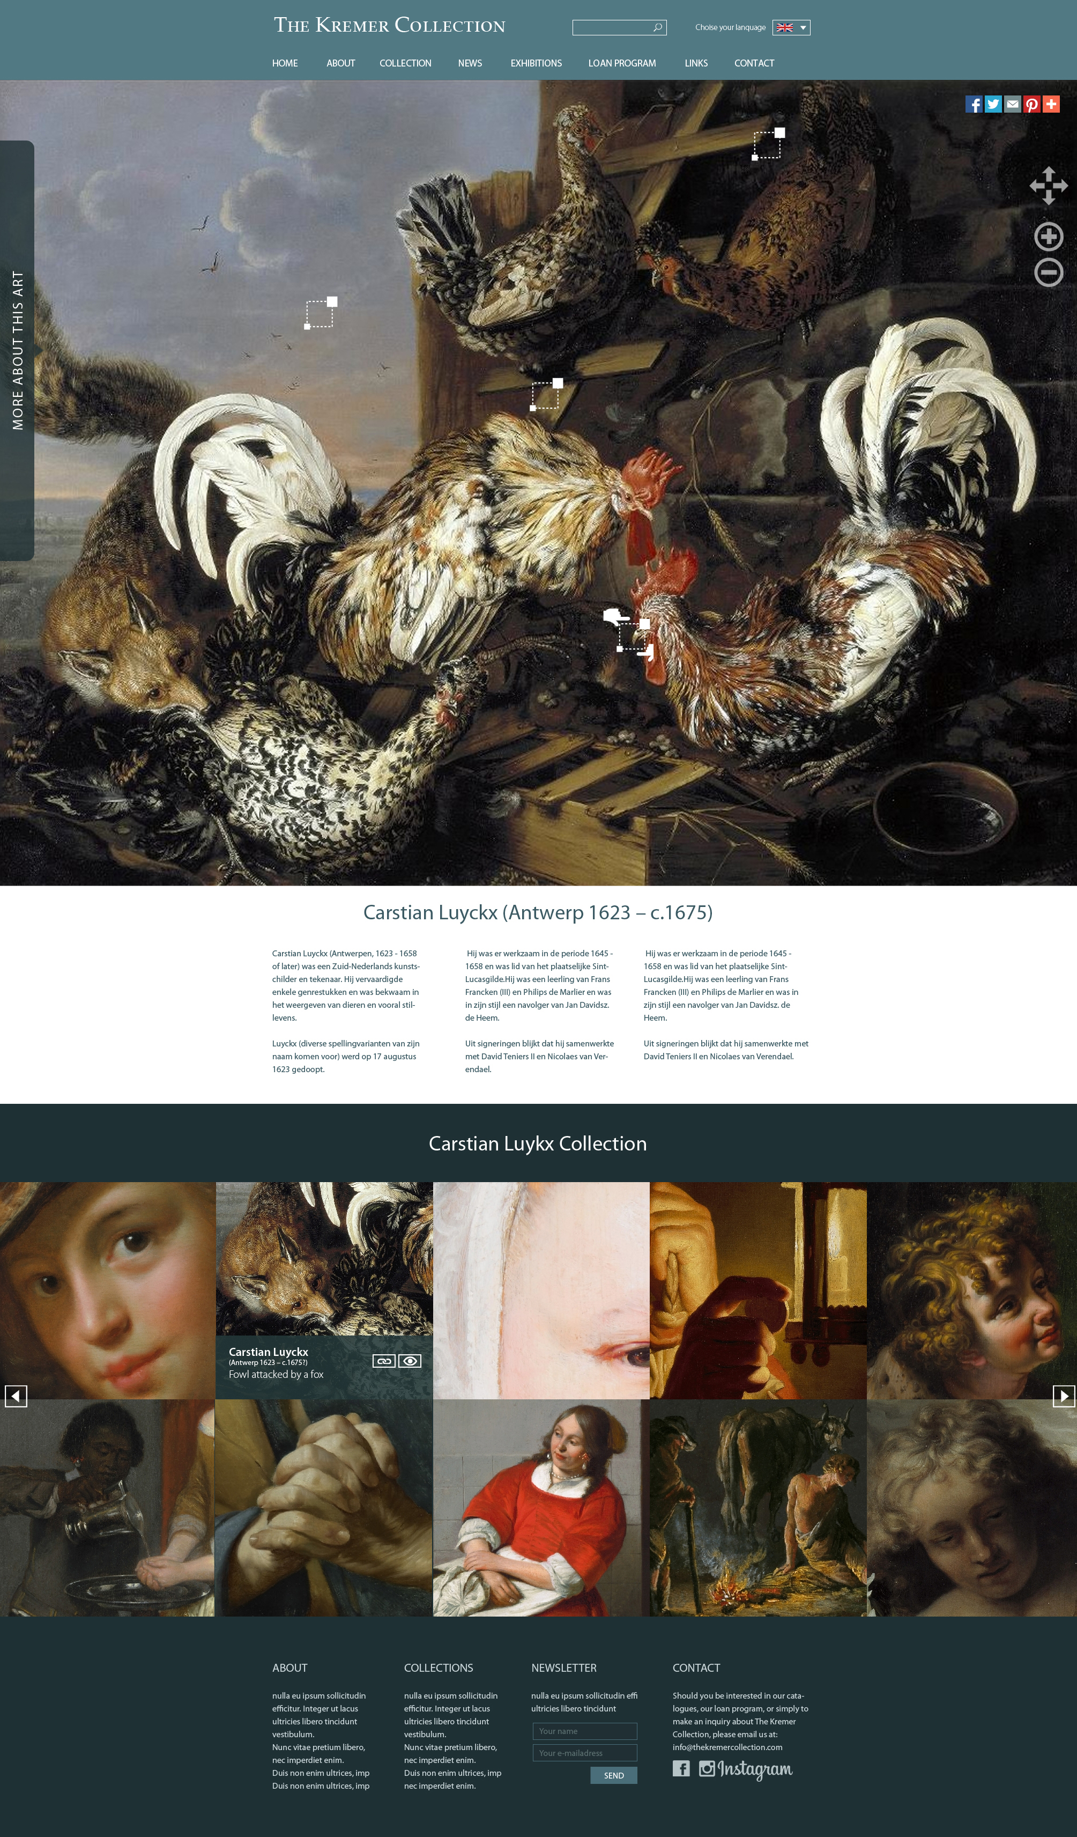
Homepage V2

Slide 4
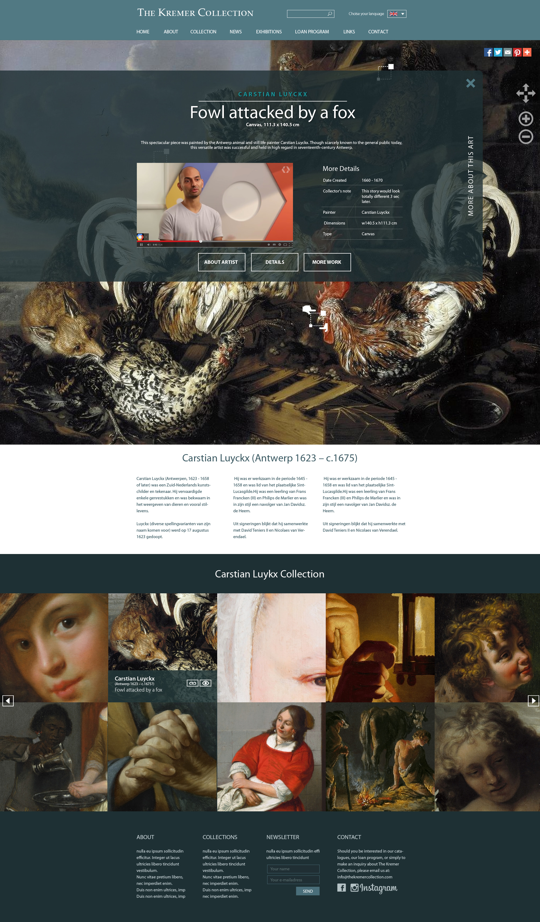
Homepage V2

