Slide 1
SOULSTRATEGY
-
MOOD BOARD
A new company with focus on growth of people and business

Slide 2



1. LOGO INSPIRATION (SIMPLE & STRONG).
CHECK BLOOMON.NL

Slide 3

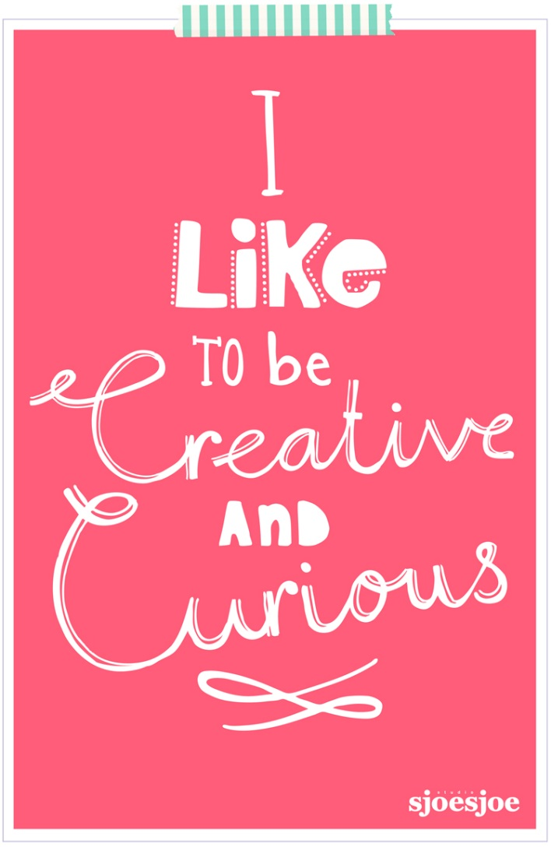

2. STYLE INSPIRATION: Next to logo

Slide 4
