Slide 1
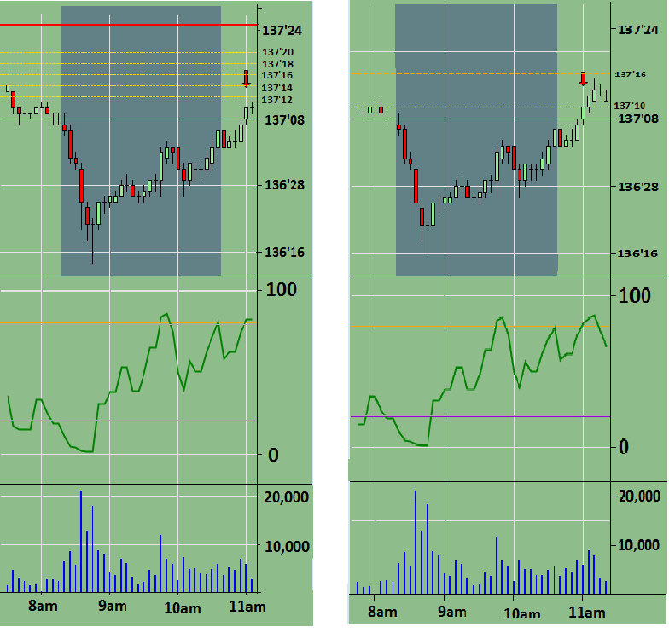
sources
Intra-day Countertrend US Hours
Example Trade: 30 year Treasury Bond, 7/31/14 “Payroll Friday”
Entry (Sell)
Exit (Buy)
RSI
RSI
Volume
Volume
Notes:
Rationale
Short term extremes in Treasury prices occur regularly due to both fundamental and technical factors.
The model trades during technical price movements is programmed to avoid trading during fundamental events.
Mechanics
RSI is used to measure the relative extremity of the price spike.
Extended and Inverted scaling strategies are used on both entry and exit scales in order to improve margins and profitability.

