Slide 1

TeamRunner
Your Event Community

Slide 2

Teams Need to Travel. TeamRunner Makes it Simple.

Slide 3
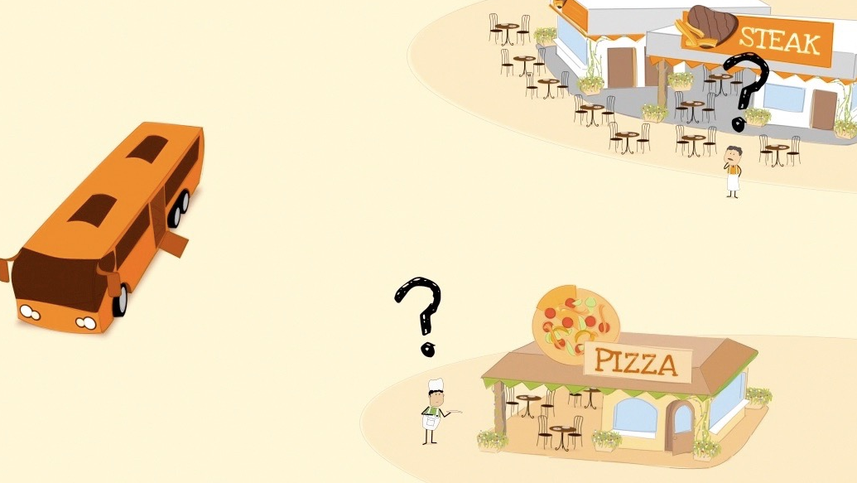
Industry Frustrations
Antiquated manual processes
Very time consuming
Inefficient & ineffective communication between markets
Teams - need a one stop shop for hotels and restaurants at a minimum
Sports organizations - need assistance providing services for teams to increase participation and satisfaction while improving revenue streams
Businesses - want visibility and communication modes for incoming teams
Time & Energy are Wasted. Revenue is Missed.

Slide 4



Market Players
Businesses
Sports Organizations
Teams

Slide 5
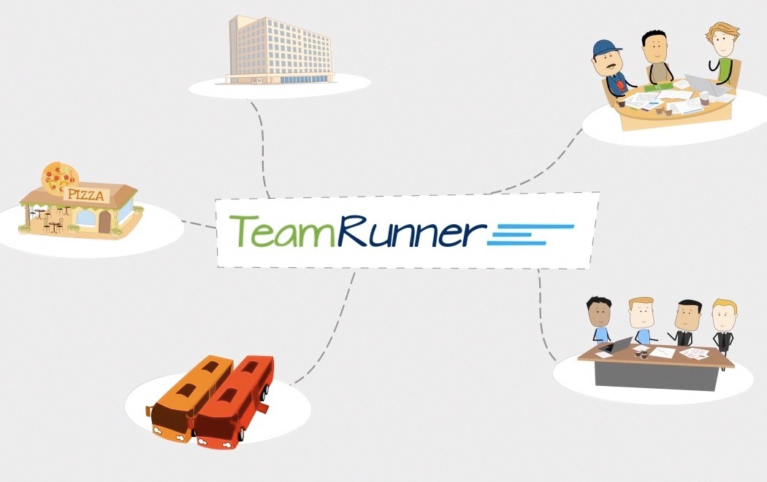





Team Travel Transformed

Slide 6

Market Size
The U.S. Sports Travel Industry is a $182 billion dollar industry
TeamRunner’s immediate addressable market is $22.5 billion in the U.S. alone and growing
    Youth Sports $7.5 billion
    High School/College (varsity+club) 15+ billion
27% of all travel is sports related
52 million youth participate in club sports
10-15 million youth play on traveling teams
Teams annually consume:
  47 million hotel nights
  50 million airline tickets
  3.8 million shuttle bus days
  2.5 billion meals at restaurants
They have a median household income of $127,000 and spend approximately $1,550 during a two day sporting event.

Slide 7




Traction & Market validation
2014 - 2015 Objectives Reached
Customer Validation
  Successfully completed beta testing with teams, sport orgs and hotels
Signed Associations, Events and Tournaments
    Cal South Soccer Association most influential soccer organization in the U.S. with over 204,000 members, 12,500 teams and 3,000 state team cups - largest tournament in the world
    Ohio North Soccer - 50,000 members - 3000 teams
    Over 40 sports tournaments in TeamRunner - current focus Southern CA
    98% retention rate of 2014 events
Signed National Hotel and Restaurant Chains
    Major Hotel Chains - Hilton, Marriott, Wyndham Sheraton etc.
    Franchise Restaurant Partners - Buca di Beppo, Jersey Mike’s Subs and Amici’s Pizzeria, Daphnes California Greek, Lucilles Smokehouse Bar.b.que, ToGo’s
Featured in the following publications:

Slide 8
Addressable Events, Teams and Members Growth

Slide 9
Revenue Model
Teams - Commission and Transaction Model
Multiple revenue opportunities to fill team needs
  Currently: hotel nights, restaurant reservations (dine-in and pick-up)
  In development: merchandise, activities, ground transportation
  Future: Vertical markets non sports groups
Businesses - Fee Based and Commission Model
Advertising, premium placement, professional & premier levels
Sports Organizations - Fee Based and Commission Model
Data mining
Event promotion opportunities

Slide 10
TEAM
Management
Ziad Tleimat CEO - software executive, soccer coach & restauranteur
Colette Kuhnsman VP Marketing - founder Jocoto Advertising, sports team manager
David Anderson VP Engineering - NASA, Oracle (15 yrs)
Wael Chatila CTO - Nook
Scott Leber Corporate Development - iSoccer CEO, former professional soccer player
Board of Advisors
Taylor Twellman - Sr soccer analyst ESPN, Major League Soccer (MLS) MVP, US Soccer National Team
Paul Miller - former director of CVBs
Ed Komo - former VP Engineering hotwire.com
Bill Glazier - President NorCal LAX, former venture partner Redwoods Venture
Support
Law Firm: - White, Summers, Caffee & James LLP - Mark White
Accounting Firm - Armanino LLP Certified Public Accountants

Slide 11

THANK YOU

Slide 12

Accelerating Growth
Increase the number of teams in TeamRunner and create more spending opportunities by continuing to build our:
Partnerships
  Access sports registration companies to expedite onboarding
  Continue to add national hotel and restaurant chains
  Build relationships with other event related service providers
Product Development:
  Continue to refine systems
  Add new features and revenue for enhanced customer satisfaction
  Add more revenue producing modules
Staffing: Increasing influential industry sales staff

