Slide 1
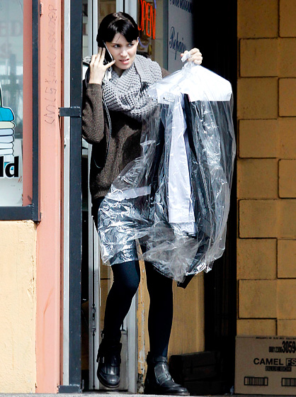

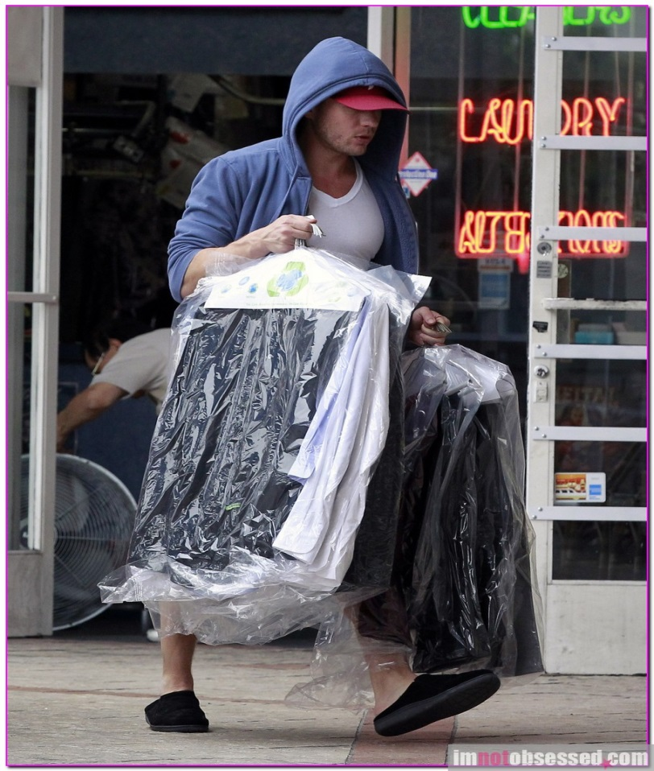


STOP driving around !
EDryCleaning.net
Your dry-cleaning service is one click away
Sign up this week to receive 10 %
off for the next 3 months
Sign up today : www.edrycleaning.net or Call 650 273 4808
LATE HOURS free pick up & delivery ( up to 10 PM !!)
VERY low prices
24 HOURS turnaround

Slide 2
