Slide 1
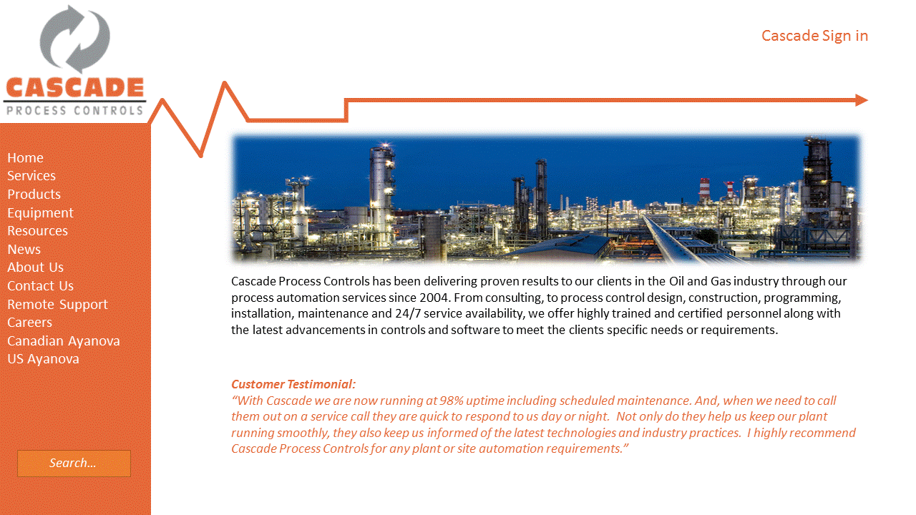
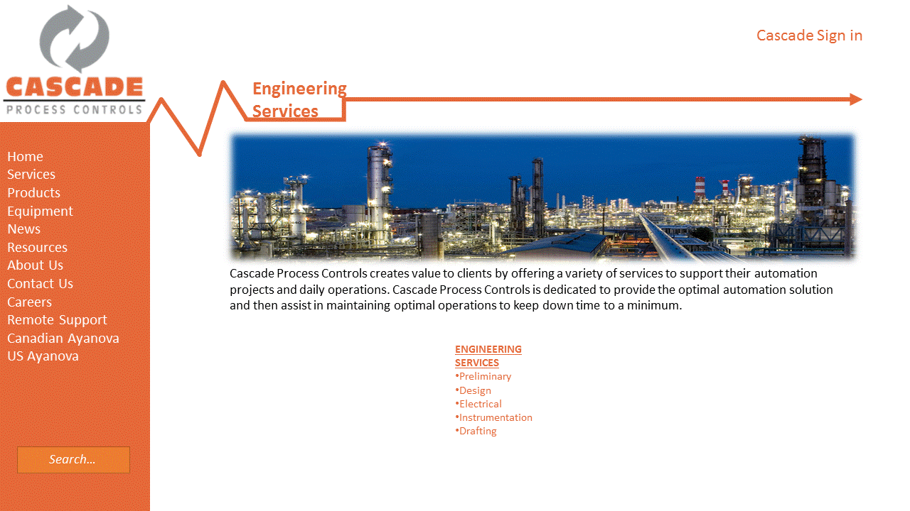
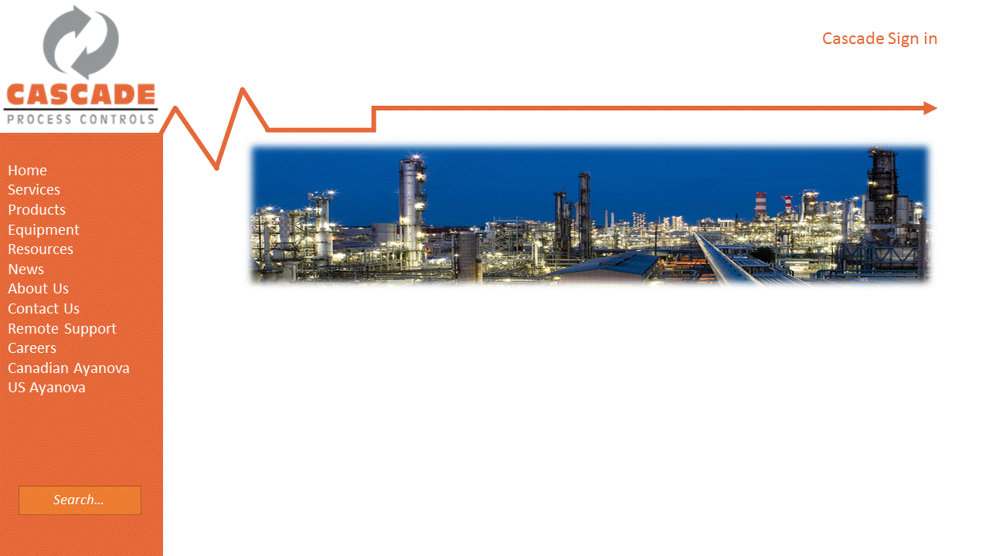
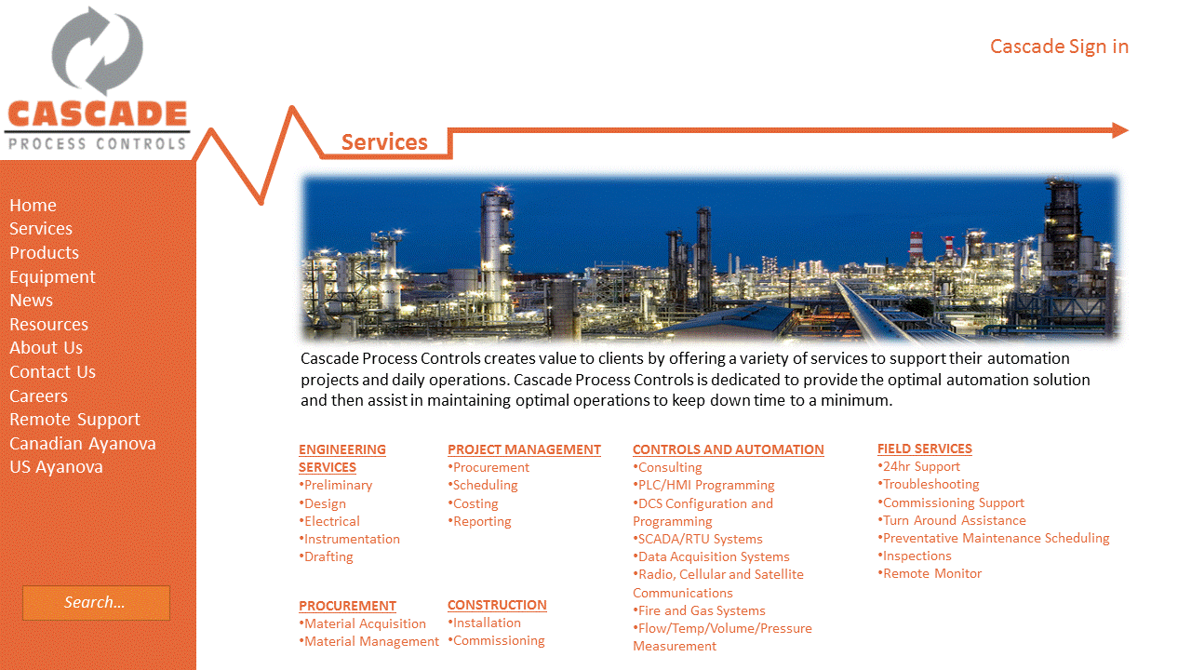
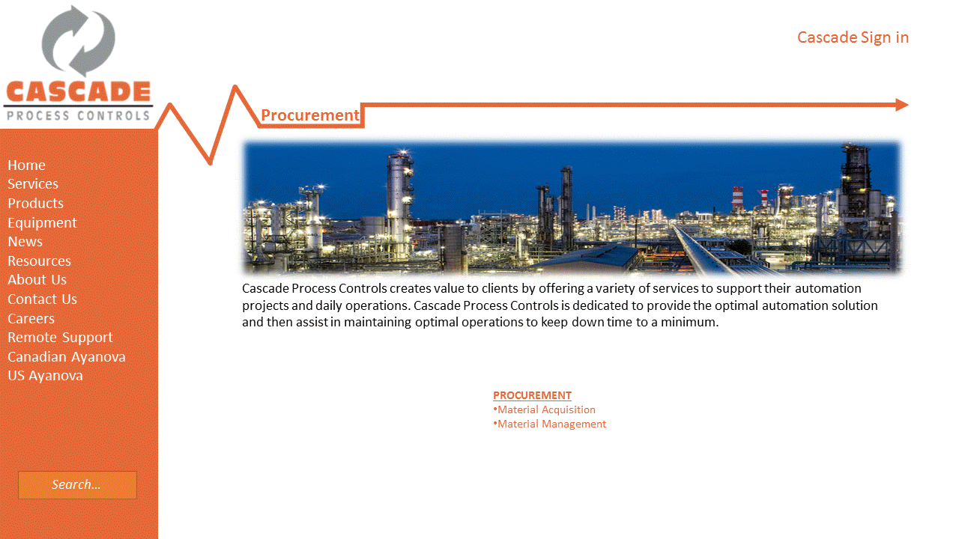
Services
Project
Management
PROJECT MANAGEMENT
Procurement
Scheduling
Costing
Reporting
Construction
Controls and
Automation
CONSTRUCTION
CONSTRUCTION
Installation
Commissioning
CONTROLS AND AUTOMATION
Consulting
PLC/HMI Programming
DCS Configuration and Programming
SCADA/RTU Systems
Data Acquisition Systems
Radio, Cellular and Satellite Communications
Fire and Gas Systems
Flow/Temp/Volume/Pressure Measurement
Field Services
FIELD SERVICES
24hr Support
Troubleshooting
Commissioning Support
Turn Around Assistance
Preventative Maintenance Scheduling
Inspections
Remote Monitor

Slide 2
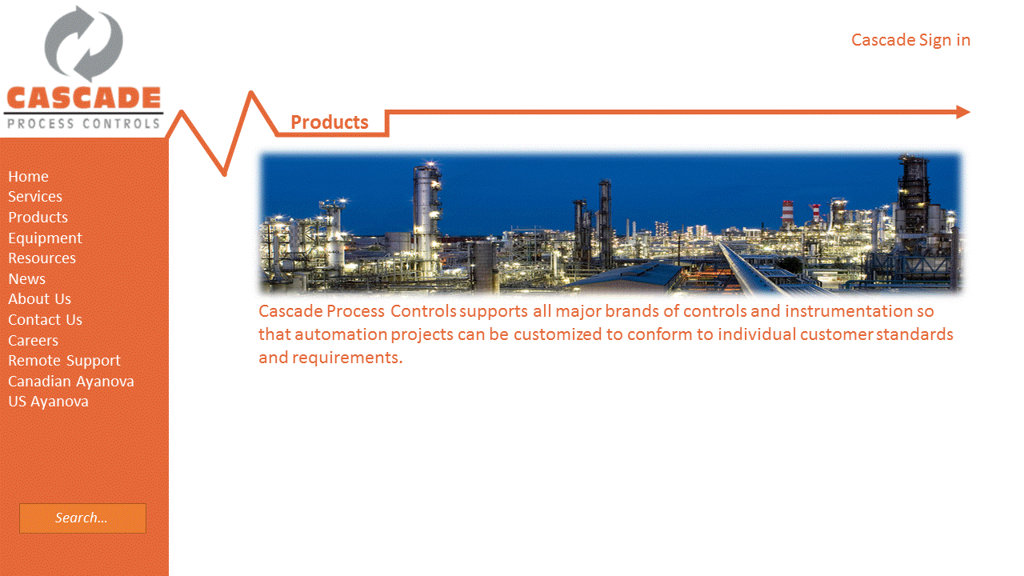
Products
Product 1
Project
Management
Product 4
Product 2
Controls and
Automation
Product 5
CONSTRUCTION
Product 3
Field Services
Product 6

Slide 3
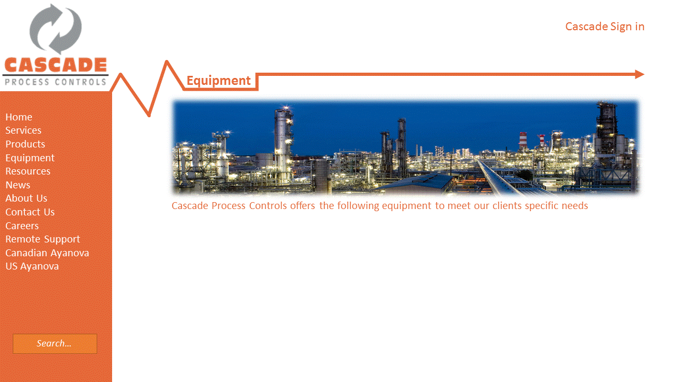
Equipment
Equipment 1
Project
Management
Equipment 4
Equipment 2
Controls and
Automation
Equipment 5
CONSTRUCTION
Equipment 3
Field Services
Equipment 6

Slide 4
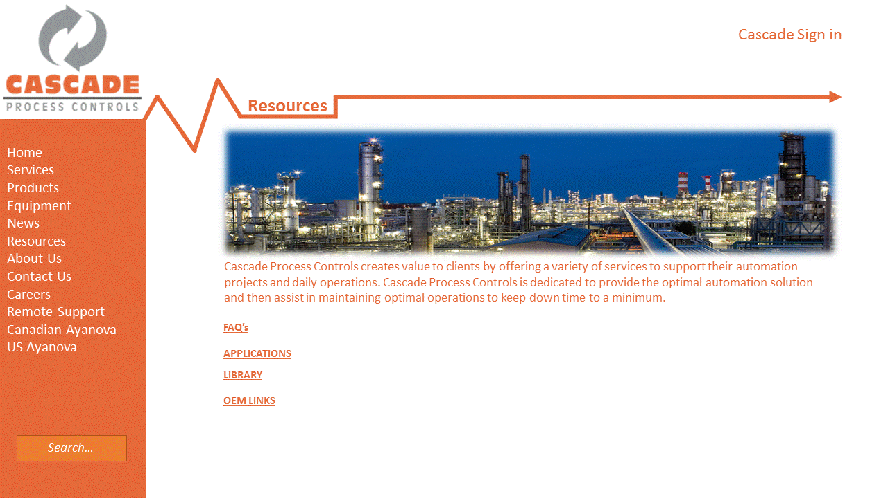

Resources
FAQ’s
App 1
Applications
Controls and
Automation
App 2
CONSTRUCTION
Library
Field Services
App 3
OEM Links

Slide 5

News

Slide 6
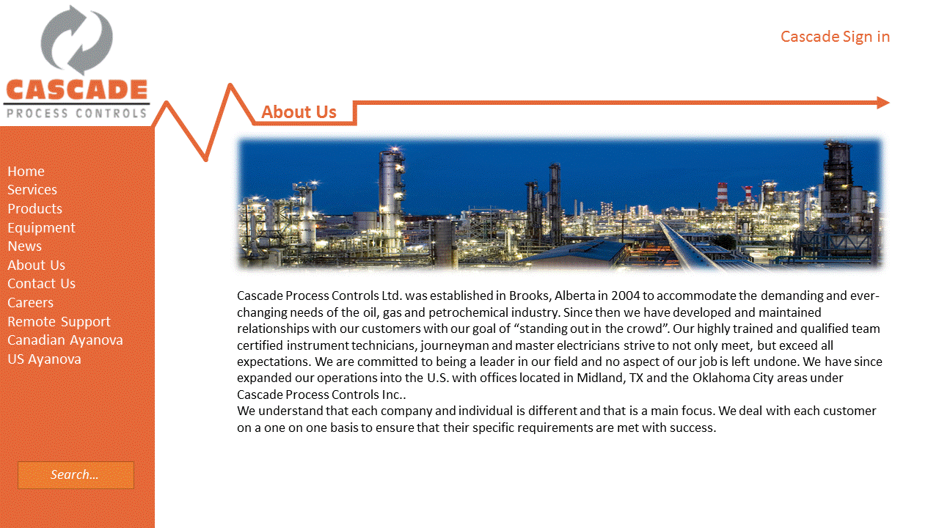
About Us

Slide 7
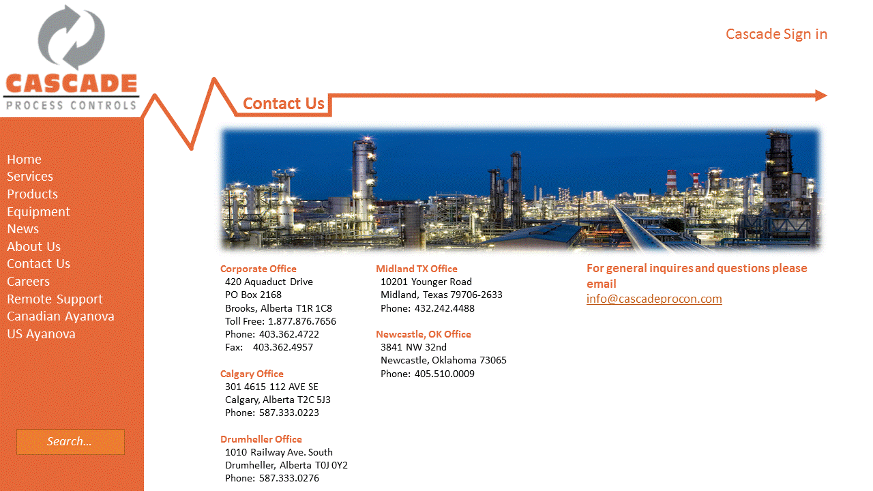
Contact Us

Slide 8
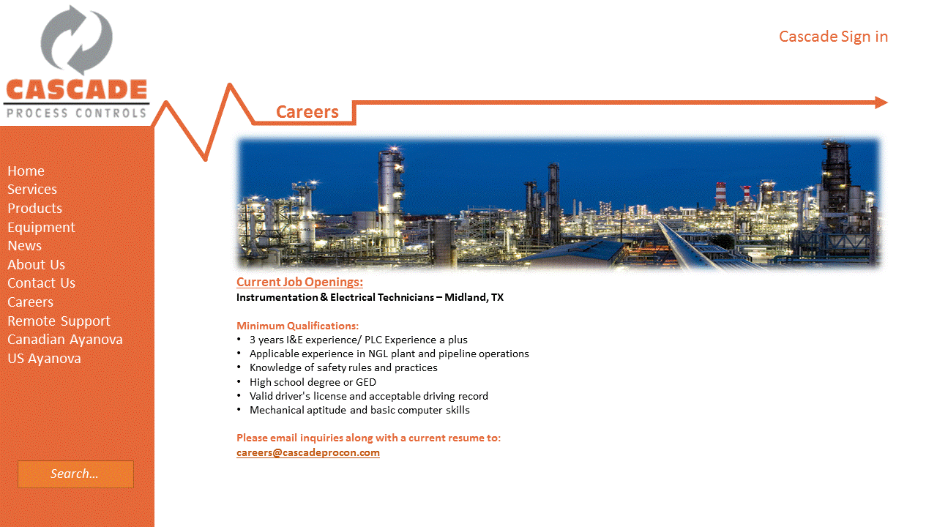
Careers

