Slide 1
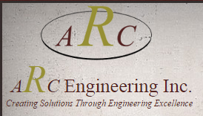
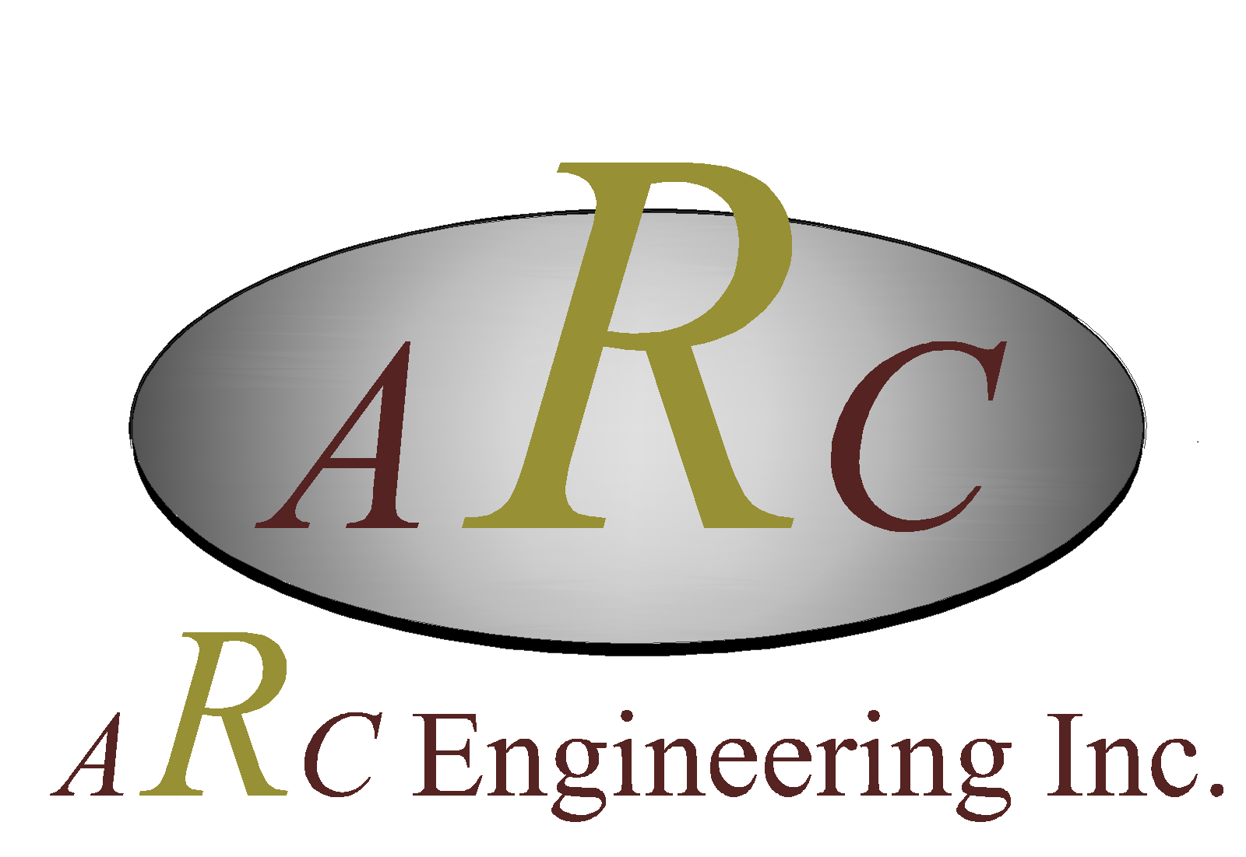
Original logo

Slide 2

Partial redesign
The logo is the issue.
They want to maintain the
Colours of the original , the arc shape
We have suggested moving away from
Serif font..
Client is happy with the
Copy half of the logo in terms
Of the tag line and the font. A tweak
Is welcome
These are the colors.. Gold, burgandy, black/ grey
Original logo

Slide 3
Project is to evolve current logo ….
They want to maintain the
Colour palette, the oval and
The A R C letters… I know
Very constraining… this is already on their
Building which is why we need to evolve
And not redesign completely
?

