Slide 1
Fundraising Board workshop
Griet Dehandschutter, CFRE
Principal, Dehandschutter & Associates
September 19, 2014

Slide 2
Agenda
  Introduction
  Philanthropy’s vital role for the Museum
  Role of the Fundraising Board
  Cultivation strategies
  Solicitation strategies
  Stewardship
  Next steps

Slide 3
Who is who?

Slide 4

Philanthropy is enabling your donors’ dreams
3
Notes:
3

Slide 5
Why do you give?
Notes:
Uw eerste philanthropische ervaring?

Slide 6
Why?
  Why did you choose to be involved or join?
  Why do major donors give?

Slide 7

People give to people who give themselves!
Build meaningful and value-based relationships
Connecting to mind & soul
Notes:
People give to people who give themselves!
Connecting to mind & soul!

Slide 8
Who gives in the US?
In 2013, American donors gave EUR 258 billion.
About 5% (EUR13 billion) goes to arts, culture & humanities.
Source: Giving USA 2014
Notes:
Corporations: $15 billion/EUR 11 billion
Foundations $42 billion/EUR 32 billion
Individuals: $242 billion/EUR 187 billion
Total: 231 billion

Slide 9
Who gives in the UK?
In 2011/2012, EUR 3.8 billion was invested in the Arts in England by three sources:
Government funding: 41%
Earned income: 37%
Private investment: 22%
  Individual giving: EUR 470 million
  Trust & Foundation: EUR 219 million
  Business Investment: EUR 143 million
Source: Art & Business, 2012
Notes:
handout
Corporations: £ 130million/ EUR 161 38%
Foundations: £120 million /EUR 148 32%
Individuals: £338 million/EUR 419
Total private investment: £589/ EUR 730
http://artsandbusiness.org.uk/media%20library/Files/Research/artsandbusienss-arts-philanthropy-facts-trends-potential_Oct2010.pdf

Slide 10
Who gives in the NL?
In 2011, EUR 4.3 billion “goede doelen” investments:
Individuals: 43% + Bequests/Wills: 6%
Corporations: 32%
Foundations:7%
Lottery: 12%
Earned income: xx%
In 2011, EUR 282 million (7%) to arts/culture:
Individuals: 26 million + Bequests/Wills: 6 million
Corporations: 124 million
Foundations:69 million
Lottery:62 million
Notes:
Individuals: 1.829+ Bequests/Wills: 256 miljoen
Corporations: 1.37 miljoen
Foundations: 294 miljoen
Lottery: 12%
Earned income: xx%

Slide 11
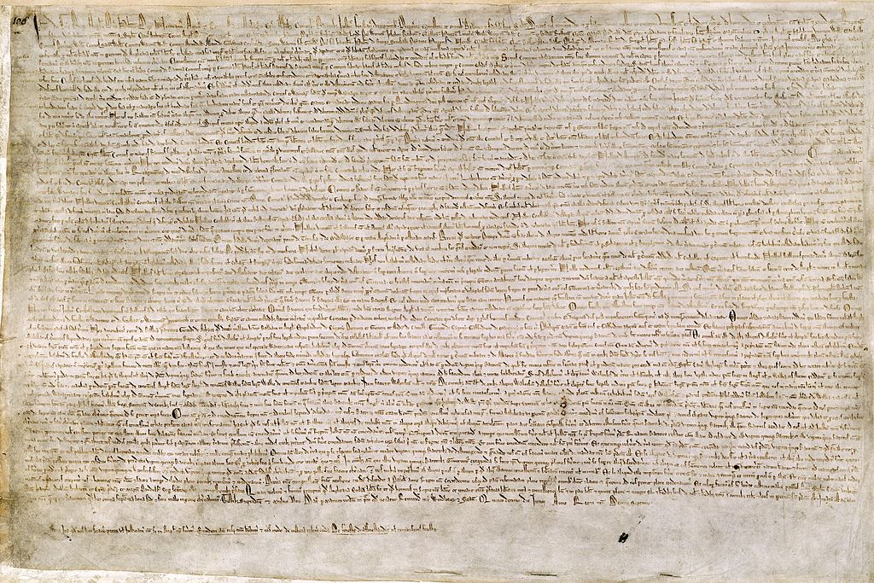
Your Role – Your Charter
Notes:
See handout: ways you can help raise money.

Slide 12
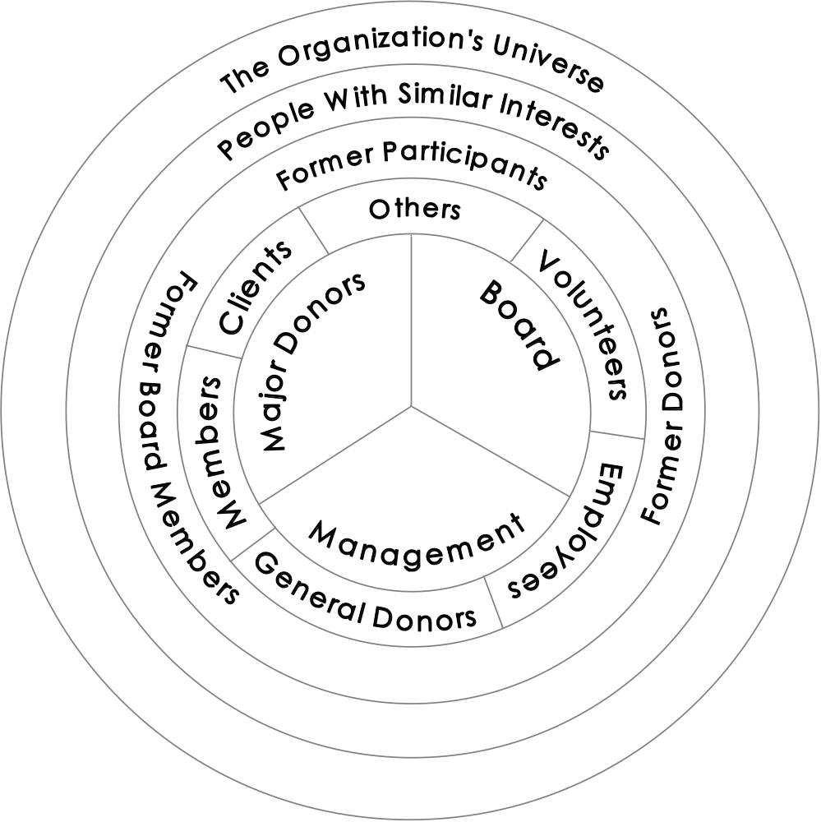
Expanding your Museum’s network
Hank Rosso, Achieving Excellence in Fundraising,
Jossey-Bass, 2003.
Notes:
11
Suggest names
Peer to peer review handout
Ambassador in community.

Slide 13
When is someone ready to be asked?
      Education
      Involvement
      Cultivation
      Inclination
      Assets
      5 for 5 = THE RIGHT TIME TO ASK

Slide 14
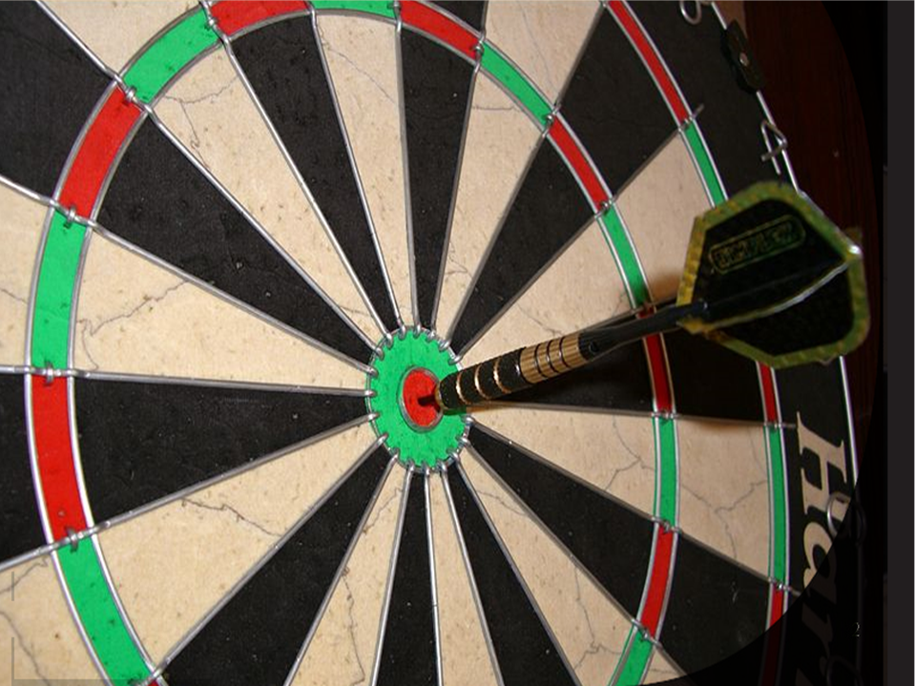
Focus on cultivating the “critical few”
13
Notes:
13
90% of gifts by 10% of donors!
Peer to peer review
Review for dinner….
Inside out/top to bottom.
Questions to ask

Slide 15
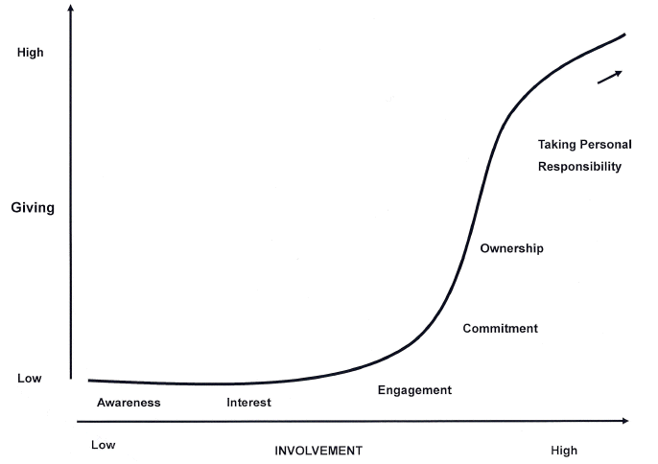
Giving increases with involvement
Source: The Tarnside Curve of Involvement
The Osborne Group

Slide 16
Cultivation tips
Formal & informal ways to cultivate
‘Boijmans Diner 2014’
Small gatherings
Tours behind the scenes
Exclusive Museum travel – Mexico
Artist meetings
Curator contact
Opportunities to engage and volunteer
Educational opportunities
Meet with leadership
Notes:
Questions to Ask

Slide 17
How do you share the Museum’s story?
Notes:
How do you ask people to join for dinner?

Slide 18
How are you sharing the Museum’s story?
  Who are you?
  How much do you want?
  What do you want it for?
  Why should I give?
  Why now?

Slide 19
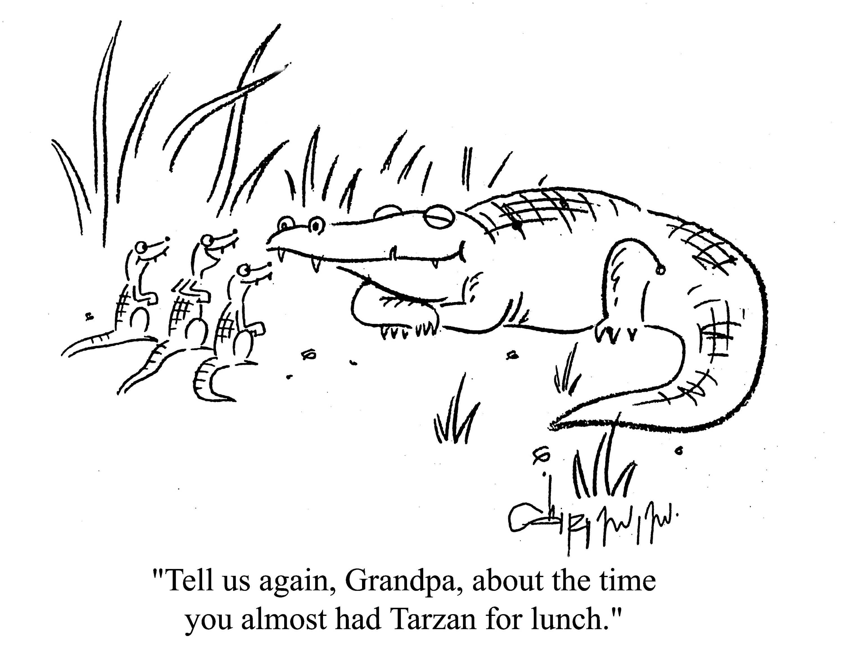
The power of storytelling

Slide 20

Tell your story from the donor’s perspective
Tom Ahern, Seeing through a Donor’s Eyes, Emerson & Church Publishers, 2009

Slide 21
Why do people hesitate to ask?
Notes:
1) Fear of not knowing person, rejection
2) Learning what makes organization unique
3) Understanding why people give – part with their money
4) Letting external forces or internal problems postpone ask
Explore what we can do about them
Know the person
When you are asking for money, you are not asking someone to give something up, you are giving them to opportunity to invest in your community and to feel good.

Slide 22
Tailor your “asking team”
Notes:
Let’s do one exercise.
We need two people. CEO and volunteer.
Who would be a good team according to you?
How do you see money?
Door opener stays involved. People give to people!
Together cultivation, together asking.
Can be exhilarating!
Ideally 2 people
CEO + volunteer (Board or donor ..)
Requires preparation
Guarantees better observation and listening…

Slide 23
Prepare for the ask
  Review “Questions to ask”
  Review “Asking tips”
  Prepare ‘prospect’ asking script
    research from a distance & up close
    cultivation or solicitation: 5 for 5?
    Specific ask (member level & purpose)
    Next steps
  Prospect list & successes

Slide 24
Your asking tools to bring
  Prospect asking script + blank sheet
  Cultivation & solicitation kit
    Brochure
    Project description
    Newsletter article
    Add gift/pledge form (only if solicitation took place)

Slide 25
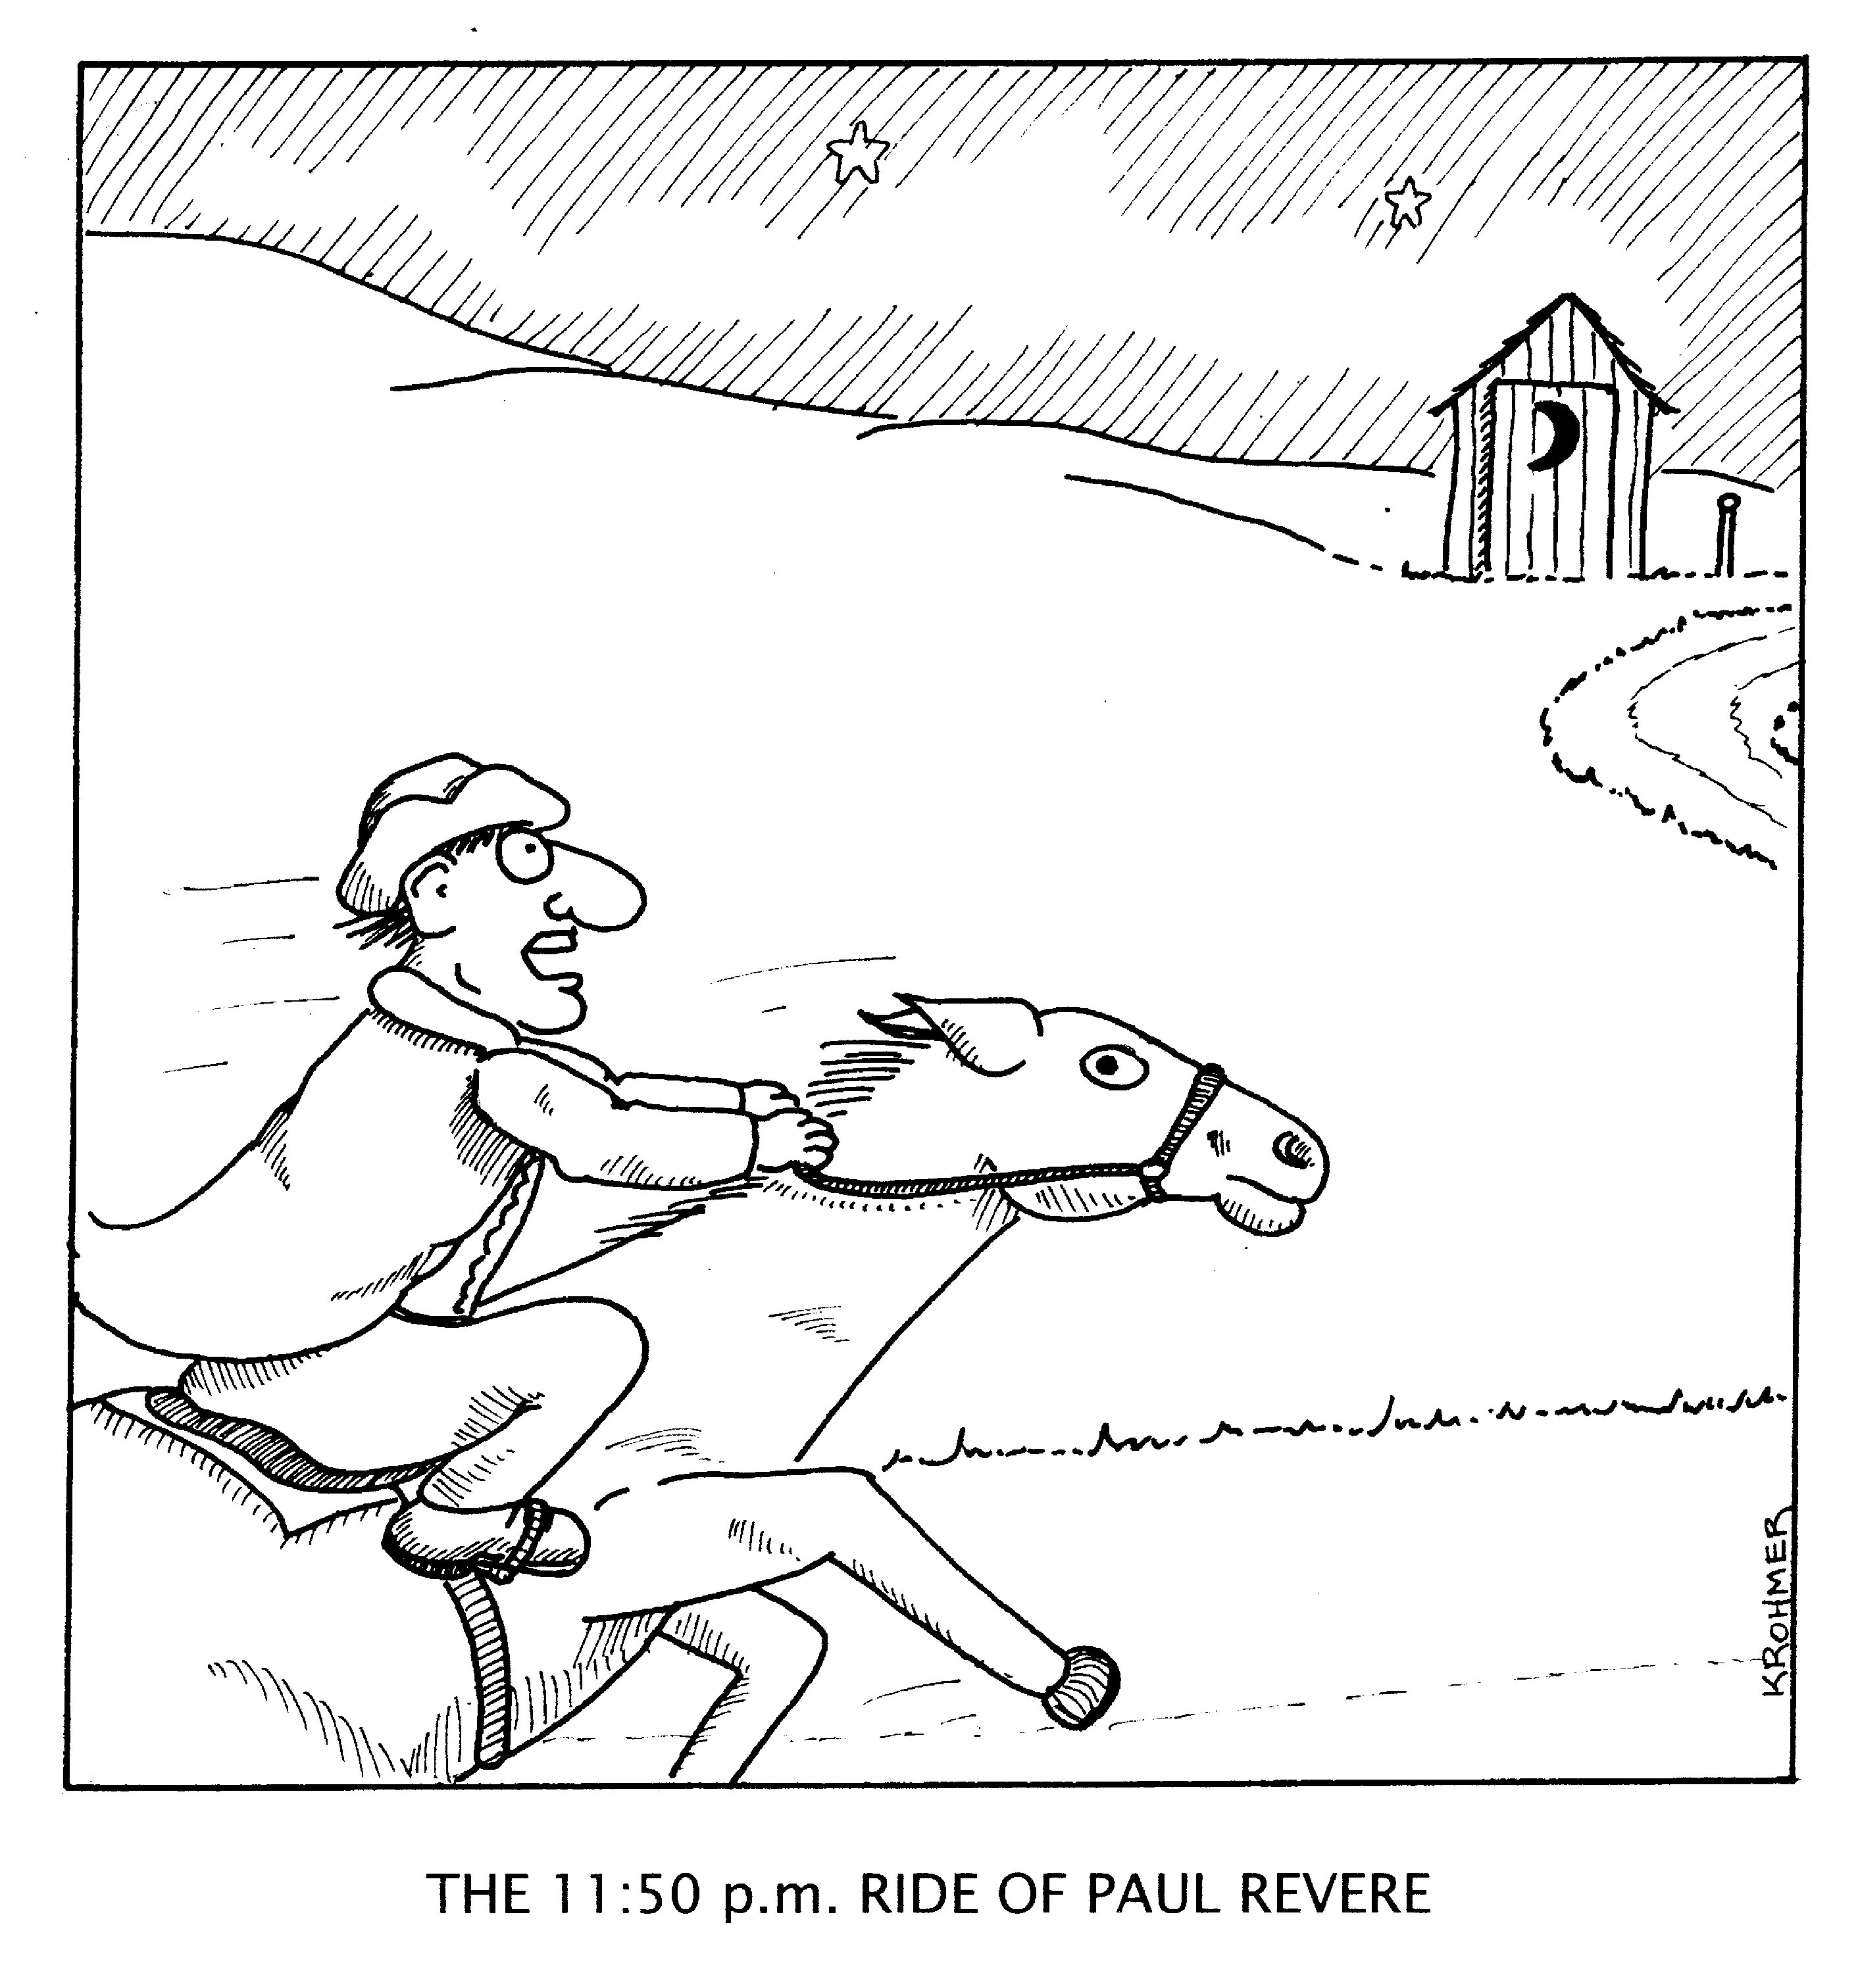
Do you bring a sense of urgency?
Notes:
Do you have a sense of urgency? With the project and the ask?
If not, definitely not now….
Do you start your capital campaign? ….only if urgent.
If not really a priority ….focus on the priority….

Slide 26
Set the right tone
Pitfalls
Right Approach
Sell
Need
Our Goal
Pressure
Persuasion
Listen
Opportunity
Donor’s aspiration,
hopes, dreams
Engagement
Inspiration

Slide 27
The asking conversation
Warm up
Ask
    Compelling case
    Transitional statement (match interest of person with project)
    Ask for specific amount and purpose (two sentences)
    Detail the benefits of the gift (beneficiaries, donor’s interest)
    Remain silent
Persons’ response
Close & follow up

Slide 28
Handling responses
Notes:
We need two people. CEO and volunteer.
Who would be a good team according to you?
How do you see money?
Door opener stays involved. People give to people!
Together cultivation, together asking.
Can be exhilarating!
Ideally 2 people
CEO + volunteer (Board or donor ..)
Requires preparation
Guarantees better observation and listening…

Slide 29
What donors want to know?
They want to be promptly and meaningfully acknowledged.
They want to know where their gift is going.
Before you ask for a new gift, demonstrate that their gift was meaningfully used. Avoid over-solicitation!
Notes:
Repeat donors 40% response increase!!!

Slide 30
Close and follow up
Thank for taking time to share the opportunity
Thank for listening
Restate the gift opportunity and benefits
Give a date to get back in response to questions & concerns
Speak as if gift will happen
Ask how person likes to be recognized
Set date and time for next meeting

Slide 31
Follow up after the ask
Internally
Complete prospect meeting reflections and share with Dev. Coordinator
Define clear next (stewardship) steps: who/what/when
Externally
Follow up with personal thank you
Formalize gift/pledge
Pledge fulfillment follow up
Execute on further cultivation or stewardship strategy

Slide 32
  Griet Dehandschutter, CFRE, Principal
  Dehandschutter & Associates
  930 Main Street Suite 101, Box 14
  Acton, MA 01720 USA
  E: griet@dehandschutter.com
  T: + 1(978) 835.3480
  www.dehandschutter.com

Slide 33
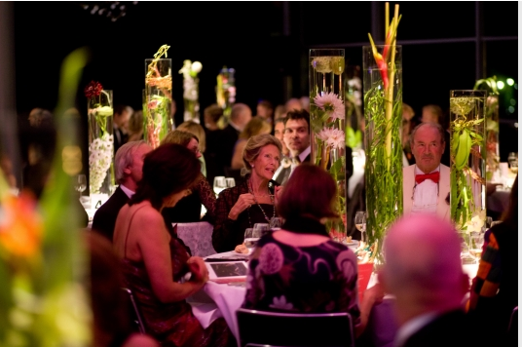
Have confidence!
Notes:
Have confidence in our common cause -
Through education, training, sharing stories, setting expectations, evaluate performance, (self-assessment and Dev. Director and Board member)
Giving roles, collective approach.
Build philanthropic organizational culture
Thank you!!!

