Slide 1
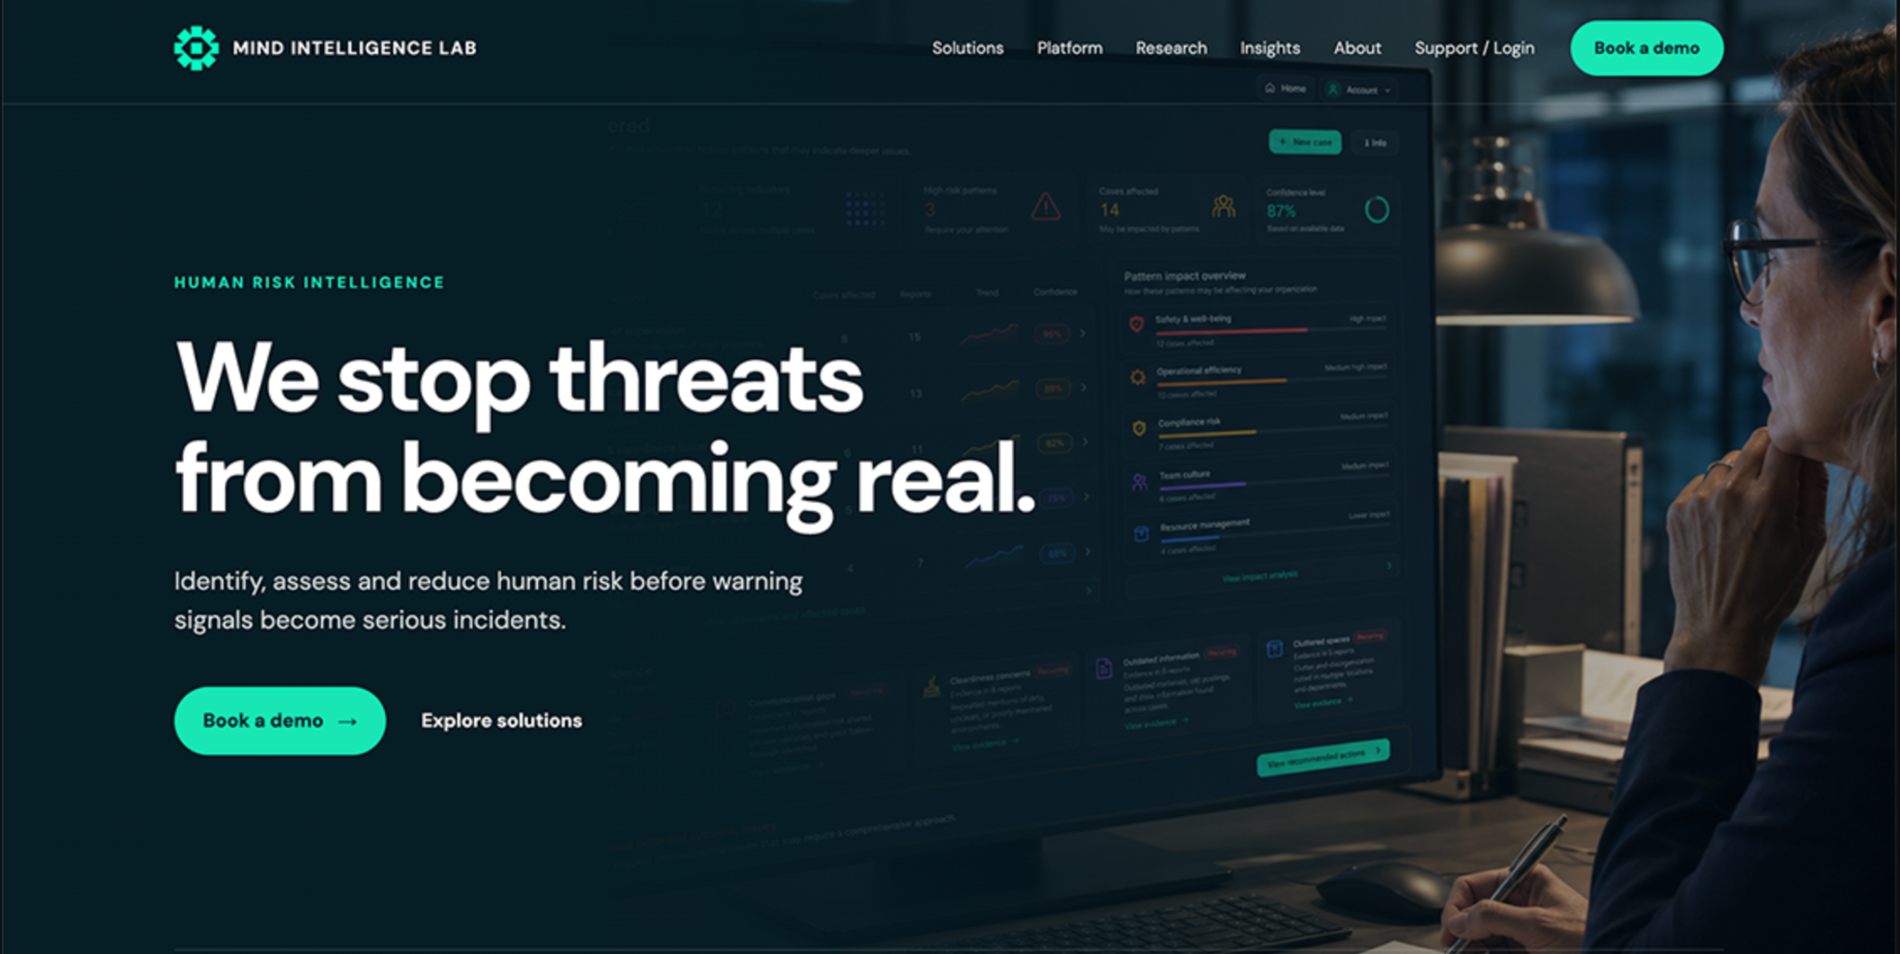
Hero - homepage > animated video in the background and vision text “We stop Threats from becoming real” + 2 CTA book a demo and Explore solutions

Slide 2
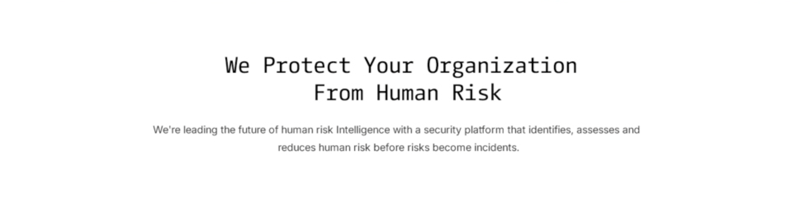
startpage sektion 2 scroll down. What we do
Alternatively, have this text “we’re leading…” directly under “We stop Threats” in the Hero. Then the section below becomes Section 3, “The Gap,” and Section 2 instead.
Homepage scroll down section 2 - What we do
White background
Alternatively, have this text “we’re leading…” directly under “We stop Threats” in the Hero. Then the section below becomes Section 3, “The Gap,” and Section 2 instead.

Slide 3
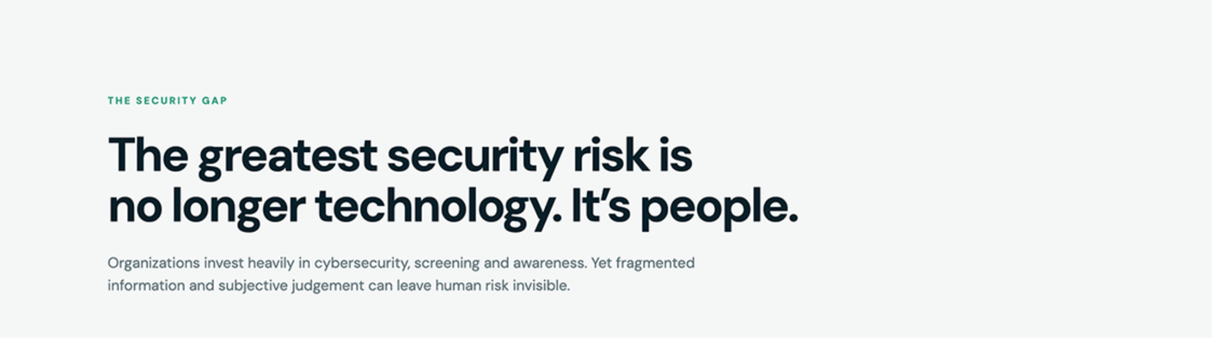
The security Gap. Maybe an image of a person on the right to make it feel more dynamic.
The Gap
The greatest security risk is no longer technology. It's people.
Organizations invest heavily in cybersecurity, background screening, and security awareness. Yet insider threats and human-driven security incidents continue to rise.

Slide 4
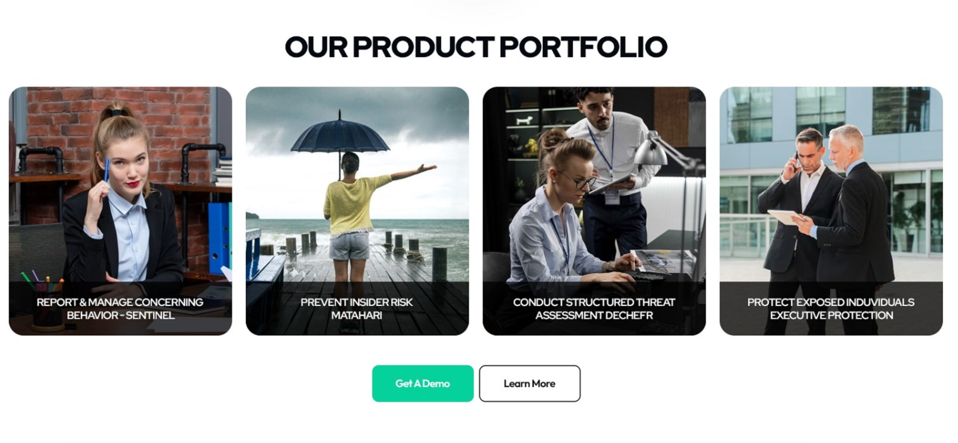
Our Solutions. ( not our product portfolio )
Here we would like a pleasant image of a person (not obviously AI-generated) for each one. Each image should follow this order: first, what it is, and underneath, the name of the product.When you hover over each image, show a brief description and a link to the product page, so each product have a own CTA ( No general CTA under the 4 products )
In this order beside eachother, Insiderprevention, Threat assessment, case management, Executive protection
Insider Prevention Threat Assessment …. ……
Matahari Dechefr
MataHari
Dechefr
When you hover over each image, show a brief description and a link to the product page.

Slide 5
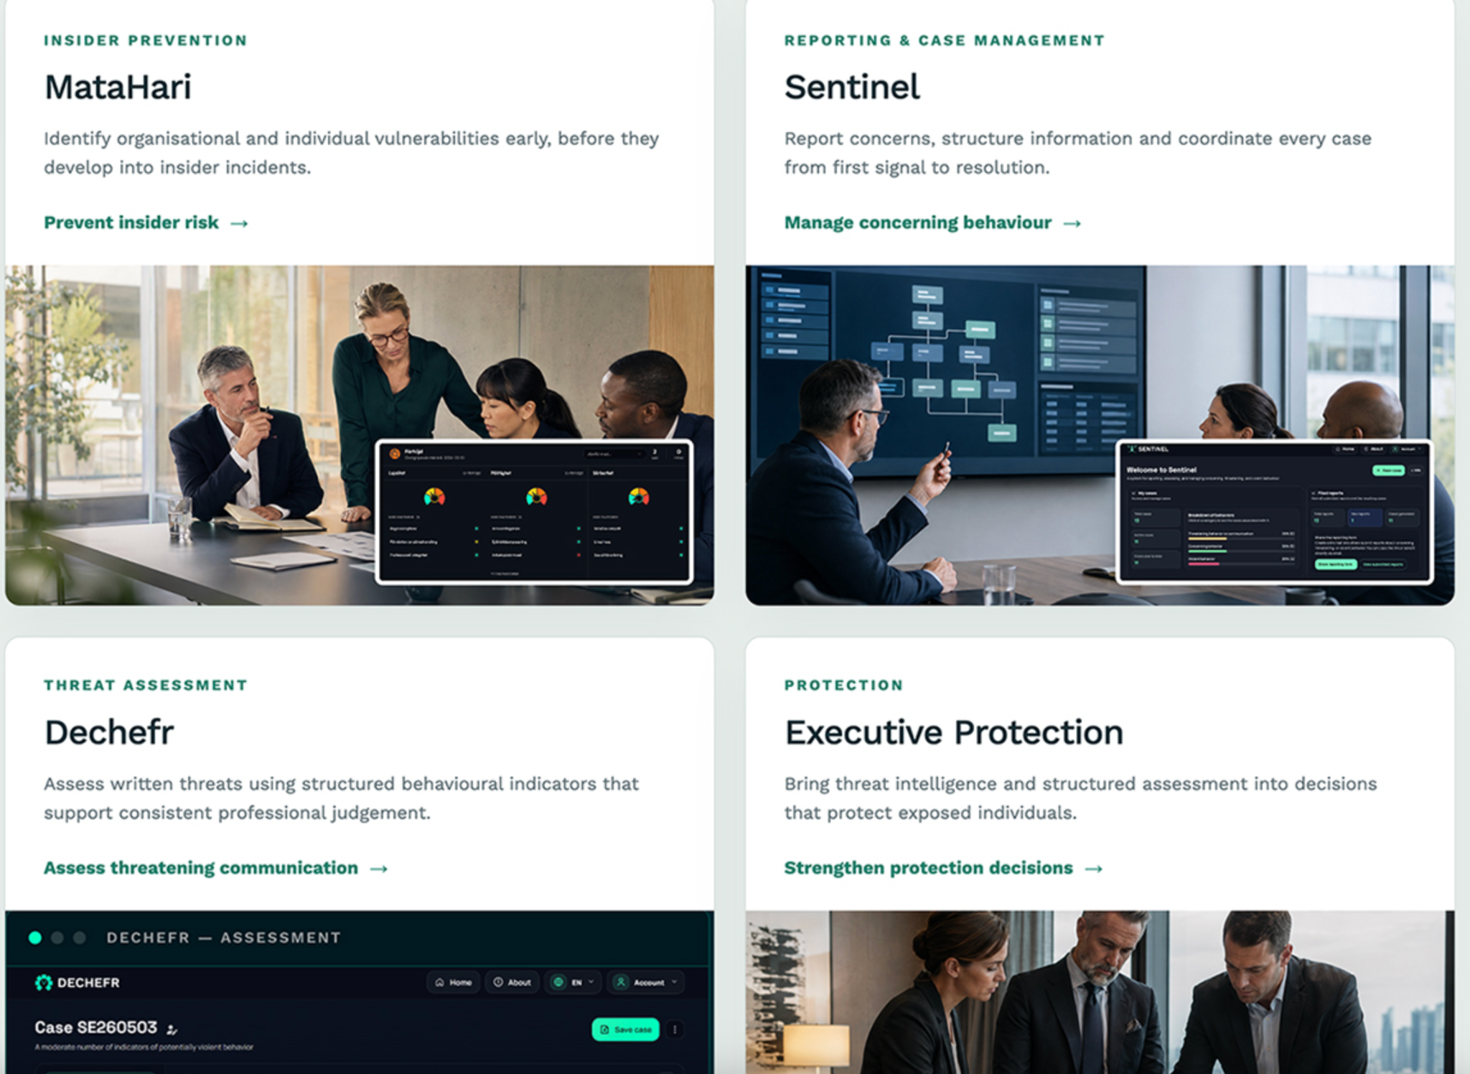
Our Solutions. Another way to do It. But without the screenshots
But the Solution area should be bigger than the product namn

Slide 6
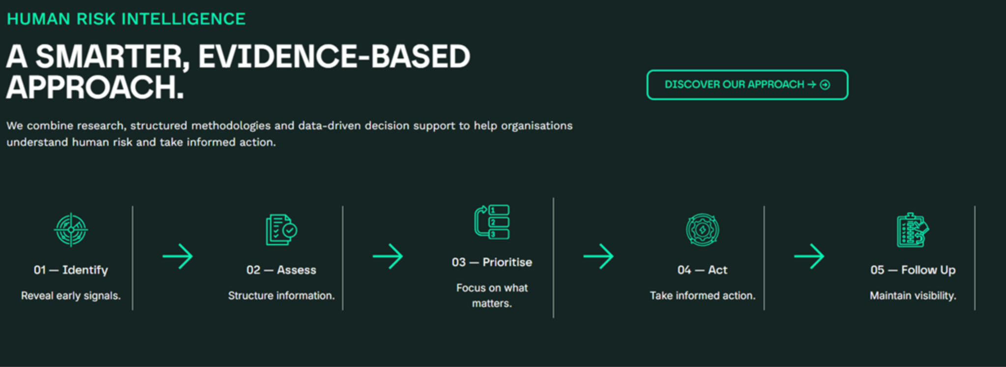
How It Works ( please feel free to design from signals to actions ) Name It From signals to actions not “ A smarter, Evidence…” dont have “Discover our approach”
From signals to action
Solution overview

Slide 7
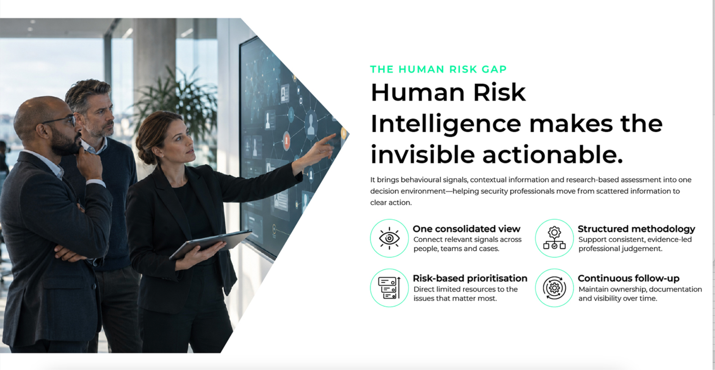
Another way to show It ( but dont call It “the human risk gap”
Solution overview

Slide 8
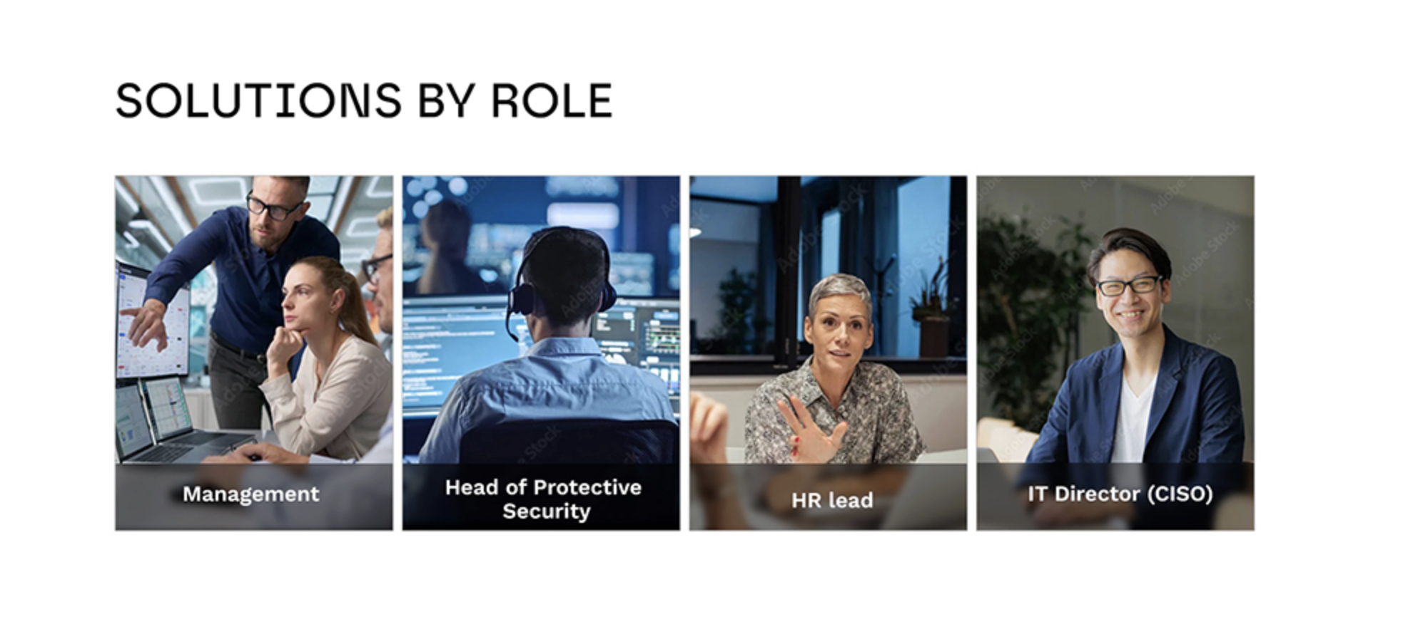
Solutions by Role
Here we would like a pleasant image of a person (not obviously AI-generated) for each one. Each image should follow this order: first, what it is, and underneath,When you hover over each image, show a brief description and a link to the solution page, so each solution have a own CTA + a general CTA under to the landing page for Solutions by role.
Solution overview

Slide 9
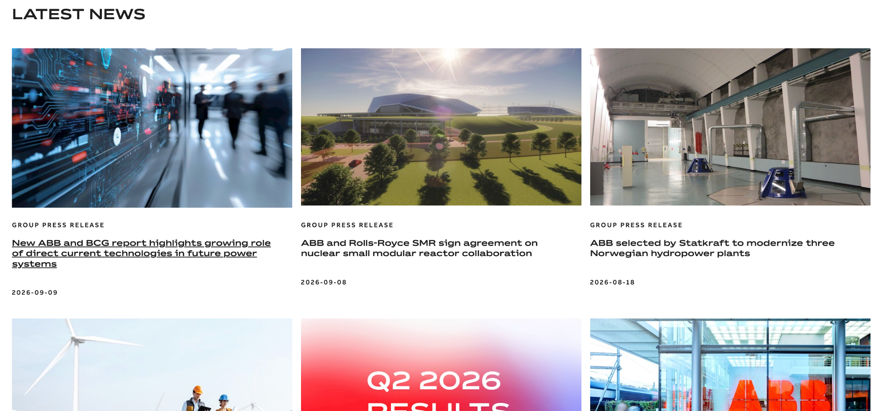
News Section at startpage. Pitcture and short text and link to the article.
Solution overview

Slide 10
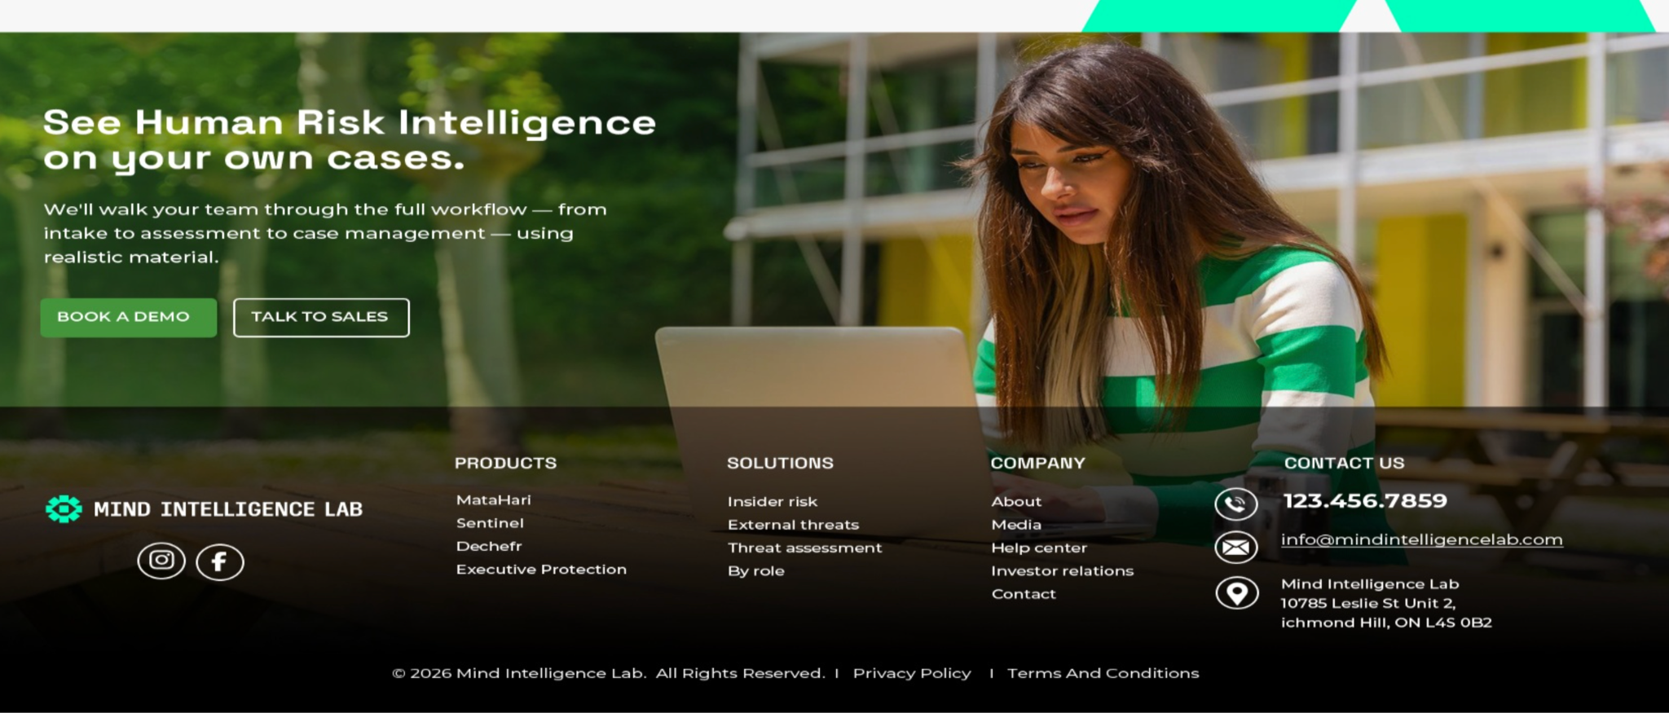
Last section startpage. Picture and our footer
Solution overview

Slide 11
Landing pages for Our Solutions and Solutions by Role
Please feel free to come up with design suggestions for subpages for both Products and Solutions by Role. However, please use the text we already have and keep the design as simple as possible.
It would be great to include images of people to create a warm and welcoming feel. If it is possible to visualize the content using a model or something similar, we would be happy to explore that as well.
Solution overview

Slide 12
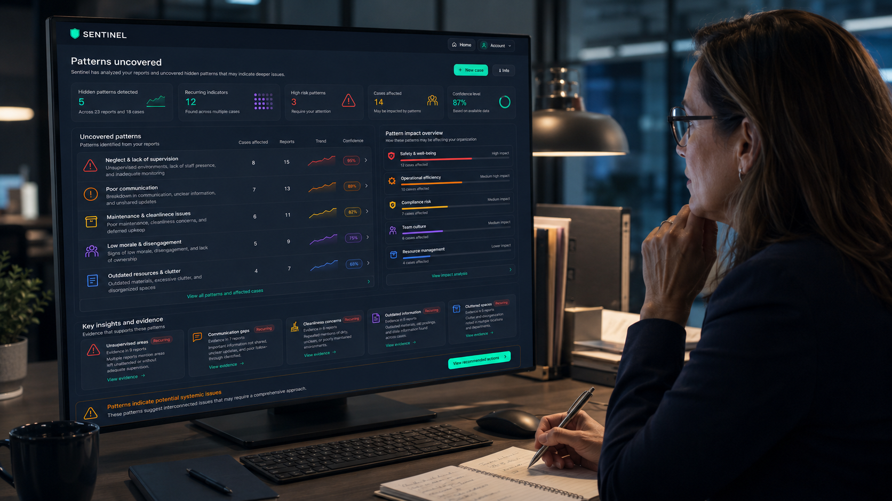
Product page - Matahari - Hero
An image showing a screen with the MataHari dashboard and person. Use a good image from the MataHari system support.
Prevent Insider Threats
Proactively
One Human Risk Intelligence platform for the entire insider risk management lifecycle.
Get a demo Contact us
The greatest security risk is no longer technology. It's people.Organizations invest heavily in cybersecurity, background screening, and security awareness. Yet insider threats and human-driven security incidents continue to rise.
The Gap

Slide 13

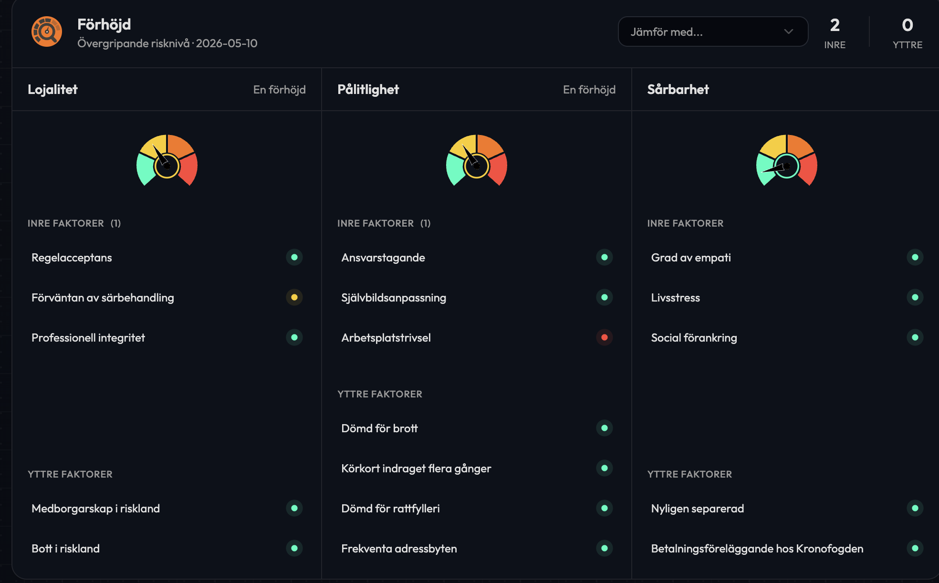
Product page section 2 - Customer benefits / customer value
Why MataHari
From reactive security to proactive risk management. From manually searching for vulnerabilities to systematically identifying them before they become incidents.
*Identify risk before it becomes an incident
Identify insider-related vulnerabilities early, across individual and organizational levels.
*Prioritize security efforts based on risk
Turn human risk data into actionable insights and focus resources where they are needed most.
*Make risk assessment objective
Replace subjective assessments with structured, evidence-based analysis for better security decisions.
*Measure change and maintain traceability
Track risk and change over time with continuous assessment, documentation and traceability.
CTA Ge a demo
Can we create a consolidated dashboard showing several areas with colors, etc., similar to Sentinel

Slide 14
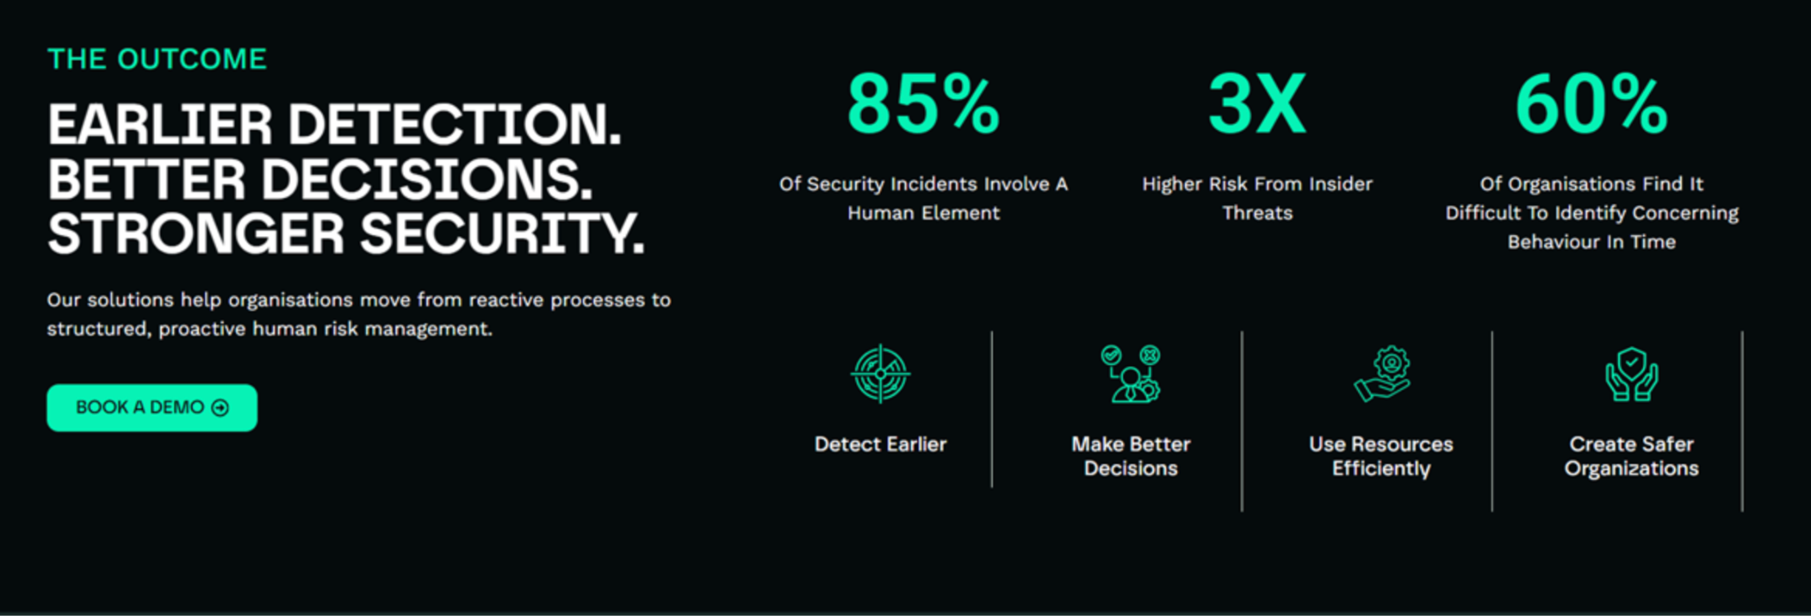
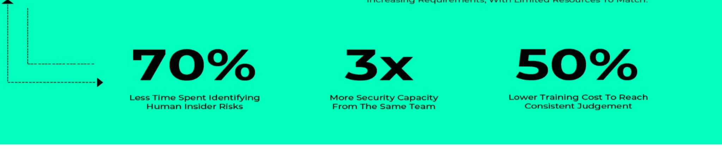
Product section 3 - MataHari.
ROI – Outcome. Use the figures and text from the lower green section, but lean more towards the design of the upper black section. However, feel free to design this in the best way you see fit, but it needs to be clean.
Prdot page sektion ( 3 ) - Select 3 business impacts
70% 3X 50%
less time spent on identifying human more security capacity lower training cost
insider risks.
Learn more >

Slide 15
sektion 4
What Changes With MataHari?
BEFORE AFTER
Manual analysis Data-driven insights
Time-consuming work to identify and assess vulnerabilities. Structured analysis that identifies vulnerabilities directly.
Subjective assessment Objective assessment
Based on individual experience and interpretation. Standardized, evidence-based methodology for objective assessment.
Reactive Proactive
Risks are addressed after an incident occurs. Risks are identified before they become incidents.
Limited follow-up Continuous visibility
Resource-intensive to track changes and emerging risks over time. Identify changes quickly and prioritize resources for ongoing security management.
Product section 4 - MataHari
Please feel free to design this in a nice way

Slide 16
sektion 4
Landing page Threat assessment > Dechefr
La

Slide 17
Product page - Dechefr - Hero
Detect and assess threats In written communication
Not every threat becomes an incident. The critical challenge is knowing which ones might.
Get a demo Contact us
The most critical signals can be hidden in words.
Threatening communication can appear across social media, forums, emails and other digital channels. The challenge is knowing which messages represent frustration, anger or intent — and which may signal a potential path from words to action.
Dechefr supports professional threat assessment by identifying and structuring relevant behavioural indicators, providing a consistent basis for evaluating the level and nature of risk.
The Challenge

Slide 18
Why Dechefr
From manually interpreting threatening communication to systematically
identifying indicators of a potential path from words to action
*Identify risk before it escalates
Dechefr detect behavioural indicators that may signal a potential progression from words
to action, enabling earlier attention and intervention.
* Accelerate professional threat assessment
Reduce the time and workload required to assess large volumes of written communication
and focus professional expertise where it matters most.
* Make risk assessment more consistent
Structure linguistic and behavioural indicators into a standardized assessment,
providing a consistent basis for professional judgement and decision-making.
* Strengthen decisions with evidence and traceability. Combine risk indicators,
comparisons and structured reporting to provide an evidence-based foundation
for decisions and a clear record of how the assessment was reached.Previously more feature-
and function-oriented; the proposal above is more WHY-focused
Product page Dechefr section 2
Please choose a picture from Dechefr dashboard
Can we create a consolidated dashboard showing several areas with colors, etc., similar to Sentinel

Slide 19
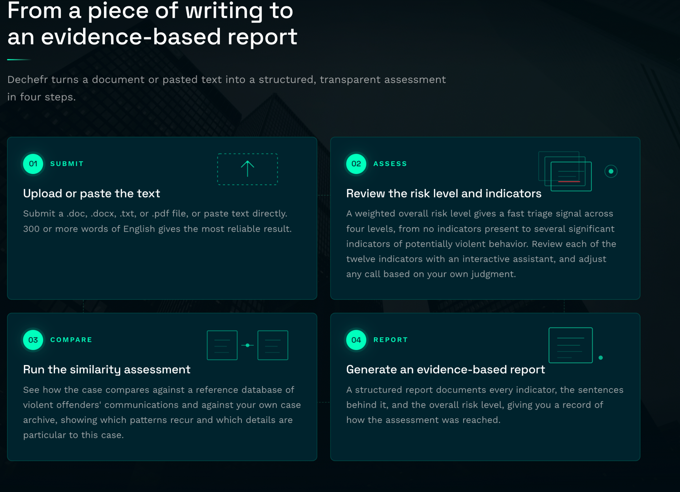
Product page section 3 Dechefr
How it works - please feel free to design this in a nice way

Slide 20
Product page Dechefr - Section ( 4 ) - Select 3 business impacts
Please feel free to design this
60% 3X 40%
less time spent assessing whether more XX lower training cost
threatening communication could
lead to action
Learn more >

Slide 21
Product section 5 Dechefr
What Changes With Dechefr?
BEFORE AFTER
Manual analysis Structured assessment
Time-consuming review of threatening communication Systematically assess communication against research-based indicators
Subjective assessment Evidence-based judgment
Assessment depends on individual experience and interpretation Standardized methodology supports consistent assessment
Intent is difficult to assess Risk becomes visible
Manually interpret whether words may signal a path toward violence Identify signals associated with potentially violent behavior
Get a demo

Slide 22
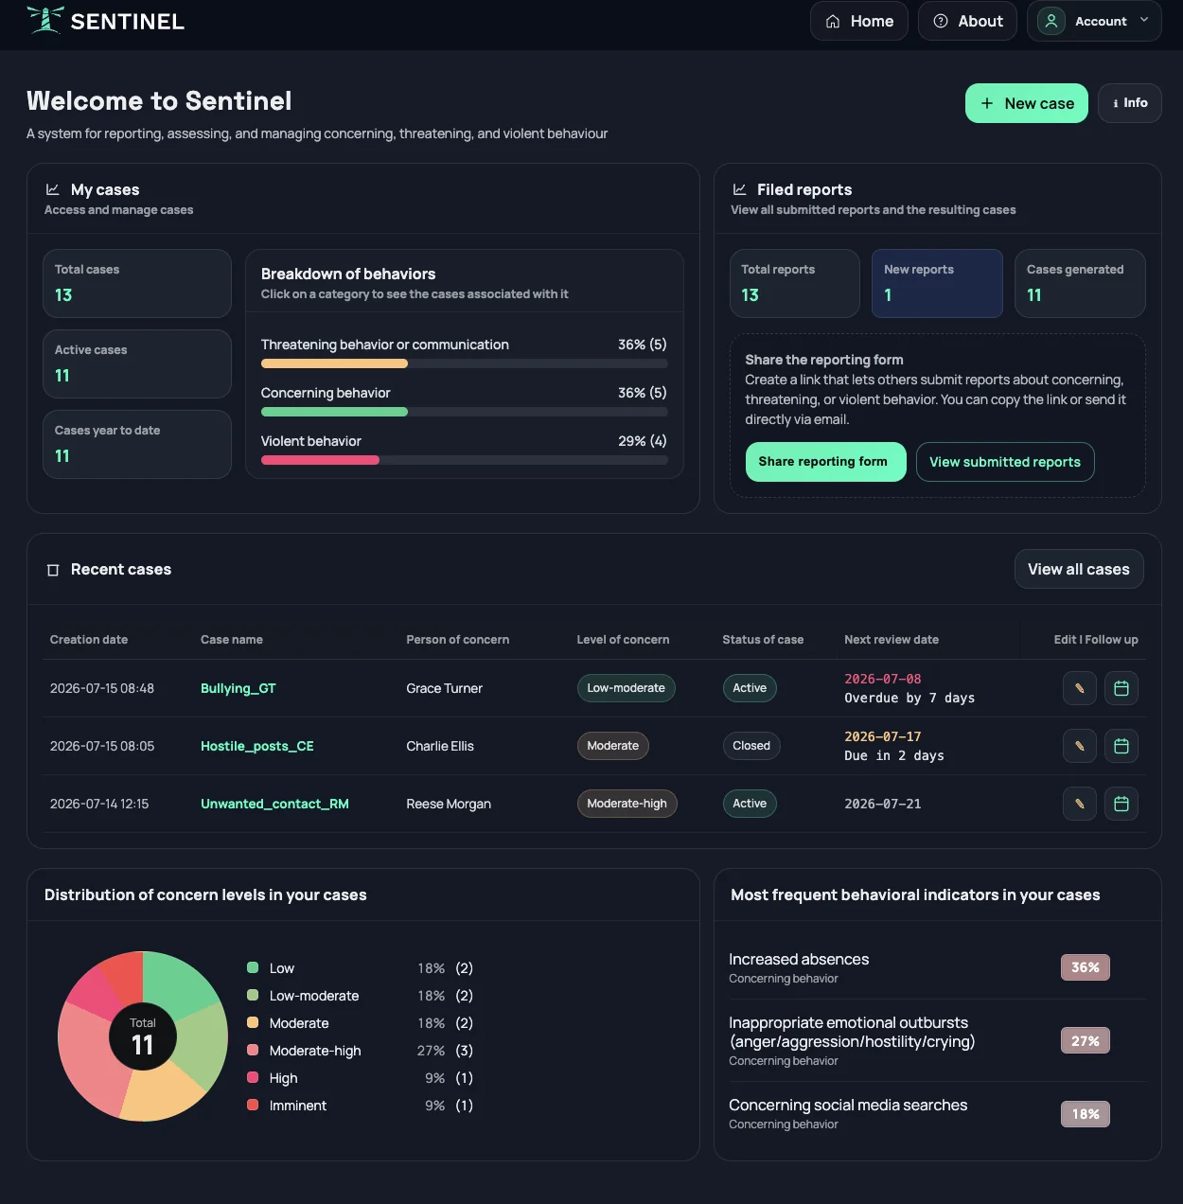
Product page - Sentinel - Hero
Include this dashboard on a computer screen that a person is looking at.Sentinl
Manage threats and cases
One structured system for reporting, assessing, managing, and following up on threats, concerning behavior, and violence.
Contact us Get a demo
WHY
Sentinel brings reporting, case management, risk assessment, actions, and follow-up into one structured system — giving teams a complete view of every case and the tools to manage it from initial concern to resolution.

Slide 23
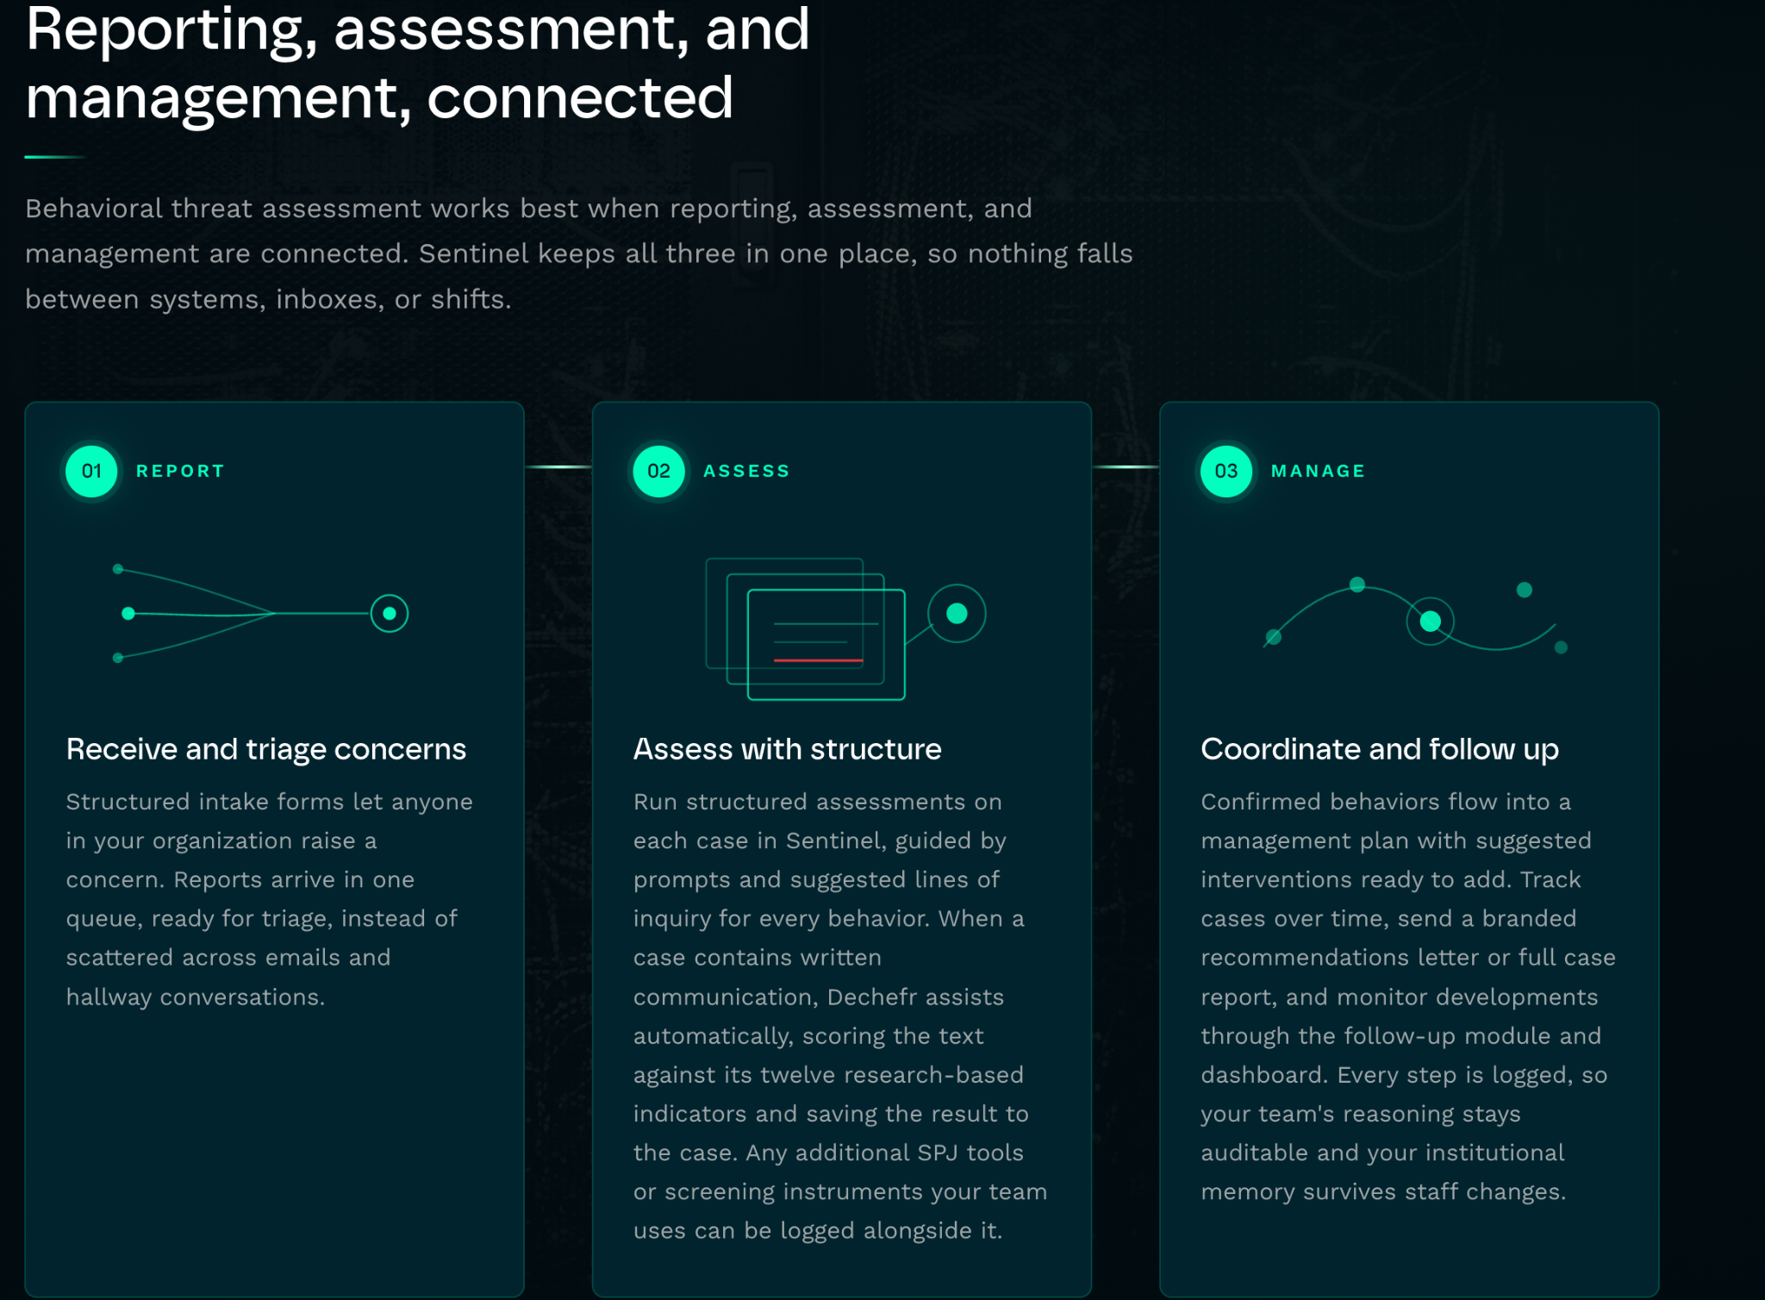
Product page Sentinel section 2 > How
Please feel free to design this in a nice and easy to understand. Not so much text

Slide 24
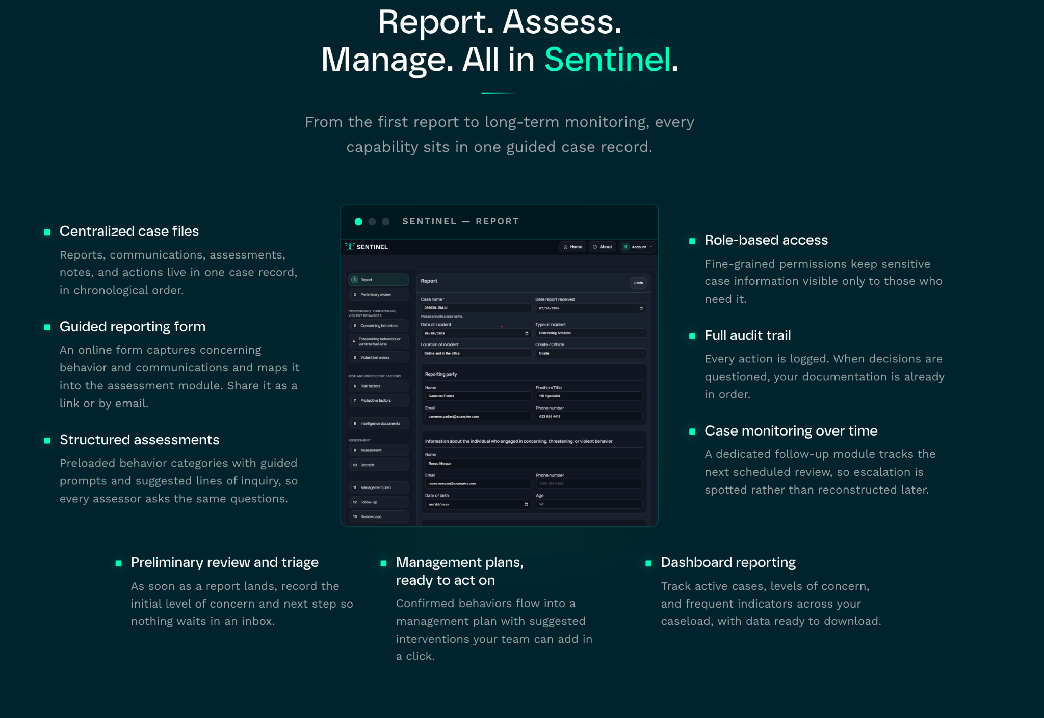
Product page Sentinel section 3
Please feel free to design this in a nice way and simple to understand and not to much text. But use the headlines

Slide 25
z
Product page - Executive protection - Hero
Include this dashboard on a computer screen that a person is looking at.Executive Protection
Executive Protection
Protect the people who carry your most critical responsibilities
The risk is personal. The impact is organisational.
Executive Protection helps organisations identify, assess and manage threats directed towards executives, key employees and other individuals in critical roles — before they escalate into incidents.
Get a demo Contact us
Threats against key individuals rarely start with an incident.
They can develop over time through social media, online communication, harassment and unwanted attention. The challenge is knowing what to look for, which signals matter and when a situation requires action.
The Challenge

Slide 26
Product page Executive protection section 2 - Customer benefits / customer value
WHY
Understand the threat landscape
Identify threats, harassment and concerning behaviour across relevant digital channels and communication.
Assess risk before it escalates
Structure and assess signals to distinguish between frustration, threats and behaviour that may indicate a more serious intent.
Protect people with the right information
Give security and decision-makers a clear and structured basis for determining appropriate protective measures.
Create a proactive protection capability
Move from reacting to incidents to continuously understanding and managing the risks surrounding your most exposed people.
Ge a demo
Please choose a picture from Executive dashboard

Slide 27
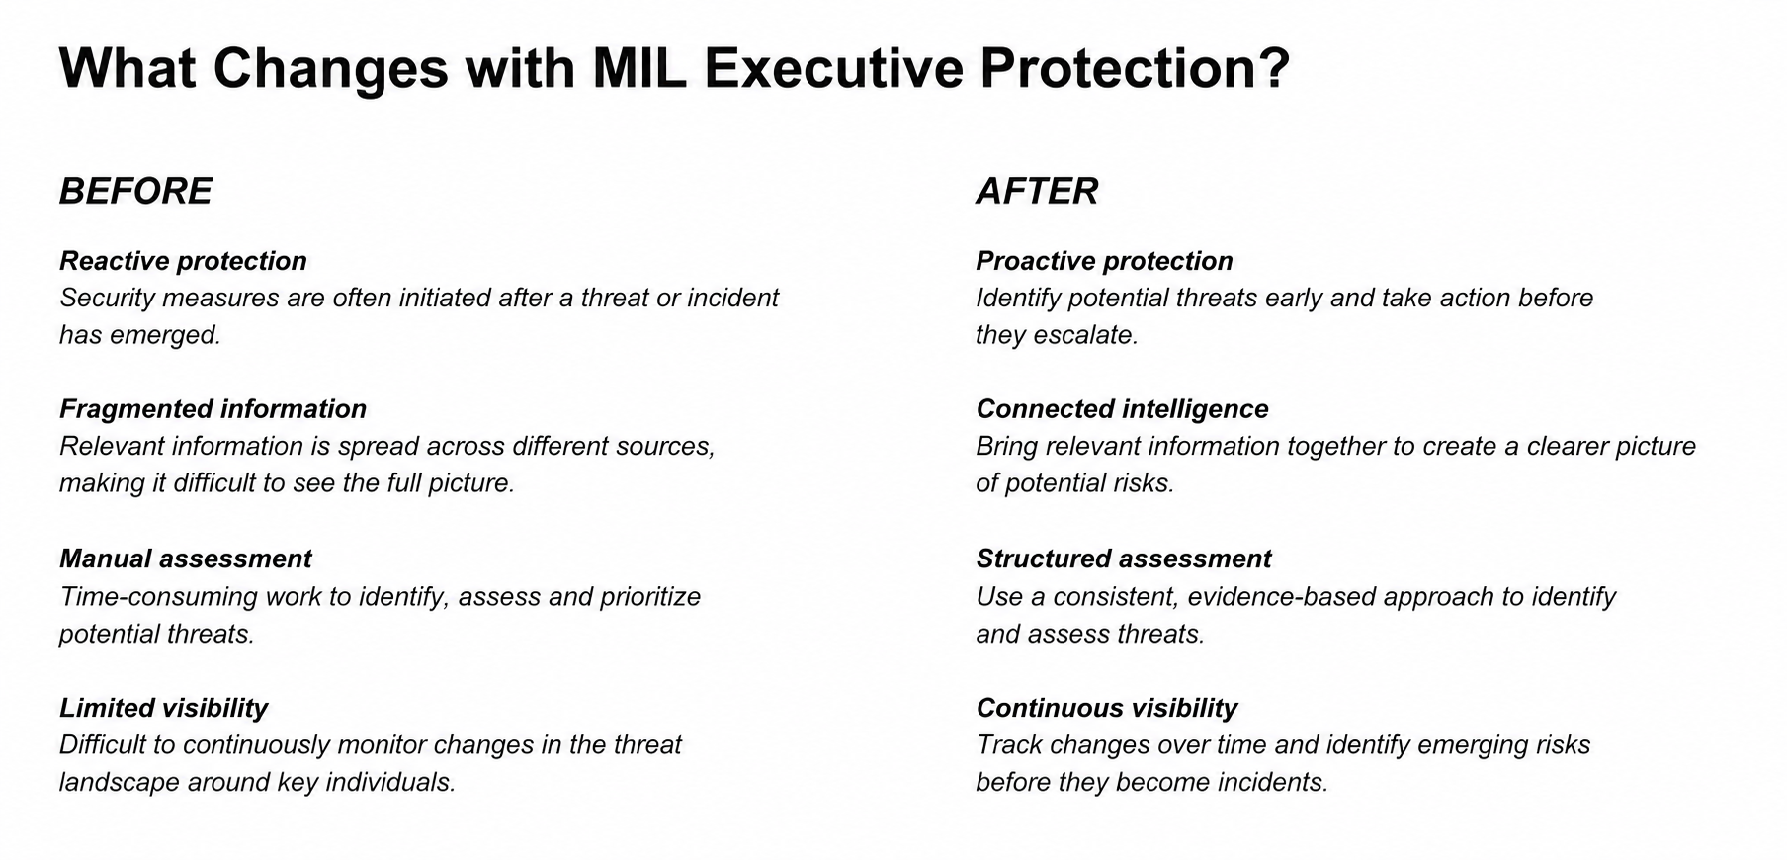
Product section 4 - MataHari
Please feel free to design this in a nice way
Product section 3- Executive Protection
Please feel free to design this in a nice way

Slide 28
Hero Solutions by Role
Two image showing two screens with dashboards for Sentinel several people looking on the screens
Security intelligence for every role.
One platform. Tailored to your responsibility.
Our solutions brings together the information, insights and capabilities each role needs to understand risk and take the right action.
WHY

Slide 29
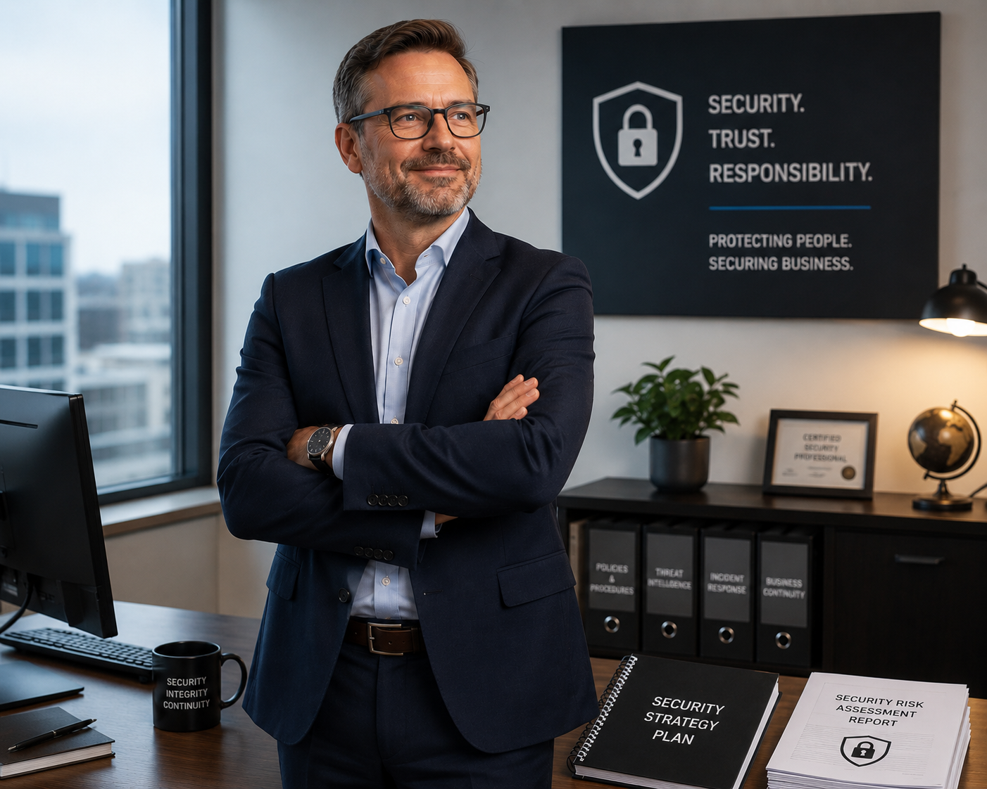
We help leadership take responsibility for the organisation’s security
✦ The insider threat is a strategic leadership issue
Insider threats affect operations, trust and finances – responsibility therefore cannot lie solely with
the security function.
✦ Take ownership of threats and concerns
Leadership must ensure that threats, harassment and concerning behaviour are reported,
assessed and managed consistently.
✦ Create a shared situational picture
Consolidated information gives leadership a better understanding of the organisation’s
vulnerabilities, risks and development over time.
✦ Act before risks become incidents
Early warning signs make it possible to implement preventive measures
before people, operations or the brand are harmed.
✦ Build a safe and secure organisational culture
Employees should know how to report concerns and feel confident that the o
rganisation will act professionally.
✦ Ensure governance, accountability and follow-up
Clear processes and decision-making support help leadership prioritise actions,
assign responsibility and follow up on results.
Landing page Management
Please chose a suitable picture to this landing page

Slide 30
We solve the Head of Protective Security's most important challenges
✦ Identify internal vulnerabilities early.Detect human risks and vulnerabilities
before they can be exploited or develop into security threats.
✦ Create a consolidated situation overview.Collect reports, observations and early
warning signals so that isolated information becomes actionable security intelligence.
✦ Assess threatening communication.Systematically analyze texts and messages t
o identify risk indicators, warning signs and potential intent.
✦ Prioritize the right risks and actions
Get support to assess which cases require immediate action and
which preventive measures should be implemented.
✦ Maintain continuous personnel security.Monitor changes over time,
not only during recruitment or the initial security screening.
✦ Ensure documentation and follow-up.Create a clear, t
raceable and structured process for ownership, actions, follow-up and reporting.
Landing page form startpage > Head of protective

Slide 31
Vi hjälper HR att bygga en trygg och säker organisation
✦ Attrahera säkerhetsmedvetna medarbetare
Visa att organisationen tar trygghet, ansvar och säkerhet på allvar – redan i arbetsgivarerbjudandet
och rekryteringen.
✦ Identifiera sårbarheter tidigt
Skapa bättre förståelse för personella risker och behov av stöd innan de utvecklas till insiderproblematik
eller konflikter.
✦ Bygg in säkerhet i hela medarbetarresan
Integrera säkerhetsmedvetenhet i rekrytering, onboarding, utveckling, förändrade roller och
avslut av anställningar.
✦ Skapa en kultur där människor vågar rapportera
Gör det enkelt och tryggt att rapportera hot, trakasserier, oroande beteenden och
andra tidiga varningssignaler.
✦ Agera innan problemen eskalerar
Ge HR underlag för tidigt stöd och relevanta åtgärder innan utsatthet, missnöje eller
konflikter utvecklas till allvarliga incidenter.
✦ Följ upp trygghet och personalsäkerhet över tid
Arbeta kontinuerligt och strukturerat för att minimera risken för insiderhot, hot och skadliga beteenden.
Landing page > HR
Please chose a suitable picture to this landing page

Slide 32
We help the IT manager create a secure and controlled environment
✦ Protect sensitive information
Ensure that personal data, threat information and security cases are handled with the right level of
protection throughout the entire information flow.
✦ Maintain control over data and operations
Choose a secure deployment model based on the organisation’s requirements,
SaaS,a dedicated cloud environment or an installation within your own IT environment.
✦ Ensure the right access to the right information
Role-based permissions restrict access and ensure that sensitive information
is only accessible to authorised individuals.
✦ Integrate without creating new security risks
Implement the tools in a controlled manner within the existing IT environment and avoid
insecure parallel systems and manual information handling.
✦ Create traceability and control
Clear logging and structured processes make it possible to track how information,
assessments and actions are handled.
✦ Ensure a sustainable long-term solution
Controlled updates, clear support and flexible deployment options reduce the
burden on the IT organisation.
Landing page - IT Director
Please chose a suitable picture to this landing page

Slide 33
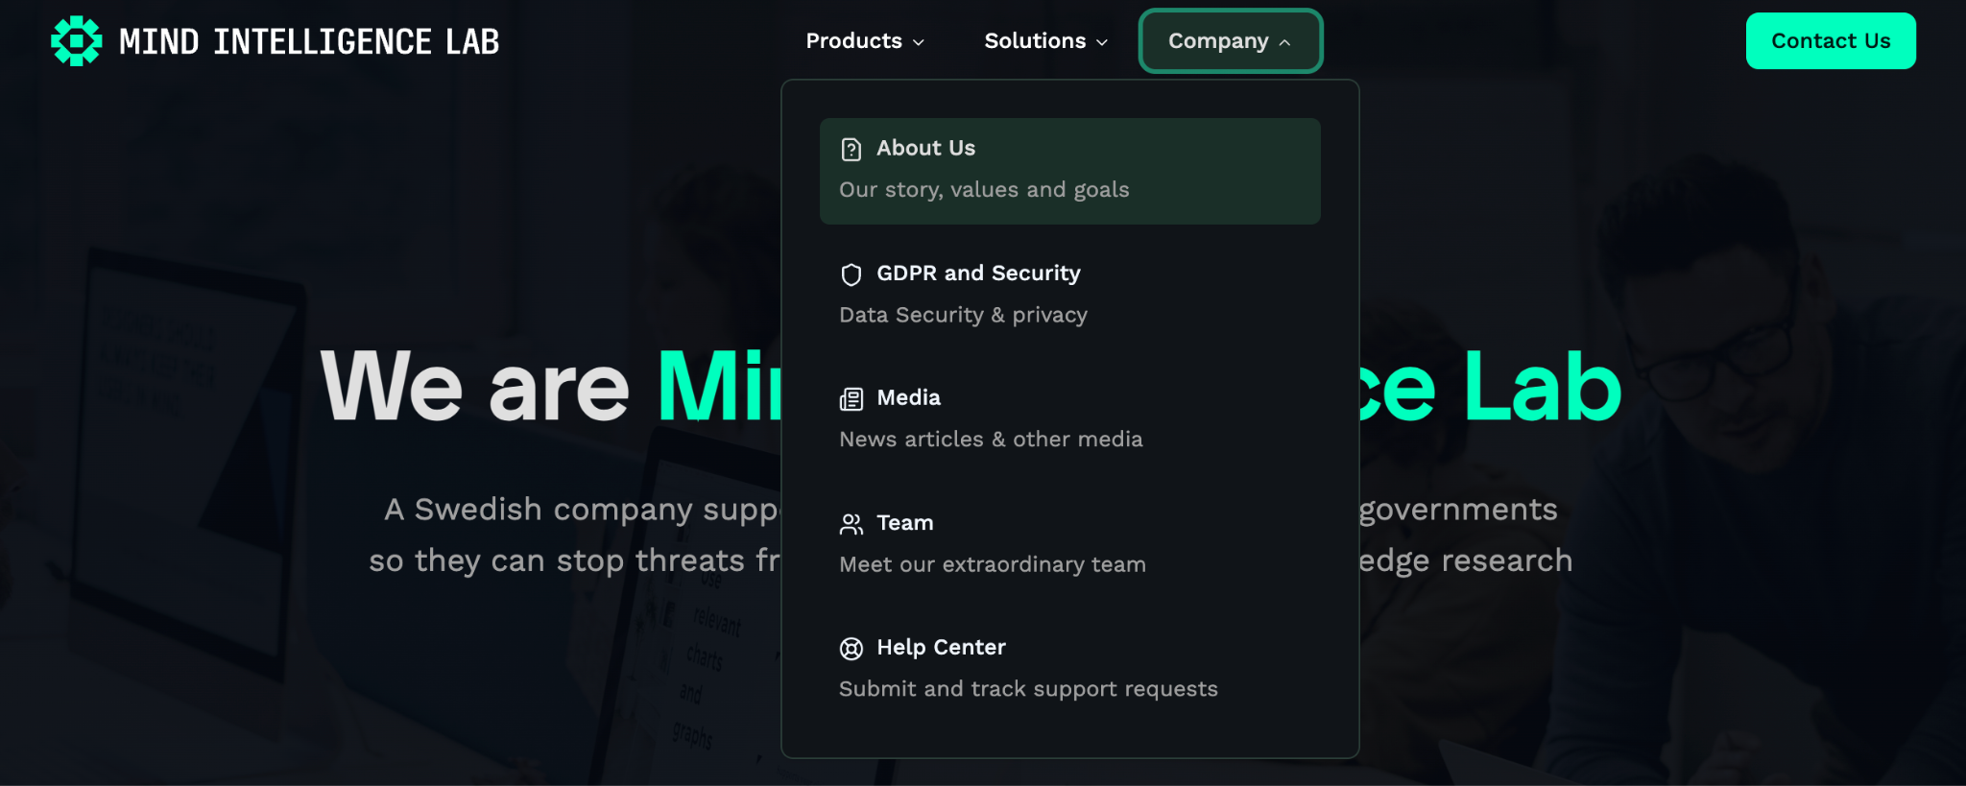
Other landing pages

Slide 34


product Logo Insider Threat assessment Executive protection
Matahari Dechefr _x000B_–
Please use this two logos in our green color
Sentinel _x000B_( to the right )
Dechefr_x000B__x000B
Executive protection
Product Logos should follow the MIL logo. Clearly show that they belong to the same company.
We can provide a brand guideline covering logos and colours.

