Slide 1

Vitamin dog:
The Future of Functional Pet Hydration

Slide 2
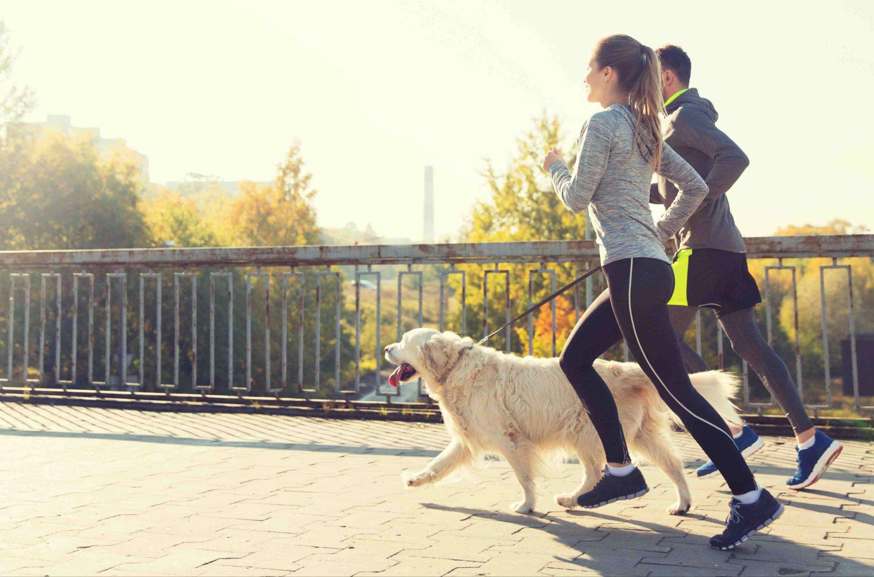


Table
Of Content
1
Owner
Why
Target group Product Sustainability Identity
Market opportunity Offer and OTM
2
3
4
5
6
7
8

Slide 3

Johan Boström
CEO / Founder
Top skills
→ Business development
→ PR
→ Customer experience
Johan Boström founded Outmore Sweden AB in 2021. Johan have since 2023 been
developing the concept for *Vitamin dog* as a product of Outmore Sweden.
With over 20 years of experience in marketing, Johan has held leadership roles, including Head of Marketing for a prominent hunting organization in Sweden. During 2024 he lead a department in a billion-dollar retail and outdoor company. Johan possesses deep expertise in branding, customer insights, PR, and strategic B2C marketing.
Over the past decade, he has played a key role in influencing hunting policies in Sweden and across Europe through strategic lobbying efforts. As an entrepreneur with a passion for business development, Johan brings a forward- thinking, results-driven approach to every endeavor.

Slide 4


Elisabeth Gunnardo
Co - Founder
Top skills
→ Meet for real
→ Strategy
→ Customer service
Elisabeth Gunnardo brings a unique blend of operational excellence and entrepreneurial drive. With a background as a project manager at Grand Hôtel Stockholm, she developed a strong foundation in leadership, precision, and high-end customer experience.
Her entrepreneurial journey includes co-founding and helping establish a Golf & Country Club, where she played a key role in building both the concept and operations from the ground up.
In addition, Elisabeth has extensive experience in realestate, including development, construction, and long-term property management. This combination of hands-on business building, project execution, and strategic thinking gives her a distinct advantage in driving startups forward — turning ideas into structured, scalable ventures with a clear focus on quality and sustainability.

Slide 5
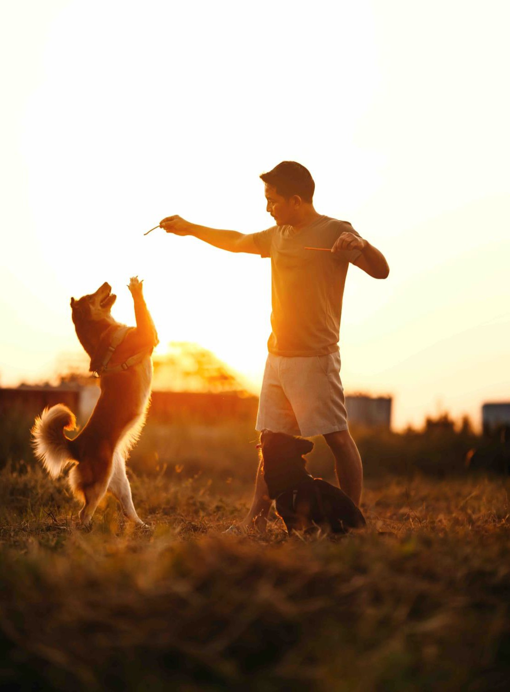


Untapped Revenue Potential
With the European market for energy and vitamin water generating €65.5 billion annually, there’s a clear opportunity to tap into this space for pets. Even capturing just 10% of the dog owner market would result in projected revenues of nearly
€89.7 million annually, showcasing the significant financial
potential in offering vitamin water for dogs.
The
”why”
Lack of Competition
Despite the rapid growth in the premium pet care sector, there are few products specifically focused on vitamin or energy water for dogs. This presents a unique chance to be a first mover and establish a strong brand presence in an underdeveloped niche.
Established Buying Behaviour
Human consumption of vitamin and energy water is already widespread, with pet owners often mirroring their own buying habits for their pets. Offering a similar product for dogs makes it easy for owners to extend this behavior, ensuring
a smooth market adoption.

Slide 6

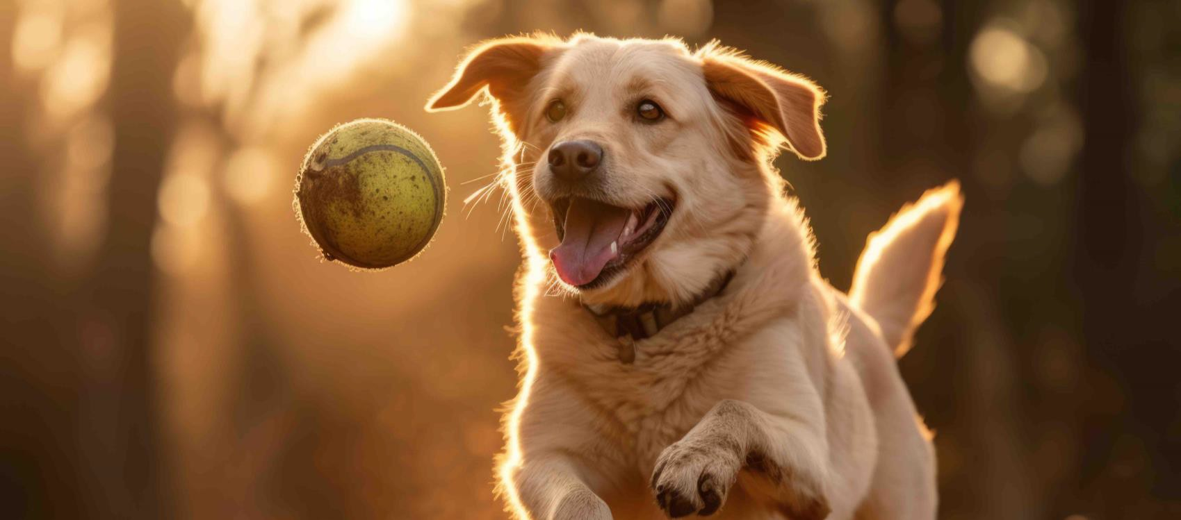

Target groups
dog lovers
Yes first and foremost. A well deserved treat is a huge sales opportunity on top of that, we believe the category is situation driven. based on where you live and what you do:
City People
A huge target group based on the amount of dog owners in cities. The natural treat for your dog matching your way of life in the city. The dog have a natural place in hotels, restaurants and cafés.
Active People
A lot of people with dogs are active. Daily exercise, running, boat, golf and so on and the dog is there with its owner. We also have agility, hunting, service dogs and so on.
Traveling People
With traveling dogs, a long day on the road is where vitamin dog becomes the convenient choice. Vitamin dog
would suit great in stores, at gas stations, kennels, special stores etc.

Slide 7

Our Vitamins
→We buy our vitamins and minerals from TRIKEM. They are mixed at TRIKEM in Malmö.
→Since 1954, TRIKEM has manufactured Swedish care products and supplements for horses, dogs and humans.
→Trikem has a dedicated team behind it with several years of experience in nutrition, biology, physiology, chemistry and of course a burning interest in animals and nature.

Slide 8
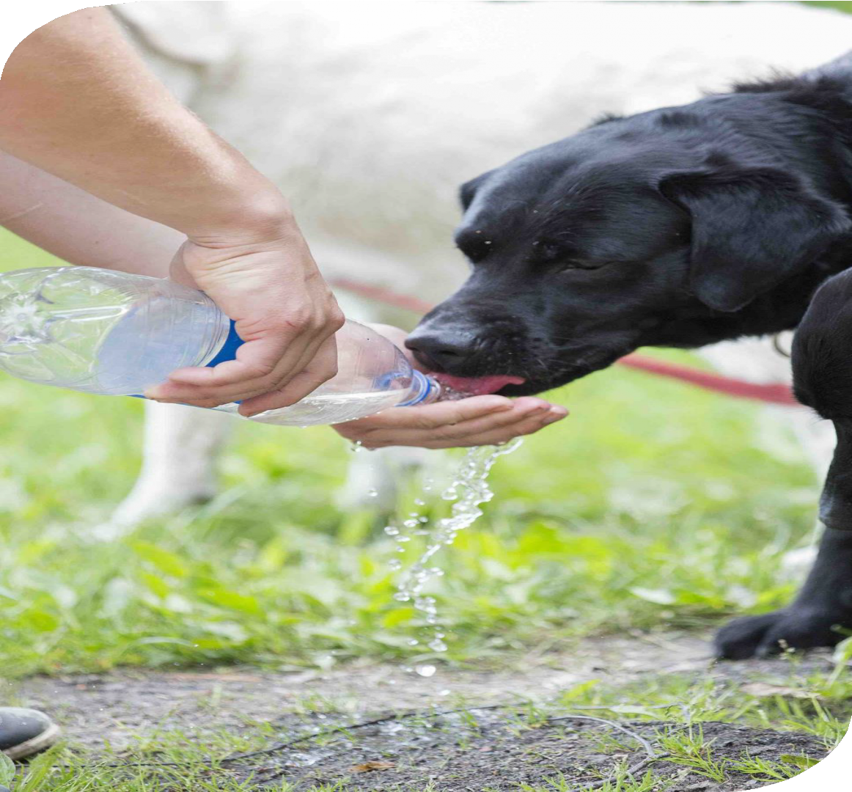
Our Water
Just like humans, dogs need a balanced intake of vitamins and minerals to stay healthy and active. Vitamin water for dogs is a specially formulated supplement that combines hydration with essential nutrients. It is designed to support overall well-being, boost immunity, and maintain healthy skin, coat, and joints.
Unlike regular water, vitamin water for dogs contains carefully measured amounts of vitamins. It is important to note that vitamin water should not replace a complete diet. Instead, it works as an extra boost.
Electrolytes
Electrolytes are essential minerals that help regulate many important functions in a dog’s body, including hydration, muscle activity, nerve signals, and overall fluid balance. The most important electrolytes for dogs are sodium, potassium, calcium, magnesium, and chloride. electrolytes should not replace fresh water or a complete diet. They are best used as a supplement in situations where your dog needs extra hydration and mineral balance.

Slide 9

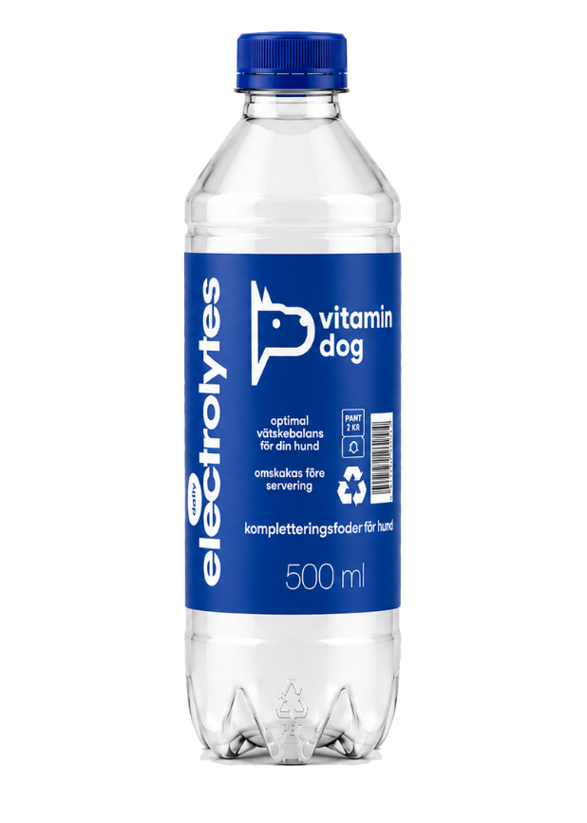
Daily
Natural
dailly
Electrolythe
Natural isn’t just water—it replenishes your dog’s hydration and electrolyte balance. While water is usually enough, extra electrolytes are needed after exercise, play, heat, or an upset stomach.

Slide 10
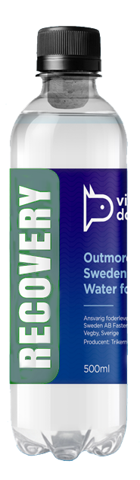

Formula
Recovery
recovery
Our RECOVERY formula contains electrolytes to restore not only hydration but also the body’s salt balance. It also includes Chondroitin, which plays a crucial role in nourishing cartilage, supporting muscle growth, reducing muscle soreness, and promoting faster and more effective cartilage repair.
With recovery, your dog gets the essential nutrients to stay strong, healthy, and ready for the next adventure!

Slide 11
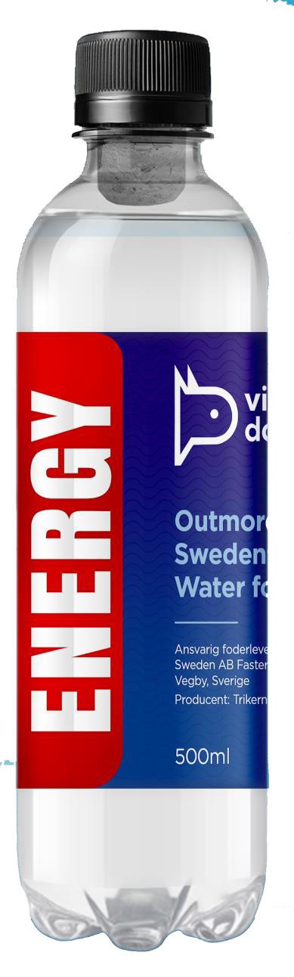
Formula
Energy
energy
Our Energy drink provides balanced supplements for quick energy and recovery. Hydration is key, and during activity, a good electrolyte solution replenishes both fluids and energy before, during, and after exertion.

Slide 12
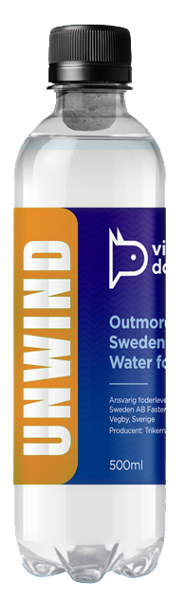
Formula
Unwind
unwind
Relax helps your dog handle stressful situations like vet visits, travel, fireworks, accidents, separation anxiety, and nervous encounters.

Slide 13
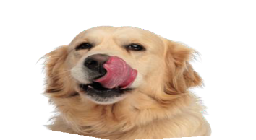
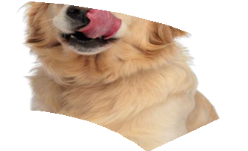
Market Opportunity
Survey conducted by CM Nordic with 408 participants
(52% men, 48% women) reveals valuable insights. Recent data shows that 9% of dog owners expressed genuine interest in our product, indicating a statistically significant level of engagement within our target audience. This level of interest aligns with broader market research, positioning our product as a strong contender in the niche market for pet-focused energy solutions.
9%
is just the start!
These findings provide a solid foundation as we continue to assess the market opportunity, with projections suggesting potential for capturing a substantial market share with profitable outcomes.

Slide 14


Market Opportunity & vision
Conclusions
The estimated gross profit of almost €33 million annually highlights
the business viability of this niche market.
If we assume we can reach 9% of all dog owners with a 10% purchase intention compared to energy drinks., vitamin dog has the potential to capture a €62,5 million annual market for energy
water for dogs. With increasing consumer interest in premium pet products and the established human behaviour of purchasing energy drinks, this represents
a high-potential and
profitable opportunity.
Million Euro
Revenue
Profit
300
225
150
75
0
9% 10% 15% 20% 25% 30%
% of dog owners with 1/10 intent to buy compared to energy drinks

Slide 15


Distribution & Sales Strategy
Our go-to-market strategy starts with sales to single clinics, pharmacystores, niche retailers to build credibility. Greymarket, hotels, restaurants and hospitality businesses will be the next stage and finally grocery retailers for scaling up volume. Key Sales Channels & Growth Plan Our startmarket is Sweden and its 1.000.000 dogs (775.000 dogowners). Our vision is to take our product to the European market with a strong partner. Europe have over 100.000.000 dogs.
E-commerce
Direct-to-consumer via our own platform.
Grocery Retail
Entry into 2500+ grocery stores, including ICA,
COOP, Lidl, Citygross, Hemköp, and Willys.
Veteriniarians & Specialty retailers
ZOO retailers, Evidencia etc for credebillity.
General Retail, Grey market Placement in Dollarstore, Granngården, Ö&B, JULA, EKOhallen, etc.
Hospitality Targeting 30,000+ restaurants and cafés that allow dogs.
Hotels
Partnership opportunities with
1,200+ pet-friendly hotels.
This phased approach allows us to test, optimize, and scale efficiently, ensuring strong market penetration and brand visibility across multiple high-traffic sales channels.

Slide 16
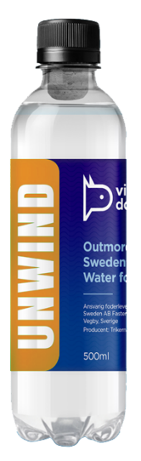



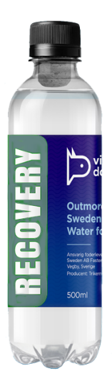



Brand Identity
High end but still playful and modern.
The dog sends a clear distinction that it’s for your pet. The colours are handpicked and chosen to represent trust, playfulness and modernity. The brand identity of
*vitamin dog* blends high-end sophistication with a
playful, modern appeal.
The logo, featuring a stylized dog, establishes an immediate connection to pets, making it instantly recognizable and relatable to our audience. Each element of the visual identity is carefully crafted, from the handpicked color palette to the clean,
bold typography. The vibrant yet balanced colors were chosen to evoke trust, playfulness, and a sense of contemporary design, appealing to both pets
and their owners.
The natural, energy, relax, and recovery logos represent distinct facets of the brand’s offerings, making it versatile and easy to navigate.
This thoughtful, cohesive approach ensures that vitamin dog feels both fun and professional, positioning it perfectly within the premium pet care market.
unwind
recovery
energy

Slide 17






Market Opportunity
Our Mission
Some Facts
Market Penetration Assumptions
Assuming dog owners spend 1/10th of what humans spend on energy water, the annual spend per dog would be
€8.97. With a target market
of 10 million dogs,
Our mission is to establish energy water for pets as a mainstream category, surpassing
€50 million
The European market for energy water for humans generates €65.5 billion annually (based on an average exchange rate of 1 USD = 0.935 EUR), with 730 million people, resulting in an average spend of €89.73 per person per year. Given that the behaviour of purchasing
in annual revenue by 2027 through innovation, early
adopter engagement, and sustained
market growth.
energy drinks and bottled water is already well-established, there is significant potential for expanding into the pet market. Europe has over 100 million dogs, but for this business case,
we assume that only 10% of dog owners—early adopters and health-conscious buyers—would be interested in energy water for their pets.
This gives us a target market of 10 million dogs.
the potential revenue
for energy water for dogs would be:
10 million dogs x times
8.97 Euros per dog =
89.7 Million
Euros annually

Slide 18
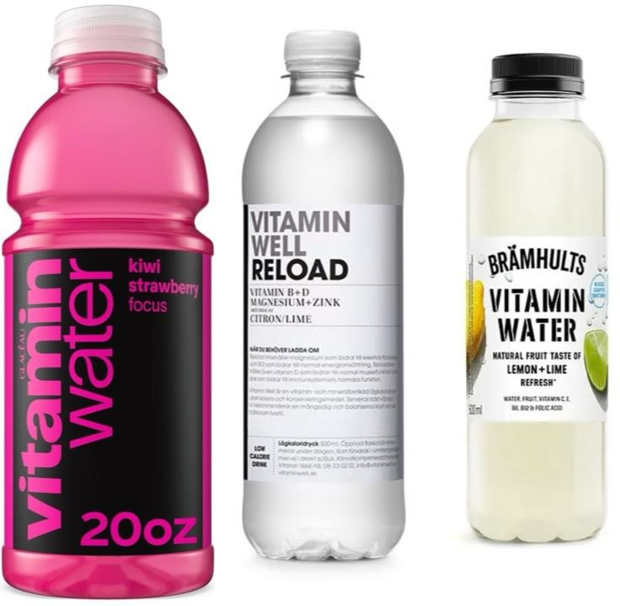
Human Behavior
Bottled water
Purchased primarily for convenience (on-the-go), taste (carbonated/flavored), and perceived quality. Most common in urban environments and while traveling. Typical buyer: urban, 20–50 years old. Frequency: 20–100 bottles/year.
Energy drinks
Driven by the need for energy, focus, and performance. Typical buyer: 18–35 years old, overweight men. Occasions: study, gaming, work, exercise. Frequency: 50–300 cans/year. High brand loyalty.
Vitamin water
Positioned as a healthier alternative to soda. Typical buyer: 18–35 years old, slightly more women. Occasions: after exercise, lunch, everyday energy. Frequency: 30–150 bottles/year.

Slide 19
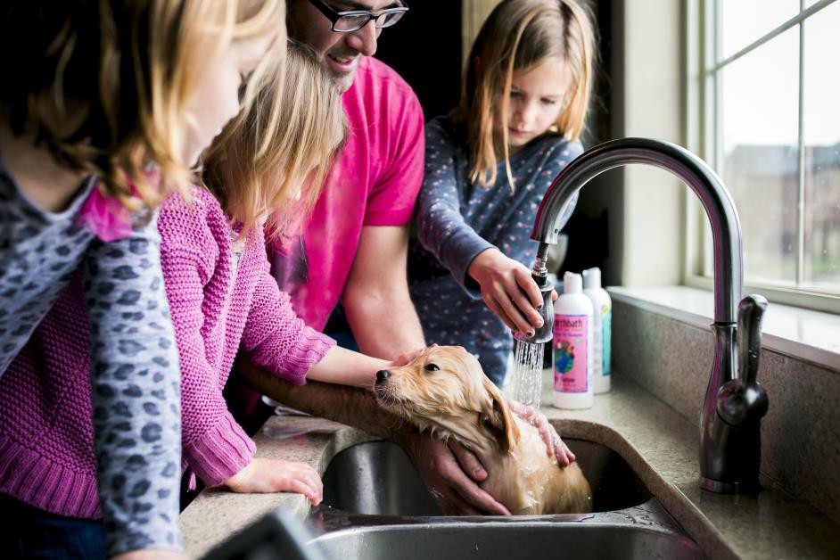
Dog owner Our customer
Overview Sweden
Dog ownership in Sweden covers approximately 15–20% of households, corresponding
to around 1,000,000 dogs.
Most people own a dog and have a strong emotional connection to their animal.
Demographics
Gender: Majority women (55–65%). Age: Core segment 30–65 years.
Income: Medium to high.
Education: Often academic background.
Geography
Dog ownership is more common in rural areas and suburbs than in inner cities. Large
cities have more small dogs
while rural areas have more working dogs.
Lifestyle
Dog owners value nature, routines and health. The dog is seen as a family member and lifestyle marker.
Purchasing behavior
Annual cost: SEK 10,000–30,000.
Premium focus: organic food, insurance.
Channels: pet stores, DVH, Greymarket and e-commerce. Decisions are driven by research and recommendations.
Segmentation by dog type
Small companion dogs – urban, trend-driven.
Family dogs – families with children.
Working dogs – performance.
Hunting dogs – rural.
Nordic breeds – outdoor.
Shepherd dogs – work + companionship.

Slide 20
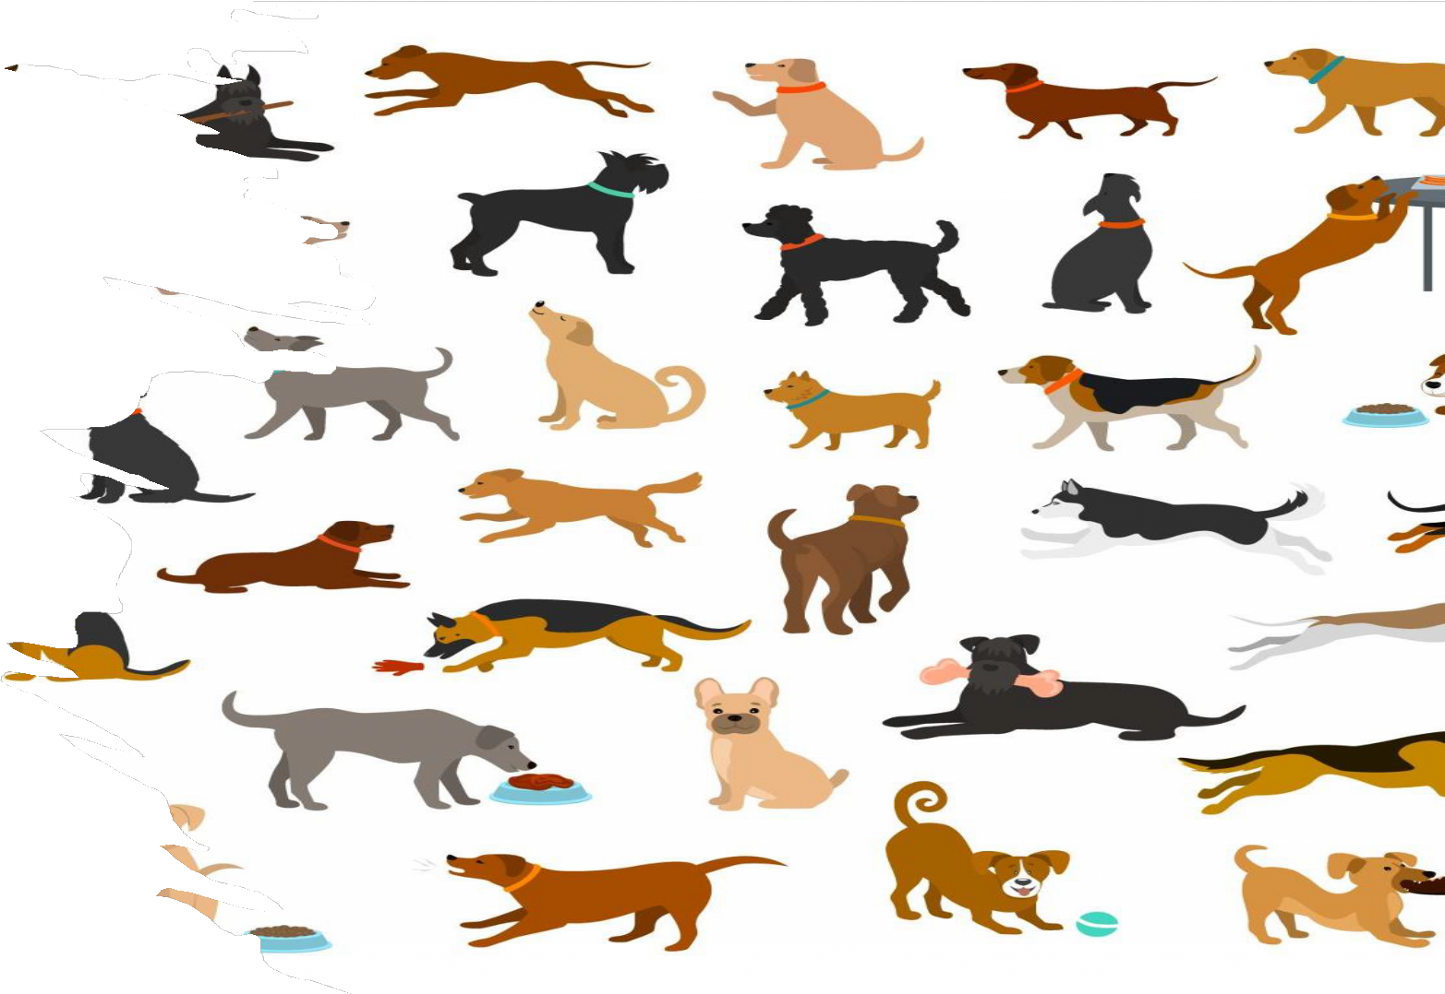
Vitamin Dog – Go-To-Market Strategy
→ This presentation explains the go-to-market strategy for launching and scaling Vitamin Dog.
→ The objective is to introduce a new category called “Functional Hydration for Dogs” and build a premium brand within the European pet wellness market.
→ The strategy focuses on first building credibility and understanding of the product before scaling distribution across larger retail channels and international markets.

Slide 21
Market Context
THE PET WELLNESS MARKET IS GROWING RAPIDLY AS MORE CONSUMERS VIEW THEIR PETS AS MEMBERS OF THE FAMILY.
DOG OWNERS INCREASINGLY SPEND MONEY ON HEALTH, NUTRITION AND LIFESTYLE PRODUCTS
THAT IMPROVE THEIR PETS’ WELLBEING. HOWEVER, THERE ARE STILL VERY FEW PRODUCTS SPECIFICALLY FOCUSED ON HYDRATION AND ELECTROLYTE BALANCE FOR DOGS.
THIS CREATES AN OPPORTUNITY TO INTRODUCE A NEW CATEGORY THAT ADDRESSES REAL SITUATIONS SUCH AS ACTIVITY, HEAT, TRAVEL AND RECOVERY.

Slide 22
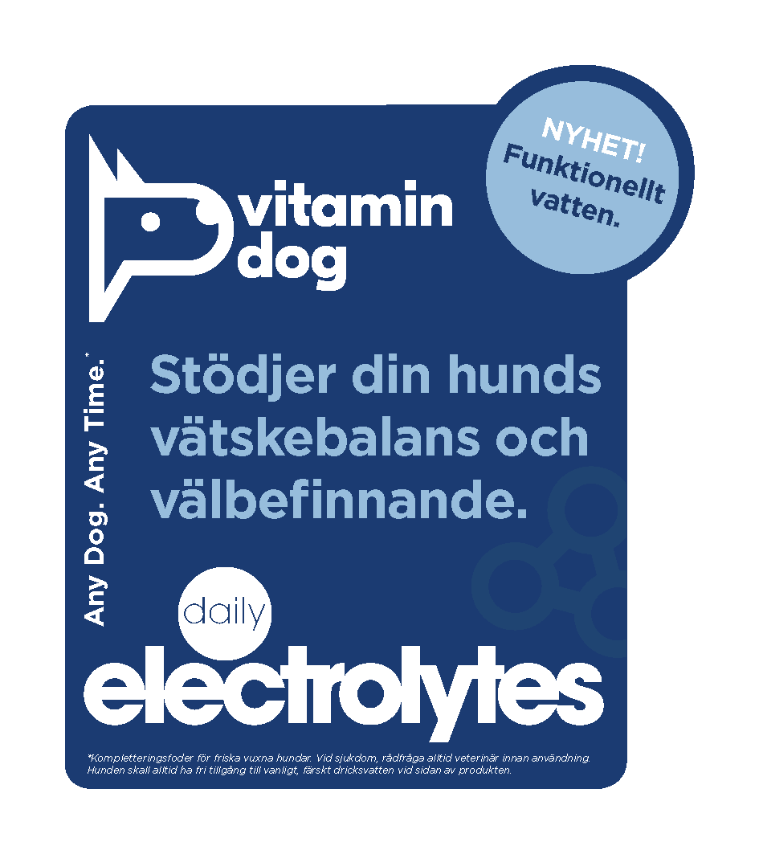
Product Positioning
→ Vitamin Dog is positioned as a functional hydration drink for dogs. The product is designed to support hydration and electrolyte balance in situations where dogs may need additional recovery or fluid intake.
→ The goal is to create a simple and intuitive concept that dog owners can easily understand, similar to how functional drinks are used by humans after exercise or during hot weather.

Slide 23
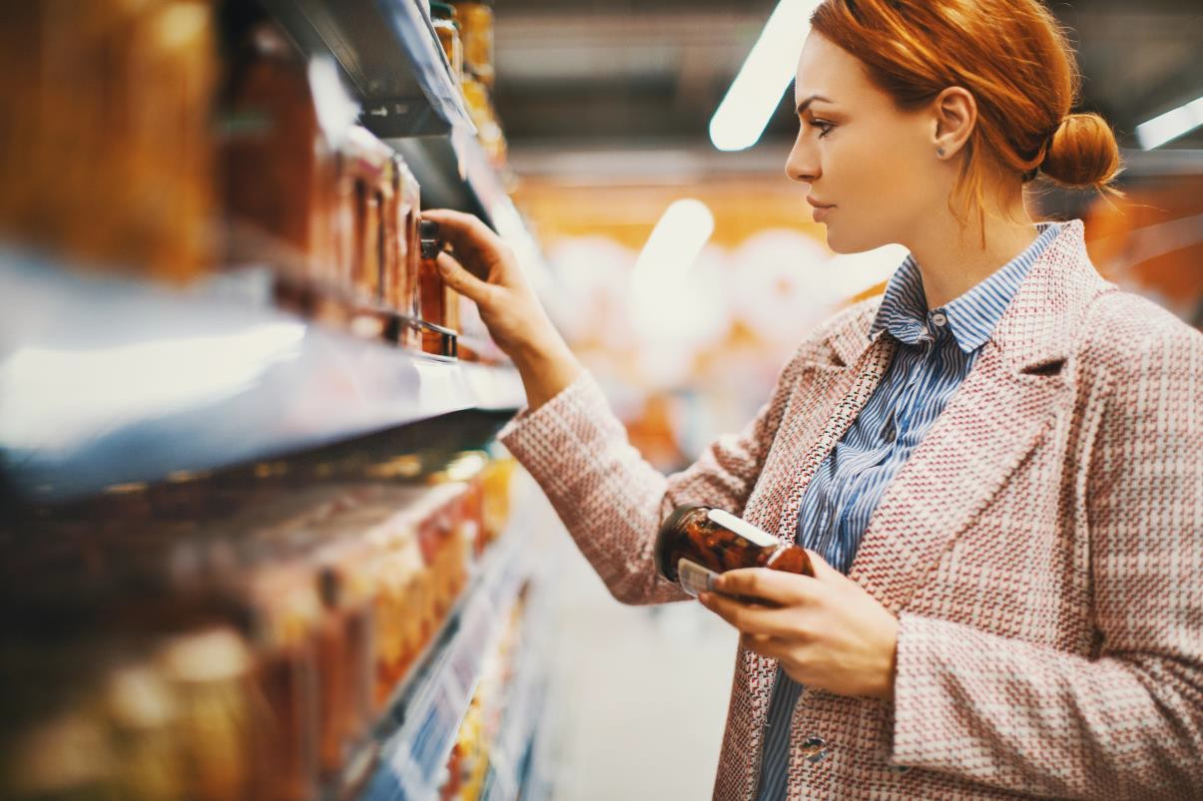
Core Consumer Use Cases
→ The product is designed to be used in everyday situations where hydration support makes sense.
→ Examples include after long walks or physical activity, during warm summer days, while travelling,
→ during stressful events such as transport or competitions, or as part of recovery after exertion.
→ By clearly communicating these situations, the brand can establish repeat purchase behaviour
→ rather than being perceived as a one-time novelty product.

Slide 24

Target Customers
→ The primary target customers include active dog owners, dog sport participants, hunters, working dog owners and urban premium consumers who already spend more on pet health and wellness products.
→ These groups are more likely to understand the value of hydration and recovery support for their animals.
→ Over time, the concept can expand to a broader population of dog owners as awareness of the category grows.

Slide 25
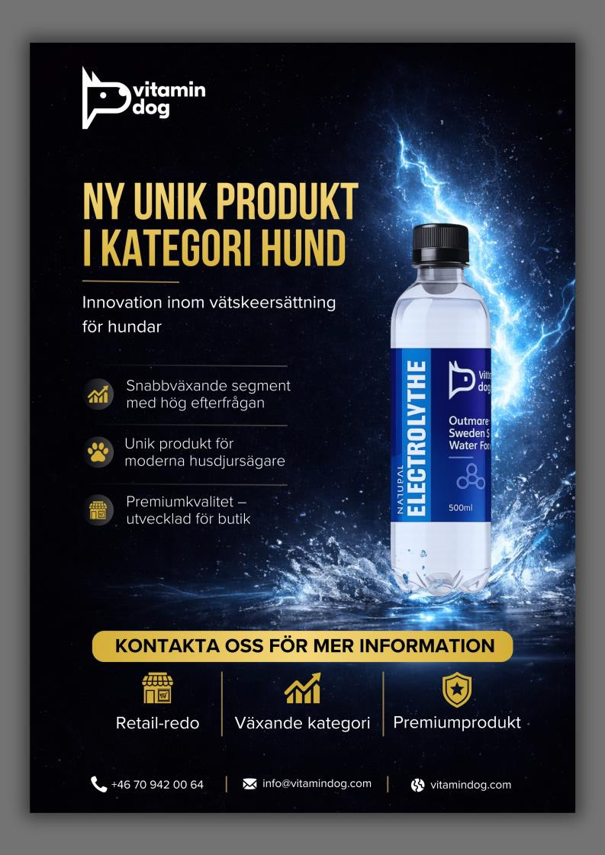
Product Launch
→We will start with one out of four
products.
→Natural Electrolythes
→We belive its a natural step to start and test the market with one product. Also the impotance to introduce one more product after 9-12 months and the third and fourth after another 4-6 months. Meanwhile we can work on product development.

Slide 26

Distribution and stock
→We use LM Logistics for our stock and distribution. They are located in Vegby outside of Ulricehamn. LM ships to both retailers aswell as directly to consumers via e-com

Slide 27
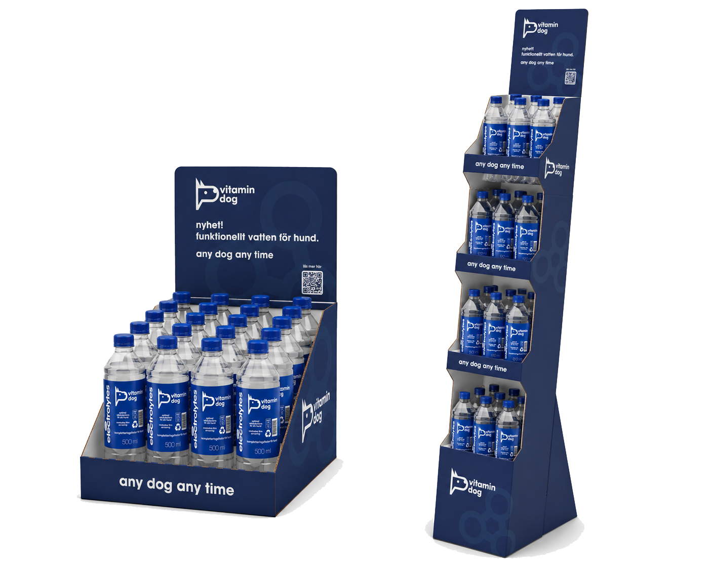
Expo material
→We get our expo och signagematerial from Billes. Anything from stands to posters, tags, displays, point of purchase, in-store signs etc
→We have 3 different packages ready for retailers

Slide 28
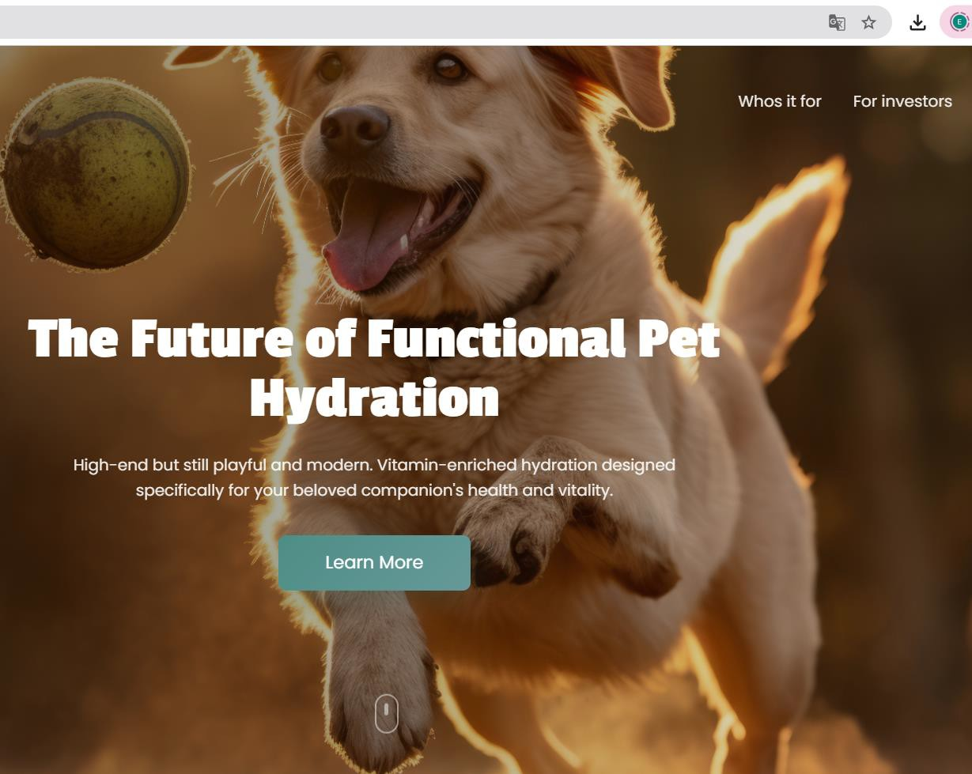
Webb and E-com
→Lovable is our system for our website
vitamindog.com
→Shopify is what we use for our webshop
→Our main domain is vitamindog.com

Slide 29


Phase 1 – Credibility and Education
The first phase of the go-to-market strategy focuses on building credibility and educating consumers about the concept of functional hydration for dogs.
Veterinary clinics and specialist pet stores play an important role during this stage because they are trusted sources of information for dog owners.
Sampling, staff education and clear product explanations help introduce the
category in a credible environment.

Slide 30

Phase 2 – Early Retail Expansion
Once the product has established credibility and early consumer adoption, the next step is to expand distribution through specialist pet retailers and e-commerce.
These channels allow the brand to increase visibility while still maintaining an environment where consumers can receive guidance and information about the product.
E-commerce also allows the company to build direct relationships with customers and encourage repeat purchases.

Slide 31

Phase 3 – Scaled Distribution
After the concept becomes better understood and repeat purchase behaviour is proven, the brand can expand into larger retail chains and grocery stores.
At this stage the category should already be familiar to consumers, making it easier for retailers to list the product and allocate shelf space.
This phase focuses on scaling volume and expanding geographic reach.

Slide 32


Marketing Strategy
→ Marketing activities focus heavily on sampling and community engagement. Dog events, sports competitions, hunting events and pet exhibitions provide natural opportunities for introducing the product to consumers.
→ Influencers, social media content and partnerships with dog communities help reinforce the concept and build awareness around the category.

Slide 33

International Expansion
→Once the concept has been validated in the initial launch market, the strategy calls for expansion into larger European markets such as Germany, the United Kingdom, France and Spain.
→Expansion is expected to happen through distributors, veterinary groups and retail chains.
→These markets have large dog populations and strong demand for premium pet products, making them attractive targets for scaling the brand.

Slide 34
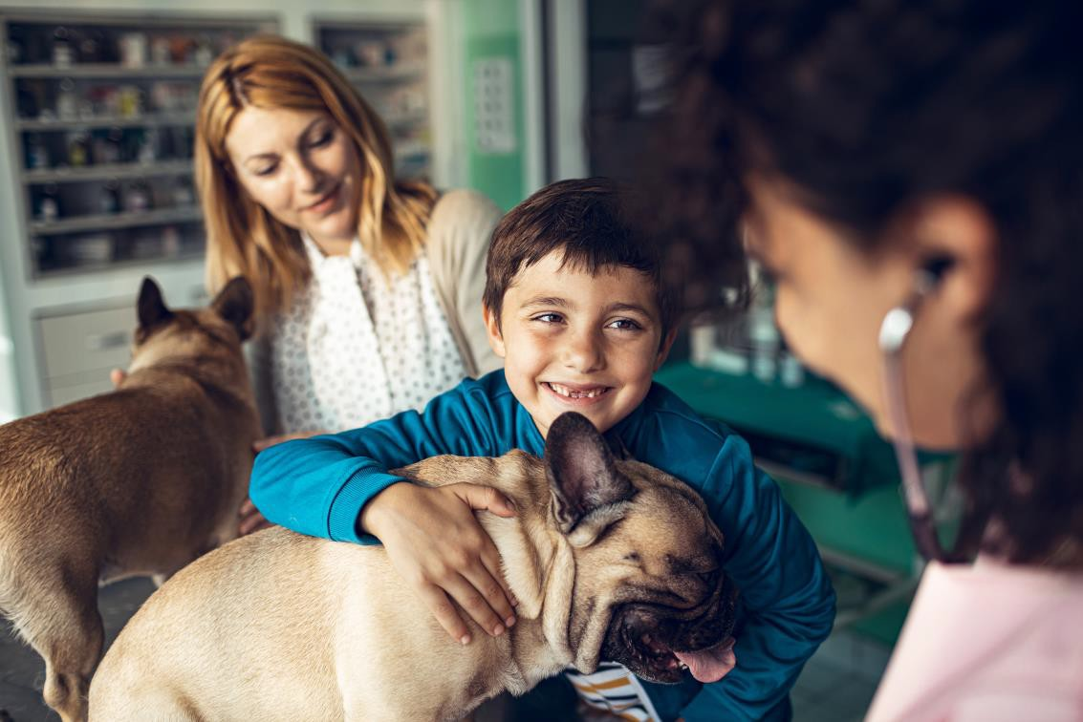
Long-Term Vision
The long-term ambition of the go-to-market strategy is to establish Vitamin Dog as the leading brand within the category of functional hydration for dogs.
By combining strong brand positioning, strategic distribution and repeat purchase behaviour, the company aims to build a scalable pet wellness brand with significant presence across Europe and potentially global markets in the future.

Slide 35







Vitamindog.com | .dog | .se | .de | .uk
facebook.com/vitamindog realvitamindog realvitamindog vitamindog
We are registered at the Agricultural agency
as a producer.
We are connected to GS1 and Validoo. Connected to Returpack.
Trademark Eupio owner of VitaminDog.
Finances is handled by ASPIA

Slide 36
Sustainability
→Deleo is our producer. Deleo AB is actively committed to sustainability and holds the ISO 14001 certification, which ensures a structured and international standard for environmental management. They also maintain FSSC 22000 for food safety and utilize EcoVadis for sustainability assessments. The company is focused on reducing its carbon footprint by continuously upgrading its production capabilities.
→Our bottles are rPet according to EU regulations
→Our vitamins are produced at Trikem. Trikem focuses on environmentally conscious production in Sweden (Malmö/Klågerup), emphasizing sustainable materials, local manufacturing, and the use of solar panels to reduce their footprint. They continuously evaluate raw materials, compensate for their climate impact by planting trees (over 500 so far), and strive to take responsibility for both nature and animals through their "Yes, we care!" initiative.

Slide 37
Outmore Sweden AB
Outmore Sweden AB
Brand Eupio – Vitamin Dog
Org number: 559303-8317
Products: Vitamin Dog Company Insurance: SVEDEA
Company Adress: Fästredssund 221, 52362 Vegby E-mail: johan@vitamindog.com
Phone: +46709420064
→If you are a potential investor or potential partner or just want to know more about Outmore Sweden AB and Vitamin Dog. Please do not hesitate to reach out for a brief meeting or a call.

