Slide 1
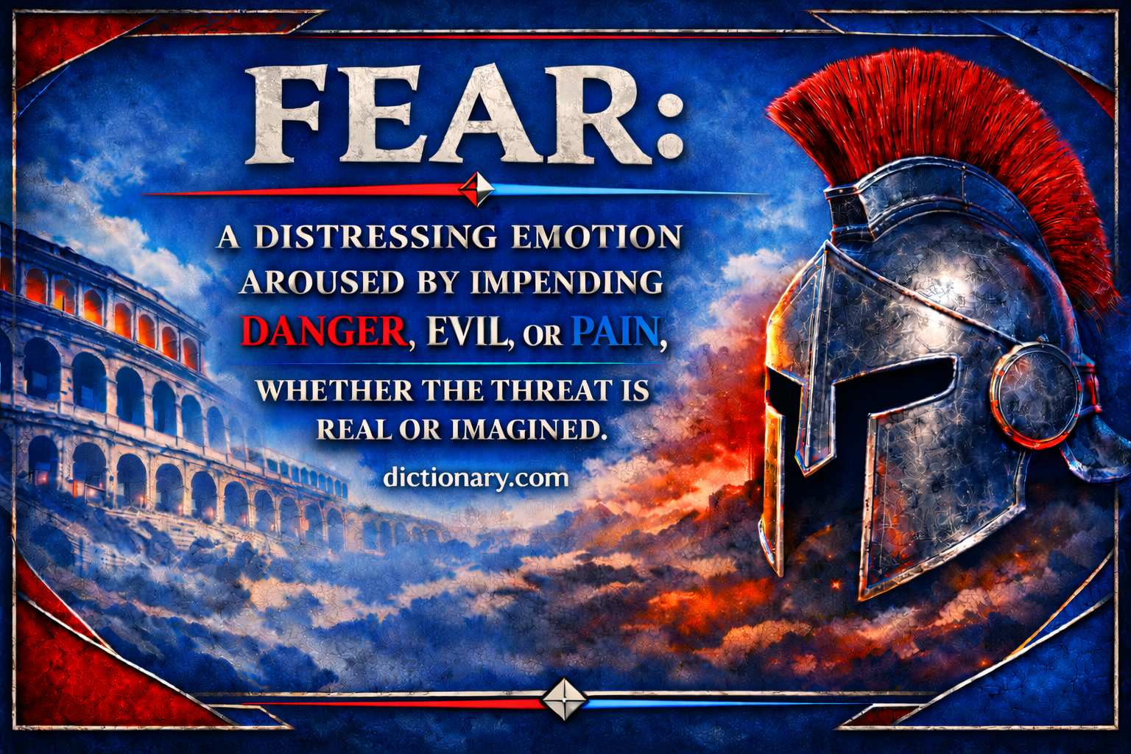

Slide 2

“The Fear Pandemic”
90%
CEOS AGREE THAT THE FEAR OF FAILURE IS THEIR MAIN CAUSE OF DISTRESS
88%
CONSISTENTLY FEARFUL OF BEING WRONG OR MAKING MISTAKES
87%
PEOPLE SUFFER FROM WORK RELATED FEARS
75%
“STUCK” OR UNABLE TO MOVEFORWARD PROFESSIONALLY
69%
EMPLOYEES WITHHOLD THEIR IDEAS DUE TO FEAR OF REJECTION OR RIDICULE
67%
HESITANT TO SPEAK UP WITH THEIR OWN POINT OF VIEW
Notes:
Social media echo chambers and their algorithm.
Dream Job—speaker and leadership consultant and coach
69% keep their ideas from you!
50+% Stoltz
8% Reflect—Herdon
25 years Anniversary Today
8% of people achieve their goals each year

Slide 3
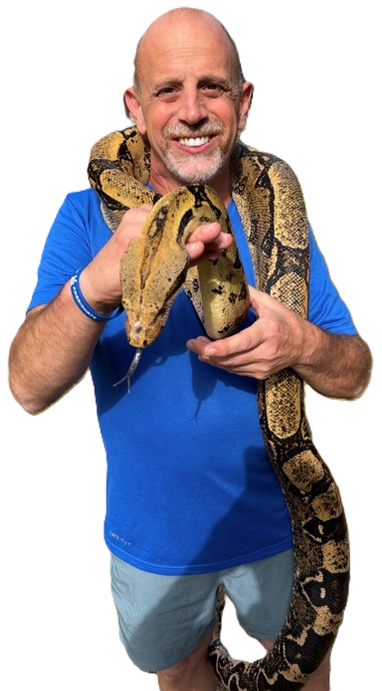
“The Fear Pandemic”
20%
INCREASE IN PROFITABILITY IF FOSTER COURAGE & VULNERABILITY OVER COMPETITION
85%
EXECUTIVES ADMIT FEAR HOLDS BACK INNOVATION
34%
ANNUAL COST OF EMPLOYEE DISENGAGEMENT
81%
FEARS & PHOBIAS HAVE NEGATIVELY AFFECTED THEIR JOBS
Notes:
Social media echo chambers and their algorithm.
Dream Job—speaker and leadership consultant and coach
69% keep their ideas from you!
50+% Stoltz
8% Reflect—Herdon
25 years Anniversary Today
8% of people achieve their goals each year

Slide 4
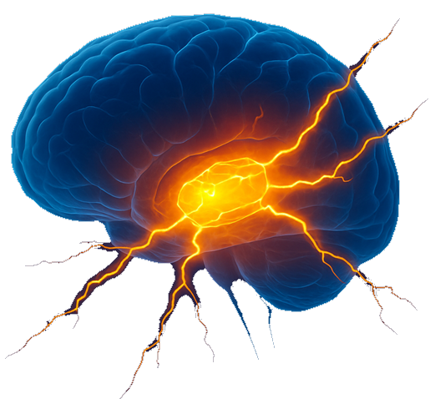
Amygdala: The Fear Center
DISRUPTS RATIONAL THINKING & LONG-TERM PLANNING
SHRINKS THE HIPPOCAMPUS ↆ MEMORY & LEARNING
2018 STANFORD STUDY
30%
DROP IN PREFRONTAL CORTEX = ↆ REASONING & INNOVATION
Notes:
The Threat Reflex flows through the amygdala, hypothalamic-pituitary-adrenal (HPA) axis
Amygdala—Sabor Tooth Tiger
PAG periaqueductal gray,—reduce endogenous opioids
Middle of Thalamus—similar in mice and men
Lowest levels of stress in autonomic nervous systems.
No action is an action
Freeze—Active response
Forward movement in face of threat---activation of collateral connected to dopamine reward center
Heightened cognition and perception
Chronic fear can shrink the hippocampus, a brain area critical for memory and learning.
— Source: Harvard Health Publishing
Fear triggers the amygdala, disrupting rational thinking and long-term planning—essential for personal development.
— Source: Psychology Today

Slide 5

Notes:
The Threat Reflex flows through the amygdala, hypothalamic-pituitary-adrenal (HPA) axis
Amygdala—Sabor Tooth Tiger
PAG periaqueductal gray,—reduce endogenous opioids
Middle of Thalamus—similar in mice and men
Lowest levels of stress in autonomic nervous systems.
No action is an action
Freeze—Active response
Forward movement in face of threat---activation of collateral connected to dopamine reward center
Heightened cognition and perception
Chronic fear can shrink the hippocampus, a brain area critical for memory and learning.
— Source: Harvard Health Publishing
Fear triggers the amygdala, disrupting rational thinking and long-term planning—essential for personal development.
— Source: Psychology Today

Slide 6

88%
CONSISTENTLY FEARFUL OF BEING WRONG OR MAKING MISTAKES
69%
EMPLOYEES WITHHOLD THEIR IDEAS DUE TO FEAR OF REJECTION OR RIDICULE
87%
PEOPLE SUFFER FROM WORK RELATED FEARS
81%
FEARS & PHOBIAS HAVE NEGATIVELY AFFECTED THEIR JOBS
75%
“STUCK’ OR UNABLE TO MOVE FORWARD PROFESSIONALLY
67%
HESITANT TO SPEAK UP WITH THEIR OWN POINT OF VIEW
34%
ANNUAL COST OF EMPLOYEE
DISENGAGEMENT
20%
INCREASE IN PROFITABILITY IF FOSTER COURAGE & VULNERABILITY
Notes:
Social media echo chambers and their algorithm.
Dream Job—speaker and leadership consultant and coach
69% keep their ideas from you!
50+% Stoltz
8% Reflect—Herdon
25 years Anniversary Today
8% of people achieve their goals each year
Fear of failure is the #1 reason people don't chase their goals.
– Research from Linkagoal shows 31% of people list fear of failure as the biggest barrier to achieving personal success.

Slide 7
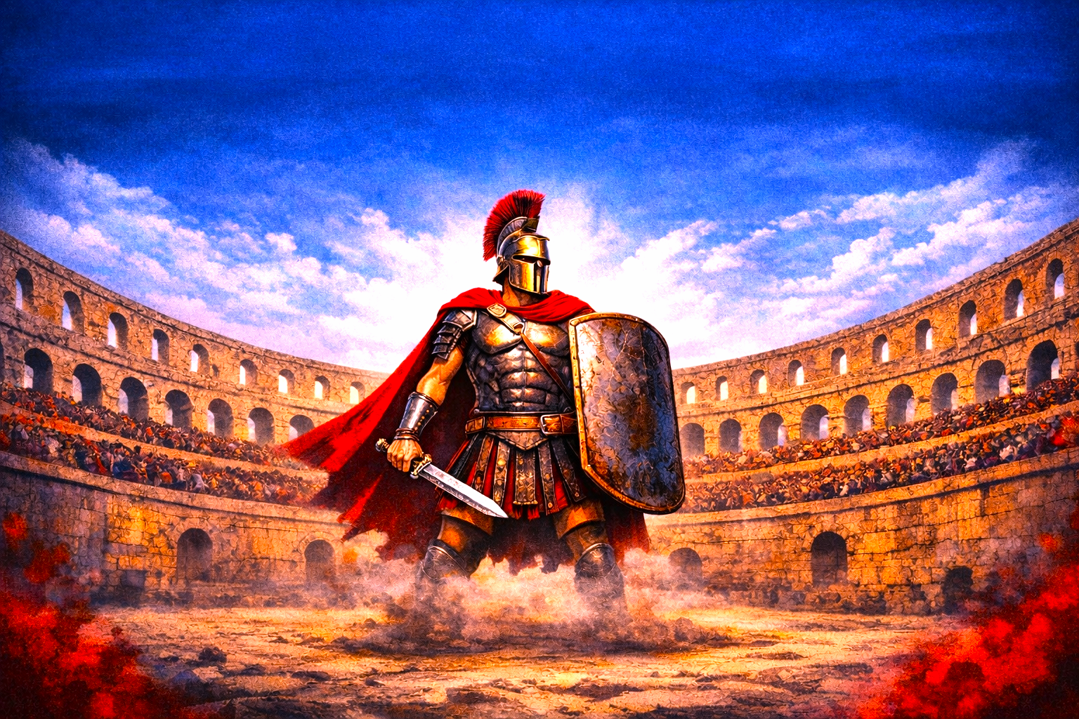




Scarcity
Mindset
Self Doubt
Avoiding Conflict
Constant Criticism & Negativity
Difficulty Making Decisions
Resistance to
Change
Emotional
Numbing
Procrastination
Muzzle
Oneself
Playing
Small
People Pleasing
Overly
Cautious
Perfectionism
Notes:
Perfectionism. The need to be perfect is a mask we wear to protect ourselves from finding true intimacy and connection
Procrastination. Always putting your goals off until “tomorrow” or “when I have more time” is a classic delay tactic of those who are living in fear. It’s time to stop making excuses and start achieving your dreams.
Numbing yourself

Slide 8

Notes:
Introduction of Flip Your Fear Narrative Framework

Slide 9



Face the Challenge
79%
OF PEOPLE HANDLE FEAR BETTER THAN EXPECTED
85% OF
WHAT WE
FEAR NEVER ACTUALLY HAPPENS
79%
OF PEOPLE HANDLE FEAR BETTER THAN EXPECTED
LABELING
EMOTIONS
REDUCES
THEIR INTENSITY
VERBALIZE FEELINGS “CALMS DOWN” THE AMYGDALA
Notes:
Buffalo walk into the storm
92% of people say they’ve grown from facing a fear.
– A survey by YouGov found that nearly everyone who intentionally confronted a fear reported positive personal growth as a result.
Fear of failure is the #1 reason people don't chase their goals.
– Research from Linkagoal shows 31% of people list fear of failure as the biggest barrier to achieving personal success.
Labeling emotions reduces their intensity — by up to 50%.
– (UCLA neuroscience study, Dr. Matthew Lieberman)Name your FEAR – Regulate the emotion
85% of what we fear never actually happens.
– A study from the University of Cincinnati showed that most fears are just mental constructs, and of the things that do happen, 79% of people said they handled it better than expect

Slide 10

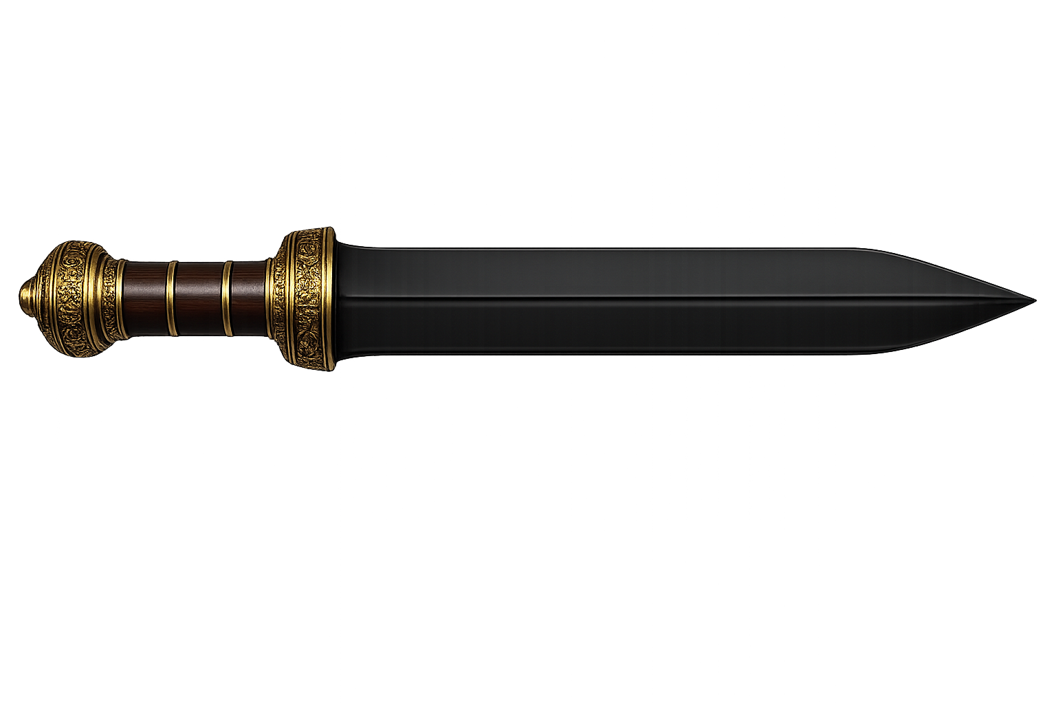
Empower Yourself
Dr. Curt Richter
Harvard Rat Study
Harvard Rat Hope Study
Visualization
Increases up 40%
Curt Richter
Harvard Rat Hope Study
Transforms Emotions & Fear Conditioning
Foreshadow the
Feeling of Failure
Notes:
Round 1 Domestic Rats died on average in 15 minutes with many in the first 2 couple of minutes
Round 2 Wild Rats similar results
Round 3—Pulled them out just before they died, giving hope 60 hours
“Elimination of hopelessness in the rats do not die.” Dr. Richter

Slide 11

Act Boldly
Action: The Antidote for Fear
Exposure-Based Results in Phobias & Performance Fears up to 90%
Morphological &
Rewiring of Amygdala
Courage is Contagious
Notes:
Exposure-based strategies have 90%+ success rate in helping individuals overcome phobias and performance fears.
— Source: American Psychological
Individuals who consistently take action despite fear report a 35% increase in career progression and a 44% boost in resilience scores.
— Source: Harvard Business Review – Leadership Growth Study
Neuroscientific research shows that repeated action in the face of fear rewires the brain’s fear centers—literally shrinking the amygdala and increasing emotional regulation.
— Source: Stanford Neuroscience Institute
73% of people who face one specific fear go on to face at least one other major fear within a year
Students and professionals who push through fear report a 29% improvement in learning retention and creative output.
— Source: Journal of Experimental Psychology: Learning, Memory, and Cognition
Neuroscientific research shows that repeated action in the face of fear rewires the brain’s fear centers—literally shrinking the amygdala and increasing emotional regulation.
— Source: Stanford Neuroscience Institute
Courage is contagious: individuals who witness others facing fears are 67% more likely to take bold action themselves.
Once someone takes action on a fear, they are 75% more likely to take bold action again within 2 weeks.
— Source: Action-Takers Longitudinal Study, 2021
Action reduces fear by up to 40%, even after a single exposure to a fearful situation.
— Source: American Psychological Association
Taking small steps of action activates the prefrontal cortex, decreasing emotional reactivity from the amygdala.
— Source: Stanford Neuroscience Institute
People who take action in the face of fear report a 24% drop in anxiety levels and a 32% increase in mental clarity.
— Source: Journal of Anxiety Disorders

Slide 12

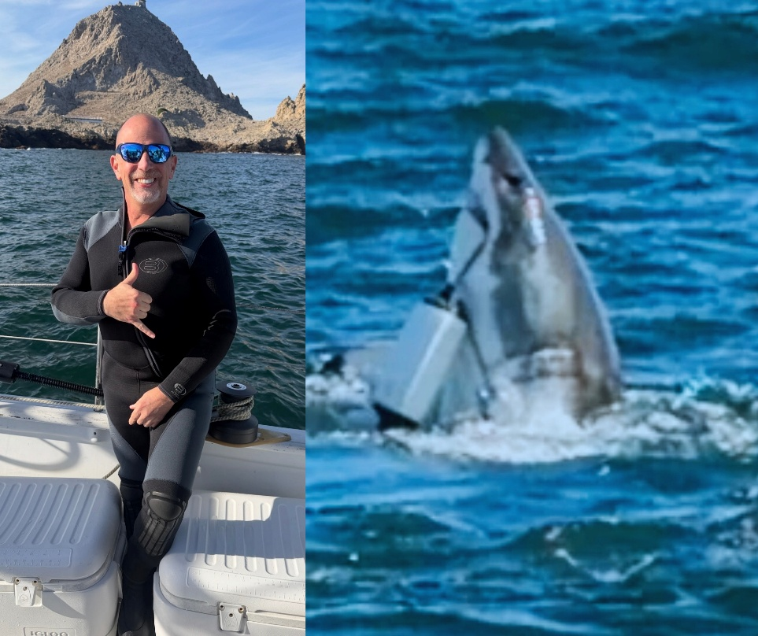
Revolutionize
Your Life
Facing Fear
Builds
Self-Confidence
Exposure to 1 Fear Reduces Nonrelated Fears
Grows Anterior Midcingulate Cortex
Facing Fear
Decreases
Anxiety
Notes:
Spiders and Heights
Huberman—Study 5 minutes of stress reduce fear and depression in mice
Googins

Slide 13
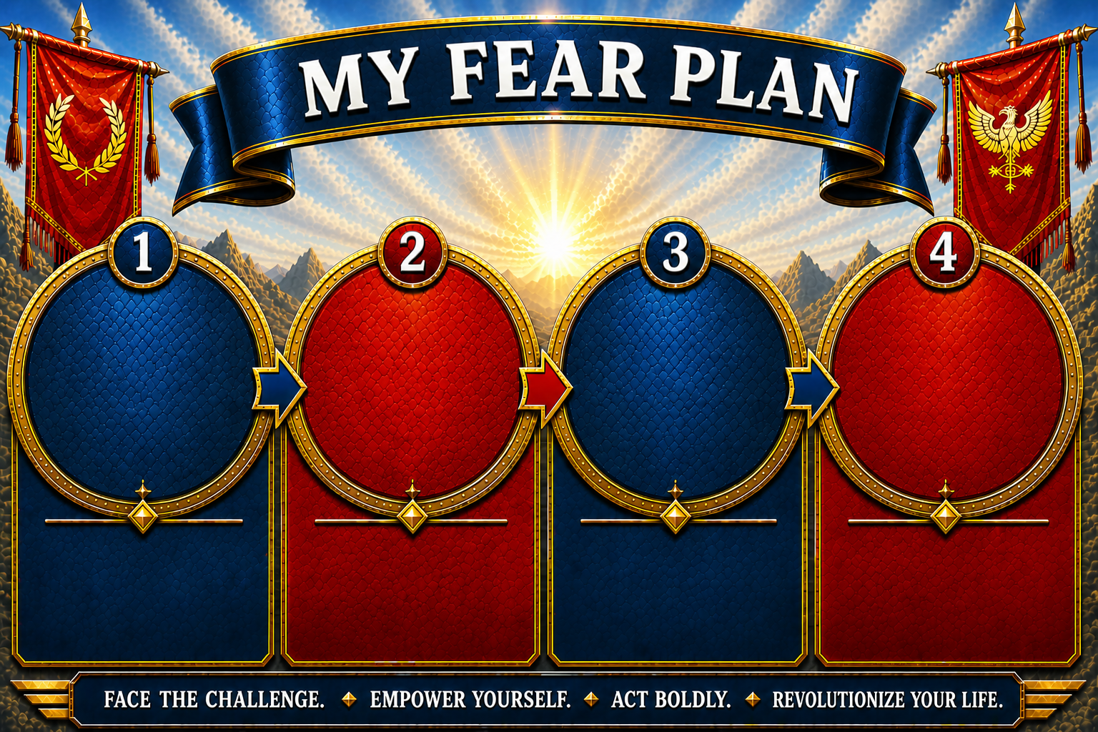
NAME THE
FEAR
YOU ARE GOING TO
CONQUER
1
ACTION
STEP IN
72 HOURS
2
MORE
ACTIONS
STEPS
IN NEXT
30 DAYS
SHARE
WITH
YOUR
COURAGE
CATALYST
Name the FEAR; Take It’s POWER
Clarity is Power.
Make a Decisive Move. Momentum Starts Now!
Build Your Fear Muscle;
Transform Your Future!
Accountability Partners Yield
Better Results!

Slide 14
